Slide 1
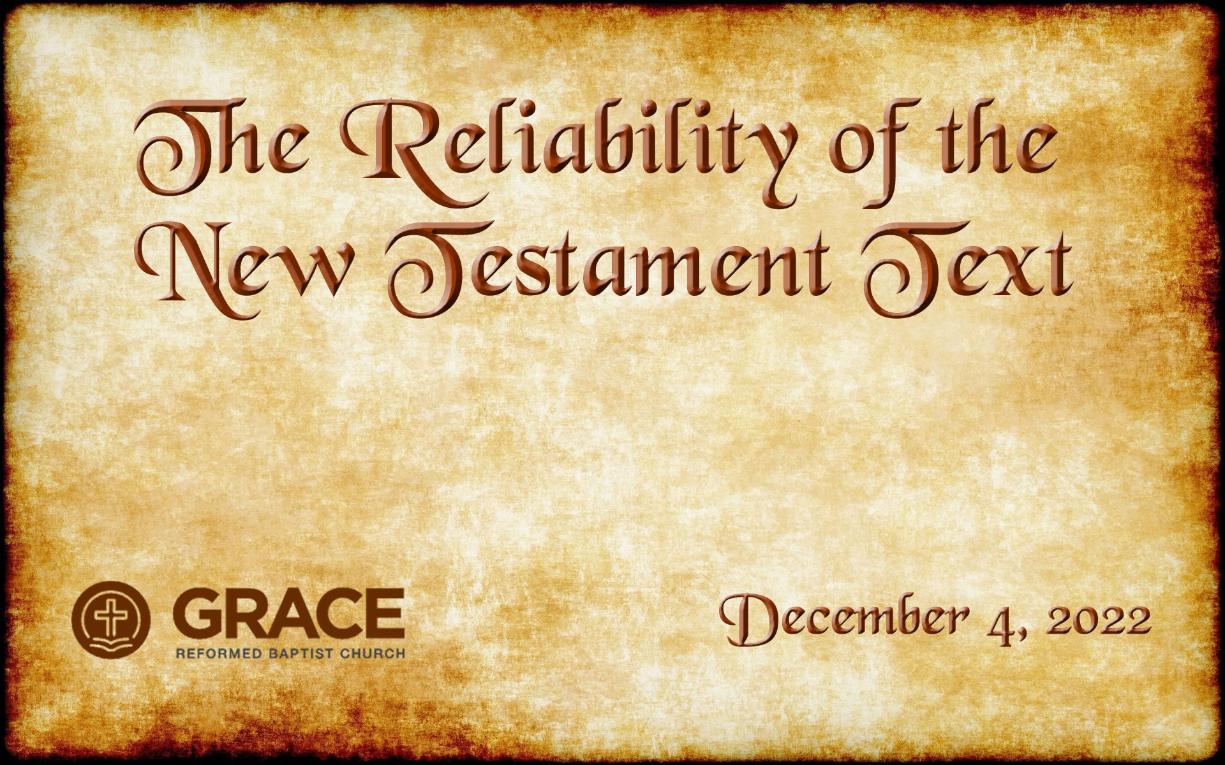
Notes:
OFF: Outlook, Thunderbird, Trillian, Webex Teams
Unmute laptop mic, MUTE speakers
Start Webex meeting (https://cisco.webex.com/meet/dwhite2), unmute Webex mic, make sure Laptop mic is selected in audio, share screen 2, drag controls to screen 1, start recording
Find 2 MEN and 2 WOMEN on the front row*
Good morning – it’s good to see you all. Welcome to this first class in the “Systematic Theology” track. I’m not going to be a regular teacher in this class, but I’ve been asked to take the first couple of classes.
I hope a lot of you were able to see the email that I sent out a couple of days ago that served as kind of an introduction to the class.
We live in a culture that is rapidly growing more secularized and more overtly hostility towards Christianity.
And one of the best ways to attack Christianity is to attack the Bible.
And to assert that the Bible is archaic, obsolete, and full of mistakes and contradictions and errors that make it entirely unreliable, and certainly not authoritative in our lives in any way.
So that’s why we’re going to take a couple of classes to look at the history and trustworthiness of the Bible. This will be a whirlwind couple of weeks – in the past I’ve taught this topic, The Reliability of the NT Text, in three separate classes – it’s gonna have to be just one class today.
*ADVANCE* (no slide change)
Next week we’ll be studying the Canon of the New Testament

Slide 2
Notes:
Next week we’ll be studying the Canon of the New Testament.
We’ll ask “how do we know we’ve got the right books in our New Testament? Who decided that? What if they made a mistake? Did they accidentally leave out some books? Or did they accidentally include any books that shouldn’t be in the Bible? How can we know for sure?”
That’ll all be next week.
I hope these couple of classes will give you confidence that God has indeed preserved his Word for us over the last 2000 years.
So, it’s going to be a fast-moving class. But as we go along, I’ll stop to highlight FOUR KEY POINTS that will summarize what this class is all about. So if you miss everything else, hopefully at least those FOUR KEY POINTS will be useful to you. And if you’d like to read more about anything we talk about today, feel free to talk to me afterwards and I can recommend some resources for you, including some we have in our own library.
So, let’s open in prayer and then we’ll get started.
*ADVANCE*
So, as we get started, let me ask you to open your Bibles to John chapter 5 and verse 4… or to bring up John 5:4 in your Bible app.
And while you’re doing that, let’s talk a bit about where the Bibles we have today came from originally.

Slide 3

Where we’re headed
Sep. 29
The Reliability of the New Testament Text (part 1)
Oct. 6
The Reliability of the New Testament Text (part 2)
Oct. 20
The Self-Authenticating
Nature of Scripture
Oct. 27
The Canon of Scripture
Notes:
So let’s take a quick look at where we’re going to be going over the next few weeks.
*CLICK*
“The Reliability of the New Testament Text” is what we’ll be studying this week and next, and this will focus on the actual TEXT of the New Testament. After all, the text in our English copies of the New Testament originate from documents written almost 2,000 years ago in a different language. How can we be sure that the English Bibles that we have today are the same authoritative Word of God that was delivered to the Apostles and to the early church almost 2,000 years ago? Can we even HAVE confidence that God has preserved His word over the last 20 centuries?
So that will be our first two classes, and after that we’ll take a break for a week as Dr. Andy McIntosh joins us on Oct. 13 to teach our SS class.
*CLICK*
Then, the following week we’ll take up the self-authenticating nature of scripture. Because even if we can be confident that the words of the NT that we have in English are accurate translations of the original text of the NT from 2,000 years ago, that doesn’t tell us whether the Bible is actually true or not. Lots of religions have ancient holy books that claim to be true, and they contradict the Bible in many ways. How can we be sure WE have the true words of God? Where does the Bible get its authority from? We’ll cover those questions in that class.
*CLICK*
And then, on Oct. 27, our last class will cover the canon of scripture. Maybe we can be confident that the word of God given to the prophets and apostles is accurate and authoritative, but can we be sure that our English Bibles actually contain that authoritative word? We have 66 books in our Bible, but some sects of Christianity have 78 books. And some have 87. Is it possible our Bibles are missing some of the right books? Or is it possible that some of the books in our Bibles really aren’t part of God’s authoritative word and shouldn’t be in here? Who decided which books should be in our Bibles anyway? Could they have made mistakes? We’ll cover those questions in our last class.
So, that’s our plan for the next few weeks
*ADVANCE*
What I want to focus on for this class and the next is the actual TEXT of the New Testament.

Slide 4
Notes:
What I want to focus on for this class and the next is the actual TEXT of the New Testament. How did we get the English Bibles that we have today? Can we even be confident that God has preserved His word over the last 2,000 years?
We’re going to be covering a lot of ground this week and next, and I apologize in advance that it’s going to be a pretty fast-moving class. If you’re trying to take notes and you’re despairing at everything we’re going to cover…
let me help you out by telling you that there are going to be FOUR KEY POINTS to understanding why the New Testament we have today is reliable and trustworthy. We’re going to cover TWO of those keys this week, and the other TWO next week. So if you don’t get anything else, maybe you can write those FOUR MAIN KEYS down, and maybe they’ll be helpful to you in the future.
So before we begin, let’s pray. (Printing press in 1450)

Slide 5

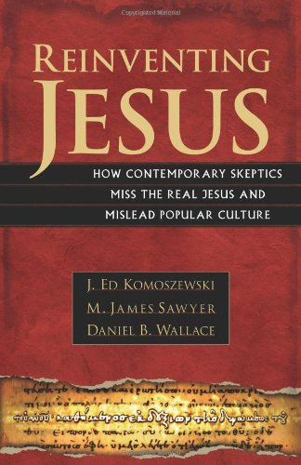
Notes:
** 9:38 **
I want to start by recommending a book to you, if you find this subject interesting.
This book, REINVENTING JESUS, is really helpful in refuting some of the false claims that skeptics make about Jesus and the New Testament. It’s written for laymen like us, and it’s pretty easy to read.
*ADVANCE*
In this book, the authors take up 5 main questions about the new testament:

Slide 6
Reinventing Jesus
How do we know the authors of the NT got the story right, decades after Jesus’ life?
How do we know the gospels and epistles were copied correctly? Is the Bible so full of copying errors that it’s hopelessly corrupted?
How do we know the Bible contains the right books? Was there a conspiracy to keep some books out of the Bible?
Did Jesus’ earliest followers believe He was divine, or just a great (but mortal) man?
How do we know that Christianity wasn’t plagiarized from other competing religions?
Notes:
In this book, the authors take up 5 main questions about the new testament:
*CLICK AND READ EACH ONE*
Now, as we begin our class, let’s start with a very basic question:
*ADVANCE*
How did we get the New Testament?

Slide 7

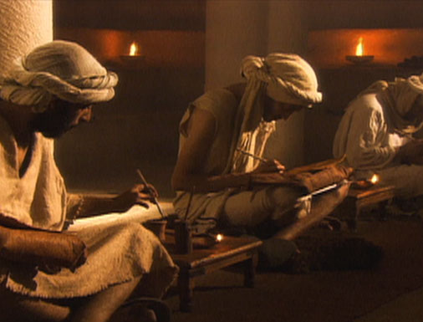
How did we get the New Testament?
Notes:
**9:33**
So, as we get started, let me ask you to open your Bibles to John chapter 5 and verse 4… or to bring up John 5:4 in your Bible app.
And while you’re doing that, let’s talk a bit about where the Bibles we have today came from originally.
The New Testament wasn’t given to the church in the form of
*CLICK*
a book that descended out of the clouds from heaven that contained the fully-written, incorruptible words of God.
It was given when God spoke through the writings of the apostles and associates of the apostles – what they wrote was the authoritative, infallible Word of God. And those documents that they wrote were transmitted through the centuries that followed
*CLICK*
by people making copies of those manuscripts. And then later Christians would make copies of the copies of manuscripts. But since many times these Christians were like you and me, and not trained as professional scribes, they often made mistakes in their copying process – sometimes little mistakes, sometimes big mistakes.
That is simply a fact of church history – that is how the documents of the New Testament were passed down through the centuries.
And it is that fact of church history
*ADVANCE*
that raises some tough questions that we have to answer. Here’s one tough question:

Slide 8

Tough Questions
“Since you no longer have the original New Testament documents, and all you have are error-ridden copies of copies of copies,
how can you possibly say that you know what the New Testament originally said?”
“Even careful copyists make mistakes,
as every proofreader knows. So we will never be able to claim certain knowledge of exactly what the original text of any biblical writing was.”
– The Jesus Seminar (The Five Gospels)
Notes:
that raises some tough questions that we have to answer. Here’s one tough question:
*CLICK and read*
And here’s an example of that question that comes from a group called “The Jesus Seminar” (don’t let the name fool you – this isn’t an orthodox Christian group at all, but a heretical organization.)
*ADVANCE*
Here’s another question we have to answer. “How do you know some early church council…”

Slide 9
Tough Questions
“Since you no longer have the original New Testament documents, and all you have are error-ridden copies of copies of copies,
how can you possibly say that you know what the New Testament originally said?”
Notes:
that raises some tough questions that we have to answer. Here’s one tough question:
*CLICK and read*
Well, We’ll come back to that later, but first
*ADVANCE*
here’s another question we have to answer. “How do you know some early church council…”

Slide 10
Tough Questions
“How do you know that some early church council didn’t change the New Testament by leaving out doctrines they didn’t like,
or inserting doctrines into the text that hadn’t been there before?”
Notes:
**9:34**
*READ*
That is a very popular belief. I had someone tell me that just a few weeks ago – the idea that some early church council, like the Council of Nicaea, made changes to the New Testament. Up until that point, Jesus’ followers had always known that he was just a man – a great man, but just a mortal man. But in the fourth century, at the Council of Nicaea, the leaders of the church decided they needed to make Jesus divine. So, they changed the scriptures and added verses that describe Jesus as being divine. And now we think that's what the original apostles said. But really, it was added to the New Testament much later.
How do we answer an assertion like that? Well, we’ll talk about that more later as well. But here’s a third tough question for us to deal with.
*ADVANCE*
“How can you say that you have God’s Word when you have Bibles that disagree with each other on what the words of the New Testament actually are?”

Slide 11
Tough Questions
When Constantine commissioned new versions of these [New Testament] documents, it enabled the custodians of orthodoxy to revise, edit, and rewrite their material as they saw fit.
It was at this point that most of the crucial alterations in the New Testament were probably made and Jesus assumed the unique [divine] status he has enjoyed ever since.
– Holy Blood, Holy Grail
Notes:
Now, I want to show you a form of that question from a book called “Holy Blood, Holy Grail”.
*READ*
Now this book would go on to be used by the author Dan Brown when he wrote his best-selling novel and movie THE DA VINCI CODE. And one of the key assertions of that book is that Jesus, up until about the fourth century was just considered to be a human. He had wife and kids just like everybody else. But in the fourth century, at the Council of Nicaea, the leaders of the church decided they needed to make Jesus divine. So, they changed the scriptures and added verses that describe Jesus as being divine. And now we think that's what the original apostles said. But really, it was added to the New Testament much later.
*ADVANCE*
Here’s the third tough question.

Slide 12
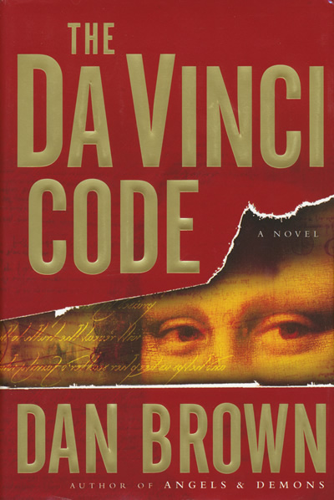
“My dear… until that moment in history [at the Council of Niceae], Jesus was viewed by His followers as a mortal prophet…
a great and powerful man, but a man nonetheless. A mortal.”
Notes:
Here’s how this idea is stated in Dan Brown’s book “The Da Vinci Code”. In the book, he has one of his main characters say this:
<CLICK AND READ>
So how can we address critics like Dan Brown who say the New Testament we have today isn’t what the apostles wrote, but what later church councils and church leaders and popes wanted Christianity to be?
*TRANSITION*
Here’s another tough question

Slide 13
The Current Onslaught
For practical reasons, New Testament scholars proceed as if we do actually know what Mark wrote, or Paul, or the author of 1 Peter… but the dim reality is that we really don’t have any way to know for sure. We simply create a little fiction in our minds that we are reading the actual words of Mark, or Paul, or Peter.
– Bart Ehrman

Slide 14
The Current Onslaught
The only reason… for God to inspire the Bible would be so that his people would have his actual words; but if he really wanted people to have his actual words, surely he would have miraculously preserved those words, just as he had miraculously inspired them in the first place. Given the circumstance that he didn’t preserve the words, the conclusion seemed inescapable to me that he hadn’t gone to the trouble of inspiring them.
– Bart Ehrman

Slide 15
The Current Attacks Emphasize:
That we no longer have the autographs (the original documents)
That the earliest NT manuscripts we have were copied many decades (if not centuries) after the autographs.
That there are thousands of textual variants between the copies that we have.

Slide 16
Tough Questions
“How can you say that you have God’s Word when you have Bibles that disagree with each other on what the words of the New Testament actually are?”
Notes:
Here’s a third tough question
“How can you say that you have God’s Word when you have Bibles that disagree with each other on what the words of the New Testament actually are?”
Now to give you an example of this, let’s go back to what I asked you to do a few minutes ago. I asked you all to turn to John chapter 5, verse 4.
How many of you who pulled out a Bible or loaded up your Bible app were unable to turn to John 5:4?
<CHECK FOR HANDS>
Some of you probably discovered that John 5 in your Bible doesn’t HAVE a verse 4.
*TRANSITION*
Let’s take a look at that. This is what John 5, verses 3-5 look like in the King James and New King James versions of the Bible

Slide 17
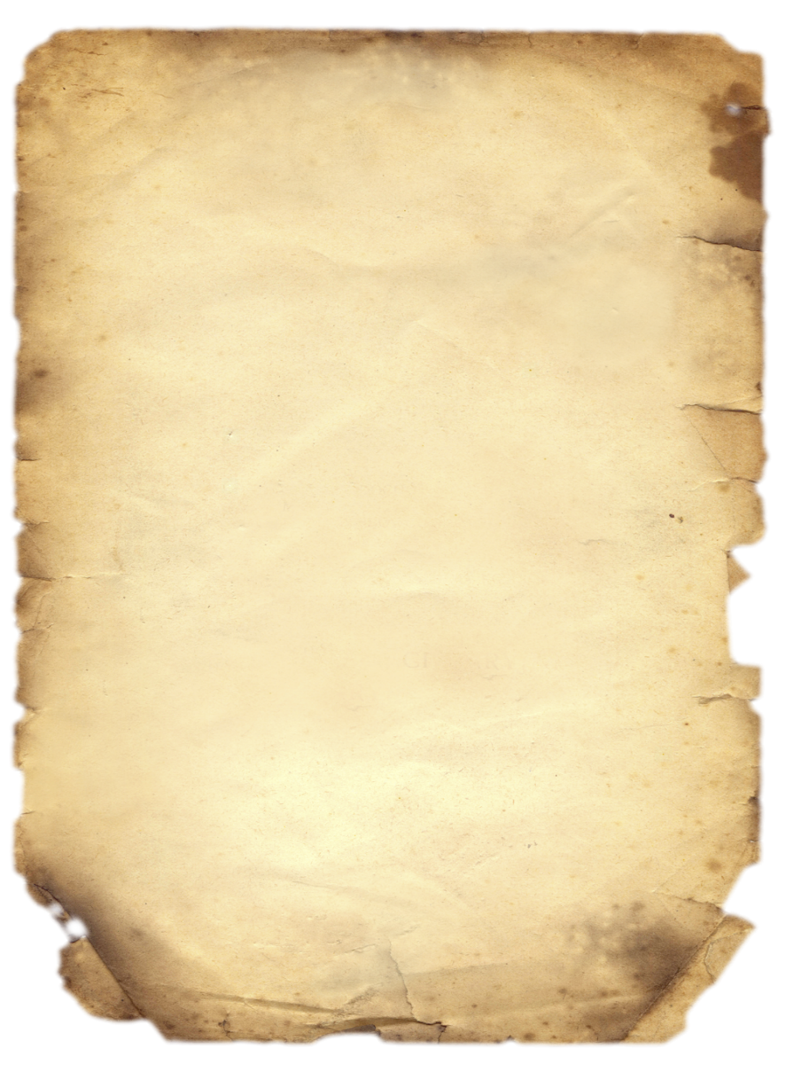
The mystery of John 5:3-5
John 5:3-5
3 In these lay a great multitude of sick people, blind, lame, paralyzed, waiting for the moving of the water. 4 For an angel went down at a certain time into the pool and stirred up the water; then whoever stepped in first, after the stirring of the water, was made well of whatever disease he had.
5 Now a certain man was there
who had an infirmity
thirty-eight years.
John 5:3-5
3 In these lay a multitude of invalids — blind, lame, and paralyzed.
<no verse 4>
5 One man was there who had been an invalid for thirty-eight years.
Notes:
**9:36**
Let’s take a look at that.
This is what John 5, verses 3-5 look like in the King James and New King James versions of the Bible
<CLICK AND READ>
So what’s going on here? Why does the KJV and the NKJV have this extra section, but the ESV, and the NASB, and the NIV and most every other translation don’t include verse 4?
I’m not going to answer that question. ☺ At least not yet! But I promise, we’ll come back to this verse later.
But these are some TOUGH QUESTIONS we’ve been looking at. Now, what do all these attacks on the New Testament have in common?
Well, they’re focusing on the fact that, in the process of these books of the NT being copied and copied over the centuries, there are a large number of TEXTUAL VARIANTS that have been introduced into the NT scriptures.
*ADVANCE*
Now, what is a textual variant?

Slide 18
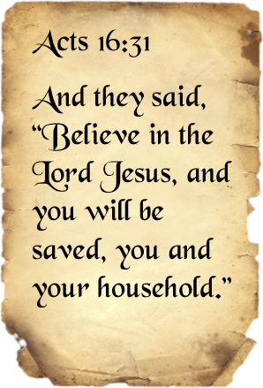
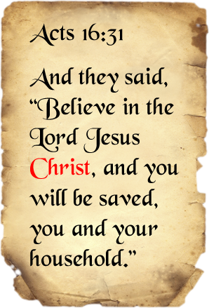
What is a textual variant?
Any place where two manuscripts differ from each other
Notes:
** 9:38 **
Now, what is a textual variant?
*CLICK*
Well, it’s simply any place where two manuscripts differ from each other
*CLICK*
So for instance, we’ve got some ancient handwritten manuscripts of Acts 16:31 that say “Believe in the Lord Jesus and you will be saved, you and your household”.
*CLICK*
But we have other ancient manuscripts that say “Believe in the Lord Jesus CHRIST” and you will be saved.
Now, obviously this is a minor textual variant, but it is still a variant – two manuscripts that do not agree with each other. And so we want to try to figure out what the original reading is – did Luke originally write just “Lord Jesus”, or did he write “Lord Jesus Christ”?
The process of dealing with these variations between manuscripts
*ADVANCE*
is called TEXTUAL CRITICISM.

Slide 19
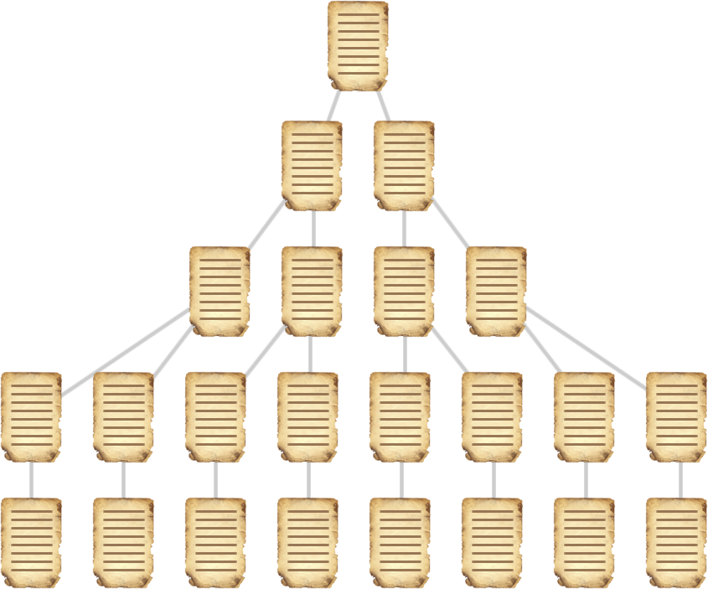
How textual variants multiply

Slide 20
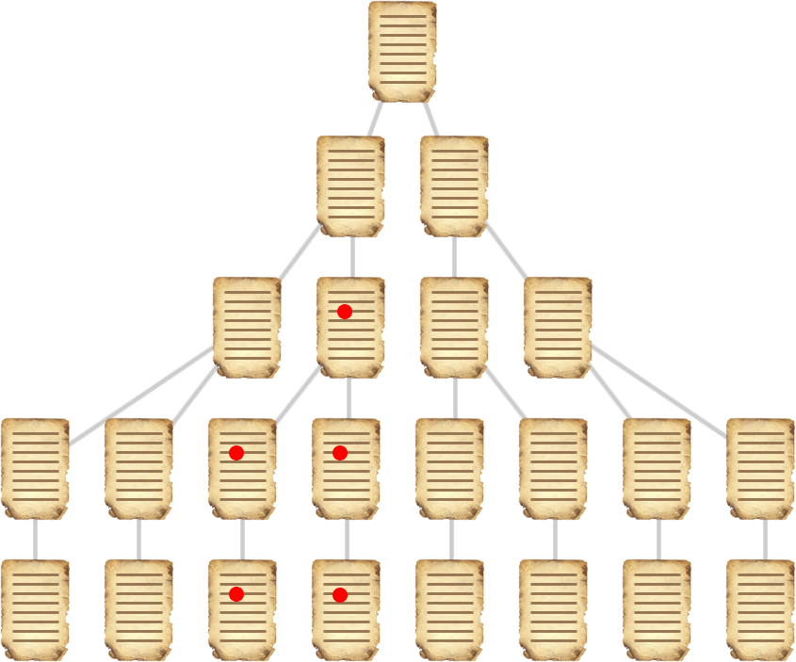
How textual variants multiply

Slide 21
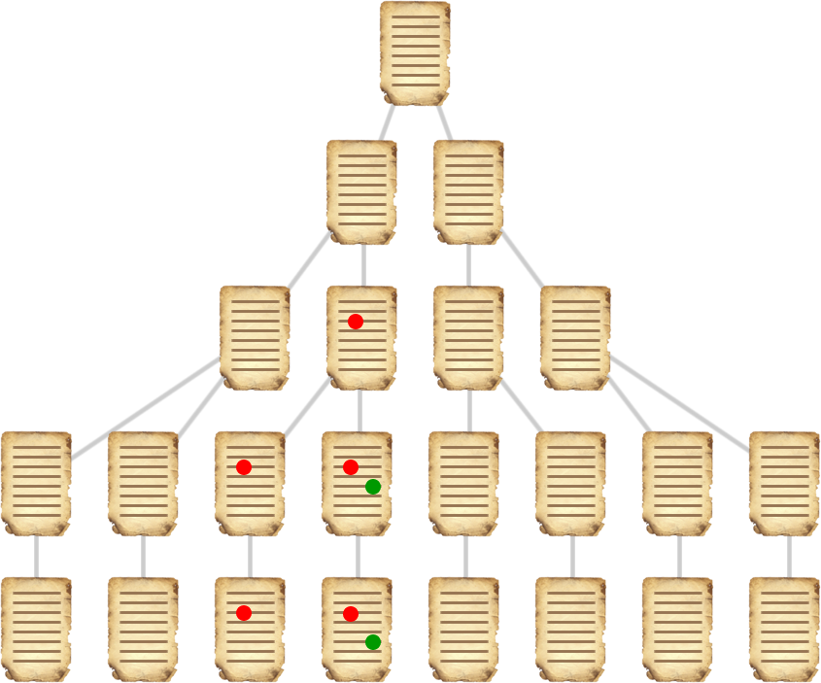
How textual variants multiply

Slide 22
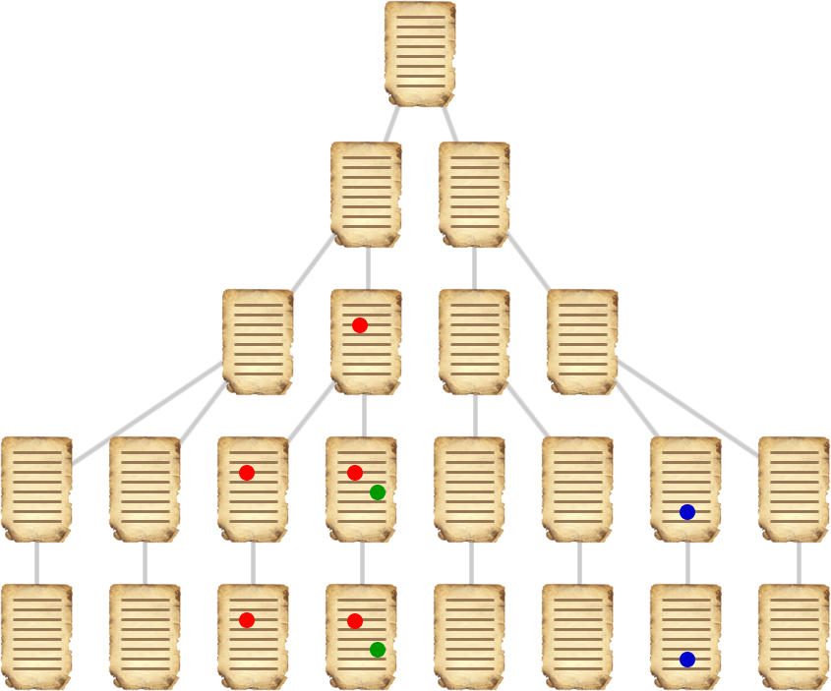
How textual variants multiply

Slide 23
What is textual criticism?
Textual criticism is the process of taking
multple copies of a document that differ from
one another and trying to determne what the original document said, even though that original document
no longer exists.
There are many different methods used to
determine the best reading among different
manuscripts.
  For example, older manuscripts are usually preferred
Notes:
Well what is textual criticism?
*CLICK*, read.
So you have a bunch of copies of the gospel of John made over the centuries, but you don’t have John’s original manuscript. How are scholars going to determine what John originally wrote based on the manuscripts we have?
*CLICK*
Well, there are many different methods that are used to determine the best reading among different manuscripts. Textual criticism is a complex discipline. But some of the techniques are things that even laymen like us can understand.
*CLICK*
For instance, when you’re comparing two documents, you’re generally going to prefer the older manuscript. That is, if you have a 4th century copy of Matthew and a 13th century copy of Matthew, and they differ from one another, you’re generally going to go with what the 4th century manuscript says:
It’s closer to the time when Matthew wrote his gospel
There’s less time for errors to creep in during the copying process
That’s just one of the methods that scholars use in textual criticism, but before we move on, I was to point out that textual criticism (even if it’s a term you haven’t heard before) is something that all of us do, and a lot of times we do it automatically without even noticing.
In fact you’ve probably being doing it yourself while you’ve been looking at the screen behind me! Because I made quite a few errors in this slide.
*CLICK and walk through errors*
Now in the process of reading this slide, and maybe without even thinking about it, you were mentally correcting the errors in this document, so that you could get back to my original words. So if you did any of that, if you saw these mistakes and corrected them, or if you just automatically corrected them without even noticing or thinking about it, then congratulations – YOU are doing textual criticism!
Ok, so we’ve talked about how early Christians had to make handwritten copies of the books of the NT, so now let’s take a look at some of the history of how that process actually happened in the first centuries.
*ADVANCE*
Here’s a map of the Roman empire, and you can see the extent of Christianity in the first century…

Slide 24
What is textual criticism?
Textual criticism is the process of taking
multiple copies of a document that differ
from one another and trying to determine
what the original document said, even though
that original document no longer exists.
There are many different methods used to
determine the best reading among different
manuscripts.
  For example, older manuscripts are usually preferred
Notes:
** 9:39 **
is called TEXTUAL CRITICISM.
*CLICK/READ*
Textual criticism is the process of taking multiple copies of a document that differ from one another and trying to determine what the original document said, even though that original document no longer exists.
So you have a bunch of copies of Acts made over the centuries, but you don’t have Luke’s original manuscript of the book of Acts. How are scholars going to determine what Luke originally wrote based on the manuscripts we do have?
*CLICK*
Well, there are many different methods that are used to determine the best reading among different manuscripts. Textual criticism is a complex discipline. But some of the techniques are things that even laymen like us can understand.
*CLICK*
For instance, when you’re comparing two documents, you’re generally going to prefer the older manuscript. That is, if you have a 4th century copy of Acts and a 13th century copy of Acts, and they differ from one another, you’re generally going to go with what the 4th century manuscript says:
It’s closer to the time when Luke wrote the book
There’s less time for errors to creep in during the copying process
That’s just one of the methods that scholars use in textual criticism. We don’t really have time to look into it deeper, but I just wanted you to know that there is a scholarly discipline out there called Textual Criticism that’s used for this very thing – getting back to what the original documents said even after the original documents no longer exist.
Ok, so we’ve talked about how early Christians had to make handwritten copies of the books of the NT, so now let’s take a look at some of the history of how that process actually happened in the first centuries.
*ADVANCE*
Here’s a map of the Roman empire, and you can see the extent of Christianity in the first century…

Slide 25
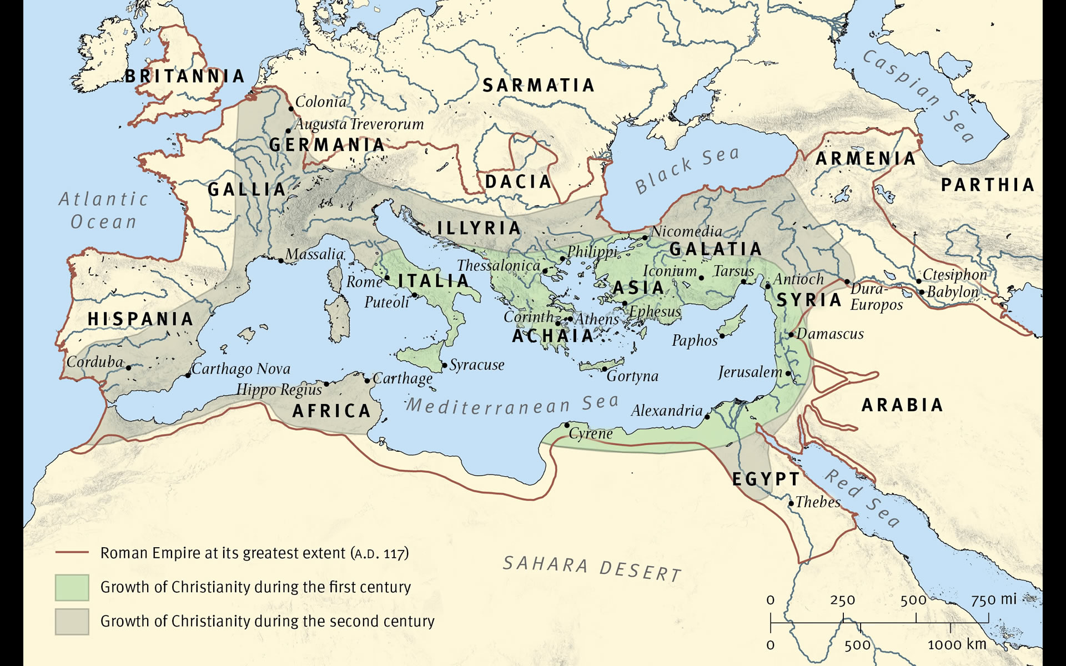



Notes:
** 9:41 **
Here’s a map of the Roman empire, and you can see the extent of Christianity in the first century…
<map showing the extent of Christianity in the first (green) and second (century)>
JOHN in EPHESUS writing his gospel, and then he sends a copy to
Jerusalem
And then a copy to Antioch
And then a copy sent to Egypt
More copies are sent north, maybe to Philippi
AND through this copying process, the gospel of John is beginning to spread throughout the Roman empire.
Similarly PAUL is in ROME writing his letter to the Ephesians, so he’s going to send a copy to
The church in Ephesus
And then copied to all the churches in the Galatian regions
A copy may be sent to the apostles in Jerusalem
Maybe someone from Egypt visits as well, and they take a copy back for their church in Egypt.
So again these New Testament GOSPELS and EPISTLES are spreading rapidly throughout the Roman empire over the course of just a few years.
Again, maybe in JERUSALEM you’ve got JAMES, the leader of the church there, writing his epistle.
- And his book will be sent off to Antioch, and to Egypt, and to other churches throughout the empire
And so you’ve got this widespread distribution of NT documents happening all over the Roman empire, and it’s all happening VERY RAPIDLY .
And as these churches begin gathering multiple letters and epistles, they’ll begin putting these manuscripts into collections, and soon you have entire sections of the NT being copied and distributed, not just individual letters.
Now, this is in keeping with the GREAT COMMISSION – the early church is following Christ’s command to go and make disciples of all the nations. And they’re using their scriptures in order to do this, to make disciples. And so they’re very happy for people to make copies of their scriptures for themselves.
What that means is that, if you were visiting Ephesus and wanted to take a copy of Paul’s letter to that church back home, the leaders of the church would probably not check to see
- how good a scribe you were,
- whether you had good handwriting,
- whether you were careful and meticulous – they would just be happy for you to make a copy for yourself.
And one of the results of this was that Christians, who are like you and me, not trained copyists, are sometimes going to make mistakes when they make copies of these documents – they get their letters or their words wrong.
But the most important result was that these documents spread WIDELY throughout the Roman empire, and RAPIDLY, over the course of just a few decades. So remember that – we’re going to come back to that idea of rapid, widespread distribution later.
But like we said, not everyone who made these copies of the NT scriptures was a skilled copyist, so ERRORS - TEXTUAL VARIANTS - are beginning to creep in. And if I’ve made a mistake in my copy of Galatians and then YOU make a copy of the manuscript from me, what’s going to happen? Your copy is going to have that same mistake that my copy has. And then you might make a mistake and create a textual variant of your own.
So with all the manuscripts that we have discovered of the NT,
*ADVANCE*
HOW MANY TEXTUAL VARIANTS ARE THERE in total?

Slide 26

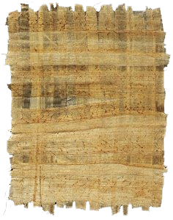
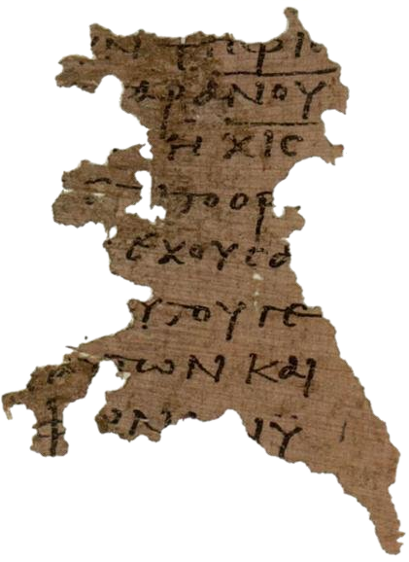
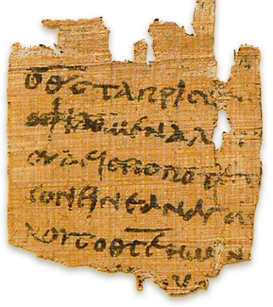
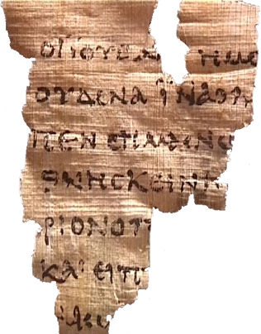
Cheap and easy to obtain
Brittle and easily damaged
Decomposed quickly, except in dry desert climates
P52
Notes:
** 9:57 **
The first was PAPYRUS, and this is what was used for the earliest NT manuscripts during the first few centuries.
Papyrus is formed by taking stems of the papyrus plant and laying them out in horizontal/vertical fashion, beating them together until they stick together. Writing is on the horizontal side, to go with the grain.
*CLICK* Papyrus was cheap and easy to obtain
*CLICK* But it was also very brittle and easily damaged
*CLICK* and being made out of plant material, it would decompose quickly, except in dry desert climates. So if you had a hand-copied papyrus manuscript of a letter from Paul in Rome or Galatia or somewhere up North, it probably wouldn’t last more than a few decades, maybe up to a century or so. On the other hand if you had papyri in a desert region like Egypt, then there’d be a better chance that your manuscript might last longer. And it turns out the oldest manuscripts of the NT we have generally were found in desert regions, where they were able to survive much longer.
*CLICK* Here are some examples of some papyri containing portions of the New Testament, and you can see that they’re fragmentary and pieces of them have broken off.
*CLICK* This one here on the left is interesting, because it’s one of the most important NT manuscripts in the world. It’s called P52. It’s quite small, only about the size of a credit card, but it is the OLDEST New Testament manuscript in existence that we know of. It dates back to the 2nd century, to about 125 AD, although some scholars have put it as far back as 75AD, and it contains a portion of the Gospel of John.
TRANSITION: Now in the 4th century, when the Roman emperor Constantine rose to power and persecution of Christianity came to an end and the church entered a time of peace, Christians began to have the resources to obtain better material for their copies.
*ADVANCE*
And so they began to switch from PAPYRI to PARCHMENT.

Slide 27
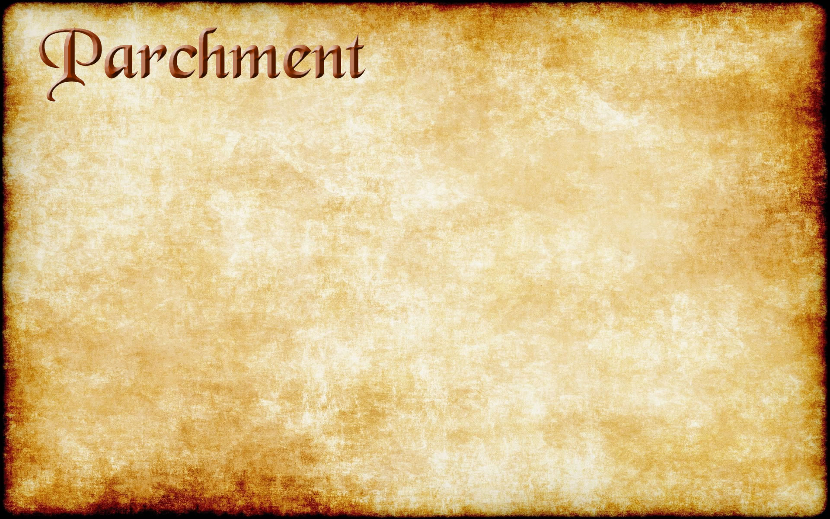
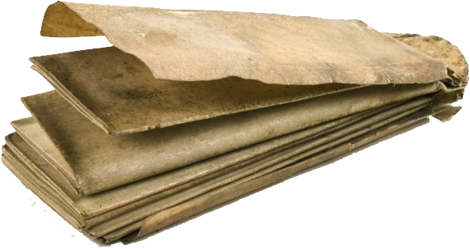
Made of animal skin
Extremely durable
Notes:
And so they began to switch from PAPYRI to PARCHMENT.
*CLICK* Parchment is made out of animal skin
*CLICK* and it’s very durable. We have a lot more PARCHMENT manuscripts of the NT than we have PAPYRI manuscripts
*ADVANCE*
And again, here are some examples of what parchment manuscripts look like

Slide 28
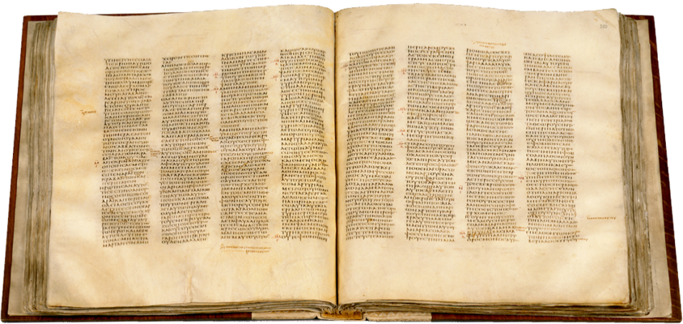
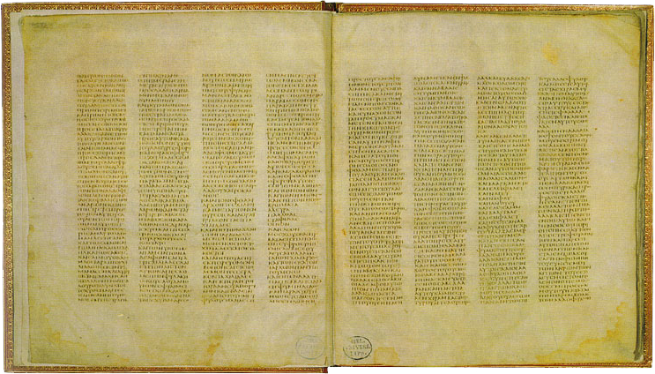
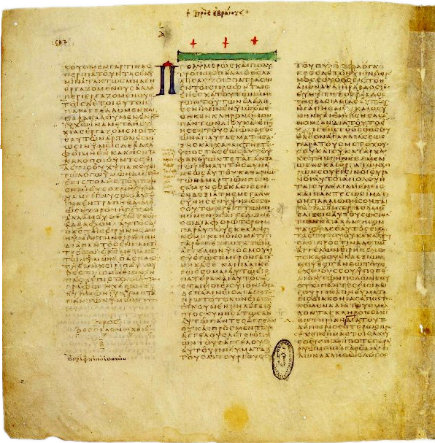
Codex Sinaiticus
(330-360 AD)
Codex Vaticanus
(330-360 AD)
Notes:
And again, here are some examples of what parchment manuscripts look like
- The one at the top is a CODEX, which have pieces of parchment sewn together and bound up very much like a modern book.
- And there at the bottom
Probably the two single most important codecies of the NT that we have today.
*CLICK*
This is Codex Sinaiticus & Codex Vaticanus
They date back to between 330 and 360 AD
And these are codices that may have been commissioned by Constantine himself.
Codex Vaticanus is an almost fully complete codex of the NT,
and Codex Sinaiticus IS the oldest fully-complete copy of the NT that we have – it has all of the NT, most of the OT, and some other books as well.
*ADVANCE*
So, as we saw from the map earlier, Christians are making copies of scripture on papyri, and then later on parchment,

Slide 29
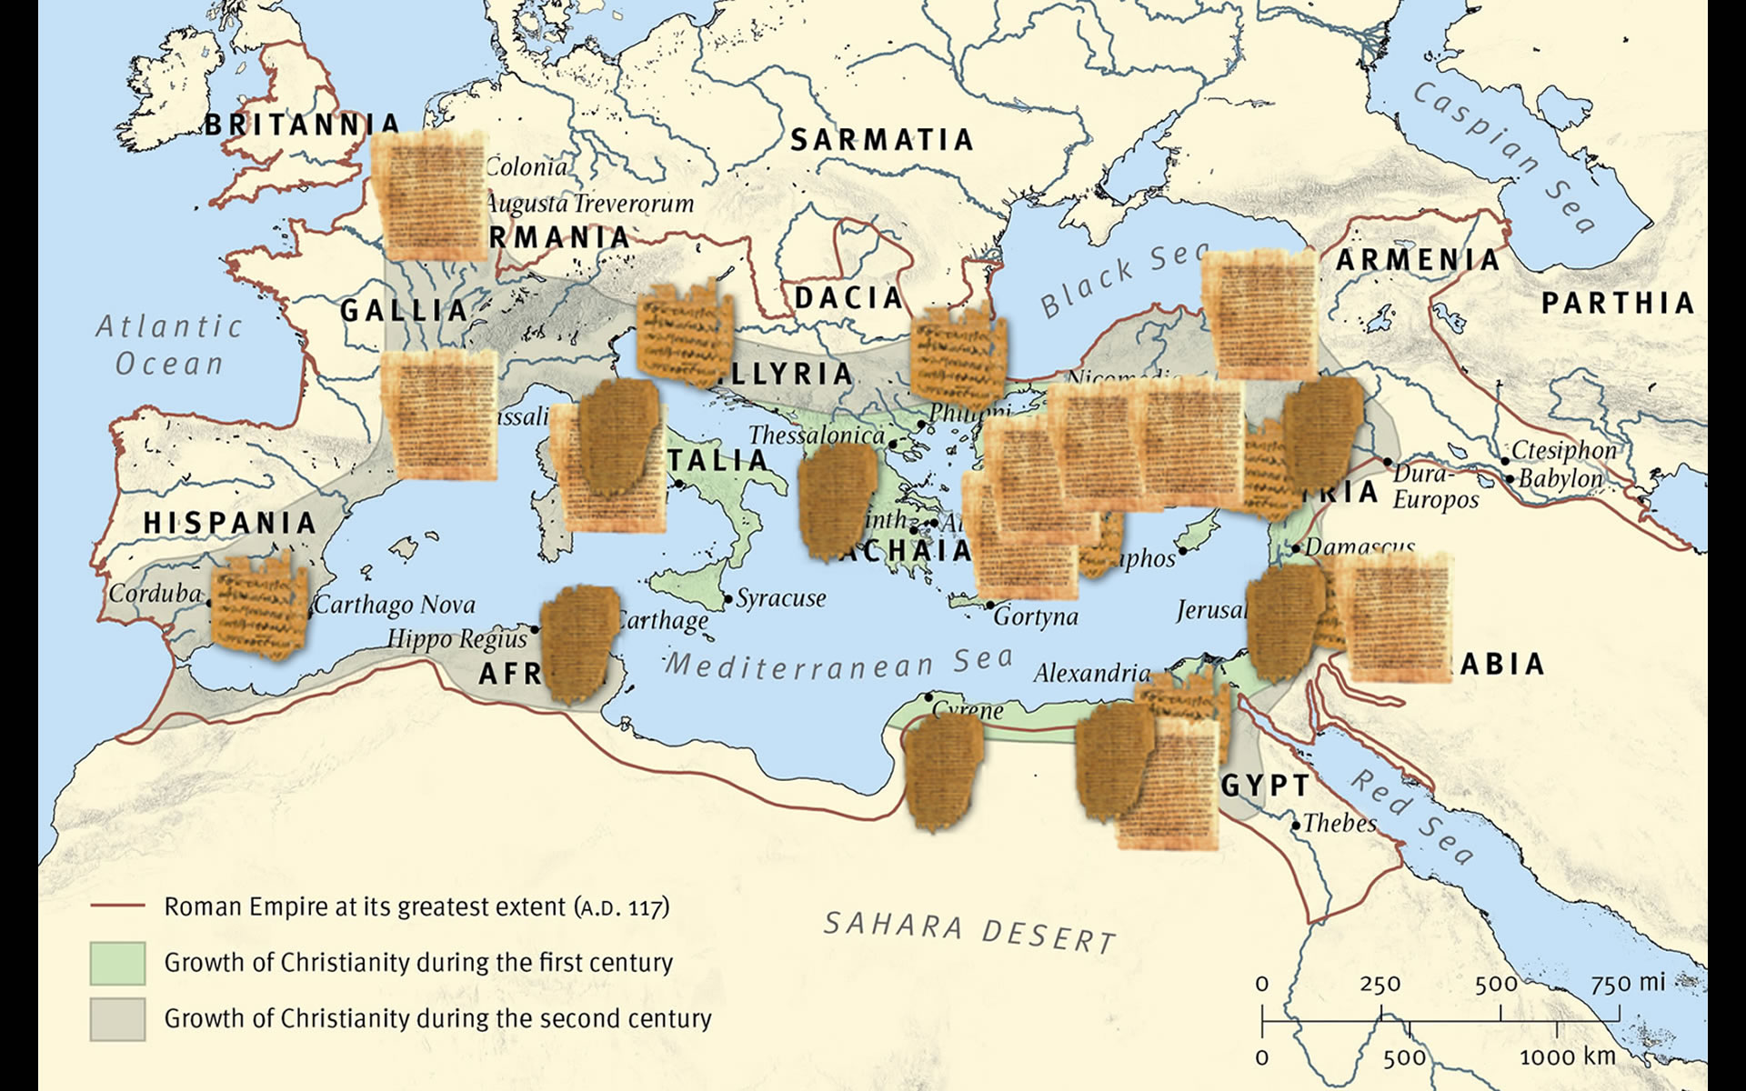
Notes:
So, as we saw from the map earlier, Christians are making copies of NT documents on papyri, and then later on they’re using parchment, and the copies are spreading rapidly through the Roman empire.
But not everyone is a skilled copyist so ERRORS - TEXTUAL VARIANTS - are beginning to creep in. And if I’ve made a mistake in my copy of Galatians and then YOU make a copy of the manuscript from me, what’s going to happen? Your copy is going to have that same mistake that my copy has. And then you might make a mistake and create a textual variant of your own.
So with all the manuscripts that we have discovered of the NT,
*ADVANCE*
HOW MANY TEXTUAL VARIANTS ARE THERE in total?

Slide 30
How many textual variants?
Approximately 400,000 textual variants
… but, we have over 5,800 Greek manuscripts of the New Testament
… and over 18,000 ancient manuscripts in other languages
The more manuscripts you have,
the more textual variants you
will have
Notes:
** 9:44 **
HOW MANY TEXTUAL VARIANTS ARE THERE in total?
Well, there are *CLICK*
Approximately 400,000 textual variants among all of our NT manuscripts.
And that sounds like a really big, scary number. It’s that kind of statistic that critics like to use when they say “The text of the New Testament has been SO corrupted! How can you have ANY certainty whatsoever about what the NT originally said, when you’ve got 400,000 variations in the text?
Well, we’re going to spend the rest of this class explaining why that number, 400,000 textual variants, isn’t something that has to shake our faith that the Bibles we have today are the true and reliable word of God..
So the very first thing I want to point out is that the reason we have so many TEXTUAL VARIANTS is because we have so many MANUSCRIPTS containing all or part of the NT
*CLICK*
we have over 5,800 manuscripts of the NT in the Greek language alone.
*CLICK* and over 18,000 ancient manuscripts in other languages like Latin, Armenian, and Arabic.
*CLICK* And the more manuscripts you have, the more textual variants you’ll have.
*ADVANCE* (no slide change)
If there was only a single handwritten copy of, say, the Declaration of Independence in existence, how many textual variants would there be?

Slide 31
How many textual variants?
Approximately 400,000 textual variants
… but, we have over 5,800 Greek manuscripts of the New Testament
… and over 18,000 ancient manuscripts in other languages
The more manuscripts you have,
the more textual variants you
will have
Notes:
If there was only a single handwritten copy of, say, the Declaration of Independence in existence, how many textual variants would there be?
There’s be zero, because there’d be nothing to compare it to. If you had five copies, all handwritten, you might find a few differences between those copies, but not too many.
But the more manuscripts you have, the more textual variants you’ll have. That’s just to be expected. And we have a HUGE number of NT manuscripts.
Let me put that number in context for you.
Let’s take the 5,800 Greek manuscripts of the NT that we have and compare that with number of manuscripts we have
*ADVANCE*
for other works of antiquity from the Greco-Roman empire written around the same time as the NT.

Slide 32
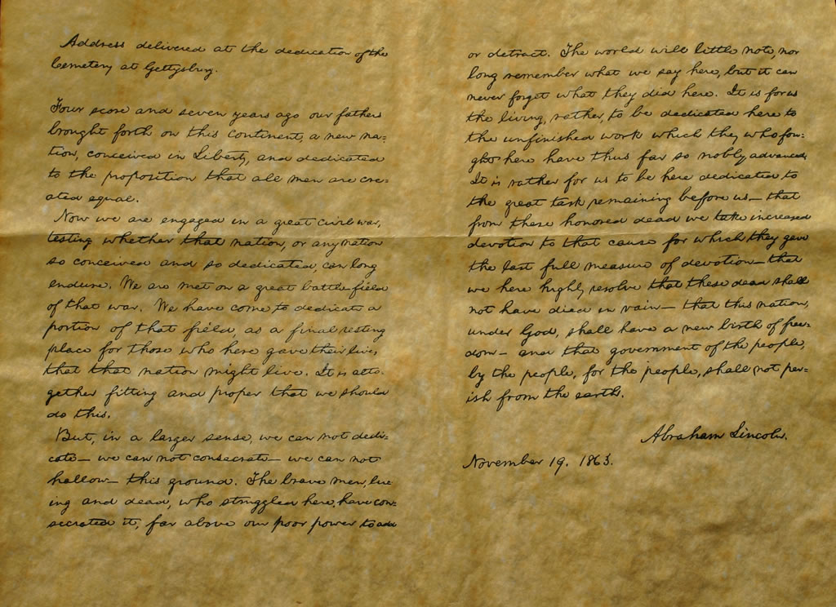
The Gettysburg Address
Notes:
** 10:04 **
Let’s take the Gettysburg Address, which was handwritten by Abraham Lincoln in 1863
Now, if you only have one copy of this speech, how many textual variants are you going to find?
ZERO, because there are no other copies to compare it with. Right or wrong, it’s the only copy there is.
Now, it so happens that there are FIVE original copies of the Gettysburg Address, all handwritten by Lincoln for different people. And when he wrote it out each time, he didn’t always use exactly the same words in each copy.
*ADVANCE*
Here’s a page that someone has put together that takes all the textual variants in each of the 5 copies of the Gettysburg Address and puts them into a single document.
272 words
67 TV’s

Slide 33
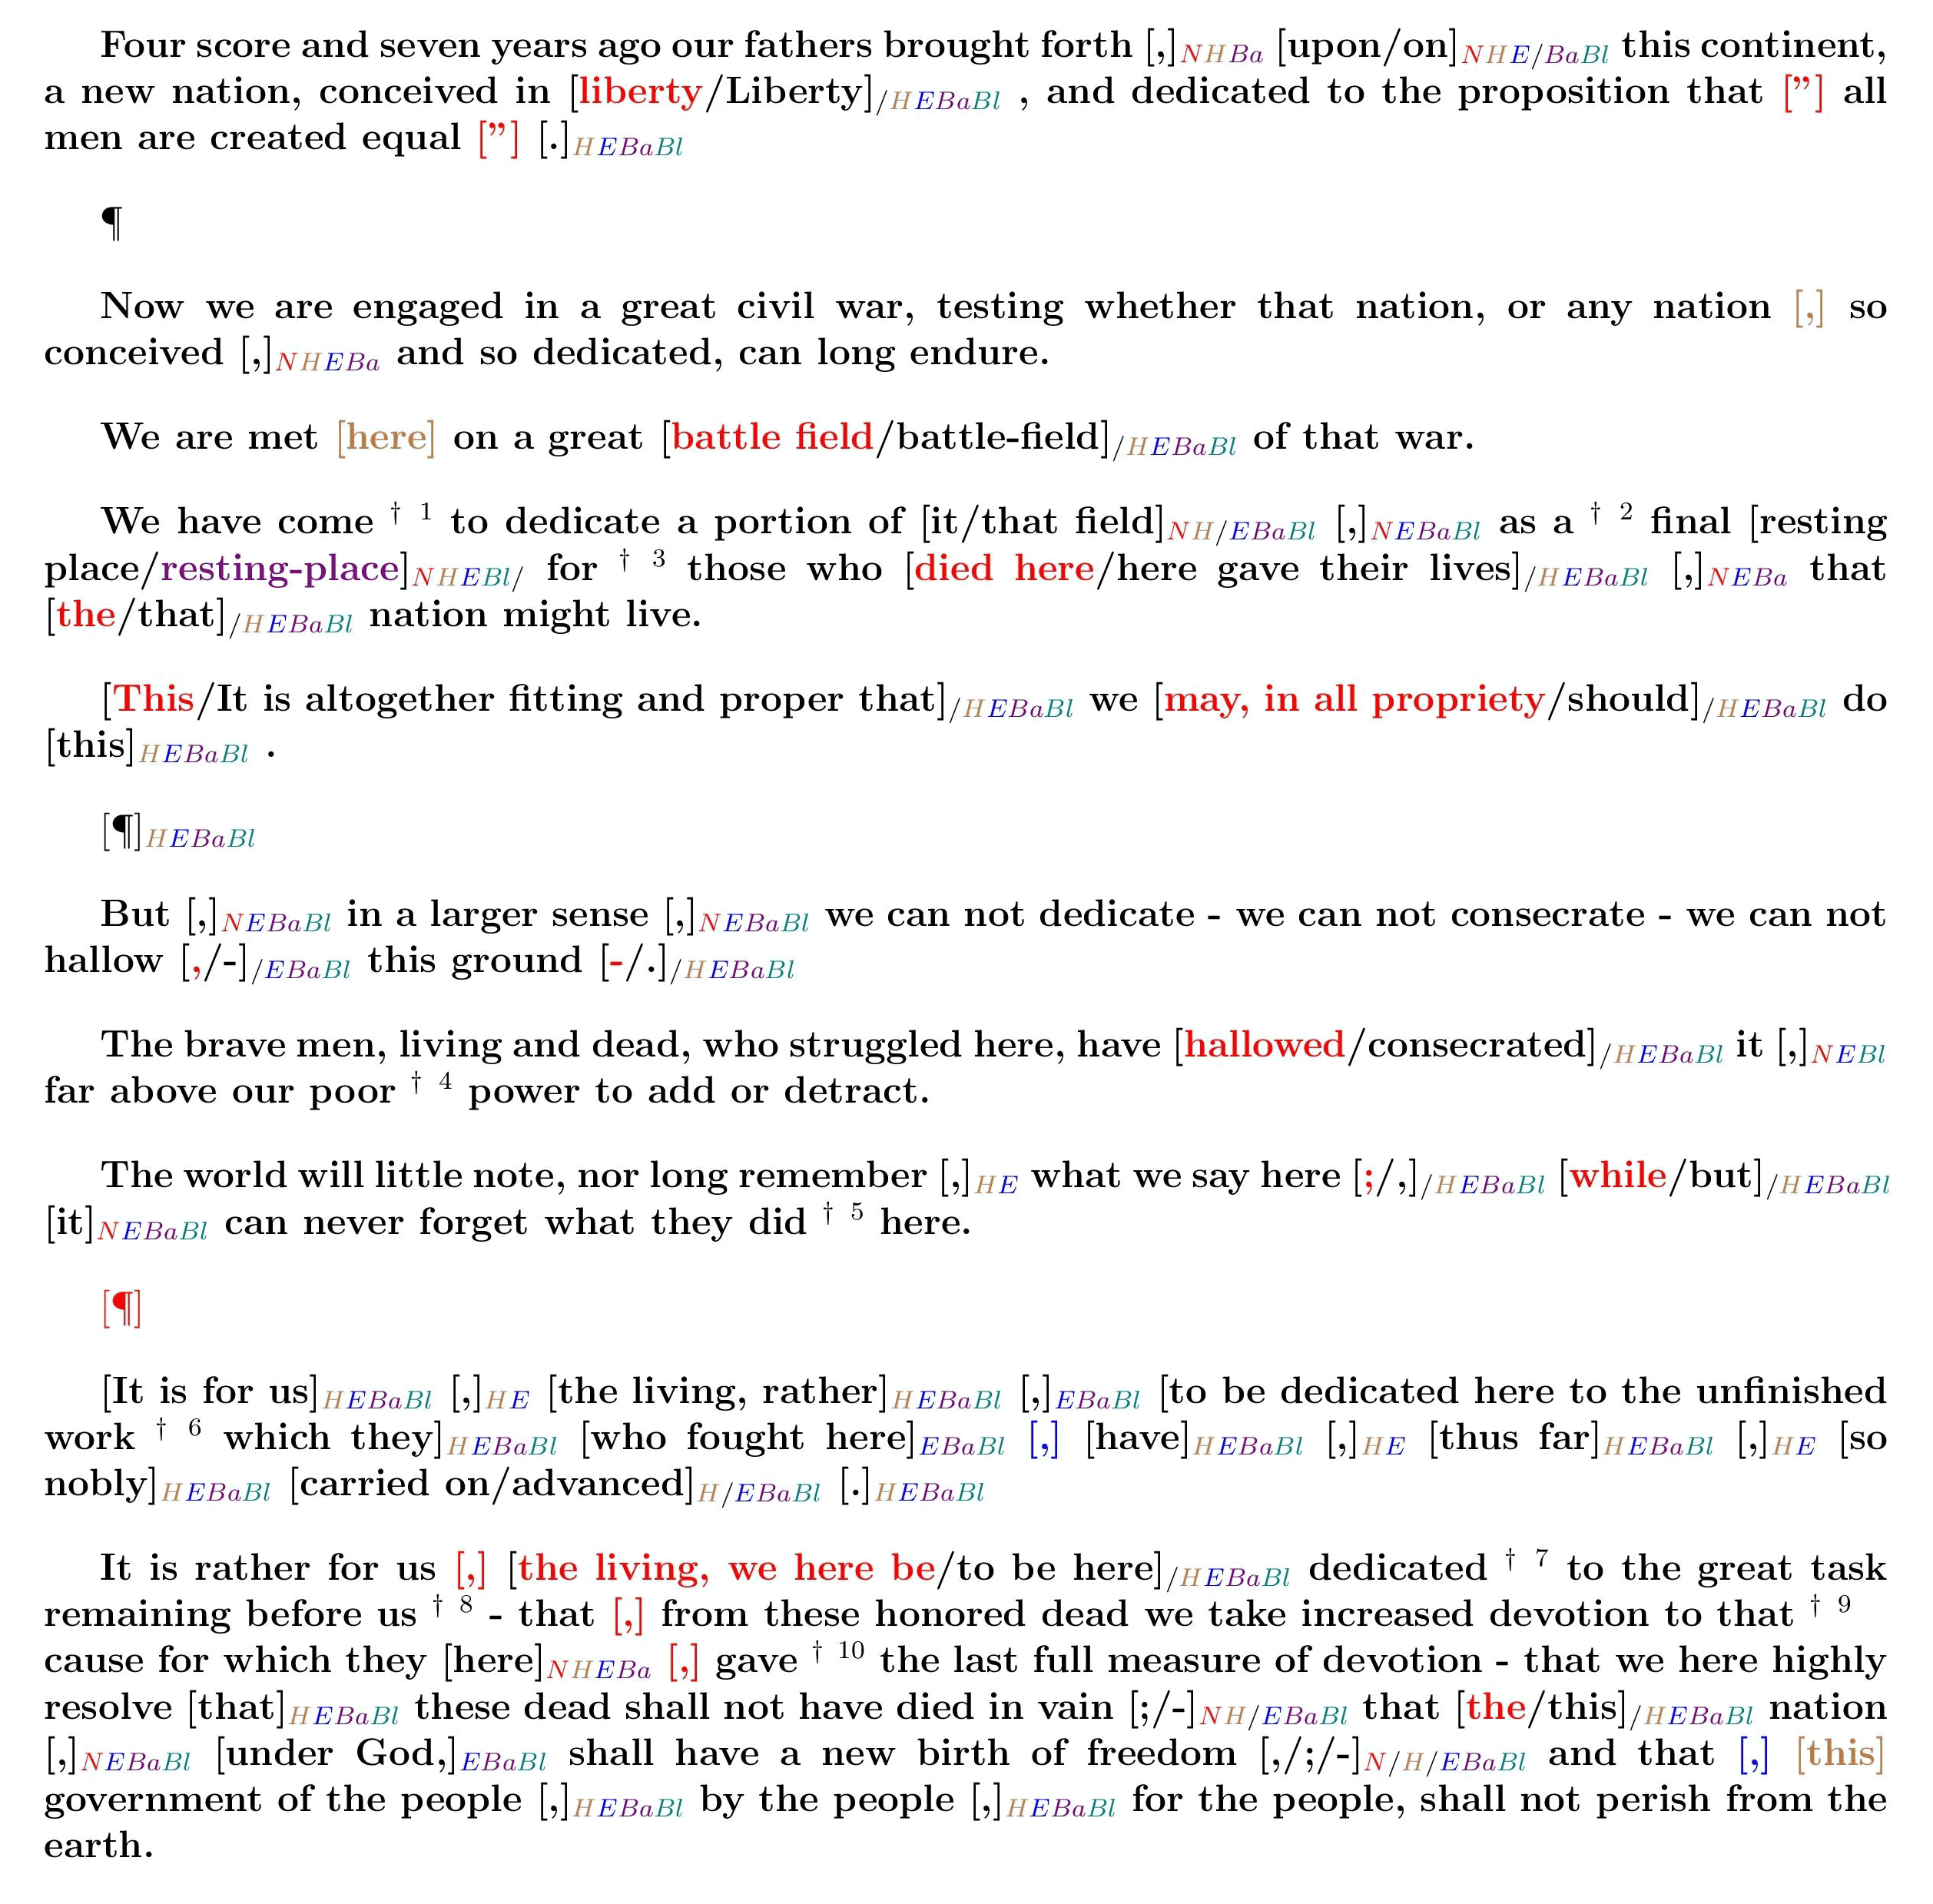
The Gettysburg Address
5
handwritten manuscripts
272
words
67
textual variants
Notes:
Here’s a page that someone has put together that takes all the textual variants in each of the 5 copies of the Gettysburg Address and puts them into a single document.
I know this is difficult to see if you’re not on the first few rows, but don’t worry about it – you don’t have to read anything here. But anywhere you can see something in color or see brackets around words in this document, that’s an indication where there’s a textual variant, where Lincoln wrote one thing in one copy, and another thing in another copy.
So we have 5 handwritten manuscripts here,
containing the Gettysburg address, which is 272 words long. How many textual variants do we find among these manuscripts?
*CLICK*
There are 67 textual variants.
67 TVs, with only 5 manuscripts and 272 words total, all copied by hand by the same man!
The NT has approximately 138,000 words, and not just 5 manuscripts, but over 5,800 manuscripts
So when you think about it that way, the fact that there are 400,000 textual variants among all the NT manuscripts really isn’t all that surprising.
TRANSITION: A large number of textual variants goes hand-in-hand with a large number of manuscripts.
*ADVANCE*
And as I mentioned, there are a LOT of NT manuscripts – over 5800 of the original greek.

Slide 34
An embarrassment of riches
Over 5,800 Greek manuscripts
Over 10,000 Latin manuscripts
Another 5,000-10,000 manuscripts in other ancient languages
Notes:
** 10:06 **
And as I mentioned, there are a LOT of NT manuscripts
*CLICK*
over 5800 manuscripts written in Greek, the original language of the NT.
And it’s not just Greek. The NT was translated into other languages very early on as well. Latin came to dominate the Mediterranean region during the first and second century, and so in addition to the 5800+ Greek NT manuscripts we have
*CLICK*
we also have over 10,000 Latin manuscripts of the NT.
In addition,
*CLICK*
we have another five-to-ten-thousand ancient manuscripts of the NT translated VERY EARLY ON into other languages:
Syriac, Coptic, Arabic, Armenian, Georgian, Gothic, Slavonik.
That’s a conservative guess, too – there are so many, they just haven’t been catalogued.
Now I’ve titled this slide “An embarrassment of riches” (to borrow a phrase from Dan Wallace, one of the authors of the book “Reinventing Jesus” that I mentioned earlier) because we may not realize just how huge a collection of manuscripts this is. In the era of the printing press, and digital copying and Amazon self-publishing, we may not realize how unusual it is to have this many manuscripts of a work of antiquity. But let me try to put these numbers here in context
*ADVANCE*
by comparing the number of manuscripts we have for the NT with other works of antiquity, from the Greco-Roman empire around the same time as the Bible.

Slide 35
Comparing ancient writings
Work of antiquity | Number of surviving manuscripts | Time between original & earliest manuscript
Livy
27
350 years
Herodotus
75
400 years
Suetonius
200+
700 years
Tacitus
3
700 years
New Testament
5,800+
< 50 years
Notes:
from the Greco-Roman empire around the same time as the Bible.
*CLICK*
So we have 5,800 manuscripts in Greek containing SOME PORTION of the NT (most of them are fragmentary, not complete copies of the NT, but most of them are still fairly sizable manuscripts).
Now this column “Time between original & earliest manuscript” is designed to answer this question:
Let’s take the oldest manuscript containing a portion of the NT that we have. How many years are there between that manuscript and the time of the original document?
*CLICK*
It’s less than 50 years old. We saw a picture of that papyrus earlier, P52, which is dated around 125AD. That’s within about 50 years of the time when John wrote his original manuscript.
These are historians and biographers writing documents in the same genre as the NT.
*CLICK*
Livy (rhymes with “divvy”) = lived between 59BC and 17AD, and wrote one of the greatest histories of Rome
Heroditus = wrote about the Persian empire and the rise of Alexander the Great in the 5th century BC
Seutonius = One of the 3 major historians of the Caesars, who gives us much of what we know about Julius Caesar and Caesar Augustus (writing 121AD) (copy in 9th C.)
Tacitus = the historian of the emperors Nero, Vespasian and Dominitian (56AD – 117AD)
How many surviving manuscripts do we have of the works of these authors?
*CLICK*
There are just a handful of manuscripts surviving from these authors - very, very few compared to what we have for the New Testament.
And what if we take the oldest copies we have for each of these authors? How many years are there between the time that each of these men originally wrote and the oldest copy that we have today?
*CLICK*
It’s a HUGE amount of time. Take Seutonius for example. He wrote his historical works in the 2nd century, but the earliest copy of his works that we have comes from the 9th century. Everything before that has been lost.
We have more historical evidence that attests to Jesus of Nazareth than we do for Homer, Socrates, Plato, Aristotle, Julius Caesar, and anyone else in the ancient world.
And like I said earlier, when you have a lot of manuscripts, it’s to be expected that you’ll also have a lot of textual variants where those manuscripts sometimes differ from one another.
*ADVANCE*
So how many textual variants did we say we have?

Slide 36
Comparing ancient writings
Work of antiquity | Number of surviving manuscripts
Livy
27
Herodotus
75
Suetonius
200+
Tacitus
3
New Testament
5,800+
Notes:
** 9:46 **
for other works of antiquity from the Greco-Roman empire around the same time as the Bible.
*CLICK*
So we have 5,800 manuscripts in Greek containing SOME PORTION of the NT (most of them are fragmentary, not complete copies of the NT, but most of them are still fairly sizable manuscripts).
*CLICK*
Now, here are some other historians and biographers writing documents in the same genre as the NT.
Livy was writing just before the time of Christ and wrote one of the greatest histories of Rome
Herodotus (in the 5th century BC) wrote about the Persian empire and the rise of Alexander the Great
Suetonius (in the second century AD) is one of the most important historians of the Caesars. Most of what we know about Julius Caesar and Caesar Augustus comes from Suetonius.
Tacitus (who lived in the first century) was the historian of the emperors Nero, Vespasian and Dominitian
How many surviving manuscripts do we have of the works of these authors?
*CLICK*
There are just a handful of manuscripts surviving from these authors - very, very few compared to what we have for the New Testament.
We have more historical evidence that attests to Jesus of Nazareth than we do for Socrates, Plato, Aristotle, Julius Caesar, and anyone else in the ancient world.
And like I said earlier, when you have a lot of manuscripts (like the New Testament does), it’s to be expected that you’ll also have a lot of textual variants where those manuscripts sometimes differ from one another.
*ADVANCE*
So how many textual variants did we say we have?

Slide 37
An embarrassment of riches
Over 5,800 Greek manuscripts
Over 10,000 Latin manuscripts
Another 5,000-10,000 manuscripts in other ancient languages
Over 1,000,000 quotations of New Testament verses by early church fathers…
… enough to reproduce almost the entire New Testament many times over just by quotations alone.
Notes:
** 10:12 **
But what if you had a magic wand and could destroy every one of these manuscripts in one fell swoop.
-- would we be left without any historical evidence of the writings of the apostles?
-- Would we have no idea what the NT said? The answer is “NO”, because we have the writings of church fathers – elders, pastors, scholars, bishops, priests – who wrote commentaries and sermons on the NT, and many of these men did not have the gift of brevity.
As a result
*CLICK*
we have MORE THAN ONE MILLION quotations of the NT by these church fathers – sometimes a part of a verse, sometimes entire passages.
*CLICK*
Enough to reproduce virtually the entirely New Testament many times over just by quotations alone.
TRANSITION: Alright, but someone might still say “This is all interesting, but it doesn’t change the fact that all these manuscripts you’re talking about have hundreds of thousands of variants in them!” So let’s address that issue now – how are we going to respond when someone says “The Bible has so many variants and errors in it, it’s impossible to know what the original looked like!”
*ADVANCE*
So how many textual variants did we say we have?

Slide 38
How many variants?
5,800+ Greek manuscripts of the New Testament still exist
Approximately 400,000 textual variants
138,162 (Greek) words in the New Testament
3 possible choices for every word in the New Testament??

Slide 39

How many variants?
400,000
Textual Variants
Notes:
** 10:13 **
So how many textual variants did we say we have?
400,000 textual variants.
But let’s take a closer look at this
and break this number down into different categories of textual variants.
*ADVANCE*
And the first category that we can put up and immediately eliminate as a problem is 70% of them, which we classify as spelling differences and nonsense errors.

Slide 40

Spelling differences &
nonsense errors
70%
Notes:
** 9:49 **
And the first category that we can put up and immediately eliminate as a problem is 70% of them, which we classify as
*CLICK*
spelling differences and nonsense errors.
Now a SPELLING DIFFERENCE would be something we’re familiar with in English – for example in England, they spell the word color “C-O-L-O-U-R”, adding a “U” in the spelling. And that sort of thing happens in Greek as well – there are differences in spelling sometimes, but the word still has the same meaning. Spelling errors present no problem in understanding the text.
**SKIP NONSENSE ERROR IF MUCH LATER THAN 9:49**
Now let me show you an example of the other type that’s listed here – a NONSENSE ERROR.
*ADVANCE*
In 1 Thes. 2:7, it says in our Bibles, “but we were gentle among you…”

Slide 41
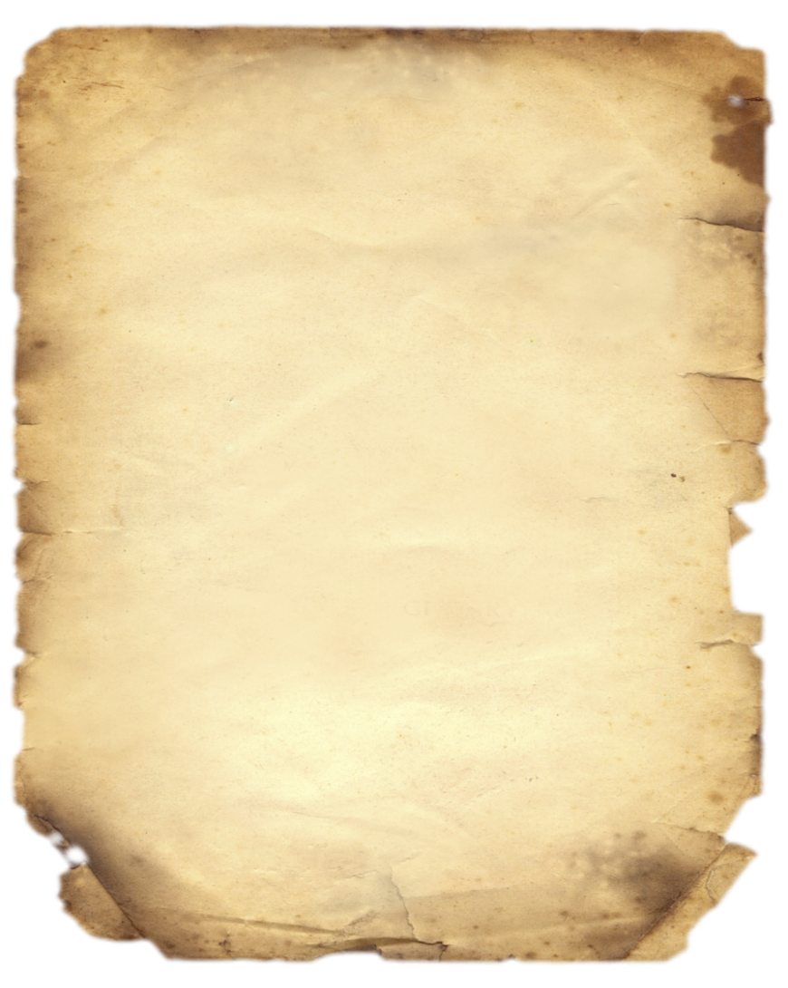
Spelling Differences
James 3:1
…for you know that
we who teach will be
judged with greater
strictness.
μου ειδοτες οτι
μειζον κριμα
ληψομεθα
James 3:1
…for you know that
we who teach will be
judged with greater
strictness.
μου ειδοτες οτι
μειζον κριμα
λημψομεθα
Notes:
Here are a couple of different manuscripts showing James chapter 3 verse one. Now at the top of each one, you can see that the English is the same on both manuscripts:
“for you know that we who teach will be judged with greater strictness”.
And that phrase is shown in Greek at the bottom. But in the word that’s translated “will be judged” on the right, you can see an extra Greek character, a “mew” character. Now that’s a spelling difference between the two manuscripts, and that is a textual variant. But the English translation is exactly the same. It’s kind of like how in England they spell the word color “C-O-L-O-U-R”. But the word still has the same meaning, whether you use the American spelling or the English spelling. So textual variants like this that are just spelling differences
*ADVANCE*
make up 70% of all textual variants in the New Testament, and don’t present us with any problem.

Slide 42

Oops.
1 Thessalonians 2:7
But we were gentle among you, like a nursing mother taking care of her own children.
1 Thessalonians 2:7
But we were horses among you, like a nursing mother taking care of her own children.
hpioi
(“gentle”)
ippoi
(“horses”)
Notes:
In 1 Thes. 2:7, it says in our Bibles,
“But we were gentle among you like a nursing mother taking care of her own children.”
Now in the 14th century, some poor scribe just blew it and got the wrong word entirely.
*CLICK*
He wrote, “but we were horses among you, like a nursing mother taking care of her own children. “
*CLICK*
In Greek the two words look somewhat similar, and for whatever reason this scribe misread or miscopied EHP-PEE-OI (“gentle”) and wrote down HIPP-OI (“horses”) instead.
Now, this can immediately be recognized as not the original thing Paul wrote. This is just a nonsense error made by an inattentive scribe in the 14th century. So we can eliminate this kind of thing easily,
*ADVANCE*
and 70% of textual variants fall into that category.

Slide 43

Spelling differences &
nonsense errors
70%
Notes:
** 9:50 **
and 70% of all textual variants fall into that category.
Just like that, we’ve eliminated some 280,000 variants we don’t have to worry about.
But we can do even more than that.
*ADVANCE*
We can also eliminate another 20% by ignoring textual variants that do not affect translation.

Slide 44
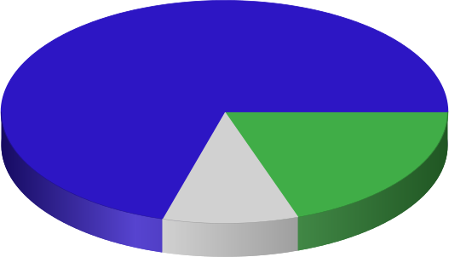
Spelling differences &
nonsense errors
Do not affect
translation
70%
20%
Notes:
We can also eliminate another 20% by ignoring textual variants that do not affect translation.
In Greek, the word order can be moved around, you can have the verb and the direct object or maybe the direct object and the verb. And technically, that's going to be a textual variant if manuscripts shuffle the word order like that, but the translation into English is going to be exactly the same. So 20% of textual variants do not affect the English translation at all. And that takes care of another 80,000 of them.
*ADVANCE*
Another 9% of textual variants are ones we would call “meaningful but not viable”

Slide 45
Variants that do not affect translation
James 3:5
ουτως και η γλωσσα μικρον μελος εστιν και μεγαλα αυχει
So also the tongue is a small member, yet it boasts of great things.
James 3:5
ουτως και η γλωσσα μικρον μελος εστιν και μεγαλαυχει
So also the tongue is a small member, yet it boasts of great things.
Notes:
A compound word (e.g. troublemaker = troublemaker)

Slide 46
How do you write “John loves Mary” ?
Ἰωάννης ἀγαπᾷ Μαρίαν
Ἰωάνης ἀγαπᾷ Μαρίαν
ὁ Ἰωάννης ἀγαπᾷ Μαρίαν
ὁ Ἰωάννης ἀγαπᾷ τὴν Μαρίαν
Μαρίαν Ἰωάννης ἀγαπᾷ
τὴν Μαρίαν Ἰωάννης ἀγαπᾷ
Μαρίαν ὁ Ἰωάννης ἀγαπᾷ
τὴν Μαρίαν ὁ Ἰωάννης ἀγαπᾷ
ἀγαπᾷ Ἰωάννης Μαρίαν
ἀγαπᾷ Ἰωάννης τὴν Μαρίαν
ἀγαπᾷ ὁ Ἰωάννης Μαρίαν
ἀγαπᾷ ὁ Ἰωάννης τὴν Μαρίαν
ἀγαπᾷ Μαρίαν Ἰωάννης
ἀγαπᾷ τὴν Μαρίαν Ἰωάννης
ἀγαπᾷ Μαρίαν ὁ Ἰωάννης
ἀγαπᾷ τὴν Μαρίαν ὁ Ἰωάννης
Ἰωάννης ἀγαπᾷ τὴν Μαρίαν
Ἰωάνης ἀγαπᾷ τὴν Μαρίαν
ὁ Ἰωάνης ἀγαπᾷ Μαρίαν
ὁ Ἰωάνης ἀγαπᾷ τὴν Μαρίαν
Μαρίαν Ἰωάνης ἀγαπᾷ
τὴν Μαρίαν Ἰωάνης ἀγαπᾷ
Μαρίαν ὁ Ἰωάνης ἀγαπᾷ
τὴν Μαρίαν ὁ Ἰωάνης ἀγαπᾷ
Notes:
Let’s look at an example of that. Let’s take the sentence in English “John loves Mary”. How would you write that in Greek?

Slide 47
Variants that do not affect translation
Revelation 19:10
η γαρ μαρτυρια
ιησου εστιν το πνευμα της προφητειας
For the testimony of Jesus is the spirit of
prophecy.
Revelation 19:10
η γαρ μαρτυρια του ιησου εστιν το πνευμα της προφητειας
For the testimony of Jesus is the spirit of
prophecy.
Notes:
Greek often includes a definite article (του = THE) before a name, but English does not

Slide 48
Spelling differences &
nonsense errors
Do not affect
translation
70%
20%
Notes:
About 80,000 variants are in this category

Slide 49
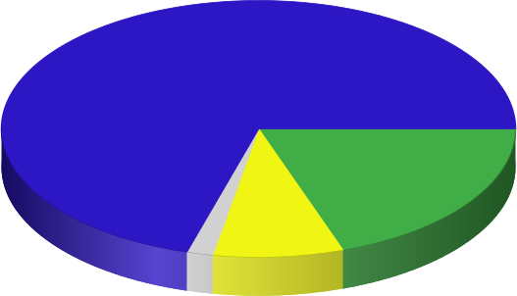
Spelling differences &
nonsense errors
Do not affect
translation
70%
20%
9%
Meaningful but
not viable
Notes:
** 9:50 **
Another 9% of textual variants are ones we would call “meaningful but not viable”.
“MEANINGFUL” in the sense that they do make a significant change to the text,
“BUT NOT VIABLE”, which means that there’s no chance that the variation is actually the original reading.
*ADVANCE*
Let me give you an example of that.

Slide 50
Meaningful but not viable
1 Thessalonians 2:9
… while we proclaimed to you the gospel of God.
1 Thessalonians 2:9
… while we proclaimed to you the gospel of Christ.
(3rd century reading)
(13th century reading)

Slide 51

Meaningful but not viable
Luke 6:22
Blessed are you when people hate you and when they exclude you and revile you and spurn your name as evil, on account of the Son of Man.
Luke 6:22
Blessed are you when people hate you and when they exclude you and revile you and spurn your name as evil.
(3rd century reading)
(11th century reading)
Notes:
Let me give you an example of that.
*CLICK THROUGH AND READ*
(in Luke 6:22 in our Bibles, it says…)
However, there is another reading in other manuscripts that looks like this
*READ*
Now, this one’s a little trickier. It’s not just a spelling error or the Greek words being reordered.
This is a MEANINGFUL difference between the two. On the left, it says that you are blessed when people hate you on account of the Son of Man. On the right, it seems to indicate you’re blessed if people hate you for ANY reason. That’s a meaningful difference.
*CLICK*
But it turns out the document on the left comes from the 3rd century, and the one on the right comes from the 11th century. Now, remember what I said earlier about how textual scholars will generally prefer older manuscripts, because they’re closer to the time of the apostles, and there’s been less time for errors to creep in. In this case, it’s not hard to conclude that someone just made a mistake in the 11th century, and accidentally left a phrase out. The original reading is still preserved in the older manuscript. So while the document on the RIGHT gives us a MEANINGFUL variant, it’s not a VIABLE one – there’s no chance that that’s actually what Luke originally wrote.
*ADVANCE*
And those kinds of variants that are meaningful but not viable account for 9% of all textual variants

Slide 52
Spelling differences &
nonsense errors
Do not affect
translation
70%
20%
9%
Meaningful but
not viable
Notes:
And those kinds of variants that are meaningful but not viable account for 9% of all textual variants
So before we go onto the final category of textual variants, I want to stop here and give you the
FIRST KEY POINT
of why we can trust that the New Testament text has been preserved for us.
Remember I said that I would have 4 key points that I hoped you could remember even if you forget everything else, so here’s the first one:
*ADVANCE*
There are over 400,000 textual variants in our New Testament manuscripts, but 99% of them are completely inconsequential. They do not present a challenge to the words that we have in our Bibles today.

Slide 53
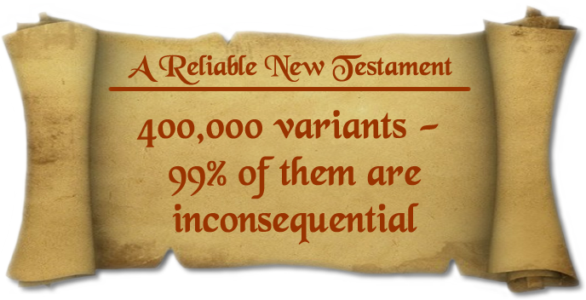
Key #1
Notes:
** 9:53 **
There are over 400,000 textual variants in our New Testament manuscripts, but 99% of them are completely inconsequential. They do not present a challenge at all to knowing what the New Testament actually says.
So, remember that the next time someone tells you that the Bible is full of copying errors and has been hopelessly corrupted. If they can’t distinguish between variations that are actually important, and those that are inconsequential, you know you’re dealing with someone who’s either ignorant of the facts, or else is not being honest with the evidence.
*ADVANCE*
Ok, so that just leaves our last category that covers 1% of all textual variants

Slide 54
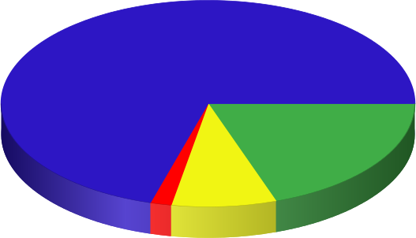
Spelling differences &
nonsense errors
Do not affect
translation
70%
20%
1%
9%
Meaningful
and viable
Meaningful but
not viable
Notes:
Ok, so that just leaves our last category that covers 1% of all textual variants
*CLICK*
which are MEANINGFUL and VIABLE. These are variants that change the meaning of the text AND it’s difficult to tell what the original reading ought to be.
*ADVANCE*
Let’s look at an example of this.

Slide 55


Meaningful and viable
Romans 5:1
Therefore, having been justified by faith, we have peace with God through our Lord Jesus Christ
Romans 5:1
Therefore, having been justified by faith, let us have peace with God through our Lord Jesus Christ
Notes:
Let’s look at an example of this. In Romans 5:1 in our Bibles, it says *READ* “therefore having been justified by faith, we have peace with God through our Lord Jesus Christ”
But there are a lot of manuscripts and old manuscripts
*CLICK*
that have this variant. *READ* “therefore having been justified by faith, LET US have peace with God through our Lord Jesus Christ”
So this is a MEANINGFUL change to the text – these two passages are saying slightly different things. And it is difficult for scholars to be 100% sure which one was the original. So now what do we do?
When we’re looking at textual variants like this, one important question to ask is “What difference to Christian doctrine does this variant make”
It IS a meaningful difference – saying “we have peace with God” and “let us have peace with God” are different statements. But do either of them present a doctrinal challenge to us? Well I think the answer to that is “no”. Because both of these are orthodox statements.
If Paul wrote “we have peace with God”, he could be speaking of the peace that exists right now between God and us on the basis of our justification by faith.
If Paul wrote “let us have peace with God”, he could be encouraging us to enter into the full experience of peace that has been bought for us by Christ and which we experience through Christ.
In either case, although this textual variant is meaningful and viable, it does not present us with any doctrinal challenges.
And that brings up KEY POINT NUMBER TWO that I hope you’ll remember
*ADVANCE*
And here it is:
NO ESSENTIAL DOCTRINES OF CHRISTIANITY ARE AFFECTED BY ANY TEXTUAL VARIANT.

Slide 56
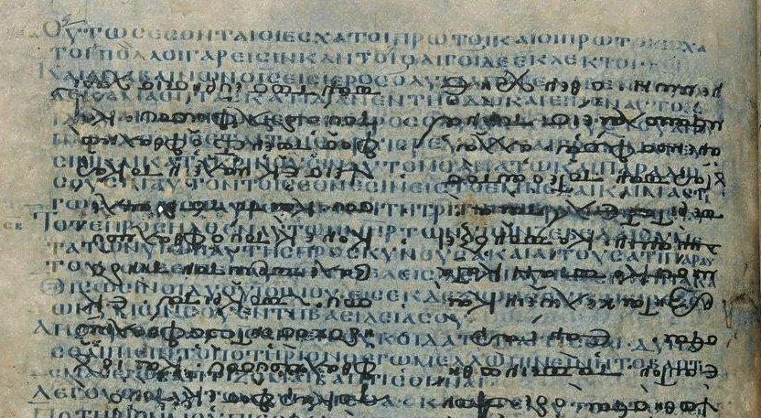
P115
Codex Ephraemi Rescriptus
c.275 AD
Notes:
** 10:23 **
Let’s look at another example of a meaningful and viable textual variant
P115, which is one of the oldest manuscripts we have containing any portion of the book of Revelation.
*CLICK*
Codex Ephraemi Rescriptus, which is also a very ancient manuscript, and one of the most important manuscripts we have containing the book of Revelation.

Slide 57
Codex Ephraemi Rescriptus
(a palimpsest)
Notes:
Codex Ephraemi Rescriptus is called a PALIMPSEST. This is a piece of parchment that has been used, then had the words scraped off and washed and cleaned so that it could be reused for something else.
(parchment was sometimes hard to obtain, so you might just reuse something old)
The text on top contains treatises from a theologian named Ephraem the Syrian who lived during the 12th century
But the faint text below it, which can be enhanced by computer imaging, show the original words of the Old and New Testament, written in the early 5th century
*ADVANCE*
And both of these manuscripts contain portions of the book of Revelation

Slide 58
Revelation 13:18
The Number of the Beast
XIS = 616
P115
Codex Ephraemi Rescriptus
c.275 AD
Notes:
And both of these manuscripts contain portions of the book of Revelation
Now what’s particularly interesting is the part of these manuscripts that deal
*CLICK*
with the Number of the Beast, found in Revelation 13:18
*CLICK*
P115: KAI – IOTA - STIGMA
Ephraemi Rescriptus: “hexakosiai deka hex (“six hundred and sixteen”)
For various reasons, most scholars believe that 666 is indeed the actual number of the beast as given by John in Revelation.
But when you have one of the oldest papyrii of Revelation and one of the most important parchments of Revelation that give the number of the beast as 616… that does add some weight to that possibility.
But again, what is going to be changed doctrinally, and in your faith, if the number of the beast is 616 instead of 666?
(other than the fact that it’s going to absolutely blow a lot of Christian fiction out of the water, like the “Left Behind” series)
The answer is, nothing. The book of Revelation is important, and given to us by the Spirit to be studied, so that we can understand “the things that must soon take place”, as Rev. 1:1 says. But there is no Christian doctrine that hangs on the number of the beast being 666. That is not part of the articles of faith of any denomination.
TRANSITION:
So this example from Revelation, and the example we looked at earlier from Romans 5:1 are examples of KEY POINT #2 that I hope you’ll remember.
*ADVANCE*
And here it is:
NO ESSENTIAL DOCTRINES OF CHRISTIANITY ARE AFFECTED BY ANY TEXTUAL VARIANT.

Slide 59
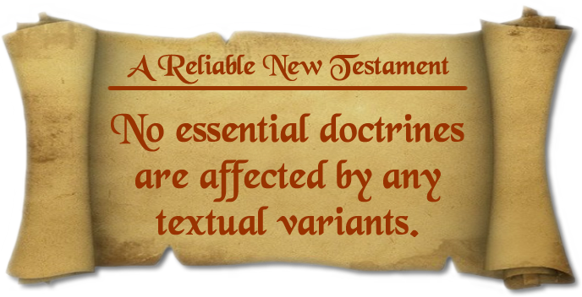
Key #2
Notes:
** 9:56 **
NO ESSENTIAL DOCTRINES OF CHRISTIANITY ARE AFFECTED BY ANY TEXTUAL VARIANTS.
Earlier I said that only 1% of all textual variants in our NT manuscripts are meaningful and viable,
and what I’m saying now is that none of those meaningful and viable textual variants would lead us to a different Christian faith.
the doctrine of God
man
sin
redemption
the death, burial, resurrection of Christ
justification by faith
our adoption as children of God
the return of Christ
and our final glorification
NONE of those doctrines are affected by ANY of the meaningful and viable textual variants we have to deal with.
OK, we’ve been talking about different categories of textual variants, and I thought it might be interesting to take just a few moments to see how those variants actually happened in history.
*ADVANCE*
Now, when I’ve taught this class in the past over three Sundays

Slide 61
Notes:
Good morning – it’s good to see you all again. I’m glad you’ve decided to come back to the second part of our class on The Reliability of the New Testament Text
This class is designed to try answer a very fundamental question about the New Testament:
IS THE NEW TESTAMENT WE HAVE NOW THE SAME AS WHAT THEY WROTE 2000 YEARS AGO?
After all, 2000 years is an awfully long time – how can we be sure that the words that Christ and the apostles delivered to the church haven’t been corrupted over the centuries?
If we can’t be sure that God has faithfully preserved his word for us…
…if it’s possible that the original message of the Bible has been corrupted or lost over 2000 years of copying
…then we can’t really be sure that the Christian faith is true or not.
Our faith will stand or fall based on whether our Bibles accurately record the words of God, or not.
**ADVANCE**
And before we begin, I want to just recommend once again this book to you, REINVENTING JESUS, which deals with some of the same topics we’re covering, and other topics that relate to the claims that skeptics and atheists will make about the NT.

Slide 62
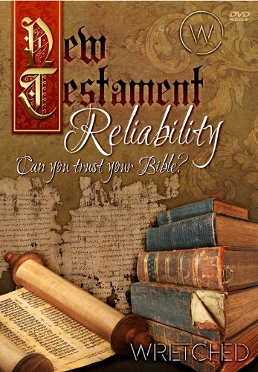
Notes:
And before we begin, I want to just recommend once again this book to you, REINVENTING JESUS, which deals with some of the same topics we’re covering, and other topics that relate to the claims that skeptics and atheists will make about the NT.
How do we know the authors of the NT got the story right, decades after Jesus’ life?
How do we know the gospels and epistles were copied correctly? Is the Bible so full of copying errors that it’s hopelessly corrupted?
How do we know the Bible contains the right books? Was there a conspiracy to keep some books out of the Bible?
Did Jesus’ earliest followers believe He was divine, or just a great (but mortal) man?
How do we know that Christianity wasn’t plagarized from other competing religions?
I also want to acknowledge a great deal of help from lectures by Dr. James White on this subject. We have one of his DVDs called “New Testament Reliability” in our DVD library, and there are also videos of him on YouTube if you’d like to get into this subject more.
**ADVANCE**
Now in our last class, we pointed out that before the invention of the printing press, the only way that anyone could get a copy of any written document (like the gospels or the letters of Paul) was to make a HANDWRITTEN copy of it.

Slide 63
Previously…
Textual Variant: Any place where two manuscripts differ from each other
Textual Criticism: The science of comparing different manuscripts
to determine the original reading when the original document no longer exists.
Notes:
Now in our last class, we pointed out that before the invention of the printing press, the only way that anyone could get a copy of any written document (like the gospels or the letters of Paul) was to make a HANDWRITTEN copy of it. And Christians made handwritten copies of the books of the NT an awful lot over the centuries. Many of those manuscripts have been lost, but today we still have over 5800 Greek manuscripts containing all or portions of the NT, or over 10000 manuscripts if you count manuscripts in other early languages like Latin.
But since Christians who made those copies were often people like you or me without special training as a scribe, they sometimes made mistakes in their copies, and that generates a large number of textual variants that we have to deal with.
**CLICK**
Textual Variant: Any place where two manuscripts differ from each other
Textual Criticism: The science of comparing different manuscripts
to determine the original reading when the original document no longer exists.
TRANSITION: And I mentioned that there are going to be 4 KEY POINTS in these lectures that I think are especially helpful, so if you forget everything else that we talk about, you can boil down everything I talk about to these 4 KEY POINTS. We got to TWO of them last week.
**ADVANCE**
and the first one is this:

Slide 64

Previously…
Key #1:
400,000 textual
variants, but
99% of them are
inconsequential.
Key #2:
No essential
doctrines are
affected by
any viable
textual variant.
Spelling differences &
nonsense errors
Do not affect
translation
70%
20%
1%
9%
Meaningful
and viable
Meaningful but
not viable
Notes:
(ADVANCE through the first 2 keys and summarize)
Those are the first 2 key points that help us understand why we can trust that God has preserved his word over the centuries, and that the English translations of the Bible that we have today ARE still the reliable word of God that was delivered by Christ and the apostles almost 2000 years ago.
TRANSITION TO FUN GAME:
Ok, so that’s where we left off our class last time.
*ADVANCE*
But before we got started today on new material, I thought it might be fun to just take a minute or two and try a real-world example of textual criticism
TRANSITION WITHOUT FUN GAME: Ok, so we spent most of the last class introducing the idea of textual variants, so I want to start off today by looking at how textual variants actually occurred. Because it turns out that scribes throughout the centuries made the same kinds of errors over and over. And whenever I say “scribe” in this class, I’m not always talking about a trained monk making a copy in a well-lit monastery somewhere. The scribe might have been a 2nd century Christian on the run from persecution, hiding in a cave somewhere, and scratching out a copy of a letter from Paul in bad lighting conditions. So let’s look at some of the common errors that scribes made.
**ADVANCE**
There are two main categories of scribal errors. The first one is what I’m calling UNINTENTIONAL ERRORS.

Slide 65
Fun and Games
______ us, O God, that we not drift numb and blind and _______________________ short, too painful to waste on ______________________ _________________________ | Fight for us O Lord God, _____ we not drift numb and blink ____________________. Life is too short, too prec____, too painful to waste on worldly bubbles that burst. | ________ us, O Lord God, that we not drift numb _____ blink and foolish into vain and empty excitements. Life is too sho_____________ ___________ to waste on worldly bubbles that bu____
Fight for us, O God, ________ not drift ______ and blind and foolish into _______ empty excitements. Life is too short, too precious, too painful to waste on worldly _______________ | Fight for us O Lord God. __________ Life is too prec____, too painful to waste on worldly bubbles that burst. | _________ us, O Lord God, that we not drift numb and blind and foolish into vain and empty exciteme_______ ___________________________________________________________________________
____ not drift numb and blink and foolish into vain and empty excitements. __________________________________________________ worldly bubbles that burst. | Fight for us, O God, that we ________ numb and blink and foolish into vain and empty excitements. Time is too short, too precious, too ____________________________________________ burst. | Fight _________ O God, that we not drift numb and blink and foolish into _______ _____ excitements. Life ______ short, ___ precious, too painful to waste on worldly bubbles that burst.
Fight for us, O God, that we not drift numb and blind and foolish
into vain and empty excitements. Life is too short, too precious,
too painful to waste on worldly bubbles that burst. – John Piper
Notes:
Ok, so that’s where we left off our class last time.
But before we got started today on new material, I thought it might be fun to just take a minute or two and try a real-world example of textual criticism
so you can see how these different kinds of textual variants work. So what I have for you here is a quotation. Unfortunately, however, the original version of this quotation has been lost. And although we have 9 different manuscripts,
none of these manuscripts agree with each other
they all have textual variants in them
and all of them have been damaged and have missing portions.
25 textual variants. Let’s assume these are all equally old.
the comma after “Fight for us”. A variant that doesn’t affect translation.
O God, or O Lord God? 4 with, 4 without. (meaningful (sort of) and viable)
3) “blink” – 5 have it, 3 have “blind”, 1 is missing. Obviously a spelling error creating a nonsense sentence.
4) “Life” or “Time”. Only one manuscript with “Time” (meaningful, but not viable)
TRANSITION: Ok, so we spent most of the last class introducing the idea of textual variants, so I want to start off today by looking at how textual variants actually occurred. Because it turns out that scribes throughout the centuries made the same kinds of errors over and over. And whenever I say “scribe” in this class, I’m not always talking about a trained monk making a copy in a well-lit monastery somewhere. The scribe might have been a 2nd century Christian on the run from persecution, hiding in a cave somewhere, and scratching out a copy of a letter from Paul in bad lighting conditions. So let’s look at some of the common errors that scribes made.
**ADVANCE**
There are two main categories of scribal errors. The first one is what I’m calling UNINTENTIONAL ERRORS.

Slide 66
Categories of Scribal Errors
Unintentional:
Mistakes in sight, memory or hearing
Mistakes due to fatigue or carelessness.
Intentional:
Harmonization of texts
Clarification of language
Misguided attempts to “correct” earlier manuscripts or “fix” questionable doctrines.
Notes:
Now, when I’ve taught this class in the past over three Sundays, we’ve had some time to look at some of the ways that early scribes made errors in their copying. Usually they were unintentional errors, where they just made mistakes, but sometimes they made what we might call INTENTIONAL variations, for various reasons. For the sake of time, I’m afraid we can’t really get into examples of these, even though I think they’re really fun to look at.
Let me just give you two examples, and we’ll let that suffice for today.
*ADVANCE*
One common type of scribal error is PERMUTATIONS

Slide 67
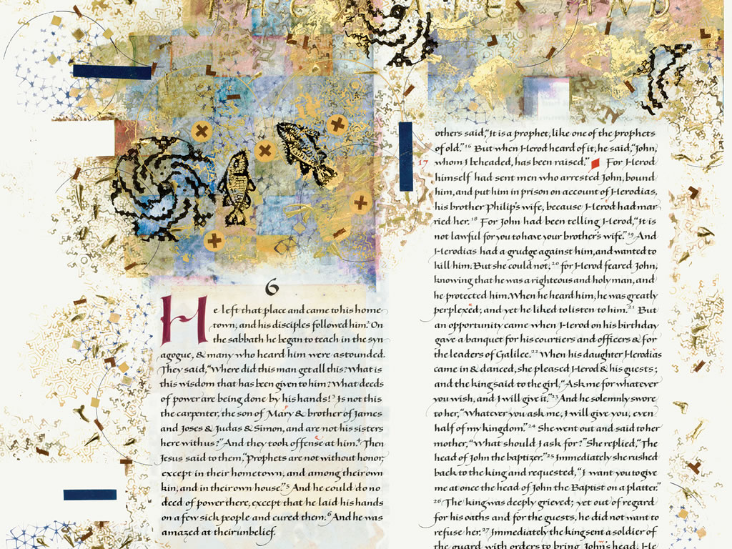
Scribal errors still happen today
Saint John’s Bible (1998)
Notes:
called the SAINT JOHN’S BIBLE.
This is an absolutely beautiful Bible that was commissioned by Saint John’s Abbey and University in Minnesota in 1998. It’s a beautiful book,
*ADVANCE*
and these pages are about 2 or 2.5 feet long, so it’s a huge set of folios.
But what I wanted to show you was this page right here, containing the text of Mark 3:20-21

Slide 68
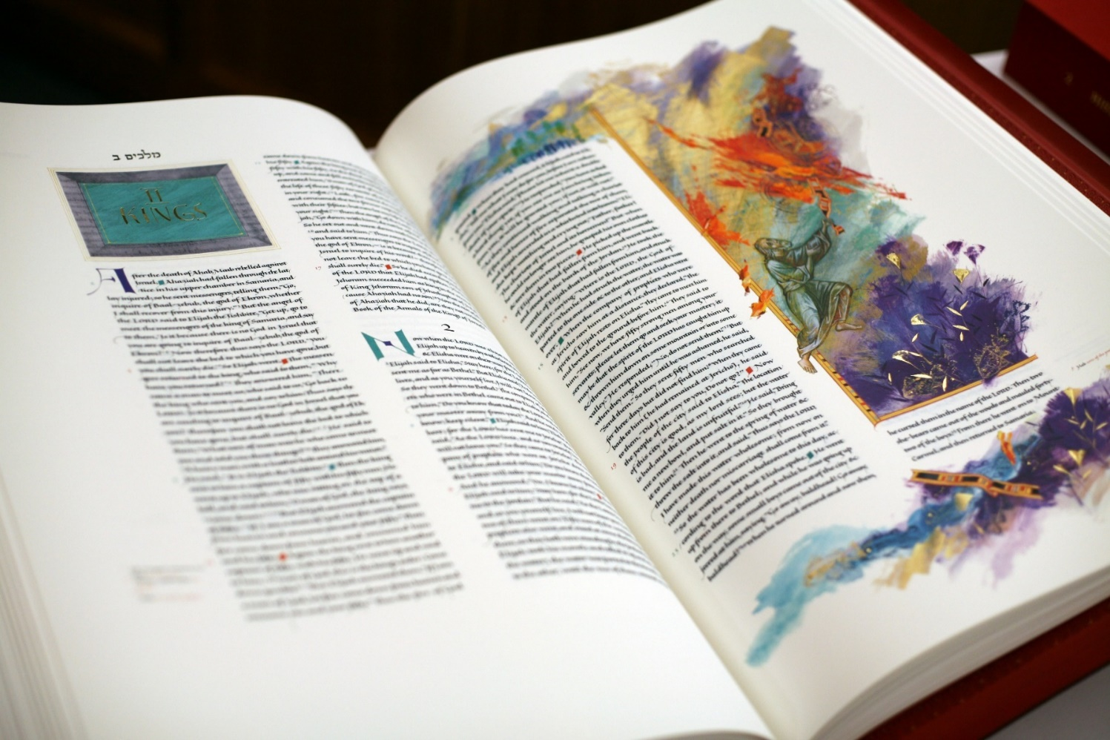
Scribal errors still happen today
Notes:
called the SAINT JOHN’S BIBLE.
This is an absolutely beautiful Bible that was commissioned by Saint John’s Abbey and University in Minnesota in 1998. It’s a beautiful book,
*ADVANCE*
and these pages are about 2 or 2.5 feet long, so it’s a huge set of folios.
But what I wanted to show you was this page right here, containing the text of Mark 3:20-21

Slide 69
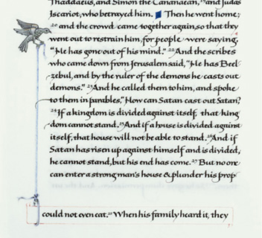
Scribal errors still happen today
Notes:
called the SAINT JOHN’S BIBLE.
This is an absolutely beautiful Bible that was commissioned by Saint John’s Abbey and University in Minnesota in 1998. It’s a beautiful book,
*ADVANCE*
and these pages are about 2 or 2.5 feet long, so it’s a huge set of folios.
But what I wanted to show you was this page right here, containing the text of Mark 3:20-21

Slide 70
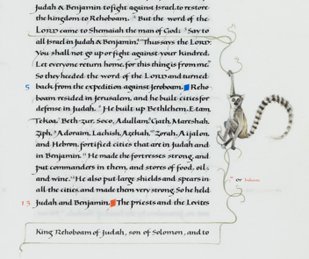
Scribal errors still happen today
Notes:
2 Chronicles 11:3
So what’s the point of this? Well, it’s just to point out that if a trained calligrapher, working it well lit, air conditioned rooms with the best tools could still make mistakes in his copying, it’s not too hard to see how ancient scribes in monasteries or even in caves could make mistakes as well.
TRANSITION:
Ok, well lets take a look at some of the actual errors that ancient scribes made during their copying of NT manuscripts,
And we’re going to start with some UNINTENTIONAL ERRORS.
**ADVANCE**
The first type is errors made by PERMUTATIONS: words that look similar with letters that are hard to distinguish from each other.

Slide 71
Types of Scribal Errors
Permutations: Letters that are hard to distinguish from each other
Acts 15:40
but Paul chose Silas and departed, being commended by the brethren to the grace of God.
Acts 15:40
but Paul received Silas and departed, being commended by the brethren to the grace of God.
Notes:
**9:57**
One common type of scribal error is PERMUTATIONS
*CLICK*
Let’s look at acts 15:40.
Our Bibles say “but Paul chose Silas and departed, being commended by the brethren to the grace of God.”
*CLICK*
But there are some manuscripts that say “but Paul received Silas and departed”
Now, the English words “chose” and “received” don’t LOOK or SOUND like each other at all, and don’t even MEAN the same thing. So what’s going on here? How did this textual variant occur?
Well, let’s look at the Greek here for these two words:

Slide 72
Types of Scribal Errors
Permutations: Letters that are hard to distinguish from each other
Chose:
EPILEXAMENOS
Received:
EPIDEXAMENOS
Notes:
In Greek, the word “chose” is EPI-LEXAMENOS
*CLICK*
And the word “received is EPI-DEXAMENOS
So now we can see where the error occurred. It turns out the difference between these words is just a single letter. It’s not even just a letter, it’s literally just a single horizontal line that distinguishes the two letters.
*CLICK*
The earliest manuscripts of the New Testament were written on papyrus, which looks like this, and papyrus had a lot of lines running horizontally through it.
So, it’s not hard to see how a scribe could see a LAMBDA and think he’s seeing a DELTA, and just like that, EPILEXAMENOS (“chose”) becomes EPIDEXAMENOS (“received”).
Permutations like this were a very common kind of scribal error.
Let’s look at just one other category of scribal errors
*ADVANCE*
which I’m simply calling ERRORS IN JUDGMENT

Slide 73

Types of Scribal Errors
Words with similar endings
1 John 3:1
Behold what manner of love the Father has bestowed on us, that
we should be called children of God. Therefore the world
does not know us…
1 John 3:1
Behold what manner of love the Father has bestowed on us, that
we should be called children of God; and such we are. Therefore the world
does not know us…
Notes:
**9:44 – 9:59**
Another type of unintentional error happened when scribes got confused over words with similar endings.
LEFT: KJV/NKJV
RIGHT: all others
(NKJV) Behold what manner of love the Father has bestowed on us, that we should be called children of God![a] Therefore the world does not know us,[b] because it did not know Him.
What’s going here?
TRANSITION:
Well to answer that question, let’s go back to a codex we looked at in our last class,
*ADVANCE*
CODEX SINAITICUS, the oldest complete Bible that we have.

Slide 74
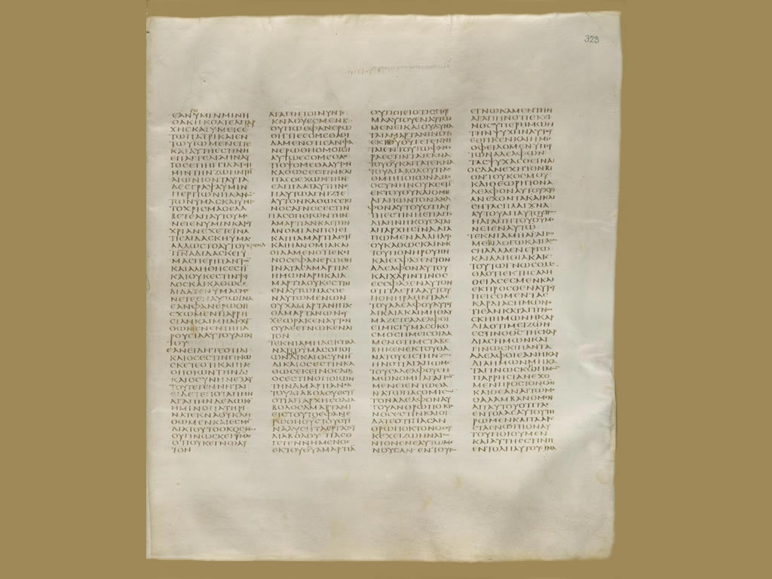
Codex Sinaiticus (330-360 AD)
1 John 2:24 – 3:23
Notes:
CODEX SINAITICUS, the oldest complete Bible that we have.
**CLICK**
It dates back to the fourth century,
and this is the page of Codex Sinaiticus that has our passage.
**ADVANCE**
So let’s jump down the bottom-left portion of this page where the section for 1 John 3:1 is.

Slide 75
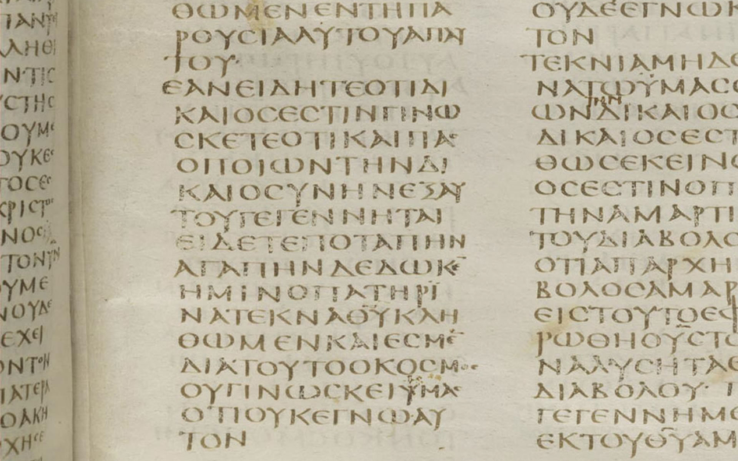
1 John
3:1
Notes:
So let’s jump down the bottom-left portion of this page where the section for 1 John 3:1 is.
**ADVANCE**
And I’ve actually put some lines here on the screen to highlight the individual words…

Slide 76
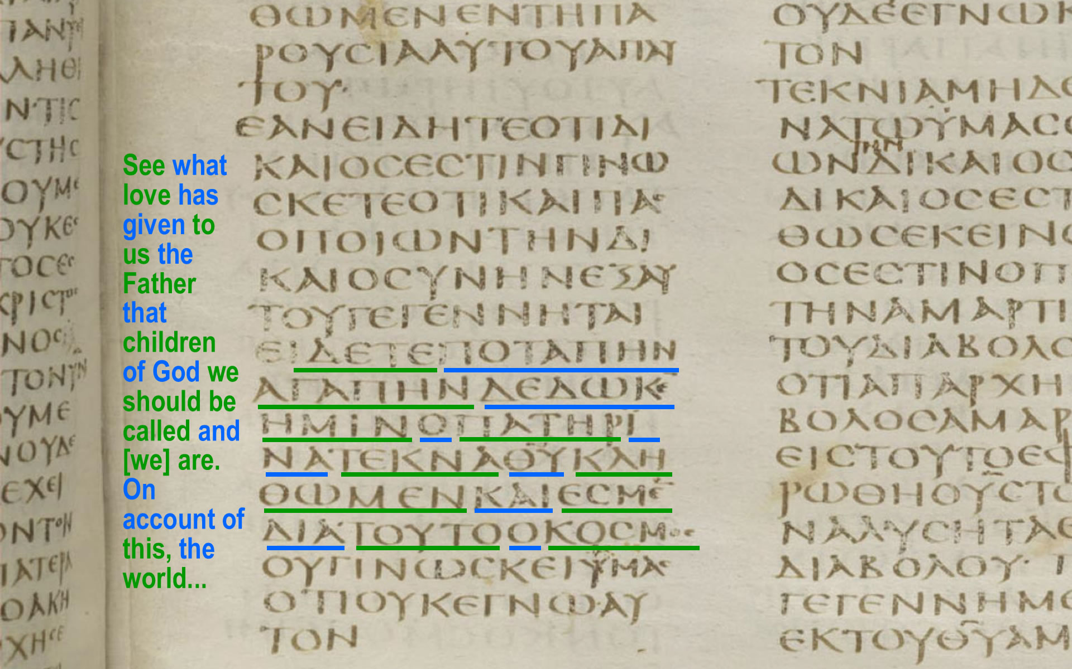
Notes:
And I’ve actually put some lines here on the screen to highlight the individual words…
Because as you can see that this manuscript was written in what is called MAJUSCULE style
MAJUSCULE means that the text was written
With All upper case letters
And with all the Words run together with no spaces,
And no punctuation.
That was the form of literary Greek for many centuries.
**ADVANCE**
So let’s take a portion of this verse as it appears in Codex Sinaiaticus, and look at it more closely.

Slide 77
Types of Scribal Errors
Words with similar endings
1 John 3:1
…that we should be called children of God, and such we are. Therefore the world…
teknaquklhqw
men
kai
es
men
diatoutookosmos
Notes:
So let’s take a portion of this verse as it appears in Codex Sinaiaticus, and look at it more closely.
Here it is, in English and Greek
TEKNA-THAY-YOU (children of God)
KLAY-THO-MEN (that we should be called)
KAI-ESMEN (and we are)
DIA-TWO-TAH-KOSMOS (Therefore the world…)
Now, we’re looking at scribal errors that occur because of words with similar endings. Can you spot the error a scribe made? Because if you’re a scribe, then you’ve got your original HERE and your copy HERE, and you’re reading, turning, writing, turning, reading….
(show error)
He’s writing KLAY-THO-MEN, and he writes M-E-N, then he goes back to his original… and sees the M-E-N that’s at the end of this word (ESMEN), not the end of the word (KLAY-THO-MEN)
He doesn’t realize he missed an entire line, and the phrase (KAI ESMEN) “and such we are” never makes it into his copy, or any of the manuscripts that scribes make from his copy. And it so happens that the manuscripts that were used in the translation of the KJV were missing that phrase, while Bibles that are based on other, older manuscripts still have that phrase “and such we are” in them
That’s an ERROR DUE TO SIMILAR LINE ENDINGS, and it was also a very common error for scribes to make.
**ADVANCE**
And the last type of unintentional error I want to mention IS ERRORS OF HEARING

Slide 78
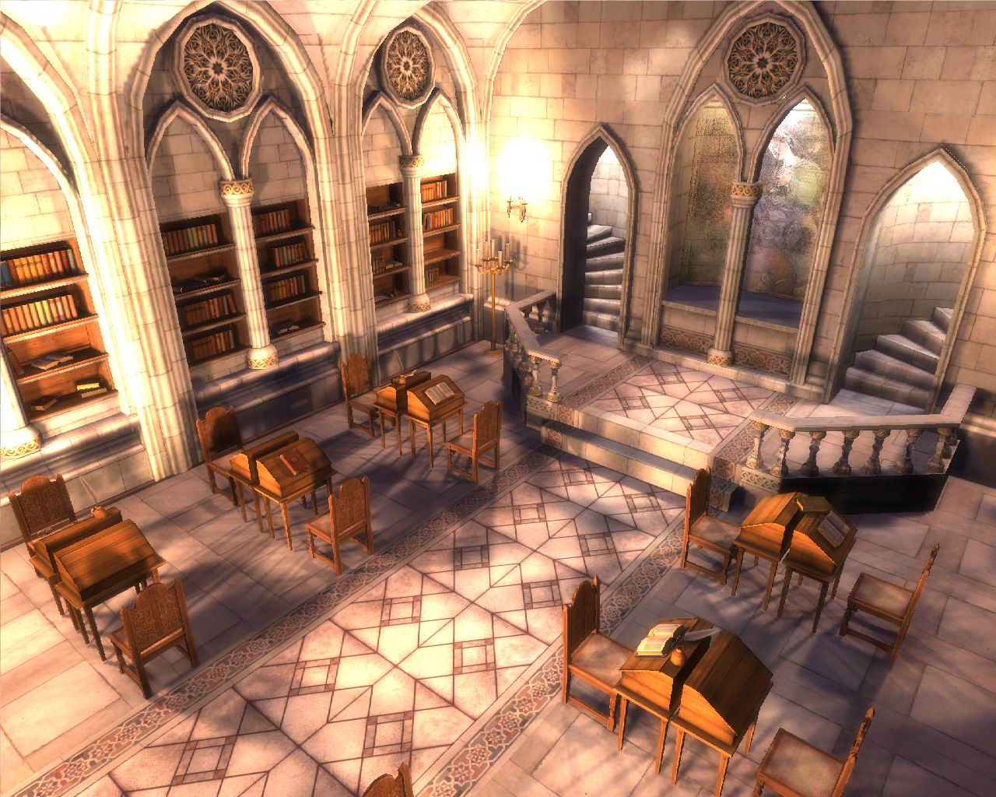
Types of Scribal Errors
Errors of hearing
Notes:
**9:47 – 10:02*
And the last type of unintentional error I want to mention IS ERRORS OF HEARING
Rather than copying a document by sight, you might be in a scriptorium in a monetary somewhere along with several other scribes,
LISTENING as a monk reads a passage of scripture, and then writing it down.
That was an efficient way to make a bunch of copies at a time,
But if the person reading the manuscript mispronounced a word,
Or you just misheard him,
Then you might write down the wrong word. You might write a word that sounded like what you thought you heard, but might actually be the wrong word.
TRANSITION:
So that covers a number of very common unintentional errors that scribes would make. Now let’s take a look at some INTENTIONAL textual variants that scribes introduced into their copies.
And I don’t mean by this that they always INTENDED to introduce an error – sometimes they thought they were correcting the error of a previous scribe, but in so doing they might introduce an error by “correcting” something that wasn’t really an error. But sometimes they really did change the text intentionally AND KNOWINGLY.
Now why would faithful, conscientious scribes do this? Well, take a look at some of these INTENTIONAL textual variants to see what that kind of thing happened, more often than you might think.
**ADVANCE**
The first one is the most common of all: HARMONIZATION OF DIFFERENT PASSAGES.

Slide 79

Types of Scribal Errors
Harmonization
Luke 11:2
And he said to them, “When you pray, say:
“Father, hallowed be Your name. Your kingdom come. Give us each day our daily bread…
Luke 11:2
So He said to them, “When you pray, say:
Our Father in heaven,
hallowed be Your name.
Your kingdom come.
Your will be done on
earth as it is in heaven. Give us day by day our
daily bread…
Matthew 6:9-10
Pray then like this:
“Our Father in heaven,
hallowed be your name. Your kingdom come,
your will be done, on earth as it is in heaven.
Notes:
**9:48 – 10:03**
The first one is the most common of all: HARMONIZATION OF DIFFERENT PASSAGES.
Let’s take a look at the Lord’s Prayer. How does the Lord’s prayer go? Well, if you have an ESV Bible,
And you read it from Luke chapter 11, it looks like this:
**CLICK and read**
Now wait a minute – that doesn’t quite sound like the Lord’s prayer that we’re used to. And if that strikes you as sounding a little odd, you’re not the only one. Some later scribes probably read this passage and said “wait a minute – this doesn’t sound like the way Matthew recorded the Lord’s prayer. And so they might pull out a manuscript of Matthew and find that it had the Lord’s prayer like this:
**CLICK**
Well, which was it? What was the actual text of the Lord’s prayer? Well, some scribes decided that the best solution would be to HARMONIZE the two gospels on this point. And most of the time in church history, Matthew was the preferred gospel, and the other synoptic gospels (Mark and Luke) would be changed to harmonize with Matthew. And so they changed the reading of Luke 11 to something like this, which is how it’s found today in the KJV and NKJV
**CLICK and read**
This is the intentional error of HARMONIZATION – it was done with the best of intentions, to smooth differences out between the gospel authors, but the result was that more textual variants were introduced into our manuscripts.
**ADVANCE**
Another intentional textual variant was CONFLATION

Slide 80

Types of Scribal Errors
Conflation
Luke 24:53
[the disciples] were continually in the temple courts b lessing God.
Luke 24:53
[the disciples] were continually in the temple courts praising God.
Luke 24:53
[the disciples] were continually in the temple courts praising and b lessing
God.
(4th century)
(5th century)
Notes:
Another intentional textual variant was CONFLATION. Here’s a reading of Luke 24:53 that comes from the 4th century – pretty early on!
But here’s a reading that comes from the 5th century.
**ADVANCE**
Another intentional textual variant was CLARIFICATIONS AND EXPLANATIONS

Slide 81
Types of Scribal Errors
Clarification and Explanation
Mark 1:2
As it is written in Isaiah the prophet, “Behold, I send my messenger before your face, who will prepare your way, the voice of one crying in the wilderness: ‘Prepare the way of the
Lord, make his paths
straight,’”
Malachi 3:1
Behold, I send my messenger, and he will prepare the way before me.
Isaiah 40:3
A voice cries: “In the wilderness prepare the
way of the LORD;
make straight in the desert
a highway for our God.
Mark 1:2
As it is written in the Prophets, “Behold, I send my messenger before your face, who will prepare your way before you, the voice
of one crying in the wilderness: ‘Prepare the way of the Lord, make his
paths straight,’”
Notes:
** 9:52 – 10:07 **
Another intentional textual variant was CLARIFICATIONS AND EXPLANATIONS
*CLICK*
Let’s take a look here at Mark 1:2
“As it is written in Isaiah the prophet…” (read)
Now, if you were a scribe who knew his Bible well, this statement made by John the Baptist as recorded by Mark might have bothered you. Because it turns out the first part of the quotation by John the Baptist comes NOT from Isaiah, from the book of Malachi.
*CLICK*
In Malachi. 3:1, God says:
“Behold, I send my messenger, and he will prepare the way before me.
*CLICK*
The rest of the quotation comes from Isaiah 40:3
A voice cries: “In the wilderness prepare the way of the LORD; make straight in the desert a highway for our God. (ESV)
But according to Mark, John the Baptist said this was written in Isaiah the prophet? Did John the Baptist make a mistake? Or even worse, did MARK make a mistake?
Now, there are various possible solutions to this. One suggestion is that when John the Baptist put these two prophecies together as a single chain of testimony of who he was, he used the source of the largest portion of text to cite it, and since the largest portion of the prophecy comes from Isaiah, he calls it the testimony of “Isaiah the prophet.”
But perhaps there were some scribes who still thought this was an embarrassing misquotation, either by John the Baptist or by Mark himself. So in order to resolve the problem, they changed the wording of this verse
**CLICK**
so that it says “As it is written in THE PROPHETS”, which nicely covers both Malachi and Isaiah. So this is an example of textual variants caused by the desire to CLARIFY a difficult passage and remove the problem. Again, it was done for good intentions, but the scribe ends up changing what Mark originally wrote into something that he didn’t.
And closely related to that type of intentional error
**ADVANCE**
is the error of DOCTRINAL “CORRECTIONS”.

Slide 82
Types of Scribal Errors
Doctrinal “corrections”
John 7:8,10
“You go up to the feast.
I am not going up to this feast, for my time has not yet fully come.”
But after his brothers
had gone up to the feast,
then he also went up…
John 7:8,10
“You go up to this feast.
I am not yet going up to this feast, for my time has not yet fully come.”
But when his brothers
had gone up, then he also
went up to the feast…
Notes:
** 9:54 – 10:09 **
And I think you’ll see why I put the word “corrections” in quotes here. *CLICK* Let’s take a look at John 7 verses 8 and 10. This is Jesus speaking to his brothers… (read)
Now, this verse appears to make it look like Jesus is lying. He said he wasn’t going to go up to the feast, but then he does. And so it appears that some scribes who were concerned to safeguard against this idea that Jesus was lying in v.8 changed the wording of the verse to say
*CLICK*
I am not YET going up to this feat.
Again, it was done for good intentions, but they altered what John originally wrote because they felt like they needed to help him say what he really meant, and prevent any misunderstandings.
*ADVANCE*
Here’s one last example of this type of doctrinal correction.

Slide 83
Types of Scribal Errors
Doctrinal “corrections”
Luke 2:43
as they were returning, the boy Jesus stayed behind in Jerusalem.
His parents did not
know it.
Luke 2:43
as they returned, the boy Jesus lingered behind in Jerusalem. And Joseph and
His mother did not
know it
Notes:
Here’s one last example of this type of doctrinal correction.
Let’s look at Luke 2:43, which speaks of Joseph, Mary and Jesus returning home from Jerusalem, back to Nazareth.
*CLICK* and read
But wait a minute, Jesus was born of the virgin Mary. He didn’t have an earthly father. Somewhere along the way, one or more scribes decided this wording would be too confusing, So in order to safeguard the doctrine of the virgin birth, they changed the wording to
*CLICK* and read (“Joseph and His Mother did not know it”)
Again, an honest attempt to help Luke explain the situation a little better, but the result was changing Luke’s words into something he didn’t actually write.
And finally, to finish off this section of SCRIBAL ERRORS, let’s look at one last category, which I am giving the very general name
*ADVANCE*
of ERRORS IN JUDGMENT

Slide 84
Types of Scribal Errors
Expansion of piety
 | Early Manuscripts | Later Manuscripts
1 John 1:7 | Jesus | Jesus Christ
1 Thes. 3:11 | our Lord Jesus | our Lord Jesus Christ
2 Cor. 5:18 | Christ | Jesus Christ
Acts 15:11 | Lord Jesus | Lord Jesus Christ
1 Cor. 16:22 | the Lord | the Lord Jesus Christ
2 John 1:3 | Jesus Christ | the Lord Jesus Christ
Notes:
“…flows from a desire to safeguard the sanctity of the Lord Jesus. It led people to naturally expand the titles used of the Lord, possibly even without their conscious effort to change the text” (KJVO, p46)

Slide 85
Types of Scribal Errors
Errors in judgment
John 5:3-5
³ In these lay a great multitude of sick people, blind, lame, paralyzed, waiting for the moving of the water. ⁴ For an angel went down at a certain time into the pool and stirred up the water; then whoever stepped in first, after the stirring of the water, was made well of whatever disease he had. ⁵ Now
a certain man was there…
John 5:3-5
³ In these lay a great multitude of sick people, blind, lame, paralyzed.
[ verse 3b-4 omitted ]
⁵ Now a certain man was there…
Notes:
**9:59**
which I’m simply calling ERRORS IN JUDGMENT. And now, at long last,
*CLICK*
we are returning to John 5, verses 3-5, that we looked at earlier.
The KJV and NKJV has this passage on the left that talks about how an angel would come down to the pool of Bethesda and stir up the waters. But that whole section is missing in other translations like the ESV and the NIV and the NASB.
So, what’s going on? Why is this passage missing in some of our Bible?
Well, there’s a reason that most translations of the Bible don’t include that section.
The most important reason is that the oldest and best manuscripts of the gospel of John that we have don’t include this passage in it. This passage only appears in much later manuscripts.
It also doesn’t sound very much like John – this section includes some words that never appear anywhere else in John’s writings.
And it also presents a strange theology as well, in which God appears to be putting sick people in competition with each other for his healing, forcing them to wait for this spontaneous unpredictable event, and then only allowing one person to be healed.
So those are some of the reasons why most modern English translations of the Bible don’t include it.
*ADVANCE (no slide change)*
NOW, what very likely happened is that a scribe was copying this chapter and thought to himself

Slide 86
Types of Scribal Errors
Errors in judgment
John 5:3-5
³ In these lay a great multitude of sick people, blind, lame, paralyzed, waiting for the moving of the water. ⁴ For an angel went down at a certain time into the pool and stirred up the water; then whoever stepped in first, after the stirring of the water, was made well of whatever disease he had. ⁵ Now
a certain man was there…
John 5:3-5
³ In these lay a great multitude of sick people, blind, lame, paralyzed.
[ verse 3b-4 omitted ]
⁵ Now a certain man was there…
Notes:
NOW, what very likely happened is that a scribe was copying this chapter and thought to himself “People are going to read that and not understand why, when Jesus asks this man if he wants to be healed, he starts talking about being put in the pool!” But this scribe knew that there was a local legend or superstition going around about an angel stirring up the waters which would heal the first person who got in.
AND so the scribe might have put a little note in the margin of the parchment he’s making to explain what’s going on. And then decades later, maybe centuries later, some scribe pulls his parchment out in order to make a new copy, and he comes across this marginal note.
Now, HE doesn’t know whether this note is just someone’s comments about the text, or part of the original gospel of John. And scribes were pretty conservative people. So the scribe keeps the marginal note, but he puts it right in line with the rest of the gospel text. And just like that, you have a new couple of verses in John.
And the manuscripts that were used when the KJV Bible was translated included this section in the gospel of John. That’s why it’s in the KJV and NKJV today, but it’s not in other translations that use different, older manuscripts.
Mistakes like this were simply ERRORS IN JUDGMENT on the part of the copyist.
So, different types of errors are being made by different people in different centuries as they copied scripture. And now we have to deal with those errors. But that very fact also demonstrates something that is really important, and in fact is SO important that it is our THIRD KEY POINT of the class.
And here it is:
*ADVANCE*
The New Testament was never controlled by a central authority.

Slide 87
Notes:
But I want to show you this map again that we looked at in our last class to go back to a point that I made last week. We talked about how the manuscripts spread throughout the Roman empire very RAPIDLY, within just a few decades of the time of the apostles, and they spread very WIDELY, over 1500 miles from end to end of the Roman empire.
And when you combine these two facts of history, RAPID DISTRIBUTION and WIDESPREAD DISTRIBUTION, it gives us a very important historical truth that is going to become our THIRD key point in understanding the reliability of the New Testament text.
This is the 3rd of the 4 points that I hope you’ll remember from these two classes, and it is this:
*ADVANCE*
The New Testament was never controlled by a central authority

Slide 88
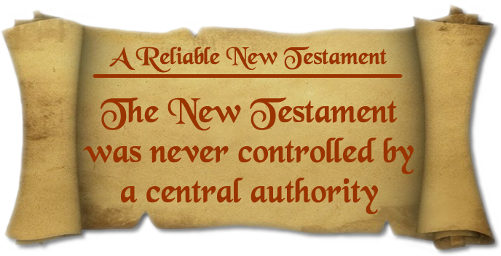
Key #3
Notes:
**10:03**
The New Testament was never controlled by a central authority.
There was never any pope, or church council, or group of people who had complete control of the NT scriptures, who could determine
Who got to make copies of it
Or, more importantly, what the actual text of the New Testament would say or not say.
**ADVANCE**
Now, this idea that church councils, like the Council of Nicaea, altered the NT to suit their purposes is a VERY POPULAR idea among skeptics.

Slide 89
A conspiracy?
When Constantine commissioned new versions of these [New Testament] documents,
it enabled the custodians of orthodoxy
to revise, edit, and rewrite their material as they saw fit.
It was at this point that most of the crucial alterations in the New Testament were probably made and Jesus assumed the unique [divine] status he has enjoyed ever since.
– Holy Blood, Holy Grail
Notes:
READ
The claim here is that church councils in the 4th century during the time of Constantine decided to rewrite portions of the new testament in order to put things in they wanted, and get rid of anything they didn’t want.
Now what I’m arguing is that this is not only UNLIKELY – it was IMPOSSIBLE.
HOW CAN WE BE SO SURE?
TRANSITION:
Well , just for fun, let’s say that this theory is true. Let’s say that the earliest followers of Jesus believed that he was merely a man – a great man and a great teacher, but certainly not divine.
**ADVANCE**
And let’s say that when Constantine rose to power and called all the leaders of the church together to the Council of Nicaea in 325 AD, that he demanded that the Christian scriptures be altered to make Jesus into a divine person.

Slide 90
“My dear,” Teabing declared, “until that moment in history [at the Council of Niceae],
Jesus was viewed by His followers as a mortal prophet… a great and powerful man, but a man nonetheless. A mortal.”

Slide 91
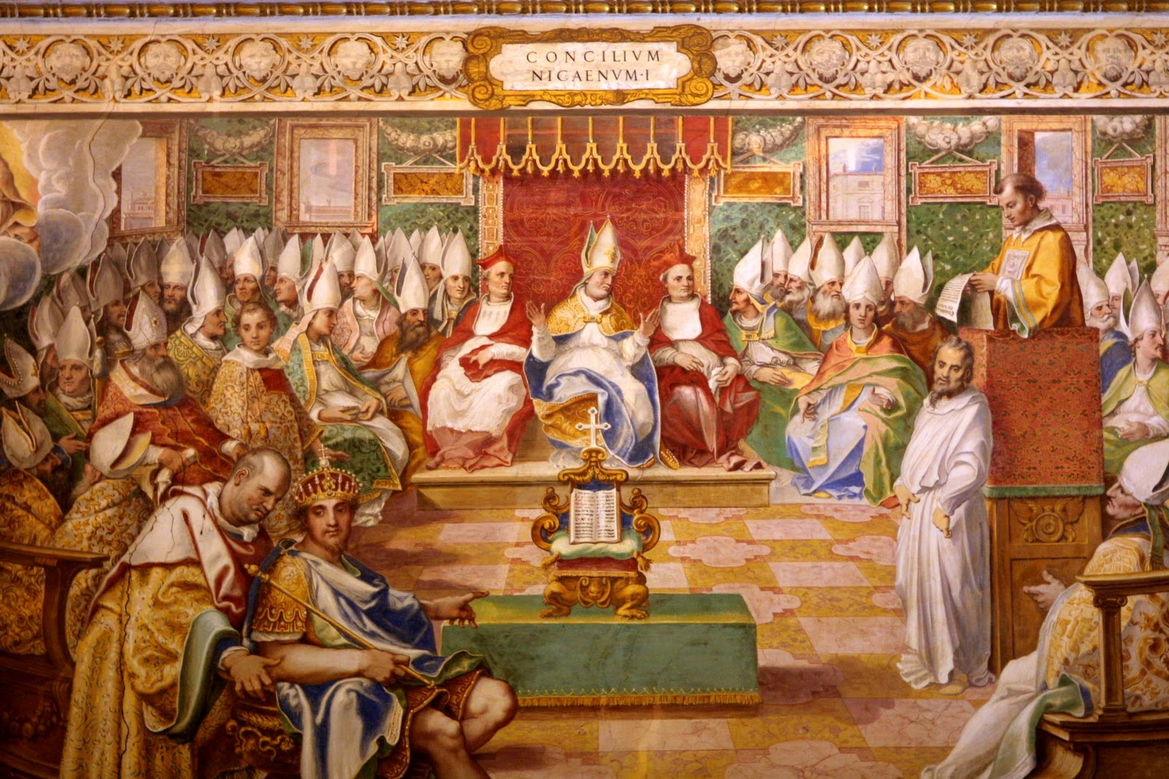
Did the church alter the New Testament?
Council of Nicaea, 325 AD
Notes:
Now, this idea that church councils, like the Council of Nicaea, altered the NT to suit their purposes is a VERY POPULAR belief among skeptics. The idea is that maybe when Constantine rose to power and called all the leaders of the church together at the Council of Nicaea in 325 AD, that he demanded that the Christian scriptures be altered to make Jesus into a divine person, even though Christians had always just believed that Jesus was a mortal man.
Now, that is a common assertion. But what’s wrong with that theory.
*ADVANCE*
Well, let’s go back to the map we looked at earlier. Christians had already been copying and spreading the New Testament for over 200 years before the Council of Nicaea.

Slide 92
Notes:
**10:04**
Well, let’s go back to the map we looked at earlier. Christians had already been copying and spreading the New Testament for over 200 years before the Council of Nicaea.
If these church leaders in the 4th century had wanted to create a new doctrine that had never been heard of before, they would have had to take control of all these manuscripts and either alter them or destroy them. But there was ABSOLUTELY NO WAY that the church could have done that. These manuscripts were FAR beyond their control.
In fact by 325 AD when the Council of Nicaea took place, some of these documents were already buried in the sands of Egypt, where they wouldn’t be re-discovered for another 1500 years.
*ADVANCE*
Now if this accusation from skeptics was true, and the doctrines of Christianity were altered and edited in the 4th century, what would we expect to see when we dig up these manuscripts buried in Egypt from the 2nd and 3rd century?

Slide 93
Did the church alter the New Testament?
Council of Nicaea, 325 AD
Notes:
**10:04**
Now if this accusation from skeptics was true, and the doctrines of Christianity were altered and edited in the 4th century, what would we expect to see when we discover manuscripts from Egypt from the 2nd and 3rd century?
We would expect HUGE DOCTRINAL DIFFERENCES – the older manuscripts would talk about a merely human Jesus, while the later manuscripts would present a divine Jesus.
But what do we actually find? When we find older, and older manuscripts going back closer and closer to the time of the apostles…
… we discover that the Christianity of the 4th century and beyond was the EXACT SAME Christianity of the 2nd century.
The doctrines hadn’t changed. No church council altered the doctrines of Christianity, because they COULDN’T. Even if they had WANTED to in 325 AD, the earliest manuscripts were beyond their reach and beyond their ability to edit them or destroy them.
And it’s because of that early, widespread distribution of manuscripts that we can say we KNOW what the NT authors like Paul actually wrote, not what some later church council THOUGHT Paul should have written.
*ADVANCE*
“But wait a minute”… someone might say “you SAY we know what Paul originally wrote. But you don’t have the original copies of Paul’s letters – they’ve been lost to history. You don’t even have any of the 1st or 2nd generation copies after that.

Slide 94
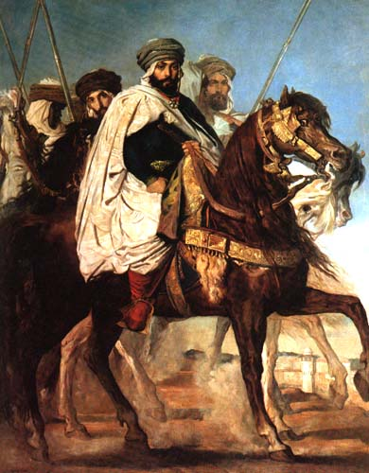
Central controlling authority: a problem for the Koran
Uthman ibn Affan
3rd Caliph of Islam (644-656 AD)
Notes:
** 10:08 – 10:23 **
Because it turns out 20 years after Muhammed died, Muslims began to have the same problem that Christians were having.
People started making handwritten copies of the Koran just like the Christians had with their scriptures, and textual variants began creeping into the copies that were being made.
The Muslims knew this had happened to the Jews and had happened to the Christian scriptures, and they did not want this for themselves.
*CLICK*
So THIS MAN here, Uthman, the third caliph of Islam, decided he was going to do something about it.
He sent orders throughout the whole Muslim world, to the Islamic centers of learning and everywhere else, and said "Send all the copies of the Koran you have to me"
So they did. All over the Muslim world, they sent the handwritten copies of the Koran to Uthman, and he began to collate them together. He setup a committee who would take those copies and compare them and determine what the best reading for every verse in the Koran was, and from that he produced what would become the official copy of the Koran, the Uthmanic Koran.
And then he sent copies of this Uthmanic Koran back to all the centers of learning in the Muslim world and said "This will be your new copy of the Koran. This is the official version."
And then he took the copies of the Koran that had been sent to him, and he burned them all. So the only Koran that was left, was the official Uthmanic Koran.
----------------------
Now the result of that is that the Koran is now a very stable text. When you get rid of all the copies you can find except for one, you're not going to have any discrepancies left to deal with.
So it turns out there are very few textual variants in the ancient manuscripts of the Koran that exist today
But do you understand what it is that they lost in that process?
*ADVANCE*
Well, do you remember this slide from last week? On the right we can see where a scribe made an unfortunate mistake

Slide 95
1 Thessalonians 2:7
But we were gentle among you, like a nursing mother taking care of her own children.
1 Thessalonians 2:7
But we were horses among you, like a nursing mother taking care of her own children.
Notes:
Well, do you remember this slide from last week? On the right we can see where a scribe made an unfortunate mistake and said that Paul and his companions were like horses among the Thessalonian believers, instead of saying that they were GENTLE. How do we know it was a mistake? Because we have many, many other copies of 1 Thessalonians that have the right word, the word “gentle”.
*CLICK*
But what if we didn’t have those other copies? What if someone destroyed all of them, and left only this copy of 1 Thessalonians. And then they had the power to tell all the followers of Christianity that this was the accurate and official reading of 1 Thes. 2:7?
Well, you might be very confused by what Paul meant… but you would have no way of knowing that it was wrong. There would be no way to discover that a mistake had been made, because all the other evidence would have been destroyed.
THAT is the price that Muslims are paying for having a stable Koran, even today.
*ADVANCE*
If you’re a Muslim, and you’re being honest, you can’t say that you know for SURE that the words you have in your Koran are the words that Allah gave to Mohammed. All you can say is that you have what UTHMAN thought the original words of the Koran were. And you had better hope that Uthman got it 100% right.

Slide 96
Central controlling authority: a problem for the Koran
Uthman ibn Affan
3rd Caliph of Islam (644-656 AD)
Notes:
If you’re a Muslim, and you’re being honest, you can’t say that you know for SURE that the words you have in your Koran are the words that Allah gave to Mohammed. All you can say is that you have what UTHMAN thought the original words of the Koran were. And you had better hope that Uthman got it 100% right.
Because if he didn’t – if he made any mistakes at all – there’s no way to know. He destroyed all the original manuscripts. The history of the Koran can be traced back to Uthman, and no further. And that’s the price of “CERTAINTY” that Muslims have to pay. And sometimes having certainty means not having the truth.
Christianity, with its free copying process, does not have that problem. All the documents used to make our English Bibles are still available. If someone doesn’t think the reading is correct, they can go back to the sources and see what they say. The vast number of copies of the NT we have means that we can be sure we have what Paul originally wrote, not what some Christian version of Uthman, or some pope or some church council THOUGHT that Paul wrote, or that Paul SHOULD have written.
END OF CLASS TRANSITION:
So that’s where we’re going to stop for today. Next week, we’re going to pick up right here, and I’m going to deal with a skeptical question that comes from what I just said, and it’s a question that has been popularized by one of most influential atheistic critics of the NT in the world, lives less than 30 miles from here. And his assertion is “wait a minute David, you just said that we “know what Paul originally wrote. but wait a minute, you don’t have the original copies of Paul’s letters, or the 1st or 2nd or 3rd generation copies after that?
What if an error occurred in the very first copy that was made, or maybe the 2nd copy. You have no way of knowing whether that happened because you don’t have those manuscripts anymore, and you don’t have the originals either? So don’t you Christians really have the same problem Muslims have?
So we’ll deal with that question next week. And we’ll also answer a question that you may have based on what I’ve said about different English translations of the Bible. More than once I’ve said “The KJV and the NKJV have this reading, but most other English Bible translations have this different reading.” And you may be wondering, why does it seem like there’s always this dividing line where the KJV and NKJV read one way, but the ESV NASB and other English Bibles read a different way? So we’ll get into a little history of how we got our English Bibles in order to answer that question.
And then the last thing we’ll do in this little series on the text of the New Testament is take a look at the 3 biggest and most well-known textual variants in the Bible. These are the ones that will most commonly be cited by atheists and skeptics when they attack the NT, so it’s a good idea for us to have some knowledge of them and be able to explain what their significance is.
So, that’s all coming up next week, Lord willing. Thank you for your attentiveness again, and let’s pray.
TRANSITION: Suppose someone says: David – you’re saying we “know what Paul originally wrote” …
*ADVANCE*
but wait a minute, you don’t have the original copies of Paul’s letters, or the 1st or 2nd or 3rd generation copies after that?
What if an error occurred in the copies you don’t have anymore – don’t you have the same problem Muslims have?
To understand this argument better, let me introduce you to a man I mentioned briefly in my last class – the man who is probably the world’s best-known skeptical New Testament scholar. His name is Bart Ehrman.

Slide 98
Notes:
*GET NAMES OF PEOPLE ON THE FRONT ROWS, and a “mistake” scribe somewhere in the middle on my left*
Good morning, and welcome to our third and final lecture on the reliability of the NT text. For the last two classes we’ve been trying to answer the question “When it comes to our English Bibles, is what we have now what they wrote then?” Has God really preserved the teaching of Christ and the apostles over centuries of copying and translation? Can we really trust that this is God’s word?
I know some of you haven’t been in the previous two classes, so I’ll just do a quick recap of where we’ve been.
We talked about how the new testament documents were copied by hand for 1500 years, because that’s the only way that copies could be made before the printing press. We talked about how scribes could often make mistakes when they made their copies, which we call TEXTUAL VARIANTS.
And I promised that if you forgot everything else we covered in this class, you’d be able to boil it all down to FOUR KEY POINTS which I hope will be helpful for you to understand why we can still believe that God has preserved his word even in spite of all the textual variants – the copying errors – that we have to deal with.
**ADVANCE**
We covered the first two key points in our first class, where we said that there are 400,000 textual variants among all the manuscript copies of the NT that we have today, but 99% of them are inconsequential

Slide 99
Previously…
Key #1:
400,000 textual
variants, but
99% of them are
inconsequential.
Key #2:
No essential
doctrines are
affected by
any viable
textual variant.
Spelling differences &
nonsense errors
Do not affect
translation
70%
20%
1%
9%
Meaningful
and viable
Meaningful but
not viable
Notes:
**ADVANCE**
We covered the first two key points in our first class, where we said that there are 400,000 textual variants among all the manuscript copies of the NT that we have today, but 99% of them are inconsequential. 99% of them consist of just spelling differences, nonsense errors, differences in Greek syntax that don’t affect the translation of the text into English, or changes that occur so late in history that they are not VIABLE – they have no chance of being the original reading because they happen long after the original NT documents were penned.
That leaves only 1% of textual variants that are meaningful and viable – differences in the text where we may not always be sure which is exactly the original reading. (Romans 5:1 - “Therefore having been justified by faith, we have peace with God… or LET US have peace with god”)
**CLICK**
But in our second point, we said that even those 1% of textual variants do not change any doctrines of the faith. Most of them are fairly trivial to the meaning of the text, and none of the doctrines of the faith are affected by any of them. There are no textual variants that teach that there is a way of salvation apart from faith in Christ, or that there are 4 persons in the Trinity, or that Jesus was not God – no doctrines of the Christian faith are affected by any textual variant.
*ADVANCE**
And then in our last class we looked at a very popular belief held by skeptics, atheists, Muslims and others that says that the NT was corrupted very early on its history, because early church leaders altered the text to suit their purposes.

Slide 100

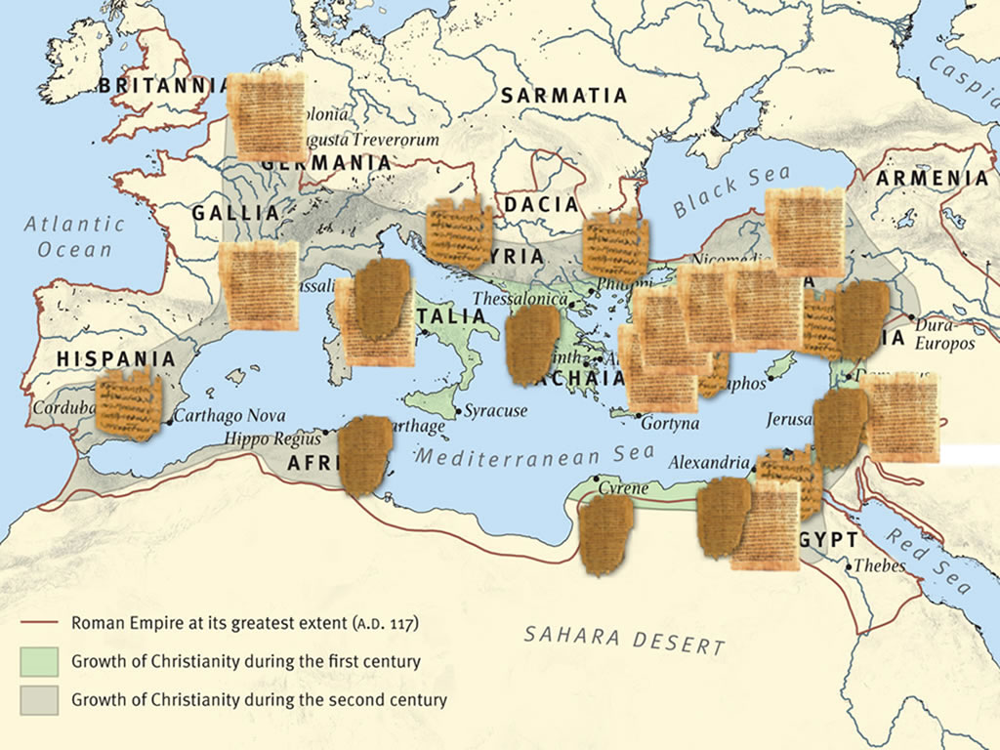
Previously…
Key #3
The New Testament
was never controlled
by a central authority
Notes:
And then in our last class we looked at a very popular belief held by skeptics, atheists, Muslims and others that says that the NT was corrupted very early on its history, because early church leaders altered the text to suit their purposes.
The assertion is that Jesus’ earliest followers never thought of him as a GOD. They thought he was a great teacher, a wise rabbi, but still… just a mortal man. But in the fourth century, Constantine declared himself to be a Christian, and as the Roman Emperor he didn’t want to serve a mere Jewish man. He wanted to serve a GOD. So he gathered the leaders of the church together in 325 AD at the Council of Nicaea and demanded that they edit the scriptures in order (for example) to insert the deity of Christ into the NT.
And so (the theory goes), the church altered the text of scripture, and inserted this new idea that Jesus was actually not just a man, but the Son of God himself. And now, when we read our English Bibles, we don’t realize that this idea of a divine Jesus was an invention by church leaders centuries after the original gospels and epistles were written.
But we talked about why that theory not only isn’t true – it’s actually COMPLETELY IMPOSSIBLE.
**CLICK**
And to show that, we looked at how the books of the NT were copied and spread all over the Roman empire for at least 200 years before the Council of Nicaea met. We talked about how this widespread, rapid copying of the NT documents was done with no one overseeing the effort, or controlling it in any way. The church was under persecution most of this time – there were no popes, no secretive church councils, no controlling authorities.
And what that means is that, by the time the council of Nicaea met in 325 AD, there was no way they could change scripture even if they wanted to (which they didn’t!) because there were so many manuscripts of the NT that had been copied and spread far and wide for OVER TWO CENTURIES. There was no way they could collect them to edit them or destroy them even if they wanted to.
**CLICK**
So that was our third point: The NT was NEVER controlled by a central authority. Nobody altered the doctrines of the faith taught by Christ and the apostles… because nobody COULD. It was impossible to control the copying and spread of the NT documents, so it was impossible to change them.
And that’s how we ended our class last week – on that point:
since nobody had control over the NT text, we can say with confidence that we know what Paul wrote, not what some church council in 325 AD SAID that Paul wrote.
**ADVANCE**
“But wait a minute”… someone might say “you’re saying we know what Paul originally wrote. But you don’t have the original copies of Paul’s letters – they’ve been lost to history. You don’t even have any of the 1st or 2nd generation copies after that.

Slide 101
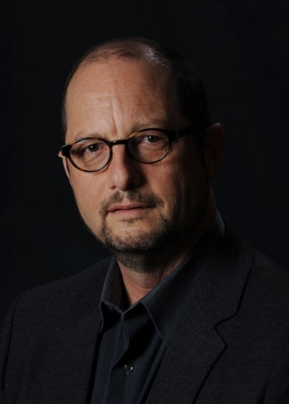
What if our earliest manuscripts are already corrupt?
But wait a minute…
“How do we know that our surviving manuscripts were copied from accurate copies instead of thoroughly erroneous ones?
How do we know that our earliest manuscripts were preserving accurate copies of accurate copies?”
Bart Ehrman
Notes:
*10:06*
“But wait a minute”… someone might say “you SAY we know what Paul originally wrote. But you don’t have the original copies of Paul’s letters – they’ve been lost to history. You don’t even have any of the 1st or 2nd generation copies after that.
*CLICK*
What if an error occurred in the copies you don’t have anymore? Isn’t it possible that there are errors in the NT that you don’t even realize are errors, because all the correct copies no longer exist?
To understand this argument better, let me introduce you to this man
*CLICK*
whose name is Bart Ehrman. Bart Ehrman is professor of religion at UNC and probably the world’s best-known SKEPTICAL New Testament scholar. He was once a professing Christian, but he’s now a devout atheist, and a best-selling author of multiple books that attack the reliability of the New Testament.
Here’s a quote from him.
*CLICK*
Now to explain Bart Ehrman’s point,
*ADVANCE*
We are all going to do a little role playing here, and we’re all going to become New Testament scribes, making copies of manuscripts.

Slide 102
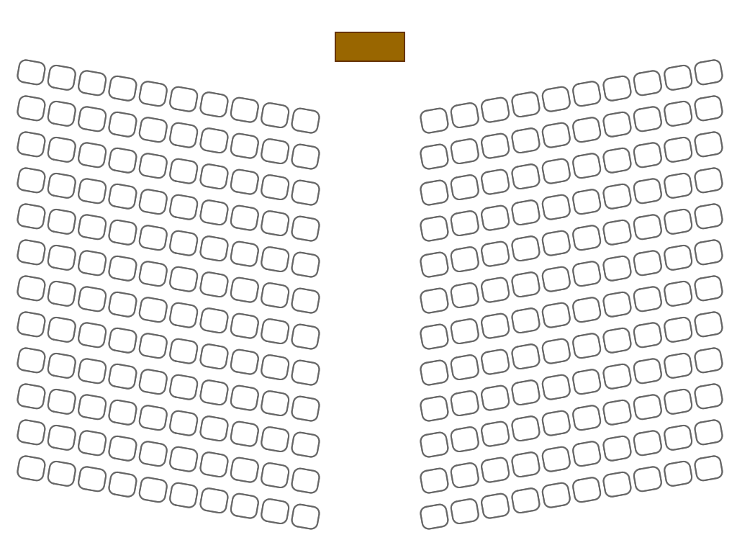
Notes:
*10:07*
We are all going to do a little role playing here, and we’re all going to become New Testament scribes, making copies of manuscripts. (Don't worry, I'm not going to actually make you do anything.) ☺
But we’re going to pretend that we’re all scribes sitting in our church’s sanctuary (that’s what’s pictured here).
So this is me up here. This is the podium. I'm the Apostle Paul for today. And I've just written the book of Galatians.
And so I'm going to take my book of Galatians, and I'm going to come over here to <MAN1> and I'm going to show him my book of Galatians.
*CLICK*
And he is going to make a handwritten copy for himself.
And then <MAN1> is going to turn around and show it to all the men on the row behind him.
*CLICK*
And they're going to make their own handwritten copies of his book. And then they're going to turn around and show it to the men behind them,
*CLICK*
they're going to choose one of the manuscripts and they will make a copy as well, they'll turn around
*CLICK*
and it's going to go all the way to the back of the room. Every man making a copy all the way to the back.
*CLICK*
So in this example, we can consider these front rows to have the earliest manuscripts, the ones closest to the time of Paul (me) and the back rows are going to be much later copies of copies of copies.

Slide 103
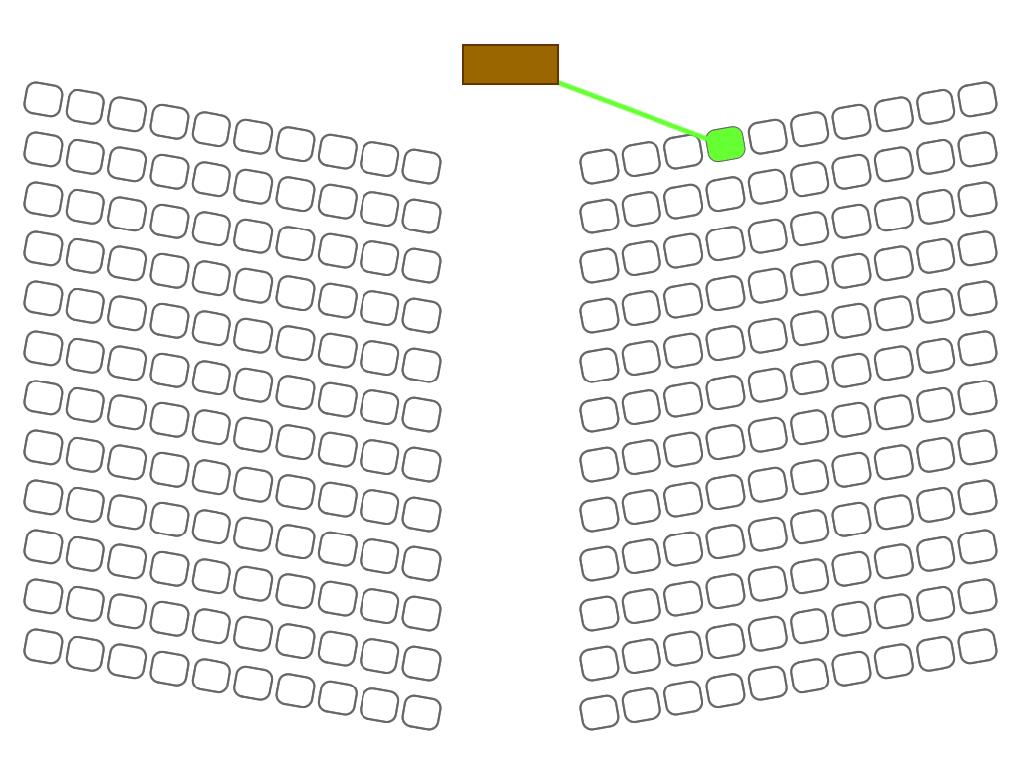
Notes:
We are all going to do a little role playing here, and we’re all going to become New Testament scribes, making copies of manuscripts. (Don't worry, I'm not going to actually make you do anything.) ☺
But we’re going to pretend that we’re all scribes sitting in our church’s sanctuary (that’s what’s pictured here).
So this is me up here. This is the podium. I'm the Apostle Paul for today. And I've just written the book of Galatians.
And so I'm going to take my book of Galatians, and I'm going to come over here to <MAN1> and I'm going to show him my book of Galatians.
*CLICK*
And he is going to make a handwritten copy for himself.
And then <MAN1> is going to turn around and show it to all the men on the row behind him.
*CLICK*
And they're going to make their own handwritten copies of his book. And then they're going to turn around and show it to the men behind them,
*CLICK*
they're going to choose one of the manuscripts and they will make a copy as well, they'll turn around
*CLICK*
and it's going to go all the way to the back of the room. Every man making a copy all the way to the back.
*CLICK*
So in this example, we can consider these front rows to have the earliest manuscripts, the ones closest to the time of Paul (me) and the back rows are going to be much later copies of copies of copies.

Slide 104
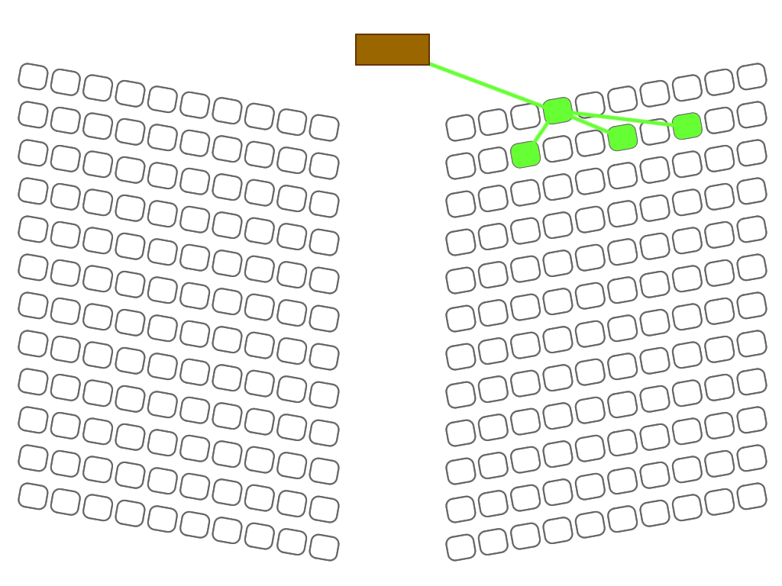
Notes:
We are all going to do a little role playing here, and we’re all going to become New Testament scribes, making copies of manuscripts. (Don't worry, I'm not going to actually make you do anything.) ☺
But we’re going to pretend that we’re all scribes sitting in our church’s sanctuary (that’s what’s pictured here).
So this is me up here. This is the podium. I'm the Apostle Paul for today. And I've just written the book of Galatians.
And so I'm going to take my book of Galatians, and I'm going to come over here to <MAN1> and I'm going to show him my book of Galatians.
*CLICK*
And he is going to make a handwritten copy for himself.
And then <MAN1> is going to turn around and show it to all the men on the row behind him.
*CLICK*
And they're going to make their own handwritten copies of his book. And then they're going to turn around and show it to the men behind them,
*CLICK*
they're going to choose one of the manuscripts and they will make a copy as well, they'll turn around
*CLICK*
and it's going to go all the way to the back of the room. Every man making a copy all the way to the back.
*CLICK*
So in this example, we can consider these front rows to have the earliest manuscripts, the ones closest to the time of Paul (me) and the back rows are going to be much later copies of copies of copies.

Slide 105
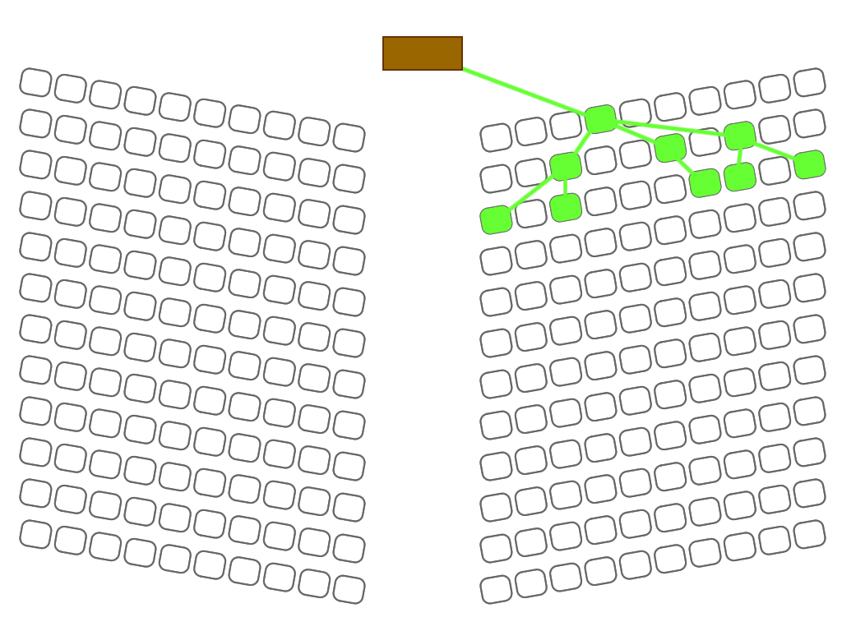
Notes:
We are all going to do a little role playing here, and we’re all going to become New Testament scribes, making copies of manuscripts. (Don't worry, I'm not going to actually make you do anything.) ☺
But we’re going to pretend that we’re all scribes sitting in our church’s sanctuary (that’s what’s pictured here).
So this is me up here. This is the podium. I'm the Apostle Paul for today. And I've just written the book of Galatians.
And so I'm going to take my book of Galatians, and I'm going to come over here to <MAN1> and I'm going to show him my book of Galatians.
*CLICK*
And he is going to make a handwritten copy for himself.
And then <MAN1> is going to turn around and show it to all the men on the row behind him.
*CLICK*
And they're going to make their own handwritten copies of his book. And then they're going to turn around and show it to the men behind them,
*CLICK*
Those men are going to CHOOSE one of the manuscripts and they will make a copy as well, they'll turn around
*CLICK*
and it's going to go all the way to the back of the room. Every man making a copy all the way to the back.
*CLICK*
So in this example, we can consider these front rows to have the earliest manuscripts, the ones closest to the time of Paul (me) and the back rows are going to be much later copies of copies of copies.

Slide 106
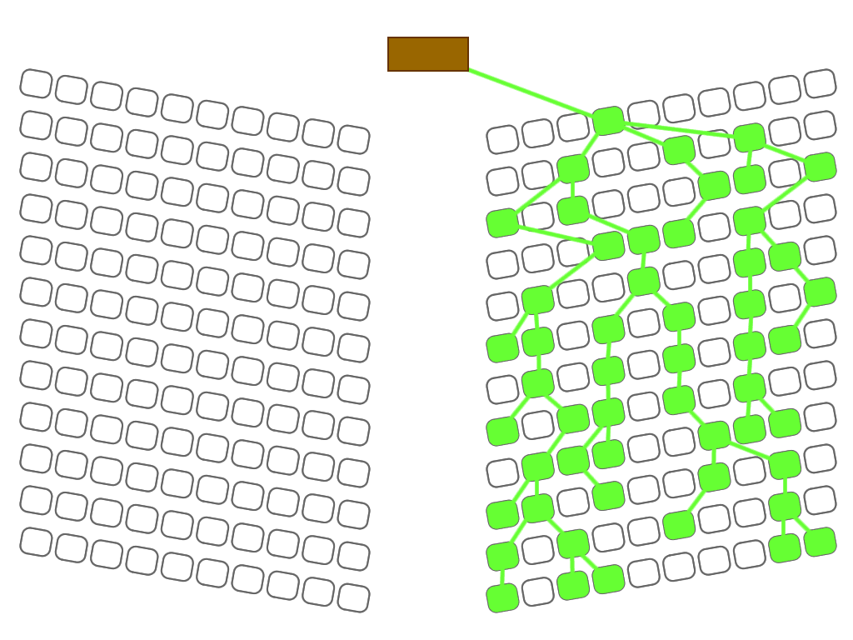
Notes:
We are all going to do a little role playing here, and we’re all going to become New Testament scribes, making copies of manuscripts. (Don't worry, I'm not going to actually make you do anything.) ☺
But we’re going to pretend that we’re all scribes sitting in our church’s sanctuary (that’s what’s pictured here).
So this is me up here. This is the podium. I'm the Apostle Paul for today. And I've just written the book of Galatians.
And so I'm going to take my book of Galatians, and I'm going to come over here to <MAN1> and I'm going to show him my book of Galatians.
*CLICK*
And he is going to make a handwritten copy for himself.
And then <MAN1> is going to turn around and show it to all the men on the row behind him.
*CLICK*
And they're going to make their own handwritten copies of his book. And then they're going to turn around and show it to the men behind them,
*CLICK*
they're going to choose one of the manuscripts and they will make a copy as well, they'll turn around
*CLICK*
and it's going to go all the way to the back of the room. Every man making a copy all the way to the back.
*CLICK*
So in this example, we can consider these front rows to have the earliest manuscripts, the ones closest to the time of Paul (me) and the back rows are going to be much later copies of copies of copies.

Slide 107

Notes:
We are all going to do a little role playing here, and we’re all going to become New Testament scribes, making copies of manuscripts. (Don't worry, I'm not going to actually make you do anything.) ☺
But we’re going to pretend that we’re all scribes sitting in our church’s sanctuary (that’s what’s pictured here).
So this is me up here. This is the podium. I'm the Apostle Paul for today. And I've just written the book of Galatians.
And so I'm going to take my book of Galatians, and I'm going to come over here to <MAN1> and I'm going to show him my book of Galatians.
*CLICK*
And he is going to make a handwritten copy for himself.
And then <MAN1> is going to turn around and show it to all the men on the row behind him.
*CLICK*
And they're going to make their own handwritten copies of his book. And then they're going to turn around and show it to the men behind them,
*CLICK*
they're going to choose one of the manuscripts and they will make a copy as well, they'll turn around
*CLICK*
and it's going to go all the way to the back of the room. Every man making a copy all the way to the back.
*CLICK*
So in this example, we can consider these front rows to have the earliest manuscripts, the ones closest to the time of Paul (me) and the back rows are going to be much later copies of copies of copies.
*ADVANCE*
Now, here's the thing. Let’s make these rows up at the front grey to indicate we no longer have my original book of Galatians.

Slide 108

Notes:
Now, here's the thing. Let’s make these rows up at the front grey to indicate we no longer have my original book of Galatians. And the first few copies are also lost to the mists of history, and the green ones represent what we have now.
*CLICK*
Now, what happens if <THIS GUY> back there makes an error while he’s copying the manuscript? Maybe he accidentally omits a phrase in his copy of Galatians - what's going to happen as a result?
*CLICK*
The result is that all the copies that come from <THIS GUY>’s copy are going to have errors in them - the copies behind him, and then the copies that follow them are going to be missing that phrase.
But we're not too worried about that. Because we've got other documents over here that don't have that problem - the correct phrase is still there. And in fact, we've got older documents that still have that phrase, so we can detect that error that <THIS GUY> made, and all the manuscripts that came after him. And we can work around it. It's not a big problem.
But here’s Bart Ehrman’s point:
*ADVANCE*
What happens if <MAN1> made an error in the very first copy, and now his copy is gone?

Slide 109

Notes:
Example error next (1 John 3:1 - “and such we are”)

Slide 110

1 John 3:1
Behold what manner of love the Father has bestowed on us, that
we should be called children of God; and such we are. Therefore
the world does not
know us…

Slide 111
Notes:
Now, here's the thing. Let’s make these rows up at the front grey to indicate we no longer have my original book of Galatians. And the first few copies are also lost to the mists of history, and the green ones represent what we have now.
*CLICK*
Now, what happens if <THIS GUY> back there makes an error while he’s copying the manuscript? Maybe he accidentally omits a phrase in his copy of Galatians - what's going to happen as a result?
*CLICK*
The result is that all the copies that come from <THIS GUY>’s copy are going to have errors in them - the copies behind him, and then the copies that follow them are going to be missing that phrase.
But we're not too worried about that. Because we've got other documents over here that don't have that problem - the correct phrase is still there. And in fact, we've got older documents that still have that phrase, so we can detect that error that <THIS GUY> made, and all the manuscripts that came after him. And we can work around it. It's not a big problem.
But here’s Bart Ehrman’s point:
*ADVANCE*
What happens if <MAN1> made an error in the very first copy, and now his copy is gone?

Slide 112

Notes:
Now, here's the thing. Let’s make these rows up at the front grey to indicate we no longer have my original book of Galatians. And the first few copies are also lost to the mists of history, and the green ones represent what we have now.
*CLICK*
Now, what happens if <THIS GUY> back there makes an error while he’s copying the manuscript? Maybe he accidentally omits a phrase in his copy of Galatians - what's going to happen as a result?
*CLICK*
The result is that all the copies that come from <THIS GUY>’s copy are going to have errors in them - the copies behind him, and then the copies that follow them are going to be missing that phrase.
But we're not too worried about that. Because we've got other documents over here that don't have that problem - the correct phrase is still there. And in fact, we've got older documents that still have that phrase, so we can detect that error that <THIS GUY> made, and all the manuscripts that came after him. And we can work around it. It's not a big problem.
But here’s Bart Ehrman’s point:
*ADVANCE*
What happens if <MAN1> made an error in the very first copy, and now his copy is gone?

Slide 113


Slide 114


Slide 115

Notes:
What happens if <MAN1> made an error in the very first copy, and now his copy is gone?
*CLICK*
The result is going to be that every single document in that tree is going to have an error in it. And here's the thing - there's no way we're going to be able to know, because the earliest manuscripts are gone. My original that had the right reading is gone. And all we’ve got left are manuscripts without that phrase, and we'll never know that it actually existed. That's what Bart Ehrman is claiming about the New Testament. And if he's right about how the New Testament was transmitted, then he's got a point because this kind of thing is plausible.
But let's change up the example a little bit.
*ADVANCE*
Let’s go back to this slide again.

Slide 116

Notes:
But here's Bart Ehrman’s point:
What happens if <MAN1> made an error in the very first copy, and now his copy is gone?
*CLICK*
The result is going to be that every single document in that tree is going to have an error in it.
And here's the thing - there's no way we’ll ever know, because the earliest manuscripts are gone. My original book of Galatians that had the right reading is gone. And all we’ve got left are manuscripts without that phrase, and we'll never know that it actually existed. That's what Bart Ehrman is claiming about the New Testament. And if he's right about how the New Testament was transmitted, then he's got a point because this kind of thing is plausible.
But let's change up the example a little bit.
*ADVANCE*
Let’s go back to this slide again.

Slide 117
Notes:
*10:11*
Let’s go back to this slide again. So here I am again with my book of Galatians. And now I walk over to <WOMAN1>,
*CLICK*
and I show <WOMAN1> my original document and she makes a copy of it. And then she turns around
*CLICK*
and shows her copy to all the women behind her and they make a handwritten copy of it.
*CLICK*
And then those women turn around, and the women behind them make a copy,
*CLICK*
and so on, so that copies of Galatians get made all the way to the back of the room.
*ADVANCE*
Then I'll come over here to <MAN2>. And I'll show him my original book of Galatians.

Slide 118

Notes:
Let’s go back to this slide again. So here I am again with my book of Galatians. And now I walk over to <WOMAN1>,
*CLICK*
and I show <WOMAN1> my original document and she makes a copy of it. And then she turns around
*CLICK*
and shows her copy to all the women behind her and they make a handwritten copy of it.
*CLICK*
And then those women turn around, and the women behind them make a copy,
*CLICK*
and so on, so that copies of Galatians get made all the way to the back of the room.
*ADVANCE*
Then I'll come over here to <MAN2>. And I'll show him my original book of Galatians.

Slide 119

Notes:
Let’s go back to this slide again. So here I am again with my book of Galatians. And now I walk over to <WOMAN1>,
*CLICK*
and I show <WOMAN1> my original document and she makes a copy of it. And then she turns around
*CLICK*
and shows her copy to all the women behind her and they make a handwritten copy of it.
*CLICK*
And then those women turn around, and the women behind them make a copy,
*CLICK*
and so on, so that copies of Galatians get made all the way to the back of the room.
*ADVANCE*
Then I'll come over here to <MAN2>. And I'll show him my original book of Galatians.

Slide 120

Notes:
Let’s go back to this slide again. So here I am again with my book of Galatians. And now I walk over to <WOMAN1>,
*CLICK*
and I show <WOMAN1> my original document and she makes a copy of it. And then she turns around
*CLICK*
and shows her copy to all the women behind her and they make a handwritten copy of it.
*CLICK*
And then those women turn around, and the women behind them make a copy,
*CLICK*
and so on, so that copies of Galatians get made all the way to the back of the room.
*ADVANCE*
Then I'll come over here to <MAN2>. And I'll show him my original book of Galatians.

Slide 121

Notes:
Let’s go back to this slide again. So here I am again with my book of Galatians. And now I walk over to <WOMAN1>,
*CLICK*
and I show <WOMAN1> my original document and she makes a copy of it. And then she turns around
*CLICK*
and shows her copy to all the women behind her and they make a handwritten copy of it.
*CLICK*
And then those women turn around, and the women behind them make a copy,
*CLICK*
and so on, so that copies of Galatians get made all the way to the back of the room by the women.
*ADVANCE*
Then I'll come over here to <MAN2>. And I'll show him my original book of Galatians.

Slide 122

Notes:
Then I'll come over here to <MAN2>. And I'll show him my original book of Galatians. And he's going to make a handwritten copy,
*CLICK*
then he'll turn around to the men behind him, they'll all make a copy,
*CLICK*
*CLICK*
and then more copies until they go all the way to the back of the room.
*ADVANCE*
Then I'll go over to <WOMAN2>, and I'll show her my book. And she’ll make a copy
*CLICK*
and then she’ll show it to the women behind her.
*CLICK*
*CLICK*
And in that way, it will go all the way to the back of the room as well.
This is what we call
*ADVANCE*
multiple lines of transmission.

Slide 123

Notes:
Then I'll come over here to <MAN2>. And I'll show him my original book of Galatians. And he's going to make a handwritten copy,
*CLICK*
then he'll turn around to the men behind him, they'll all make a copy,
*CLICK*
*CLICK*
and then more copies until they go all the way to the back of the room.
*ADVANCE*
Then I'll go over to <WOMAN2>, and I'll show her my book. And she’ll make a copy
*CLICK*
and then she’ll show it to the women behind her.
*CLICK*
*CLICK*
And in that way, it will go all the way to the back of the room as well.
This is what we call
*ADVANCE*
multiple lines of transmission.

Slide 124

Notes:
Then I'll come over here to <MAN2>. And I'll show him my original book of Galatians. And he's going to make a handwritten copy,
*CLICK*
then he'll turn around to the men behind him, they'll all make a copy,
*CLICK*
*CLICK*
and then more copies until they go all the way to the back of the room.
*ADVANCE*
Then I'll go over to <WOMAN2>, and I'll show her my book. And she’ll make a copy
*CLICK*
and then she’ll show it to the women behind her.
*CLICK*
*CLICK*
And in that way, it will go all the way to the back of the room as well.
This is what we call
*ADVANCE*
multiple lines of transmission.

Slide 125

Notes:
Then I'll come over here to <MAN2>. And I'll show him my original book of Galatians. And he's going to make a handwritten copy,
*CLICK*
then he'll turn around to the men behind him, they'll all make a copy,
*CLICK*
*CLICK*
and then more copies until they go all the way to the back of the room.
*ADVANCE*
Then I'll go over to <WOMAN2>, and I'll show her my book. And she’ll make a copy
*CLICK*
and then she’ll show it to the women behind her.
*CLICK*
*CLICK*
And in that way, it will go all the way to the back of the room as well.
This is what we call
*ADVANCE*
multiple lines of transmission.

Slide 126

Notes:
Then I'll come over here to <MAN2>. And I'll show him my original book of Galatians. And he's going to make a handwritten copy,
*CLICK*
then he'll turn around to the men behind him, they'll all make a copy,
*CLICK*
*CLICK*
and then more copies until they go all the way to the back of the room.
*ADVANCE*
Then I'll go over to <WOMAN2>, and I'll show her my book. And she’ll make a copy
*CLICK*
and then she’ll show it to the women behind her.
*CLICK*
*CLICK*
And in that way, it will go all the way to the back of the room as well.
This is what we call
*ADVANCE*
multiple lines of transmission.

Slide 127

Notes:
Then I'll come over here to <MAN2>. And I'll show him my original book of Galatians. And he's going to make a handwritten copy,
*CLICK*
then he'll turn around to the men behind him, they'll all make a copy,
*CLICK*
*CLICK*
and then more copies until they go all the way to the back of the room.
*ADVANCE*
Then I'll go over to <WOMAN2>, and I'll show her my book. And she’ll make a copy
*CLICK*
and then she’ll show it to the women behind her.
*CLICK*
*CLICK*
And in that way, it will go all the way to the back of the room as well.
This is what we call
*ADVANCE*
multiple lines of transmission.

Slide 128

Notes:
Then I'll come over here to <MAN2>. And I'll show him my original book of Galatians. And he's going to make a handwritten copy,
*CLICK*
then he'll turn around to the men behind him, they'll all make a copy,
*CLICK*
*CLICK*
and then more copies until they go all the way to the back of the room.
*ADVANCE*
Then I'll go over to <WOMAN2>, and I'll show her my book. And she’ll make a copy
*CLICK*
and then she’ll show it to the women behind her.
*CLICK*
*CLICK*
And in that way, it will go all the way to the back of the room as well.
This is what we call
*ADVANCE*
multiple lines of transmission.

Slide 129

Notes:
Then I'll come over here to <MAN2>. And I'll show him my original book of Galatians. And he's going to make a handwritten copy,
*CLICK*
then he'll turn around to the men behind him, they'll all make a copy,
*CLICK*
*CLICK*
and then more copies until they go all the way to the back of the room.
*ADVANCE*
Then I'll go over to <WOMAN2>, and I'll show her my book. And she’ll make a copy
*CLICK*
and then she’ll show it to the women behind her.
*CLICK*
*CLICK*
And in that way, it will go all the way to the back of the room as well.
This is what we call
*ADVANCE*
multiple lines of transmission.

Slide 130

Notes:
This is what we call multiple lines of transmission.
We’ve now got four independent lines of transmission (represented by the different colors) that DO NOT DEPEND on each other.
Each of these four colored lines trace back to the original book of Galatians that Paul wrote, because remember, the original NT manuscripts would have stayed around for a long time. When the church of Galatia received Paul’s letter, it didn’t just disappear a few months later. It would have lasted for decades, and many people would have been copying off of Paul’s original letter. I've only got four lines of transmission on this slide, but there's really dozens if not hundreds of independent lines of transmission all going back to that original letter.
And that is our FOURTH and final KEY POINT for this class:
*ADVANCE*
Multiple lines of transmission have preserved the text.

Slide 131

Key #4
Notes:
**10:13**
Multiple lines of transmission have preserved the text.
What this means is that we are not dependent on just a single line of manuscripts, where we have to hope and pray that the person in the chain before us got it right.
We have MULTIPLE chains of manuscripts that are not dependent on each other
*ADVANCE*
So that means even if the oldest copies of our manuscripts are gone,

Slide 132
Notes:
So that means even if
*CLICK*
The oldest copies of our manuscripts are gone,
*CLICK*
And one of the earliest scribes made a mistake
*CLICK*
We can still recognize that a mistake occurred, because all the documents that came from other independent lines of transmission don’t have that error.
**ADVANCE**
The NT was not transmitted to us in the same way you play the phone game.

Slide 133

Notes:
So that means even if the oldest copies of our manuscripts are gone,
*CLICK*
And one of the earliest scribes made a mistake
*CLICK*
And now this whole line of manuscripts has that mistake,
we can still recognize that a mistake occurred, because all the documents that came from other independent lines of transmission don’t have that error.
**ADVANCE**
The NT was not transmitted to us in the same way you play the phone game.

Slide 134

Notes:
So that means even if the oldest copies of our manuscripts are gone,
*CLICK*
And one of the earliest scribes made a mistake
*CLICK*
And now this whole line of manuscripts has that mistake,
we can still recognize that a mistake occurred, because all the documents that came from other independent lines of transmission don’t have that error.
**ADVANCE**
The NT was not transmitted to us in the same way you play the phone game.

Slide 135

Notes:
So that means even if the oldest copies of our manuscripts are gone,
*CLICK*
And one of the earliest scribes made a mistake
*CLICK*
And now this whole line of manuscripts has that mistake,
we can still recognize that a mistake occurred, because all the documents that came from other independent lines of transmission don’t have that error.
**ADVANCE**
The NT was not transmitted to us in the same way you play the phone game.

Slide 136

Notes:
**10:14**
The NT was not transmitted to us in the same way you play the phone game.
the old game where someone would whisper into someone's ear something and then then they whisper to the next person, and to the next person until it gets to the very end. And it's usually pretty funny at the end, because it’s gotten so scrambled along the way.
That's not the way the Bible works, where you only start with one copy, and then someone makes a copy of that, and then someone makes a copy of the copy, and then errors come in and then more errors, until by the end you’re left with a copy that’s hopelessly full of errors.
That’s a single line of transmission.
*ADVANCE*
But we have MULTIPLE lines of transmission.

Slide 137
Notes:
But we have MULTIPLE lines of transmission. which can serve to correct any mistakes that might creep in along the way.
Maybe there’s a mistake in this entire green chain of manuscripts. But the other chains don’t have that error, so we can detect it and correct it without much difficulty.
Maybe there’s an entirely different error in the orange chain. But again, the other three lines aren’t going to have that same error, so we can spot it and correct it.
Errors like incorrect words or differences in phrases may get introduced, but we don’t ever lose the original reading when we take all the lines together.
**ADVANCE**
Someone has compared the new testament manuscripts that we have to a 1,000 piece jigsaw puzzle… and we have 1,010 pieces.

Slide 138

Key #5
Notes:
Remember, when a scribe took a manuscript off the shelf and made a new copy of it, he didn’t then just take the old manuscript and burn it. The older manuscript would be kept, and could be referred to if there were any questions about the text. That means if a scribe accidentally added something to the text, like the legend about the pool of Bethesda, we can DETECT that by looking at other manuscripts - older manuscripts – and seeing “oh, that wasn’t part of the original gospel of John – some scribe added this later.” And it also means that if a scribe left something out – EVEN INTENTIONALLY and maliciously, because he just didn’t like what the manuscript said at that particular part, we have many different manuscripts to compare that with and say “oh, this scribe left something out.”
Bart Ehrman says we can’t be sure – maybe a mistake got made in the first couple of centuries. The reality is, we have so many independent chains of manuscripts that come from the original manuscripts that it would be virtually impossible for anything to have disappeared from the text of the New Testament.
When the church in Ephesus got a letter of Paul written to them, how many times do you think someone pulled out that letter and made a copy of it? Maybe 30 times? 40? 50? 100 times? That original letter could have been in the possession of that church for decades before it finally fell apart, and surely dozens and dozens of copies would have been made from it. And if someone made a mistake in that first generation, there were still dozens of other copies that didn’t have that mistake.
That’s how we can be confident that the original reading of the text is TENACIOUS – it still exists among the manuscripts that we have, and using textual criticism helps us figure out what that original reading is.
**ADVANCE**
And just in case that’s not clear, let’s look at this sanctuary drawing one more time

Slide 140


Slide 141


Slide 142
Tenacity
“The transmission of the New Testament textual tradition is characterized by an extremely impressive degree of tenacity. Once a reading occurs it will persist with obstinacy.”
“We can be certain that among these [manuscripts] there is still a group of witnesses which preserves the original form of the text.”
– Kurt and Barbara Aland
Notes:
Demonstrated by almost all TVs! e.g. the longer ending of Mark – these are variations that have persevered (and been copied). Ditto Pool of Bethesda and Comma J.

Slide 143

Notes:
I want to give you one more illustration on this. Let’s reset our sanctuary drawing and make 16 lines of transmission for the book of Romans.

Slide 144

Notes:
I want to give you one more illustration on this. Let’s reset our sanctuary drawing and make 16 lines of transmission for the book of Romans.

Slide 145

Notes:
I want to give you one more illustration on this. Let’s reset our sanctuary drawing and make 16 lines of transmission for the book of Romans.

Slide 146

Notes:
I want to give you one more illustration on this. Let’s reset our sanctuary drawing and make 16 lines of transmission for the book of Romans.
*ADVANCE*

Slide 147
16 original copies of Romans
For the wages of sin is death, but the free gift of God is eternal life in Christ Jesus our Lord. | For the wages of sin is death, but the free gift of God is eternal life in Christ Jesus our Lord. | For the wages of sin is death, but the free gift of God is eternal life in Christ Jesus our Lord. | For the wages of sin is death, but the free gift of God is eternal life in Christ Jesus our Lord.
For the wages of sin is death, but the free gift of God is eternal life in Christ Jesus our Lord. | For the wages of sin is death, but the free gift of God is eternal life in Christ Jesus our Lord. | For the wages of sin is death, but the free gift of God is eternal life in Christ Jesus our Lord. | For the wages of sin is death, but the free gift of God is eternal life in Christ Jesus our Lord.
For the wages of sin is death, but the free gift of God is eternal life in Christ Jesus our Lord. | For the wages of sin is death, but the free gift of God is eternal life in Christ Jesus our Lord. | For the wages of sin is death, but the free gift of God is eternal life in Christ Jesus our Lord. | For the wages of sin is death, but the free gift of God is eternal life in Christ Jesus our Lord.
For the wages of sin is death, but the free gift of God is eternal life in Christ Jesus our Lord. | For the wages of sin is death, but the free gift of God is eternal life in Christ Jesus our Lord. | For the wages of sin is death, but the free gift of God is eternal life in Christ Jesus our Lord. | For the wages of sin is death, but the free gift of God is eternal life in Christ Jesus our Lord.
Notes:
So here is Rom 6:23, copied out 16 times from Paul’s original letter of Romans. Now, let’s suppose that a lot of problems happened when these copies were made.
*ADVANCE* and walk through illustration.
147

Slide 148
16 original copies of Romans
For the wages of sin is death, but the free gift of God is eternal life in Christ Jesus our Lord. | For the wages of sin is death, but the free gift of God is eternal life in Christ Jesus our Lord. | For the wages of sin is death, but the free gift of God is eternal life in Christ Jesus our Lord. | For the wages of sin is death, but the free gift of God is eternal life in Christ Jesus our Lord.
For the wages of sin is death, but the free gift of God is eternal life in Christ Jesus our Lord. | For the wages of sin is death, but the free gift of God is eternal life in Christ Jesus our Lord. | For the wages of sin is death, but the free gift of God is eternal life in Christ Jesus our Lord. | For the wages of sin is death, but the free gift of God is eternal life in Christ Jesus our Lord.
For the wages of sin is death, but the free gift of God is eternal life in Christ Jesus our Lord. | For the wages of sin is death, but the free gift of God is eternal life in Christ Jesus our Lord. | For the wages of sin is death, but the wages of God is eternal life in Christ Jesus our Lord. | For the wages of sin is death, but the free gift of God is eternal life in Christ Jesus our Lord.
For the wages of sin is death, but the free gift of God is eternal life in Christ Jesus our Lord. | For the wages of sin is death, but the free gift of God is eternal life in Christ Jesus our Lord. | For the wages of sin is death, but the free gift of God is eternal life in Christ Jesus our Lord. | For the wages of sin is death, but the free gift of God is eternal life in Christ Jesus our Lord.
Notes:
Let’s suppose one of the scribes made a mistake with the wording here. Instead of “gift of God” he accidentally wrote “wages” of God. But that’s an easy mistake to detect, because we have 15 other copies that all agree that the original word was “gift”.
148

Slide 149
16 original copies of Romans
For the wages of sin is death, but the free gift of God is eternal life in Christ Jesus our Lord. | For the wages of sin is death, but the free gift of God is eternal life in Christ Jesus our Lord. | For the wages of sin is death, but the free gift of God is eternal life in Christ Jesus our Lord. | For the wages of sin is death, but the free gift of God is eternal life in Christ Jesus our Lord.
For the wages of sin is suffering, but the free gift of God is eternal life in Christ Jesus our Lord. | For the wages of sin is death, but the free gift of God is eternal life in Christ Jesus our Lord. | For the wages of sin is death, but the free gift of God is eternal life in Christ Jesus our Lord. | For the wages of sin is death, but the free gift of God is eternal life in Christ Jesus our Lord.
For the wages of sin is death, but the free gift of God is eternal life in Christ Jesus our Lord. | For the wages of sin is death, but the free gift of God is eternal life in Christ Jesus our Lord. | For the wages of sin is death, but the wages of God is eternal life in Christ Jesus our Lord. | For the wages of sin is death, but the free gift of God is eternal life in Christ Jesus our Lord.
For the wages of sin is death, but the free gift of God is eternal life in Christ Jesus our Lord. | For the wages of sin is suffering, but the free gift of God is eternal life in Christ Jesus our Lord. | For the wages of sin is death, but the free gift of God is eternal life in Christ Jesus our Lord. | For the wages of sin is death, but the free gift of God is eternal life in Christ Jesus our Lord.
Notes:
And then here, we have 2 scribes who wrote in “suffering” instead of the word death. But that’s still easy to detect because we have 14 other other good manuscripts that show that the original word was really “death”.
And notice that the manuscript we saw earlier that got the word “wages” wrong is still helpful in this situation. The scribe made an error elsewhere earlier, but he got this word “death” right, so that helps correct the wrong word “suffering”.
149

Slide 150
16 original copies of Romans
For the wages of sin is death, but the free gift of God is eternal life in Christ Jesus our Lord. | For the wages of sin is death, but the free gift of God is eternal joy in Christ Jesus our Lord. | For the wages of sin is death, but the free gift of God is eternal life in Christ Jesus our Lord. | For the wages of sin is death, but the free gift of God is eternal life in Christ Jesus our Lord.
For the wages of sin is suffering, but the free gift of God is eternal life in Christ Jesus our Lord. | For the wages of sin is death, but the free gift of God is eternal life in Christ Jesus our Lord. | For the wages of sin is death, but the free gift of God is eternal joy in Christ Jesus our Lord. | For the wages of sin is death, but the free gift of God is eternal joy in Christ Jesus our Lord.
For the wages of sin is death, but the free gift of God is eternal joy in Christ Jesus our Lord. | For the wages of sin is death, but the free gift of God is eternal life in Christ Jesus our Lord. | For the wages of sin is death, but the wages of God is eternal life in Christ Jesus our Lord. | For the wages of sin is death, but the free gift of God is eternal life in Christ Jesus our Lord.
For the wages of sin is death, but the free gift of God is eternal life in Christ Jesus our Lord. | For the wages of sin is suffering, but the free gift of God is eternal life in Christ Jesus our Lord. | For the wages of sin is death, but the free gift of God is eternal life in Christ Jesus our Lord. | For the wages of sin is death, but the free gift of God is eternal joy in Christ Jesus our Lord.
Notes:
Here’s an even more extreme, and frankly very unlikely situation – suppose 5 copyists of those original 16 copies all independently got this word wrong. They wrote “joy” instead of life. And yet even here, we have 11 other copies of Romans that show what the original reading should have been. And again, this is about as worst-case a scenario as you could think of – 5 scribes making the same error independently, and only 16 original copies of Romans. In reality there would very likely be dozens and dozens of original copies of Romans, not just 16.
So the reason I wanted to go through this is to show you something that you may not have noticed, in all these textual variants. In each case up here where we have a textual variant, something NEW has been added to the text that wasn’t there before. But in all these variants, all these mistakes being made… how much of the text of Romans 6:23 was lost?
NONE of it was lost.
*ADVANCE*
This is one of the great benefits of having “Multiple Lines of Transmission.”
150

Slide 151
Multiple Lines of Transmission: Although textual variants are added, none of the original text is lost
For the wages of sin is death, but the free gift of God is eternal life in Christ Jesus our Lord. | For the wages of sin is death, but the free gift of God is eternal joy in Christ Jesus our Lord. | For the wages of sin is death, but the free gift of God is eternal life in Christ Jesus our Lord. | For the wages of sin is death, but the free gift of God is eternal life in Christ Jesus our Lord.
For the wages of sin is suffering, but the free gift of God is eternal life in Christ Jesus our Lord. | For the wages of sin is death, but the free gift of God is eternal life in Christ Jesus our Lord. | For the wages of sin is death, but the free gift of God is eternal joy in Christ Jesus our Lord. | For the wages of sin is death, but the free gift of God is eternal joy in Christ Jesus our Lord.
For the wages of sin is death, but the free gift of God is eternal joy in Christ Jesus our Lord. | For the wages of sin is death, but the free gift of God is eternal life in Christ Jesus our Lord. | For the wages of sin is death, but the wages of God is eternal life in Christ Jesus our Lord. | For the wages of sin is death, but the free gift of God is eternal life in Christ Jesus our Lord.
For the wages of sin is death, but the free gift of God is eternal life in Christ Jesus our Lord. | For the wages of sin is suffering, but the free gift of God is eternal life in Christ Jesus our Lord. | For the wages of sin is death, but the free gift of God is eternal life in Christ Jesus our Lord. | For the wages of sin is death, but the free gift of God is eternal joy in Christ Jesus our Lord.
Notes:
This is one of the great benefits of having “Multiple Lines of Transmission.” Although some mistakes are added, and we have new textual variants, none of the original text is actually LOST to us. We have to deal with words that are introduced that shouldn’t be there, but we don’t have to worry that the original words disappeared somewhere along the way and are no longer with us.
**ADVANCE**
Someone has compared the new testament manuscripts that we have to a 1,000 piece jigsaw puzzle… and we have 1,010 pieces.
151

Slide 152

A 1,000-piece jigsaw puzzle with 1,010 pieces
Notes:
**10:15**
Someone has compared the new testament manuscripts that we have to a 1,000 piece jigsaw puzzle… and we have 1,010 pieces.
We have work to do to figure out which 10 pieces actually don’t belong to the puzzle, but we don’t have to worry that we only have 990 pieces and that 10 pieces got lost along the way. The original readings for all the books of the NT are still there in our manuscripts – we just have to do the work to make sure we have the right readings.
So those are the 4 key points I wanted to give you as to why we can be sure that the New Testament that we have today is reliable and trustworthy.
So as we start to wrap up the class, let’s take a closer look
*ADVANCE*
at one of the most well-known textual variants in the Bible. There are three major textual variants that sort of stand in significance over others, but we only have time to cover one today. I’ll mention the other two just in passing, and I’m happy to talk to you about them later if you’d like.

Slide 153
The Most Well-Known Textual Variant in the New Testament
Notes:
at one of the most well-known textual variants in the Bible. There are actually THREE major textual variants that stand in significance over others, but we only have time to cover one today. I’ll mention the other two just in passing, and I’m happy to talk to you about them later if you’d like.
*ADVANCE*
The first one of these is called the “Comma Johanneum”, which is a fancy Latin phrase used to refer to the passage that appears in 1 John 5:7-8

Slide 154

1. The Comma Johanneum
1 John 5:7-8
1 John 5:7-8
⁷ For there are three that bear witness in heaven: the Father, the Word, and the Holy Spirit; and these three are one.
⁸ And there are three that bear witness on earth: the Spirit, and the water, and
the blood; and these
three agree as one.
1 John 5:7-8
⁷ For there are three that testify:
⁸ the Spirit and the water
and the blood; and these
three agree.
Notes:
**10:16**
The first one of these is called the “Comma Johanneum”, which is a fancy Latin phrase used to refer to the passage that appears in 1 John 5:7-8
*CLICK*
Here on the left is how 1 John 5:7-8 reads in the KJV and the NKJV
(Read verses, then *CLICK* for ESV)
Now this discrepancy has historically made a lot of people quite upset. Because this reading on the left has been in the King James Bible for 400 years, and it’s a really useful text when arguing for the Trinity – it mentions the Father, the Son (the Word) and the Holy Spirit in one verse. So why is this missing from most other translations of the Bible when it’s such a useful text?
And that brings up something else you might have noticed during this class: when we talk about textual variants, why do we often see that the KJV and NKJV will have a particular reading, while almost all the other English translations we commonly use have a different reading?
Is there something about the KJV and the NKJV that make them different from most other translations?
Well there is. And in order to understand that, we’re going to have to go back to the 16th century
*ADVANCE*
and look at the life of this man. His name is Desiderius Erasmus.

Slide 155

Desiderius Erasmus
(1466-1536)
Notes:
**10:19**
and look at the life of this man. His name is Desiderius Erasmus,
and in 1516 he was preparing one of the first printed editions of the Greek New Testament.
The printing press had been invented in 1440, and Erasmus was working on creating a Greek New Testament that took the best readings from all the manuscripts he could get.
*ADVANCE*
Now, it so happened that Erasmus only had

Slide 156

Notes:
Now, it so happened that Erasmus only had
*CLICK*
7 Greek NT manuscripts to work with,
*CLICK*
and none of them dated back any earlier than the 10th century. Now it’s not that there WEREN’T other manuscripts or older manuscripts of the NT in existence – it’s just that these were the only ones he had access to.
So Erasmus takes these seven manuscripts and faithfully collates them, and in 1516 he publishes his Greek New Testament
*ADVANCE*
which comes to be knows as the “Textus Receptus”.

Slide 157

Notes:
Now, it so happened that Erasmus only had
*CLICK*
7 Greek NT manuscripts to work with,
*CLICK*
and none of them dated back any earlier than the 10th century. Now it’s not that there WEREN’T other manuscripts or older manuscripts of the NT in existence – it’s just that these were the only ones he had access to.
So Erasmus takes these seven manuscripts and faithfully collates them, and in 1516 he publishes his Greek New Testament
*ADVANCE*
which comes to be knows as the “Textus Receptus”.

Slide 158

Notes:
Now, it so happened that Erasmus only had
*CLICK*
7 Greek NT manuscripts to work with,
*CLICK*
and none of them dated back any earlier than the 10th century. Now it’s not that there WEREN’T other manuscripts or older manuscripts of the NT in existence – it’s just that these were the only ones he had access to.
So Erasmus takes these seven manuscripts and faithfully collates them, and in 1516 he publishes his Greek New Testament
*ADVANCE*
which comes to be knows as the “Textus Receptus”.

Slide 159

Notes:
which comes to be knows as the “Textus Receptus”.
The Textus Receptus was very popular, but outraged the Roman Catholic church because it didn’t have the Comma Johanneum – it did not have the portion of the verse that spoke of the Father, The Word, and the Holy Spirit.
And so the RCC said to Erasmus “Where are these verses about the Trinity? We have them in the Latin Vulgate, and we want them in your Textus Receptus!” Erasmus protested “None of my 7 Greek manuscripts have this passage in it.”
However, the church continued to insist, and eventually Erasmus bowed to pressure, and in the 3rd edition of the Textus Receptus, he included the Comma Johanneum.
Well, as the years went on, the TR went through other revisions. Other men based their Greek New Testaments on it, and finally in 1611
*ADVANCE*
a new English translation of the Bible was commissioned – the King James Bible. Its New Testament was largely based on the Textus Receptus.

Slide 160

Notes:
a new English translation of the Bible was commissioned – the King James Bible. Its NT was largely based on the Textus Receptus.
And the rest was history. The King James Bible became the most popular English translation of the Bible for the next four hundred years.
*CLICK*
And in 1982, an updated version was produced called the New King James Version. The NKJV differs from the KJV in two main ways.
The first way is that it has updated language – it replaced all the thee’s and thou’s and updated some of the more archaic language in the KJV.
The other way that it differs from the KJV I’ll get to in a minute.
*ADVANCE*
But meanwhile, in the 400 years that followed the publishing of the KJV, work on ancient Greek scholarship continued.

Slide 161

Notes:
a new English translation of the Bible was commissioned – the King James Bible. Its NT was largely based on the Textus Receptus.
And the rest was history. The King James Bible became the most popular English translation of the Bible for the next four hundred years.
*CLICK*
And in 1982, an updated version was produced called the New King James Version, which mainly differs from the King James by having updated language. It replaced all the thee’s and thou’s and updated some of the more archaic language in the KJV.
*ADVANCE*
But meanwhile, in the 400 years that followed the publishing of the KJV, work on ancient Greek scholarship continued.

Slide 162

Notes:
But meanwhile, in the 400 years that followed the publishing of the KJV, work on ancient Greek scholarship continued.
We began to get a better understanding of 1st century Greek words and syntax and grammar.
And, more and more ancient Greek manuscripts were discovered.
*CLICK*
The 19th century was a period of massive archaeological digs all over the world, and a big century for the discovery of ancient NT documents. And so, here in the 21st century, we now have (as I mentioned)
*CLICK*
over 5,800 Greek manuscripts containing all or part of the NT.
And in 1898, a new edition of the Greek NT was produced
*ADVANCE*

Slide 163

Notes:
But meanwhile, in the 400 years that followed the publishing of the KJV, work on ancient Greek scholarship continued.
We began to get a better understanding of 1st century Greek words and syntax and grammar.
And, more and more ancient Greek manuscripts were discovered.
*CLICK*
The 19th century was a period of massive archaeological digs all over the world, and a big century for the discovery of ancient NT documents. And so, here in the 21st century, we now have (as I mentioned)
*CLICK*
over 5,800 Greek manuscripts containing all or part of the NT.
And in 1898, a new edition of the Greek NT was produced
*ADVANCE*

Slide 164

Notes:
But meanwhile, in the 400 years that followed the publishing of the KJV, work on ancient Greek scholarship continued.
We began to get a better understanding of 1st century Greek words and syntax and grammar.
And, more and more ancient Greek manuscripts were discovered.
*CLICK*
The 19th century was a period of massive archaeological digs all over the world, and a big century for the discovery of ancient NT documents. And so, here in the 21st century, we now have (as I mentioned)
*CLICK*
over 5,800 Greek manuscripts containing all or part of the NT.
And in 1898, a new edition of the Greek NT was produced
*ADVANCE*

Slide 165

Notes:
And in 1898, a new edition of the Greek NT was produced
called the NESTLE-ALAND Greek NT. The Nestle-Aland is still being updated today, based on our continually-improving understanding of NT Greek words and syntax – it’s up to the 28th edition now – and is pretty much considered the gold standard when it comes to knowing what the original text of the NT is. The authors of the Nestle-Aland collated all these manuscripts and created a text of the NT with the readings they considered to be the best. But they also included details about all the textual variants, so you can find out which manuscripts read a certain way, which ones read another way, and why scholars prefer one reading over another.
So the Nestle-Aland Greek new testament is able to benefit from all these manuscripts that have been discovered, including manuscripts that were not available to Erasmus or to the translators of the King James Bible. And most modern English translations of the Bible are based on the Nestle-Aland text
*ADVANCE THROUGH*
the RSV, the NASB, the NIV, the NLT, and the ESV.

Slide 166

Notes:
the RSV
*CLICK*
the NASB
*CLICK*
the NIV
*CLICK*
the New Living Translation
*CLICK*
and the ESV.
And because the oldest of those Greek manuscripts that we have do not include the verse in 1 John about the Father, the Word and the Spirit, you won’t find it in modern translations.
So that’s the story behind the Comma Johanneum, and also a bit of history as to why the KJV and NKJV sometimes have different readings than most other English New Testament translations.
*ADVANCE*
Now, let’s go back to KEY POINT #2 that I mentioned earlier.

Slide 167

Notes:
the RSV
*CLICK*
the NASB
*CLICK*
the NIV
*CLICK*
the New Living Translation
*CLICK*
and the ESV.
And because the oldest of those Greek manuscripts that we have do not include the verse in 1 John about the Father, the Word and the Spirit, you won’t find it in modern translations.
So that’s the story behind the Comma Johanneum, and also a bit of history as to why the KJV and NKJV sometimes have different readings than most other English New Testament translations.
*ADVANCE*
Now, let’s go back to KEY POINT #2 that I mentioned earlier.

Slide 168

Notes:
the RSV
*CLICK*
the NASB
*CLICK*
the NIV
*CLICK*
the New Living Translation
*CLICK*
and the ESV.
And because the oldest of those Greek manuscripts that we have do not include the verse in 1 John about the Father, the Word and the Spirit, you won’t find it in modern translations.
So that’s the story behind the Comma Johanneum, and also a bit of history as to why the KJV and NKJV sometimes have different readings than most other English New Testament translations.
*ADVANCE*
Now, let’s go back to KEY POINT #2 that I mentioned earlier.

Slide 169

Notes:
the RSV
*CLICK*
the NASB
*CLICK*
the NIV
*CLICK*
the New Living Translation
*CLICK*
and the ESV.
And because the oldest of those Greek manuscripts that we have do not include the verse in 1 John about the Father, the Word and the Spirit, you won’t find it in modern translations.
So that’s the story behind the Comma Johanneum, and also a bit of history as to why the KJV and NKJV sometimes have different readings than most other English New Testament translations.
*ADVANCE*
Now, let’s go back to KEY POINT #2 that I mentioned earlier.

Slide 170

Notes:
the RSV
*CLICK*
the NASB
*CLICK*
the NIV
*CLICK*
the New Living Translation
*CLICK*
and the ESV.
And because the oldest of those Greek manuscripts that we have do not include the verse in 1 John about the Father, the Word and the Spirit, you won’t find it in modern translations.
So that’s the story behind the Comma Johanneum, and also a bit of history as to why the KJV and NKJV sometimes have different readings than most other English New Testament translations.
*ADVANCE*
Now, let’s go back to KEY POINT #2 that I mentioned earlier.

Slide 171

Notes:
Now, let’s go back to KEY POINT #2 that I mentioned earlier. What doctrines of the faith are affected by these different Greek New Testaments? What doctrines are different between the KJV/NKJV and the other Bible translations? NONE.
**ADVANCE**
We are not dependent on this passage in 1 John for our understanding of the doctrine of the Trinity. That doctrine can be defended without that verse.

Slide 172
1. The Comma Johanneum
1 John 5:7-8
1 John 5:7-8
⁷ For there are three that bear witness in heaven: the Father, the Word, and the Holy Spirit; and these three are one.
⁸ And there are three that bear witness on earth: the Spirit, and the water, and
the blood; and these
three agree as one.
1 John 5:7-8
⁷ For there are three that testify:
⁸ the Spirit and the water and the blood; and these
three agree.
Notes:
We are not dependent on this passage in 1 John for our understanding of the doctrine of the Trinity. That doctrine can be defended without that verse.
So even though this is probably the best known textual variant in all the Bible, it does not affect the doctrine of the Trinity, or any other essential Christian doctrine.
*ADVANCE*
Well, unfortunately time doesn’t permit us to talk about the other two major textual variants.

Slide 173

2. Woman caught in adultery
John 7:53 – 8:11
Notes:
**10:25**
Well, unfortunately time doesn’t permit us to talk about the other two major textual variants. I’ll just point them out, so you can be aware of them.
NUMBER TWO is the passage of the woman caught in adultery that starts in John 7:53, another passage that does not appear in the oldest New Testament manuscripts that we have, and is widely considered not to be an original part of John’s gospel.
*ADVANCE*
The third one is the longer ending of Mark.

Slide 174
2. Woman caught in adultery
John 7:53 – 8:11
Notes:
about a woman who the Pharisees drag to Christ and demand that he tell everyone what ought to happen to her. They’re trying to publicly embarrass Jesus and force him to either deny the punishment demanded by the law, or else damage his own reputation as a compassionate teacher by publicly declaring that the woman should be put to death. But Jesus is able to confound the Pharisees, and send them slinking off in embarrassment. And then he tells the woman that he does not condemn her, and she should go and sin no more.
This is a great story. And Dan Wallace, one of the authors of “Reinventing Jesus” calls this his “favorite story that’s not in the Bible”.
In fact, if you look at these verses in modern translations of the Bible like the ESV or others, you will see these verses enclosed in brackets, or else see a note that indicates these verses may not belong in John at all.
Why?
*ADVANCE*
Why is this passage considered to be a later addition to the Gospel of John, and not part of the original?

Slide 175
2. Woman caught in adultery
Why is this passage considered to be
a later addition to the Gospel of John?
It does not appear in any Greek manuscript of the Gospel of John until the 5th century.
It doesn’t sound like John
It “floats” around, appearing in different places in different manuscripts.
  Sometimes earlier in John
  Sometimes after John 21, after the death,
  burial and resurrection of Christ
  Sometimes in an entirely different gospel (Luke)
Notes:
Why is this passage considered to be a later addition to the Gospel of John, and not part of the original?
Well, there are several reasons
*CLICK and walk through*
This passage doesn’t appear in any Greek manuscript of John until the 5th century
MULTIPLE LINES OF TRANSMISSION tells us that the original reading of a text is not lost. But if this passage REALLY IS what John originally wrote, then that must mean that somehow what John wrote could be LOST to the church for hundreds of years, until it’s finally recovered in the 5th century.
But that’s not what happened. There’s no evidence that this passage was original, then lost, then found again hundreds of years later. Rather it demonstrates a sudden APPERANCE in the text where it had been before.
- Also this passages doesn’t sound like John. For example this paragraph contains at least 14 words that never appear anywhere else in the Gospel of John, like the word “scribes”, or “mount of olives”, which are words that John never uses.
And lastly, when we do find manuscripts from the 5th century or later containing this passage, floats around and appears in different places
*CLICK* sometimes appearing earlier in the gospel of John
*CLICK* sometimes added as a story after John 21, just put in as an addendum after the account of the death, burial and resurrection of Christ,
*CLICK* and sometimes even appearing in Luke, an entirely different Gospel
– for textual critical scholars, this is evidence of a text written much later in history, looking for a home.
NOTE: No doctrine of scripture affected (Key #2)
Already know that the Pharisees hate Jesus and want to trap him
Already know that Jesus is compassionate towards sinners, even big sinners

Slide 176
3. Longer ending of Mark
Mark 16:8-20
8 So they went out quickly and fled from the tomb, for they trembled and were amazed. And they said nothing to anyone, for they were afraid. 9 Now when He rose early on the first day of the week, He appeared first to Mary Magdalene, out of whom He had cast seven demons.
10 She went and told those who had been with Him, as they
mourned and wept…
Mark 16:8
8 And they went out and fled from the tomb, for trembling and astonishment had seized them, and they said nothing to anyone, for they were afraid.
< End >
Notes:
The third one is the longer ending of Mark. Almost all manuscripts of Mark agree up to the end of verse 8, but the oldest manuscripts we have simply end at that verse, while other, later manuscripts include additional verses after that, sometimes entirely different narratives that don’t agree with each other at all.
In both cases, with this variant and the passage of the woman caught in adultery, your Bible probably DOES include the verses but puts them in double brackets or has a footnote, letting you know that these passages might not be original inspired scripture.
*ADVANCE*
So, here at the end of the class, you might be saying “David, I don’t like any of this.”

Slide 177
3. Longer ending of Mark
Mark 16:8-20
8 So they went out quickly and fled from the tomb, for they trembled and were amazed. And they said nothing to anyone, for they were afraid. 9 Now when He rose early on the first day of the week, He appeared first to Mary Magdalene, out of whom He had cast seven demons.
10 She went and told those who had been with Him, as they
mourned and wept…
Mark 16:8
8 And they went out and fled from the tomb, for trembling and astonishment had seized them, and they said nothing to anyone, for they were afraid.
< End >
Notes:
** 10:05 **
All Bible have these verses, but in modern English translations you’re going to have double-brackets around the words starting in verse 9,
**CLICK**
Indicating that the passage should be read this way (READ) – THE END of the gospel of Mark.
**ADVANCE**
Now why is this passage considered to be a later addition to the Gospel of Mark?

Slide 178
3. Longer ending of Mark
Why is this passage considered to be
a later addition to the Gospel of Mark?
The earliest and best manuscripts we have (including Codex Sinaiticus and Vaticanus) end at verse 8.
There are actually multiple longer endings of Mark in different manuscripts.
Notes:
Now why is this passage considered to be a later addition to the Gospel of Mark?
**CLICK**
Well, once again the earliest and best manuscripts of Mark that we have (including Codex Sinaiticus and Vaticanus) do not have anything past v.8
And of the manuscripts that DO have something past verse 8,
**CLICK**
it turns out that there are actually multiple longer endings of Mark.
**ADVANCE**
For instance, here’s one of them. (READ)

Slide 179

3. Longer ending of Mark
Mark 16:8
8 And they went out and fled from the tomb, for trembling and astonishment had seized them, and they said nothing to anyone, for they were afraid.
They reported briefly to those around Peter all that they had been commanded. After these things Jesus himself sent out through them, from the east to the west, the holy and imperishable preaching of eternal salvation. Amen.
Notes:
For instance, here’s one of them. (READ)
There is a whole family of manuscripts that include THIS as the ending of Mark.
And there are other endings of Mark as well – some are longer, some are shorter.
Now that’s sort of clue to scholars – when you look at the manuscripts we have for Mark and all of them pretty much agree on everything up to v.8, and then you suddenly have this divergence with several different endings… that’s a clue that maybe Mark actually ended his gospel at v.8 .
And it’s not hard to understand why some scribes reading this passage and seeing how it ends (with the disciples feeling the tomb because they’re afraid) would have felt the need to add more to the text to kind of smooth things out and wrap things up. And so different scribes came up with different endings for Mark.
So the fact that there are MULTIPLE longer endings of Mark out there is a clue that all of them were later additions.
**ADVANCE**
And finally, one other reason to consider this passage as a later addition to Mark is that none of the longer endings actually sound very much like Mark.

Slide 180
3. Longer ending of Mark
Why is this passage considered to be
a later addition to the Gospel of Mark?
The earliest and best manuscripts we have (including Codex Sinaiticus and Vaticanus) end at verse 8.
There are actually multiple longer endings of Mark in different manuscripts.
None of the longer endings sound very much like Mark.
Notes:
And finally, one other reason to consider this passage as a later addition to Mark is that none of the longer endings actually sound very much like Mark.
Mark has a particular vocabulary and style that you can pick up as you read his Gospel, and none of the longer endings of the Gospel after v.8 seem to fit his style.
There are at least 14 words and phrases in v9-20 that do not appear anywhere else in the gospel of Mark.
Also early church fathers don’t seem to know about the longer ending (Origen, Tertullian, Cyrian, Cyril of Jerusalem)

Slide 181
Couldn’t God have perfectly preserved His Word?
Of course… but is that a reasonable expectation?
  Preserve the original papyri for thousands of years?
  Thousands of supernatural events to prevent any scribe from ever making a mistake?
Instead, God has chosen a different way of preserving His word
Notes:
**10:26**
So, here at the end of the class, you might be saying “David, I don’t like any of this.”
“I thought this class was going to be about how God had preserved His word. And I thought that meant my New Testament was a 100% accurate copy of what the apostles wrote.”
"but we've talked about all these THOUSANDS of textual variants, all these places where copyists made mistakes. And now we're talking about not just a few words, but entire PASSAGES that you say may not even belong in our Bibles”
“How can we possibly say God has preserved his word? Couldn’t he have done things differently?
**CLICK**
Couldn’t He have ensured that his word would be preserved perfectly, 100% error free throughout the centuries?
**CLICK**
Well yes, of course He could have… but is that a reasonable expectation?
**CLICK**
that God would perform an extraordinary miracle to preserve the original papyri for 2000 years? And who would you trust to be the caretaker of those original documents? The pope? The Roman Catholic Church? The king of England? Joe Biden?
**CLICK**
And is it reasonable to expect that God would perform countless miracles throughout the centuries to prevent scribes from ever making a mistake? That any time a scribe got sleepy and was about to write the wrong word, God would supernaturally intervene to prevent that?
==================================================
Well, that’s not what God has chosen to do.
**CLICK**
God has chosen a different way to preserve his word. Instead of a series of incredible, extraordinary, flashy events, God has used very ordinary and quiet methods to preserve the New Testament text. And what's the result of that process been? This ordinary process of people making copies of scripture - can we see any divine fingerprints on it?
**ADVANCE**
Well, let’s take a look at our 4 key points one last time.

Slide 182
Couldn’t God have perfectly preserved His Word?
The idea that “preservation” requires
all copies to be 100% word-for-word accurate is a standard that was not demanded by Christ or the Apostles.

Slide 183

How Jesus and the Apostles viewed preservation
1 Peter 4:18
…“If the righteous one is scarcely saved, where will the ungodly and the sinner appear?”
(NKJV)
Proverbs 11:31
If the righteous scarcely be saved, where will the ungodly and the sinner appear?
(Septuagint
translation of Hebrew)
Proverbs 11:31
If the righteous will be recompensed on the earth,
how much more the ungodly and the sinner.
(NKJV
translation of Hebrew)

Slide 184

How Jesus and the Apostles viewed preservation
Matthew 21:16
...And Jesus said to them, “Yes. Have you never read, ‘Out of the mouth of babes and nursing infants You have perfected praise’?”
Psalm 8:2
Out of the mouth of babes and nursing infants
You have ordained strength, because of Your enemies, that You may silence the enemy…
Psalm 8:2
Out of the mouth of babes and nursing infants you have perfected praise, because of your enemies; that you might put down the enemy…
(Septuagint translation
of Hebrew)
(NKJV translation
of Hebrew)
(NKJV)

Slide 185

400,000 textual variants –
99% inconsequential
No central controlling authority
Multiple lines of transmission
No essential doctrines are affected by any viable textual variants
Notes:
**10:28**
And I’ve put this summary in a different order so that I can emphasize the most important thing at the end:
*CLICK*
400,000 textual variants, but 99% of them are inconsequential
*CLICK*
There was never a central controlling authority that could force the New Testament to say they wanted it to say.
*CLICK*
We have multiple lines of transmission, allowing us to detect copying errors and correct them
*CLICK*
AND MOST IMPORTANTLY, no essential doctrines are affected by any viable textual variants
So based on this,
**ADVANCE**
Can we know for certain what the New Testament authors originally wrote?

Slide 186
Can we know for certain what the
New Testament authors originally wrote?
In all particulars? Perhaps not.
In all essentials? Absolutely.
Notes:
**10:29**
Can we be certain what the New Testament authors originally wrote?
*CLICK*
In all particulars? Perhaps not. There are some passages in the NT where we may not be certain about which of the choices is the original reading.
*CLICK*
But In all essentials? Absolutely.
The central aspects of Christian doctrine are not affected at ALL by ANY viable textual variants.
**ADVANCE**
We can be confident that the English Bibles we have today are the Word of God, and contain everything we need to know in order to be right with God.

Slide 187

From an interview with Bart Ehrman
Why do you believe these core tenets of Christian orthodoxy to be in jeopardy based on the scribal errors you discovered in the biblical manuscripts?
Essential Christian beliefs are not affected by textual variants in the manuscript tradition of the New Testament.
Notes:
*10:15*
where they asked Bart Ehrman certain questions. And here’s one of the questions they asked him:
*CLICK AND READ*
You see, the book “Misquoting Jesus” talked about the things we’ve talked about over the last three weeks – all these textual variants and unintentional and intentional copying errors that happened. And the publishers of Bart Ehrman’s book thought that his conclusion was that these textual variants have so corrupted the central teachings of Christianity, to the point where the core message Christianity has been hopelessly lost. But here was Bart Ehrman’s answer:
*CLICK AND READ*
He knows. Even Bart Ehrman, who has sold millions of books attacking Christianity knows that the core, central beliefs of Christianity are not threatened in the slightest by textual variants.

Slide 188
Conclusion
God has preserved his Word, by means of the rapid, uncontrolled, widespread distribution of the New Testament beyond the ability of anyone to
control it, alter it, or stop it.
Notes:
** 10:16 **
And so we can be confident that God HAS preserved his word…
And the way he has chosen to preserve His word is not necessarily in the way that we sometimes think he OUGHT to have done it, through some supernatural or extraordinary means of preservation.
Rather He has preserved His word through (READ THE SLIDE) the rapid, uncontrolled, widespread distribution of the New Testament beyond the ability of anyone to control it, alter it,
or stop it.
TRANSITION:
And the results of that ordinary process have been incredible:
(ADVANCE)
--- 5,800+ Greek manuscripts - well over 25,000 manuscripts if you count those written in Latin, Coptic, Syriac and other languages
--- a copying process that spanned a period of 1500+ years before the invention of the printing press
--- over 2.6 million HANDWRITTEN pages of the New Testament.
--- and in those 2.6 million pages, we only have 2000-4000 textual variants to deal with.
That is the INCREDIBLE history of the New Testament – an INCREDIBLY accurate history of transmission. You could even be forgiven for calling it a miraculous level of preservation, unlike any other document in human history.
(NEXT BULLET – READ ALOUD and ADVANCE SLIDE WHILE READING)
Is the ESV the word of God? Yes it is. Is the KJV is the word of God? Yes it is. They differ from each other in certain non-essential areas,
…but in the areas that are CENTRAL to the Christian faith they teach the exact same message.
They both teach everything we need to know about:
* The sinfulness of man
* the grace of God
* salvation through faith alone in Christ alone
* and the way to be reconciled with God.
And the fact that we can say, 2000 years after these doctrines were first revealed – that we know EVERYTHING we need to know to be right with God is EVIDENCE of the miracle that God has done to preserve His Word for us.

Slide 189
The Incredible Results:
Over 5,800 Greek manuscripts
Over 25,000 manuscripts in ancient languages
A copying process that spanned 1,500 years before the printing press
More than 2,600,000 handwritten pages of the New Testament…
… and only about 1,000 textual variants that we need to deal with.
Notes:
And the results of that ordinary process have been incredible:
--- 5,800+ Greek manuscripts - well over 25,000 manuscripts if you count those written in Latin, Coptic, Syriac and other languages
--- a copying process that spanned a period of 1500+ years before the invention of the printing press
--- over 2.6 million HANDWRITTEN pages of the New Testament.
--- and in those 2.6 million pages, we only have about 1,000 textual variants to deal with.
That is the INCREDIBLE history of the New Testament – the history of an incredibly accurate transmission. It wouldn’t be going too far to say this is a MIRACULOUS level of preservation, unlike any other document in human history.
TRANSITION:
And so what is our conclusion?
*ADVANCE*
We can be confident that the English Bibles we have today are the Word of God, and contain everything we need to know in order to be right with God.

Slide 190

Notes:
**10:30**
We can be confident that the English Bibles we have today are the Word of God, and contain everything we need to know, in order to be right with God.
The ESV – the NASB – they differ from the KJV and NKJV in certain non-essential areas
but they all agree on the doctrines of Christianity. They all teach us everything we need to know about:
How sinful we are
and how gracious God is
and that the way to be reconciled with God…
is through faith alone in Christ alone
And the fact that we can say, 2000 years after these doctrines were first revealed, that we know EVERYTHING we need-to-know to be right with God…
…is evidence of the miracle that God has done to preserve His Word for us.

