Slide 1
Proverbs – Learning God’s Wisdom
What is it?

Slide 2
What is Wisdom?
D
The knowledge of God and his word that is applied to daily life. .

Slide 3
How do we get this wisdom?
We pray – James 1:5
We seek it in his word - Proverbs 2

Slide 4
Proverbs

Slide 5
What is the beginning of wisdom?
The fear of the Lord
- Proverbs 1:7

Slide 6
Proverbs 2:1-5
Treasure
Make attentive
Incline your heart
Call out for
Receive
Raise your voice
Seek and search

Slide 7
What hinders us growing in wisdom?
Pride! – we don’t want to listen
Habitual sins – not learning from past mistakes (I Peter 2:1-3)
Original sin –
Investing in people or things that draw us away from God
Not having discretion or discernment
Not investing in people who draw us to God

Slide 8
Proverb
A wise pithy saying

Slide 10
Proverbs
Author: Solomon, Agur (chapter 30), Lemuel (chapter 31)

Slide 11
Solomon
He was a man of prayer especially at the beginning of his life (I Kings 3:12)
He was admired by the world as a wise man (I Kings; 4:29-34)
He was the son of David (Psalm 72:1)
David had instructed him (I Kings 2:1-4; I Chron. 28:9)
Jesus speaks of Him and that His wisdom is even greater (Matt. 12:42)

Slide 12
More Facts
Probably written at the end of his life
King Hezekiah’s copied also had a part in collecting them (Proverbs 25:1)
Key verse: Proverbs 1:7
Ancient seal of King Hezekiah
https://www.patternsofevidence.com/2015/12/11/unique-evidence-of-bibles-king-hezekiah-discovered-in-jerusalem/

Slide 13
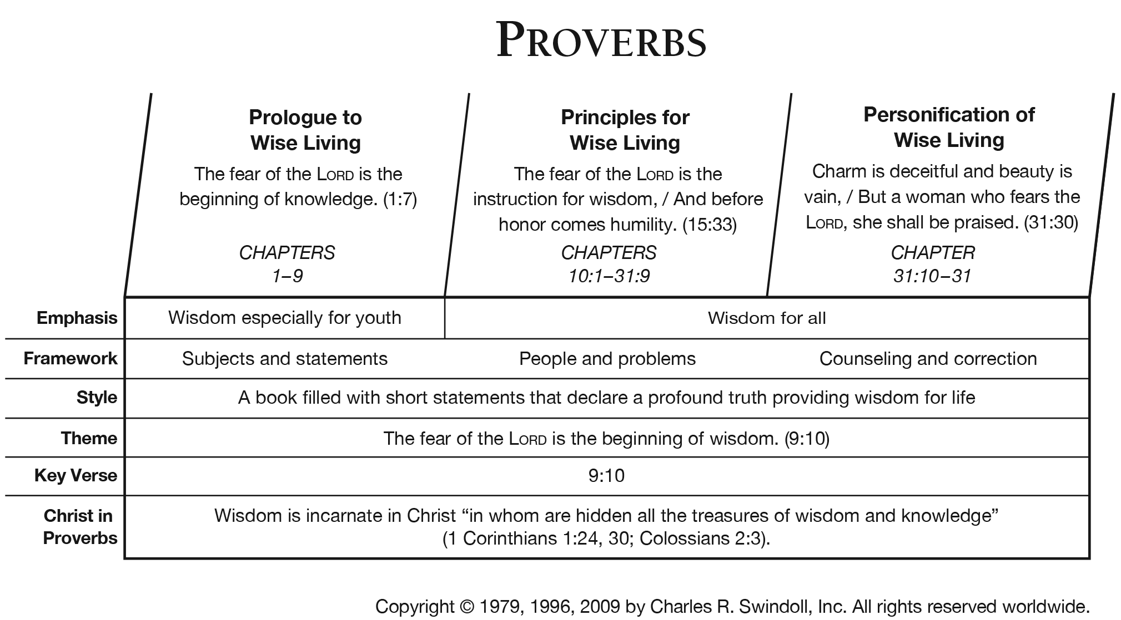

Slide 14
Another Outline
Discourses of Solomon (1:1-9:18)
Proverbs of Solomon (10:1-22:16)
Sayings of Wise (22:17-24:34)
Proverbs of Solomon copied by Hezekiah (25:1-29:27)
Appendices (30:1-31:31)
Agur (30:1-33)
Lemuel (31:1-9)
Ideal wife (31:10-31

Slide 15
Think

Slide 16
Some suggestions:
Usually, you will find a contrast. (especially in chapters 10-15). Such as in Proverbs 12.13 – An evil man is trapped by his sinful talk, but a righteous man escapes trouble.”
Often, they evaluate conduct. Proverbs 15.27 – “he who hates bribes shall live”
They can give consequences to behavior – Proverbs 10.1- A wise son brings joy to his father.

Slide 17
Some suggestions:
They use figurative language. “Like cold water to a weary soul, so is good news from a far country.” Proverbs 25.25
Direct comparisons – Proverbs 28.6 – Better a poor man whose walk is blameless than a rich man whose way is perverse.
They tend to be earthy. That is examples from daily life. Words that even children can understand such as honeycomb, ants, etc.

Slide 18
Activity:
Choose a “proverb” from chapters 10-20 of Proverbs
What does it mean?
What does it not mean?
How might it apply to your life?
What was the imagery or illustration used?

Slide 19
Themes within Proverbs:
Wisdom
Marriage and purity
Wealth and poverty
Power of the tongue – using our words
Principles for raising children
Person discipline
Friendship
Other areas

Slide 20
One last tip: Read a chapter every day in the 31- day months

Slide 21
Ecclesiastes

Slide 22
Ecclesiastes Notes:
Author: Solomon –written maybe at the end of his life
Hebrew name is the Qoheleth (the root word is kahal meaning gathering) and (speaker to it)
1.12, 7.27
Prose and poetry
An important book of Scripture and one which the Lord has used more than a few times in the conversion of the lost.

Slide 23
Chapter 1
What are the images that are used in this chapter?
What is the purpose?
Rivers into the sea
Swirling wind
Sun
Eyes and ears
Time – what was and what will be –sameness
Show Vanity

Slide 24
Ecc. 1:6
The wind goes toward the south, And turns around to the north; The wind whirls about continually, And comes again on its circuit.

Slide 25
Some specifics…

Slide 26
Leupold uses these key words:
Comfort
Disillusionment
Warning

Slide 27
Ecclesiastes
Vanity – (Hebrew - hebel) “meaningless”
Obvious things
Questionable things
Good things
Dever – Job learned by losing everything; Solomon learned by gaining everything.

Slide 29
Ecc. 11.1-2 What does this mean?
Cast (send) your bread upon the waters, for you will find it after many days. Give a portion to seven, or even to eight, for you know not what disaster may happen on earth. ESV
Cast your bread on the surface of the waters, for you will find it ^{[a]}after many days. ² Divide your portion to seven, or even to eight, for you do not know what misfortune may occur on the earth. (NASB)

Slide 30
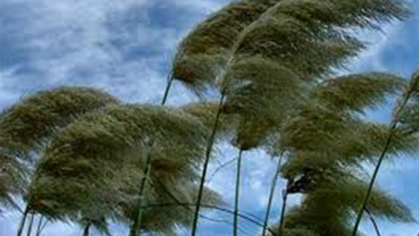
About life:
As you do not know what is the way of the ^{[a]}wind, Or how the bones grow in the womb of her who is with child, So you do not know the works of God who makes everything.
Ecc. 11.5

Slide 31
All the rivers run into the sea, Yet the sea is not full; To the place from which the rivers come, There they return again. Ecc. 1.7

Slide 32
Ecclesiastes 12:13-14
Let us hear the conclusion of the whole matter:
Fear God and keep His commandments,
For this is man’s all.
For God will bring every work into judgment,
Including every secret thing,
Whether good or evil.

Slide 33
Song of Solomon
Has been called Canticles
Part of the Writings
Interpretations:
Dramatic – like a play
Allegory – God’s love for the church
Typology – greater type – Christ
Human love poem

Slide 34
