Slide 1
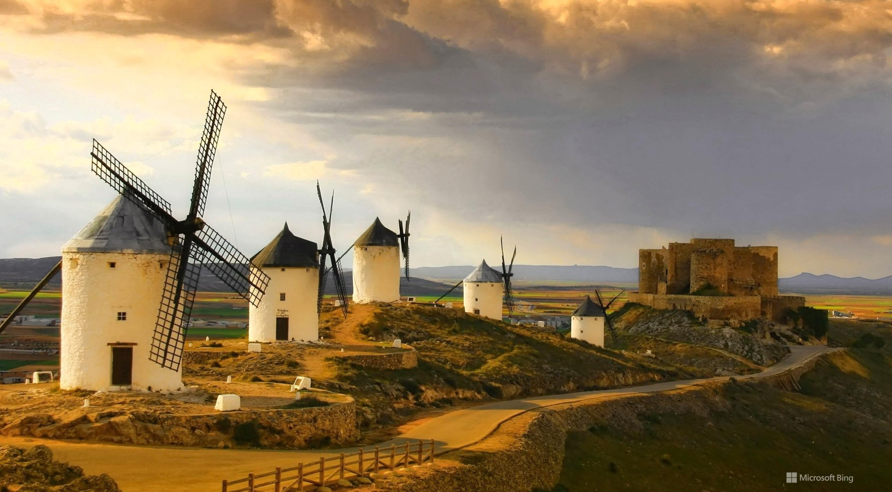

Slide 2
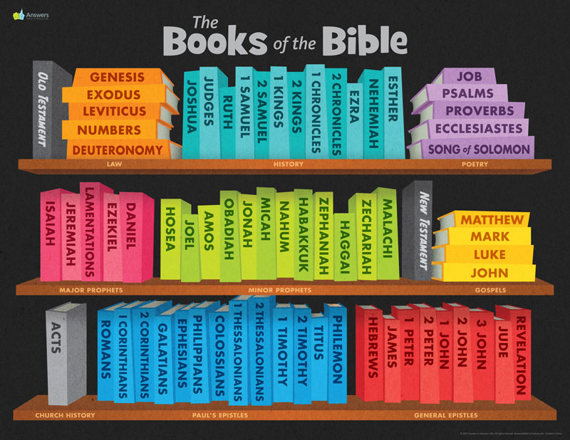

Slide 3

Our books to Cover this morning:
Isaiah
Jeremiah and Lamentations
Ezekiel

Slide 4

Overview

Slide 5
Word count
Jeremiah - 21835
Isaiah - 16932
Ezekiel – 18730

Slide 6
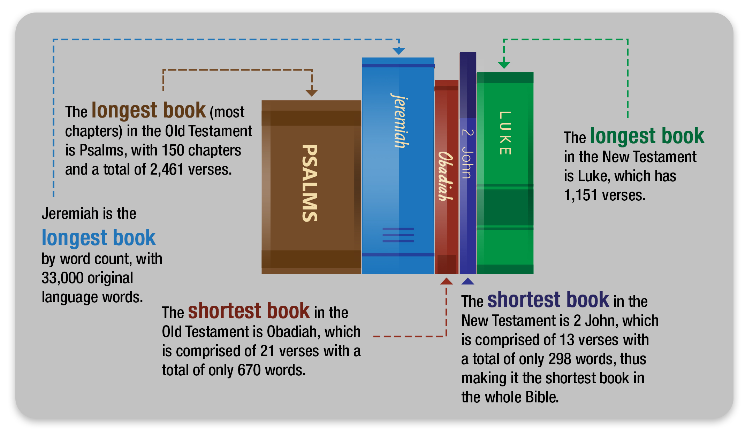

Slide 7
Major Prophets
How many chapters?
Isaiah -
Jeremiah -
Ezekiel -
These are the major prophets
66
52
48

Slide 8
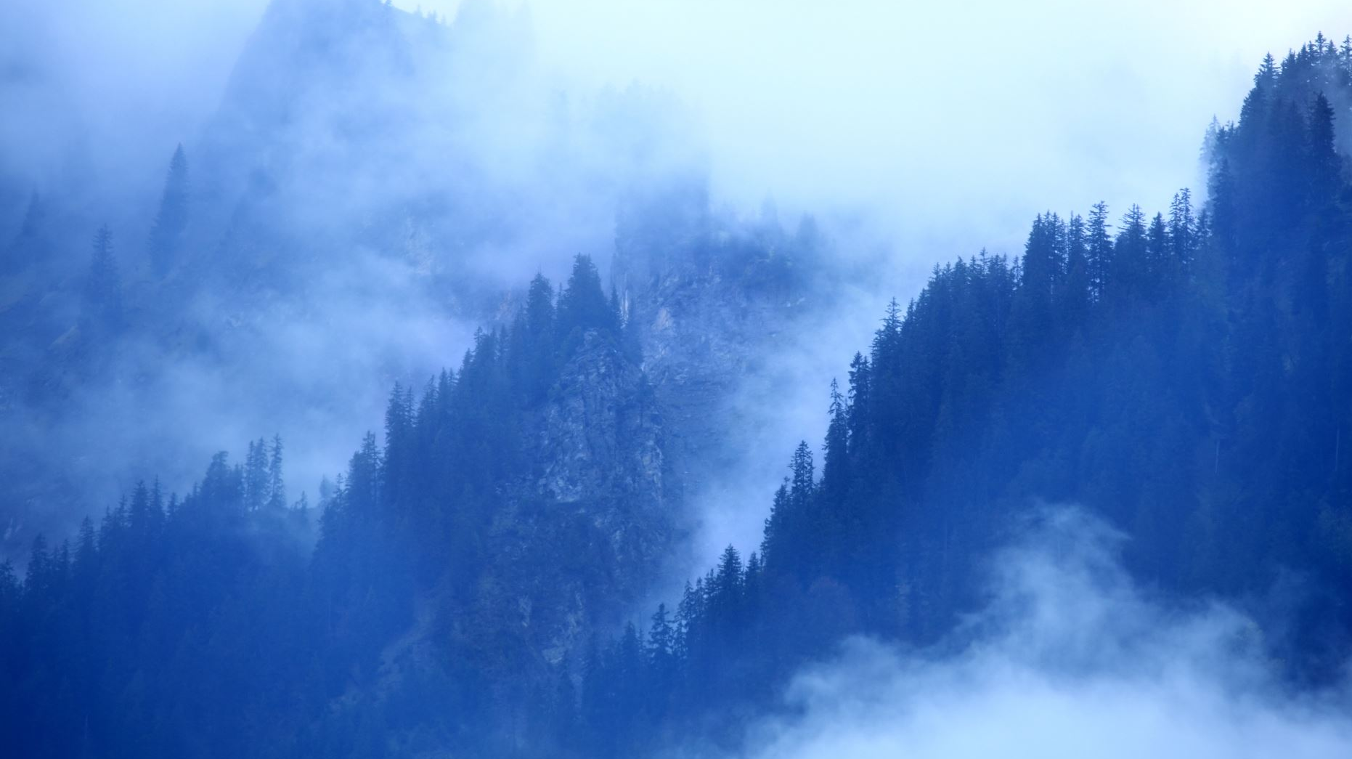
Basics About these books:
Poetry
Prophecy
Mystery
Calling of Each of the Authors
Fulfillment in Christ
Future fulfilment

Slide 9

Statements about the New Covenant.

Slide 10
Acts 28:23b – “From morning till evening he expounded to them, testifying to the kingdom of God and trying to convince them about Jesus both from the Law of Moses and from the Prophets.”
Expound – to set forth, to declare
Testifying – to give solemn evidence (warn); to affirm
Trying to convince (persuade) – to urge, to persuade because trustworthy
Source – Law of Moses and Prophets

Slide 11
Take Time to Meditate or take notes on I Peter 1:10-12
“Concerning this salvation the prophets…the Spirit of Christ in them was indicating when he predicted
the sufferings of Christ
And the subsequent glories…”

Slide 12
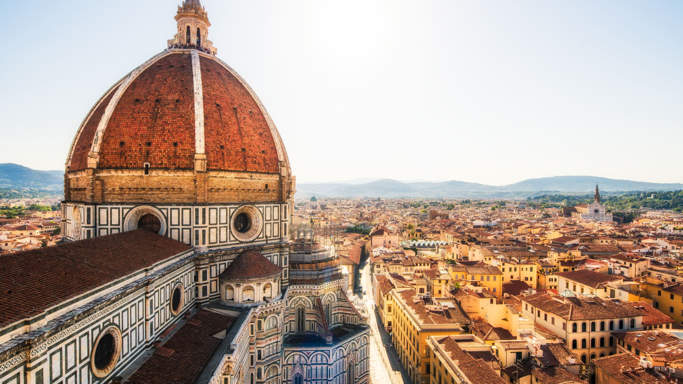
Isaiah
God’s Salvation

Slide 13
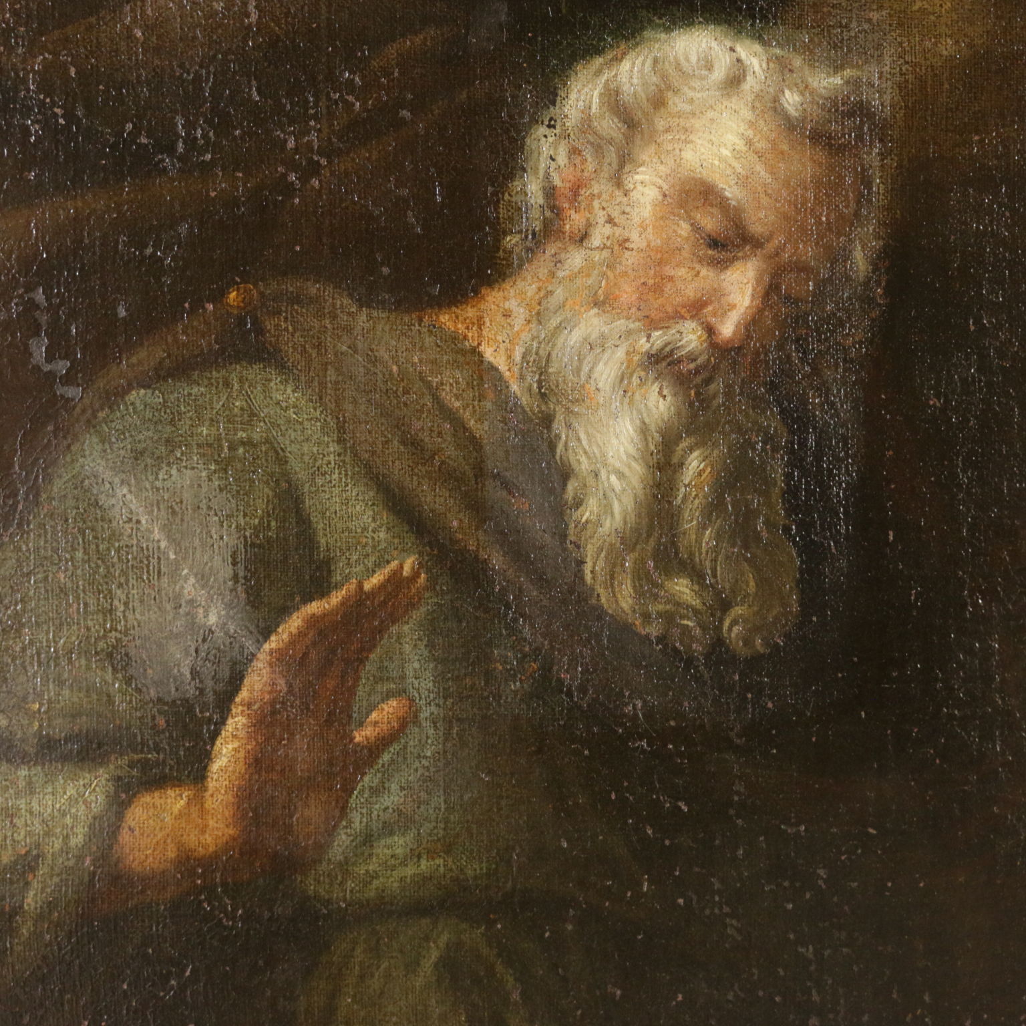
Isaiah

Slide 14
Some facts
Time: He prophesied during the reign of four kings of Judah—Uzziah, Jotham, Ahaz, and Hezekiah (1:1)
03
Author: Isaiah (Lit. The Lord is salvation)
01
Key Verse: Isaiah 9:6
02

Slide 15

Probably ministered for about 50 years
Especially during the reign of good King Hezekiah
See Isaiah 36-39

Slide 16
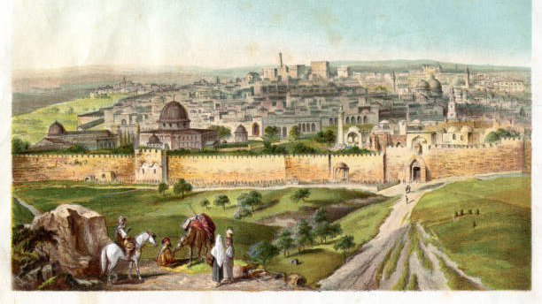

Slide 17
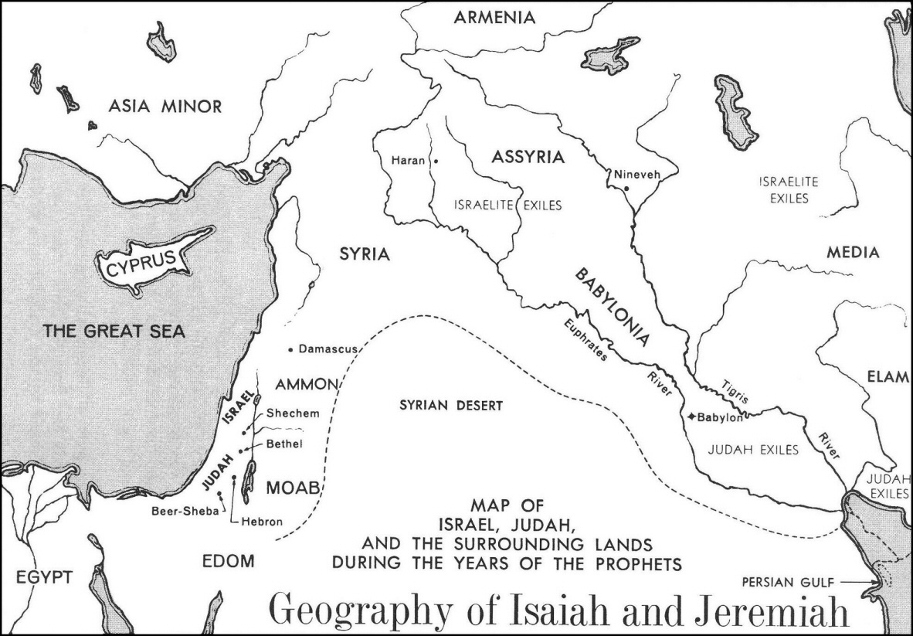

Slide 18

King Hezekiah

Slide 19
King Hezekiah
He calls the people of Judah to repentance.
He was a man who worshipped God and called the people to do the same.
He had the people keep the Passover.
He organized the priests in the worship of God in the temple.
Yet He experienced trouble; though he was faithful. (2 Chron. 32:1)

Slide 20
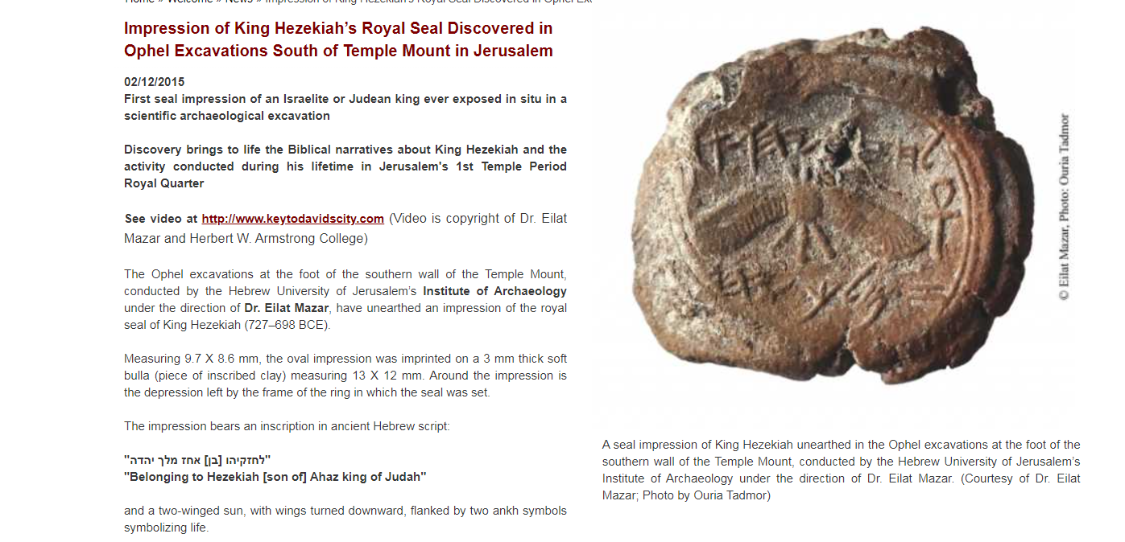
Information on Hezekiah
More information https://www1.cbn.com/cbnnews/israel/2018/august/king-hezekiah-prophet-isaiah-debut-in-oklahoma

Slide 21
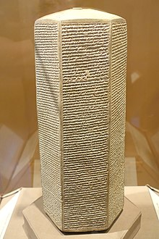
Trusting and hoping in God- and His Messiah
Isaiah 1-35 – Prophecy and poetry
  Warnings against nations
  Some strong mentioning of the Messiah
Isaiah 36-39 – History
Isaiah 40-66 – Prophecy and poetry
  Coming of Christ – His life, death, etc.
  Kingdom of God
  Second coming
Six-sided clay prism containing narratives of Sennacherib's military campaigns, Oriental Institute Museum of Chicago University

Slide 22
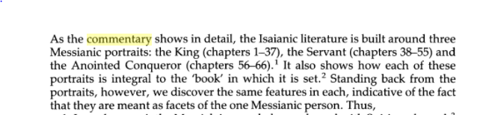
J Alex Motyer states:

Slide 23
Israel
They trusted other kings – Is. 31:3
01
They trusted other gods – Is. 2:8
02
They trust themselves – Isaiah 1:13-18, 29
03
They must trust in God alone; whom do you trust?
05
They trust unfaithful leaders – Is. 3:1-3
04

Slide 24
Trust – another outline
God’s judgment
God’s deliverance and salvation
God’s Messiah
  The King – Is. 9:6, 32:1
  Servant – Is. 42
  The coming One – Is. 61
  Special thanks to Mark Dever and His sermons on the Old Testament

Slide 25
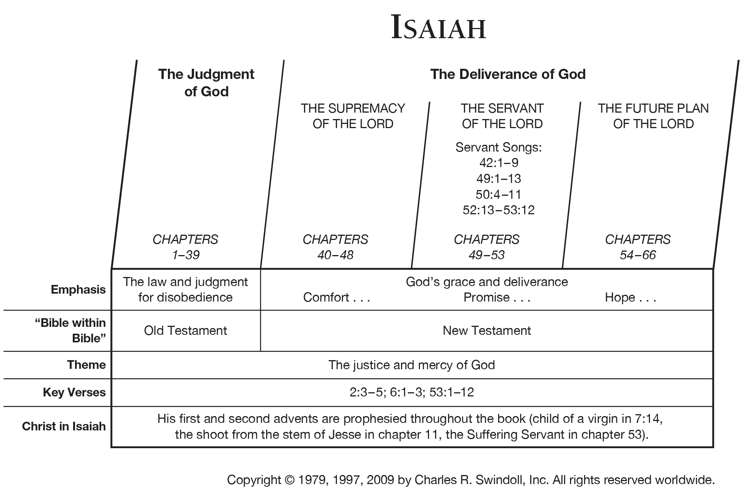

Slide 26
Quotations of Isaiah
How many times do you think it is quoted in the
New
Testament?

Slide 27
Isaiah 53
Some background Acts 8:26ff
Remember this is prophecy.
What does this chapter teach us about Jesus Christ?
He was born into a common family.
He was despised during his life and ministry.
He was a true; He “no beauty that we should desire Him.”
He was the perfect sacrifice and answered not a word back.
He will see the travail of His soul and be satisfied.
We see the ugliness of sin and the price it requires to be forgiven.

Slide 28
Do you have a Favorite Chapters or Verse in Isaiah?
Isaiah 7:12 and 9:6
Isaiah 12
Isaiah 26:3
Isaiah 30:18
Isaiah 32
Isaiah 40-43, 53, 60-66

Slide 29
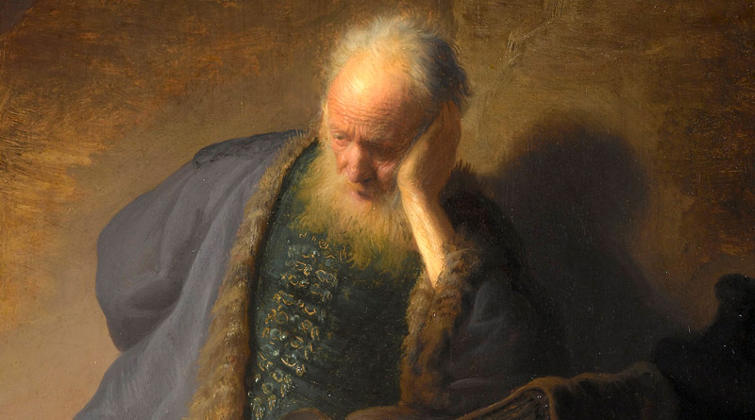
Jeremiah:
The Weeping Prophet

Slide 30

Read Jeremiah 1

Slide 31
Jeremiah’s call:
God had appointed him even before he was born.
Jeremiah pushes back at God’s call.
God promises His presence with Jeremiah- “You can’t back out.”
God promises to fill his mouth with his word.
God gives Jeremiah a “prophecy test.”

Slide 32
Jeremiah the Prophet
Brief Notes ON Jer. 1:1-19
  Vs. 1-3 – Context or History of Jeremiah’s Call
  Vs. 4-10 – Calling Of Jeremiah
  Vs. 11-18 – Vision Test
  Vs 19 – Assurance
Theme: God’s coming judgment

Slide 33
Jeremiah – Facts
Author: Jeremiah, the priest and prophet; son of Hilkiah, the priest
Served under several kings
  King Josiah
  King Jehoiakim
Assisted by Baruch
  Jer 45:1-3
From Anathoth
  See Jer. 21.8
  Explains Jer. 32:37
  Biblegateway

Slide 34
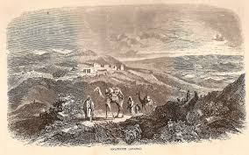
Anathoth – next two pictures;
  The area where Jeremiah was from and probably born.

Slide 35
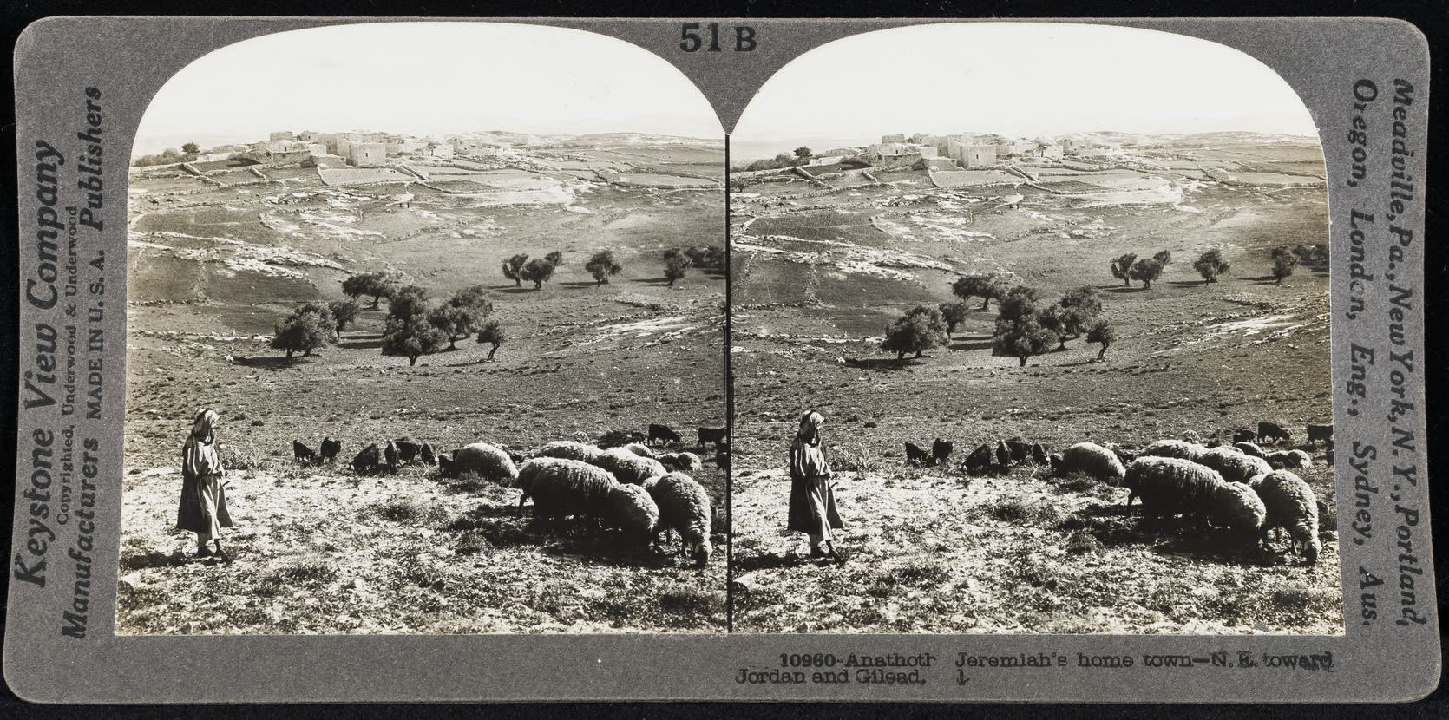
Jewish Museum

Slide 36
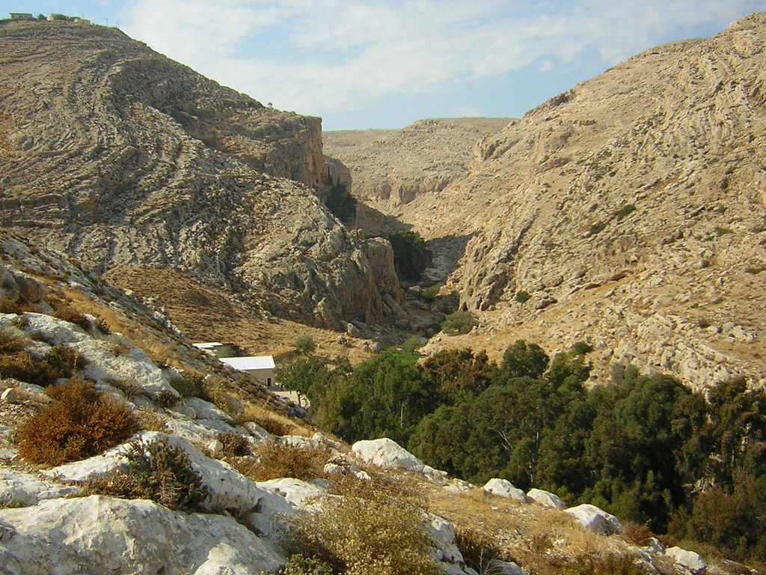

Slide 37
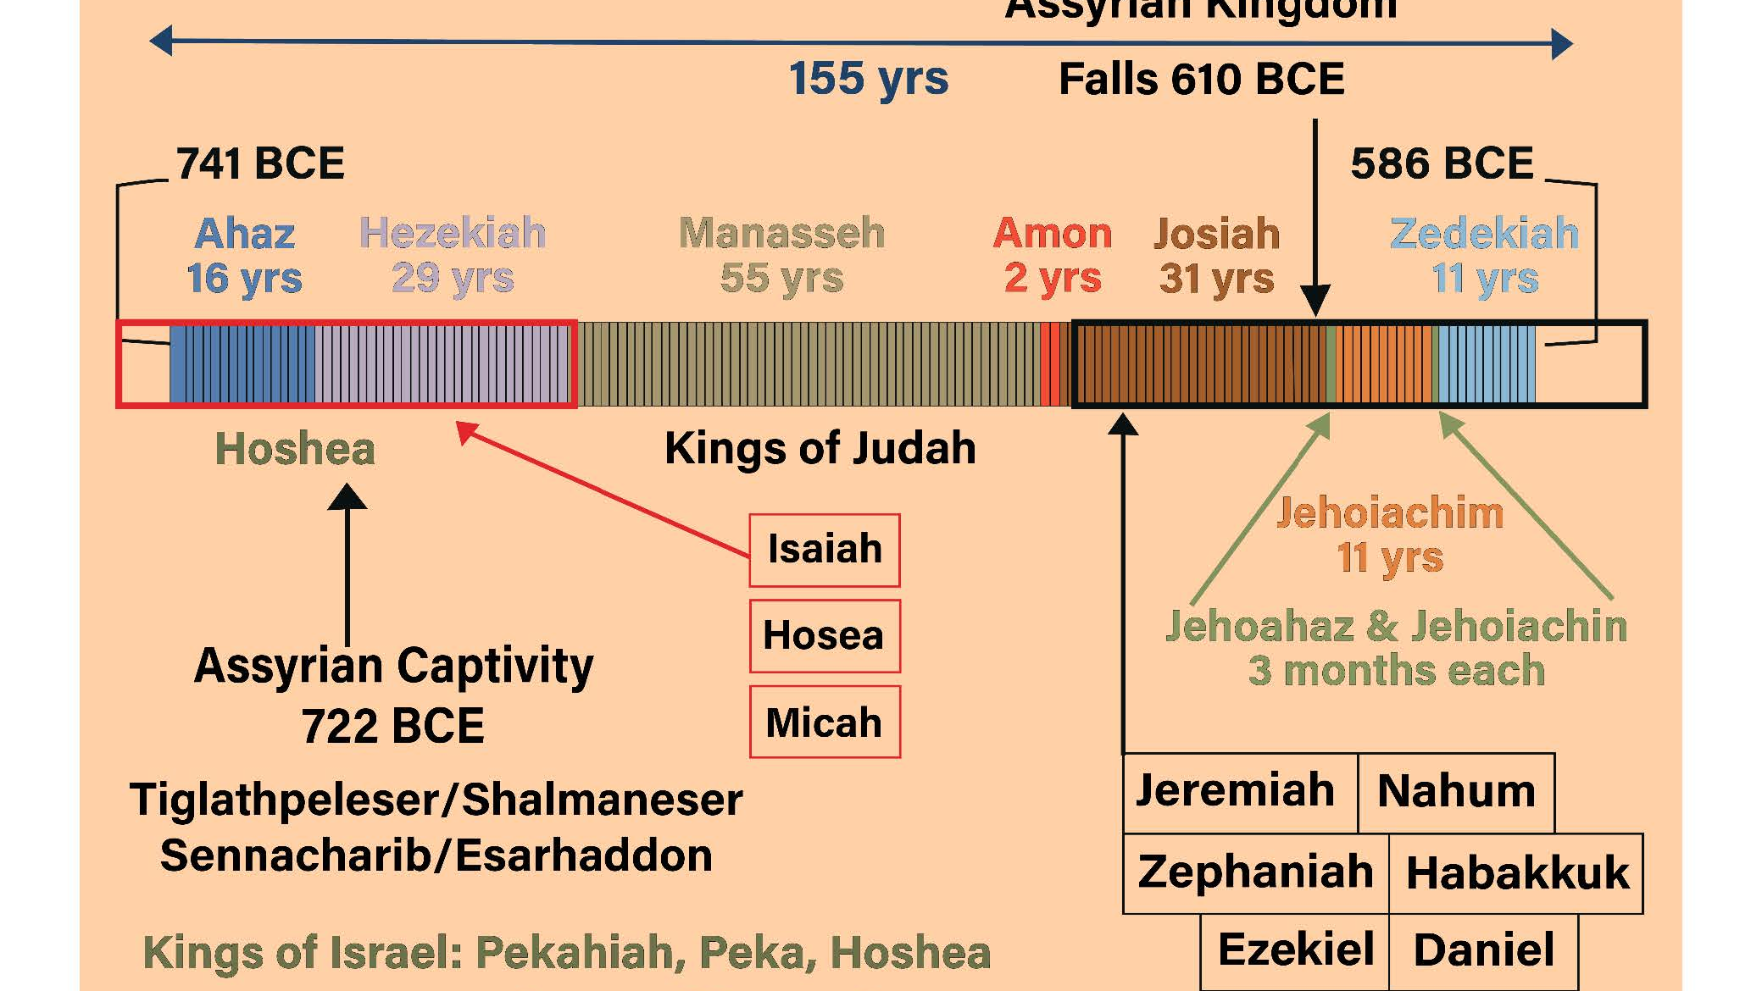

Slide 38
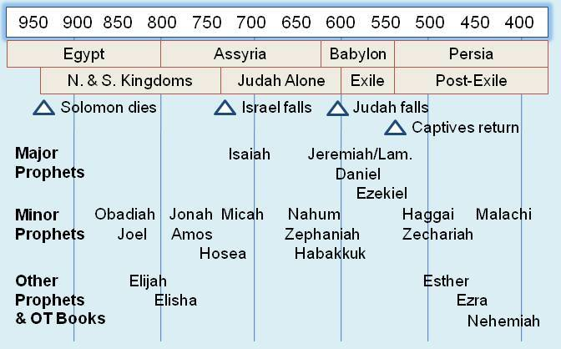

Slide 39
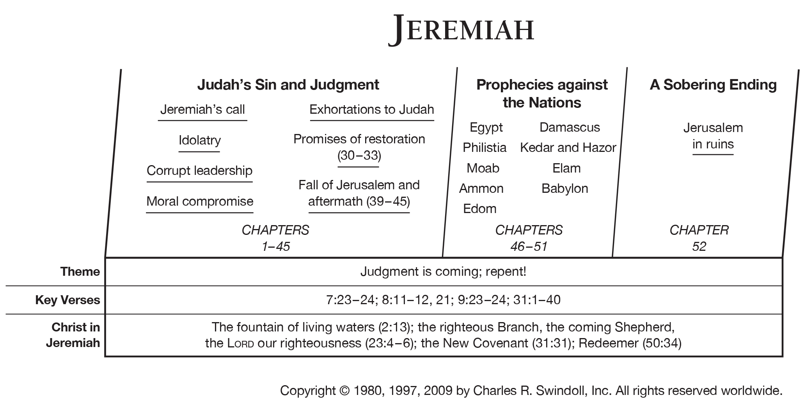

Slide 40
Key Themes:
God and humanity (Jer. 10:12)
Old covenant, Messiah, and the new covenant (Jer. 31)

Slide 41
Chapter Highlights
Jeremiah – His call
Jeremiah 25-27 – Captivity and Return
Jeremiah 32-33 – Call to me…
End of the book – history and away to exile
With Josiah

Slide 42
Why study Jeremiah?

Slide 43
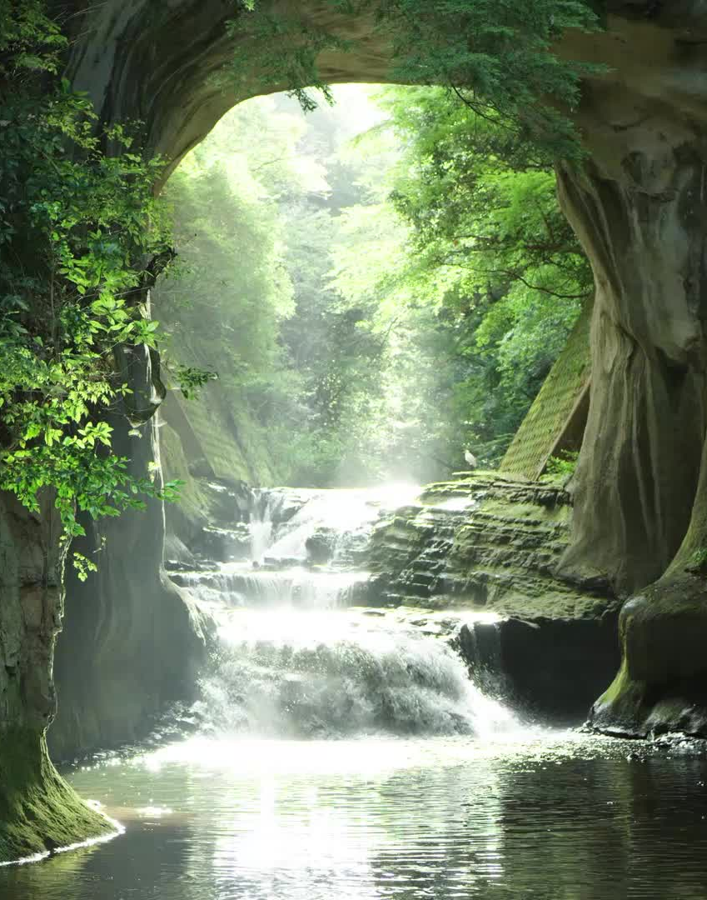
Streams of living water here…
Jeremiah 31

Slide 44
Lamentations

Slide 45
Lamentations:
Author: Not expressly mentioned in the book but external evidence from Jewish and Christian fathers attribute it to him. Internal evidence is like Jeremiah.
Time: Probably when Nebuchadnezzar took over Jerusalem in 586 BC.
Amazing poem in its literacy structure
Title comes from two Hebrew words
  Ekah – Ah, how
  Ginoth – Elegies or lamentation

Slide 46
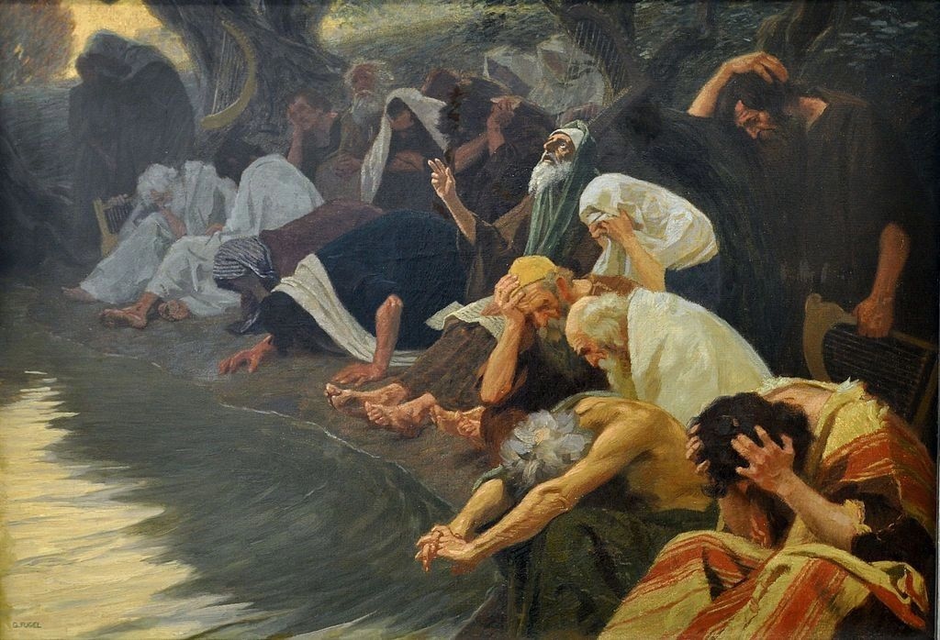
What is a lamentation?
Definition: the passionate expression of grief or sorrow; weeping.
Synonyms:
weeping
  wailing
  crying
  sobbing
  moaning

Slide 47
Why might one lament?
One’s sins
Sins of a people

Slide 48
Lamentations 3:22-23 - … his compassions fail not…great is your faithfulness…

Slide 49
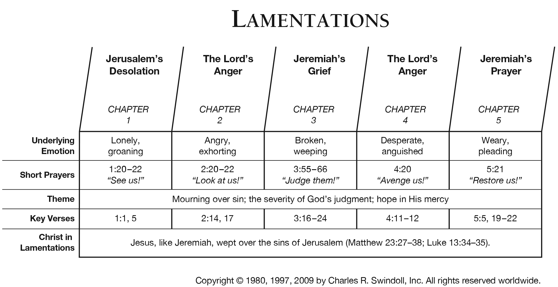

Slide 50
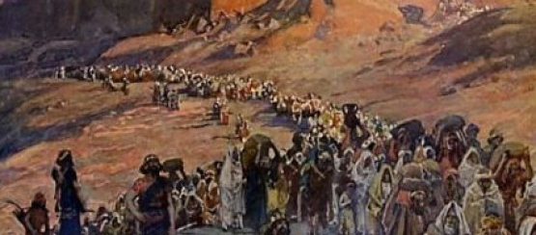
The people of Judah will go into exile of whom are Ezekiel and Daniel.
These books set the stage for especially Daniel.

Slide 51
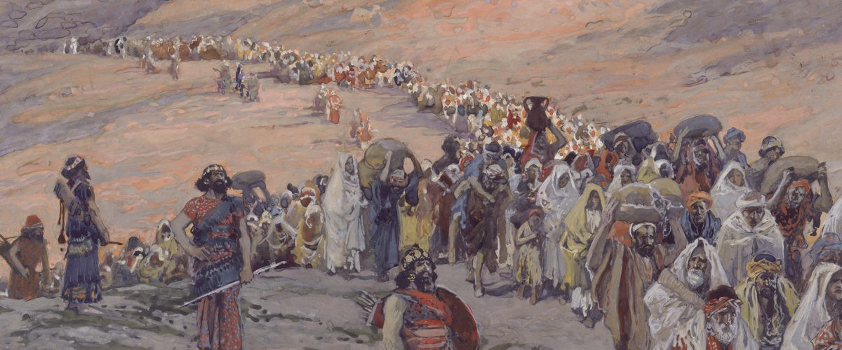

Slide 52

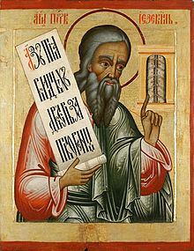
Ezekiel
“God will strengthen”

Slide 53
Ezekiel
Ezekiel was a priest.
Probably written about 593-571 BC
Key Word – Glory
Recipients – Jewish exiles in Babylon
The invading Babylonians brought around ten thousand Jews to the village in 597 BC, including Ezekiel and the last king of Judah, Jehoiachin (2 Kings 24:8–14).

Slide 54
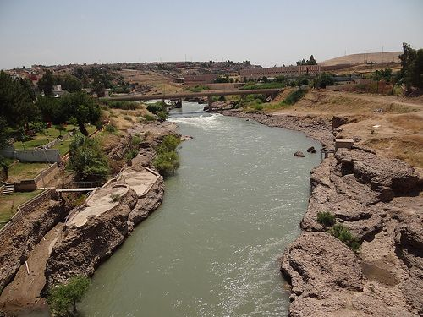
Ezekiel lived among the Jewish exiles in Babylon at a settlement along the river Chebar called Tel Abib (Ezekiel 3:15), less than one hundred miles south of Babylon.

Slide 55
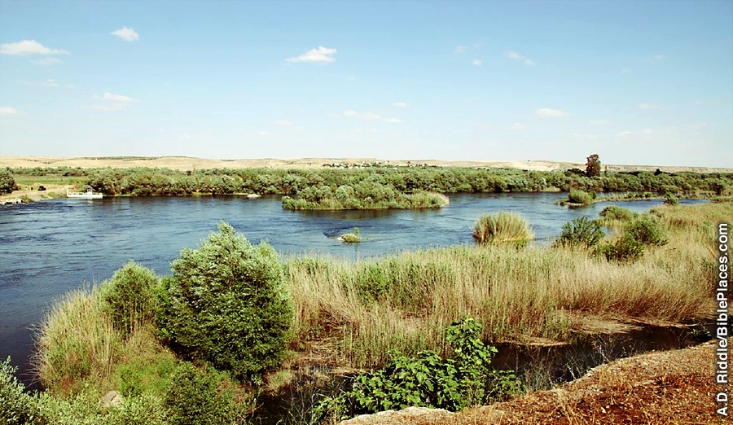

Slide 56
God Call’s Ezekiel to Ministry
Ezekiel 1-3

Slide 57
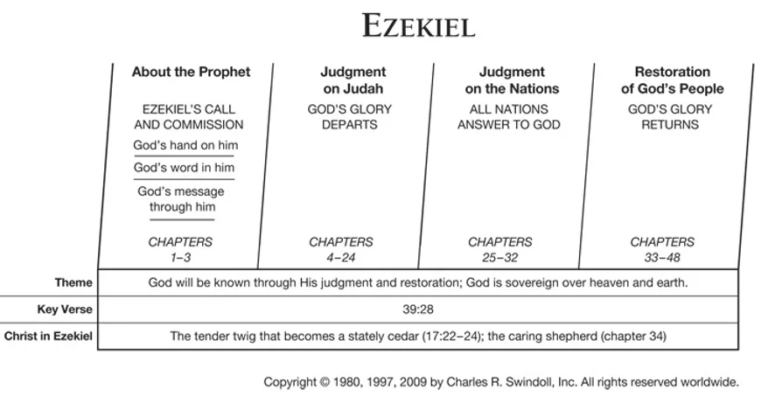

Slide 58

Further Notes:

Slide 59
Outline (from Duiguid’s commentary)
Ezekiel’s Call and Commissioning (1.1-3.27)
Oracles of Doom (4.1-24:27)
Oracles Against the Nations (25.1-32.32)
Oracles of Good News (33.1-48.35)

Slide 60
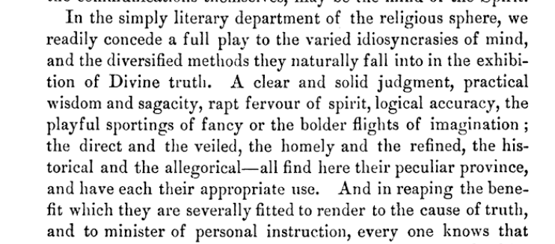
Patrick Fairbairn on Ezekiel

Slide 61

Babylon
World Monument Fund… interesting video.

Slide 62
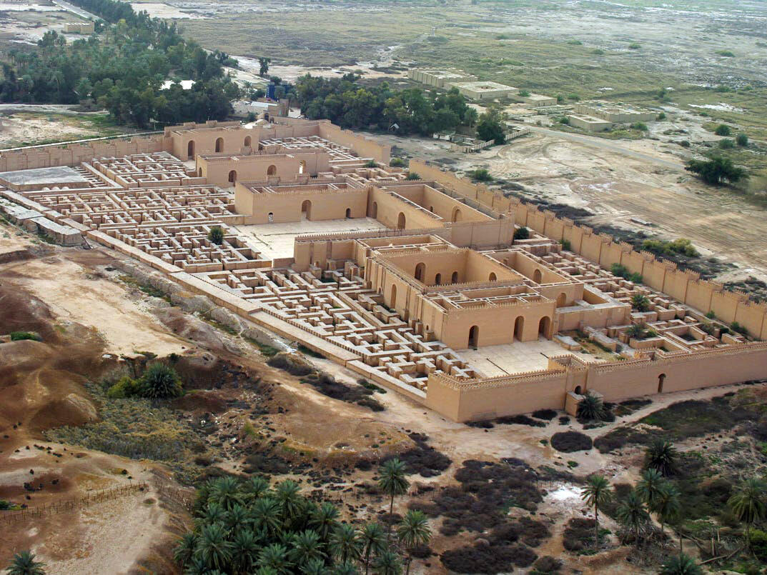

Slide 63
Chapter
34 – God Will Bring a Shepherd
36 – A new Covenant
37 – The Power of God to save
40ff – The New Temple

Slide 64
Revelation 10:17
but that in the days of the trumpet call to be sounded by the seventh angel, the mystery of God would be fulfilled, just as he announced to his servants the prophets.

Slide 65
References:
Mark Dever – Sermons on the Old Testament
Ed Hindson & Elmer Towns – Bible Survey
Chuck Swindoll – Insight for Living

