Slide 1
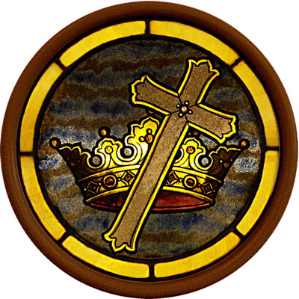
The REVELATION of jesus Christ

Slide 2
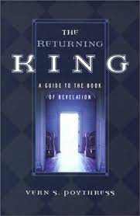
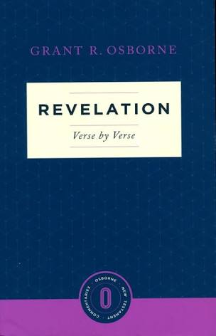
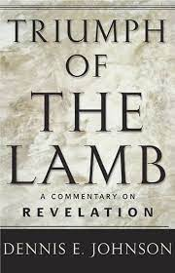
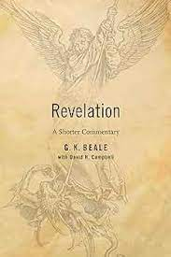

Slide 3
Taken from “Mystery Explained: A Simple Guide to Revelation” by David Campbell

Slide 5
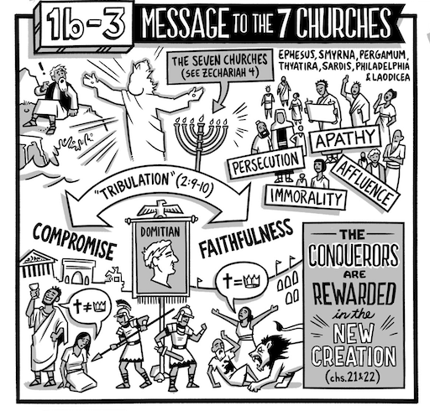

Slide 6
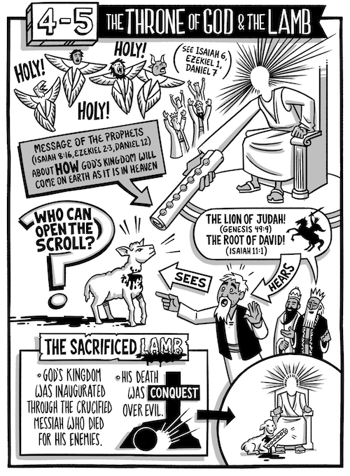

Slide 7
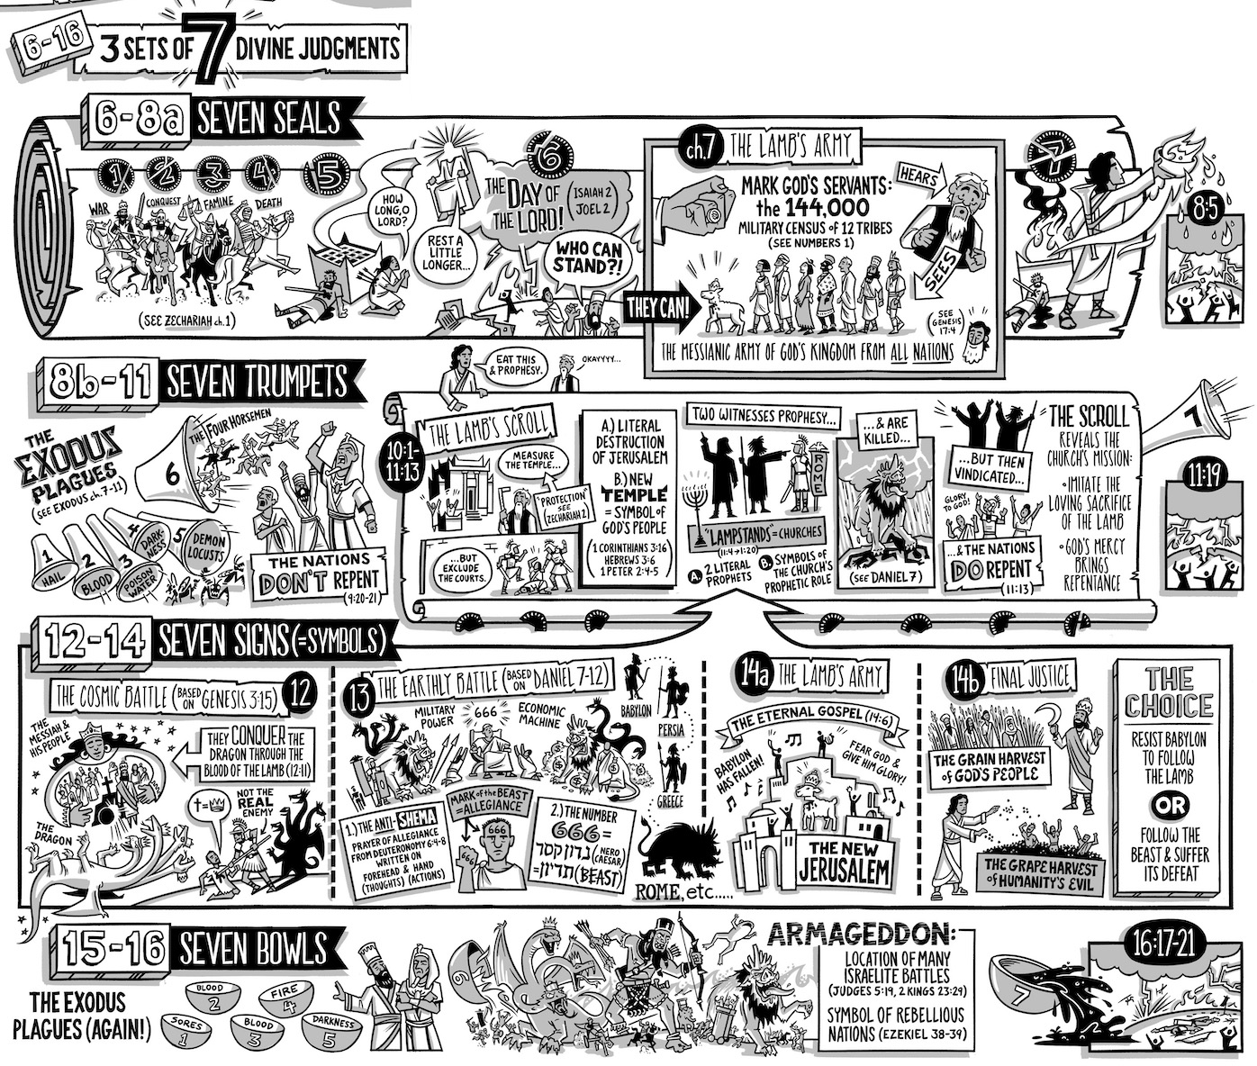

Slide 9
“The angel took the incense burner, filled it with fire from the altar, and hurled it to the earth; there were peals of thunder, rumblings, flashes of lightning, and an earthquake.” (Rev. 8:5)

Slide 11
“The seventh angel blew his trumpet, and there were loud voices in heaven saying, The kingdom of the world has become the kingdom of our Lord and of his Christ, and he will reign forever and ever.” (Rev. 11:5)
“Then the temple of God in heaven was opened, and the ark of his covenant appeared in his temple. There were flashes of lightning, rumblings and peals of thunder, an earthquake, and severe hail.” (Rev. 11:19)

Slide 13
“Then the seventh poured out his bowl into the air, and a loud voice came out of the temple, from the throne, saying, ‘It is done!’ There were flashes of lightning, rumblings, and peals of thunder. And a severe earthquake occurred like no other since people have been on the earth, so great was the quake. “
“The great city split into three parts, and the cities of the nations fell. Babylon the Great was remembered in God’s presence; he gave her the cup filled with the wine of his fierce anger. Every island fled, and the mountains disappeared. Enormous hailstones, each weighing about a hundred pounds, fell from the sky on people, and they blasphemed God for the plague of hail because that plague was extremely severe.” (Rev. 16:17-21)

Slide 14
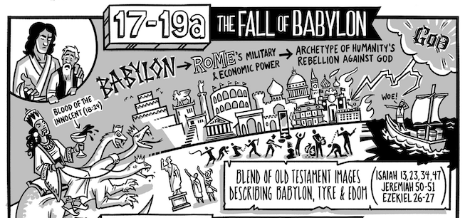

Slide 15
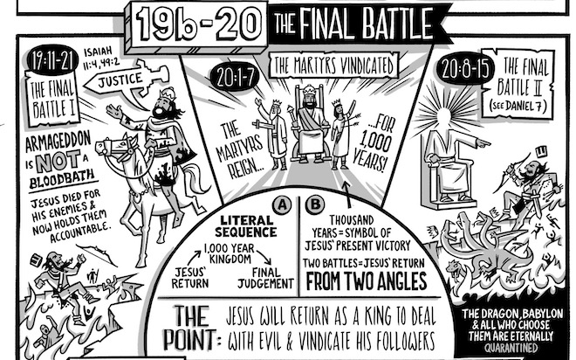

Slide 16
