Slide 1
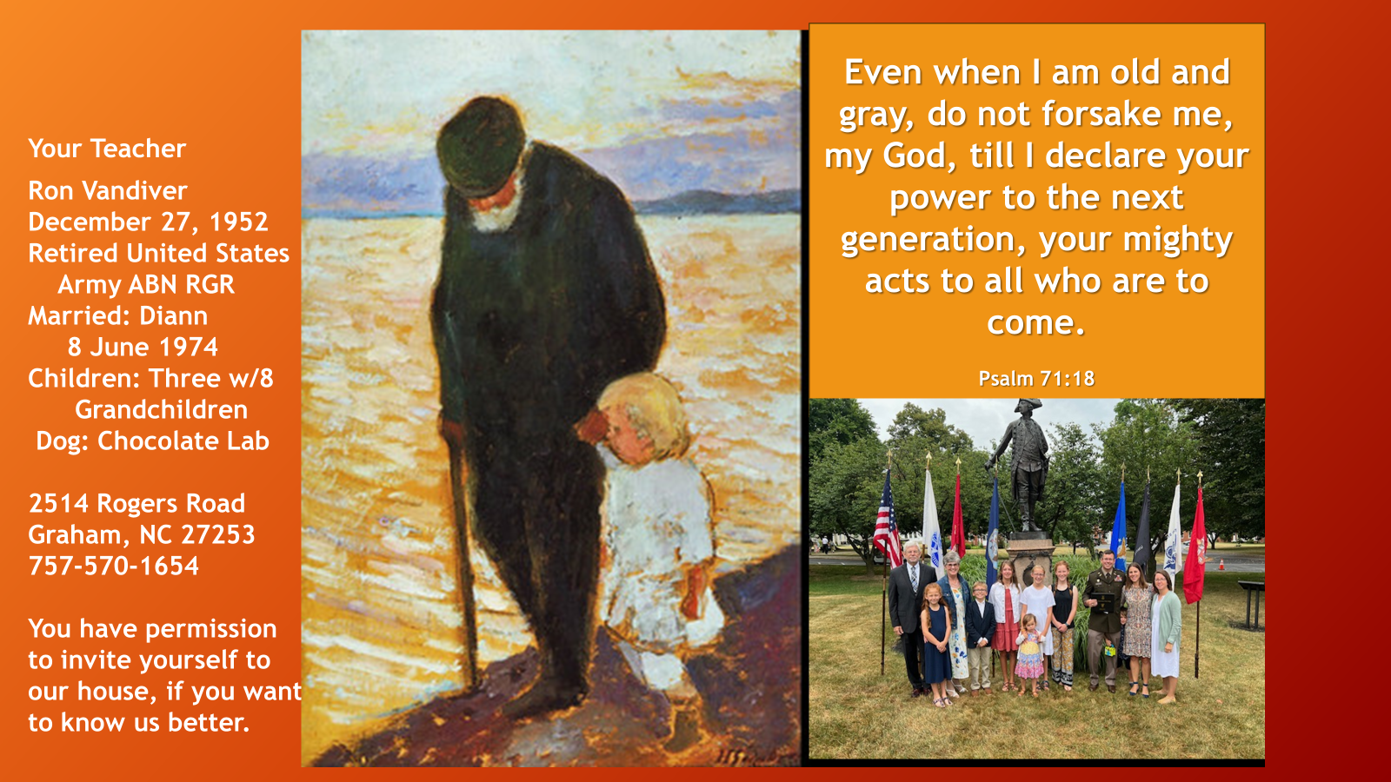

Slide 2
A Series of Bottomlines To Remember: If we are to live the Christian life faithfully and understand what God requires of us, we must do more than casually read the Bible and depend upon others to share the fruit of their study. We must interact with God’s Word personally, by allowing the Holy Spirit to saturate His message into, and etch His truth upon, our hearts and minds. There are many ways to study the Bible, but the most important principle to remember is that we need to read the Bible for ourselves in a way that will help us to answer what it says, what it means, and how to apply it to our lives. Our Father wants us to understand the immeasurable benefits of the Word in our life. It is the Word that wakens our faith and produces in us a sweeter, higher, longer joy than anything this world can offer. And this joy we share for the Word is a community treasure. As the Word is alive in us, it is alive within the fellowship of our church. And the outcome of the overflow of that reality at work in benefits all.

Slide 3

“In order to understand the Bible, you must read it.” This is an axiom that we both firmly believe. A secondary principle to which we both hold is, “If you didn’t understand it the first time, read it again.” More than anything else, the understanding of the Bible requires reading it, and then reading it some more. For many generations, committed believers held to the principle of the clarity of Scripture. Among other things, this simply means that if followers of Jesus the Messiah read the Bible, they can understand it. Nevertheless, there are some qualifications for this general principle:
Understanding the Bible requires effort—we need to work at studying the Scriptures.
Understanding the Bible will take time—we won’t get it all immediately.
Understanding the Bible requires that the Holy Spirit open our hearts and minds to the Scriptures.
Understanding the Bible will happen only if we are willing to obey it.
Understanding the Bible will never be complete—we can always learn more.
*(Michael A Rydelnik, Michael G Vanlaningham, editors, The Moody Bible Commentary)

Slide 4
Instead of studying resources about the Bible, inductive study focuses first upon the Bible. You need to be willing to lay aside your preconceived notions, pet interpretations, ready references, study notes, sermon tapes, etc, coming to the Scriptures as for the first time. Your primary resource is God's Word, then other secondary resources.
The tendency for many Bible students at the beginning of a study is to rally secondary resources that will do the "observing" and "interpreting" for the reader. It's quick but is it correct? How can you know if you don't make your own independent observations and arrive at your own interpretation based on those observations? And why even go to the Scriptures if you almost immediately forget what you've just read?
Research show that we learn more and retain more, the more actively we are involved in the learning process.
Reinforces my caution
pertaining to the abuse
of the preceptaustin web
site.

Slide 5

"I hear and I forget"
"I see and I remember"
"I do and I understand"
PERCENTAGE REMEMBERED COMPARED to METHOD of LEARNING
1 | 10% | Of what we read
2 | 20% | Of what we hear
3 | 30% | By watching a demonstration
4 | 50% | Combining #2 and #3
5 | 70% | Combine #4 with writing out what you learn
6 | 90% | All of the above plus application or practice

Slide 6
OBSERVATION, interpretation, and application lead to transformation. This is the goal of our study of the Word of God. Through it we are changed from glory to glory into the image of the Lord Jesus Christ.

Slide 7
INDUCTIVE BIBLE STUDY: IS IT BIBLICAL
In the book of Acts we encounter a group of saints often referred to as the "Bereans" who seem to approach the Scriptures with an inductive mindset. The Bereans were open to the Truth, but as any good inductive student would do, they searched the scrolls for themselves which may explain why Dr. Luke referred to them as noble-minded.
This Greek word (eugenes, Strong's # 2104 from eu = good, well + génos = race, family) can mean "of noble birth", but in context conveys the idea that these men and women were open-minded, unbiased and characterized by a willingness to learn and evaluate something fairly.
This is the attitude we should have as we begin to explore a passage inductively. The moment we come to a passage and say "I know what this one means", we are in "trouble".
Luke records that as a result of jealousy, the Jews stirred the city of Thessalonica into an uproar which prompted...
the brethren (to) immediately (send) Paul and Silas away by night to Berea and when they arrived, they went into the synagogue of the Jews. Now these (Jews at Berea) were more noble-minded than those (Jews) in Thessalonica, for they received the word with great eagerness, examining ("searched" KJV) the Scriptures daily to see whether these things were so. Therefore (term of conclusion) many of them believed. (Acts 17:10-12)

Slide 8

INDUCTIVE BIBLE STUDY: IS IT BIBLICAL?
For the Bereans, God's Spirit along with God's Word was their final "judge" which enabled them to assess the authenticity and accuracy of Paul's "commentary" on the Scriptures! As good Inductive Bible Students the primary goal of the Bereans was to know what "saith the LORD", a goal they achieved by practicing the art and skill of careful observation which led to accurate interpretation.
Although the Berean approach is not specifically called "inductive Bible study", I think you will come to agree that their approach to the Scriptures closely parallels the inductive method as you understand it better.

Slide 9
INDUCTIVE BIBLE STUDY DEPENDS UPON THE HOLY SPIRIT
The key to inductive Bible Study is the understanding and acceptance that the Bible is our primary Source and the Holy Spirit our Primary Teacher
This is an amazing truth – God Himself wants to be our Teacher, John teaches that His Spirit abides in us in order that we might be enable to distinguish truth from error:
“And as for you, the anointing which you received from Him (in context referring to the Holy Spirit) abides in you, and you have no need to have anyone teach you; but as His anointing teaches you about all things, and is true and is not a lie, and just as it has taught you, you abide in Him.”
I John 2:27

Slide 10
INDUCTIVE BIBLE STUDY CALLS FOR
CONTINUAL DEPENDENCE ON THE HOLY SPIRIT
Alexander Maclaren said “He who has the Holy Spirit in his heart and the Scriptures in his hands has all he needs.” The Bible, God's Holy Word, is our primary Source and His Holy Spirit is our primary Teacher.
As John Piper says "no one can see these wonderful things for what they really are without God's supernatural help...If God does not open our eyes, we will not see the wonder of the Word. We are not naturally able to see spiritual beauty. When we read the Bible without the help of God, the glory of God in the teachings and events of the Bible is like the sun shining in the face of a blind man. Not that you can't construe its surface meaning, but you can't see the wonder, the beauty, the glory of it such that it wins your heart."

Slide 11
INDUCTIVE BIBLE STUDY CALLS FOR
CONTINUAL DEPENDENCE ON THE HOLY SPIRIT
Paul instructed Timothy "Consider (fix your mind upon, ask 5W/H questions, reflect on) what I say, for the Lord (Your Teacher the Spirit) will give you understanding in everything." (2Ti 2:7) Our responsibility is to "Consider." The Spirit's gracious provision is to grant us "understanding."
As Puritan Stephen Charnock wrote “The Word is the chariot of the Spirit, the Spirit the Guider of the Word.” When we devote ourselves to the study of His Word, with a keen awareness of our need to continually depend upon our Teacher, the Holy Spirit, we will experience the joy of Spirit led discovery of God's Truth ("self-discovery" enabled by the Spirit) and the Truth He unveils to our heart will set us free so that we might be free indeed! (Jn 8:31, 36)
The Holy Spirit has inspired the Word and He alone can illuminate the Word in the "eyes of our heart" as we read it.

Slide 12
THE BENEFITS OF
INDUCTIVE BIBLE STUDY
(1) You will learn how to carefully observe the Scriptures and in so doing you will be enabled to "rightly divide the Word of Truth" (2Ti 2:15) and you be equipped to accurately interpret God's Word on your own.
(2) You will no longer be dependent on commentaries, devotionals, pastor's sermons, conferences, etc. Please do not misunderstand. Believers should sit under a godly teacher of the Word, but this should be a stimulus, not a substitute for getting into the book for ourselves!
(3) When you encounter differences between interpretations in commentaries, which you frequently will, IBS enables you to discern which comment represents the most accurate interpretation.
(4) You will increase in the knowledge of God and His ways, growing "in the grace and knowledge of our Lord and Savior Jesus Christ." (2Pe 3:18)

Slide 13
THE BENEFITS OF
INDUCTIVE BIBLE STUDY
(5) Your personal faith will be greatly strengthened for "faith comes from hearing and hearing by the word of Christ." (Ro 10:17)
D. L. Moody - "The study of God’s Word brings peace to the heart...light for every darkness,
life in death, the promise of our Lord’s return, and the assurance of everlasting glory.“
Henry Ward Beecher - "The Bible is God’s chart for you to steer by, to keep you from the
bottom of the sea, and to show you where the harbor is, and how to reach it without running
on rocks and bars.“
(6) You will become increasingly aware of what it means to be "in Christ" and to "be holy for I am holy" (Lev 11:44; 1Pe 1:16) for Jesus prayed "Sanctify them (His disciples) in the Truth. Thy Word is Truth." (Jn 17:17) The NLT paraphrases it "Make them pure and holy by teaching them Your words of truth."
Howard Hendricks quips that "Dusty Bibles lead to dirty lives. In fact, you are either in the
Word and the Word is conforming you to the image of Jesus Christ, or you are in the world
and the world is squeezing you into its mold."

Slide 14
THE BENEFITS OF
INDUCTIVE BIBLE STUDY
(7) You will develop an increasing assurance that you are believing not what someone else teaches but what the God's Word truly teaches. And since we behave on the basis of what we believe, we can be certain that we are "walking (living) in a manner worthy of the Lord, to please Him in all respects, bearing fruit in every good work and increasing in the knowledge of God” (Col.1:10).
(8) You will learn a method of independent Bible study that can be passed on to others who in turn can go out and teach others. (2Ti 2:2).

Slide 15



Might we have a couple of individuals willing to share some aspect of their journey with the Inductive Bible Study Methodology?
AS TIME PERMITS

Slide 16
Two Prerequisites For Inductive Bible Study
Willingness to slow down
Desire to carefully observe what the passage is saying

Slide 17
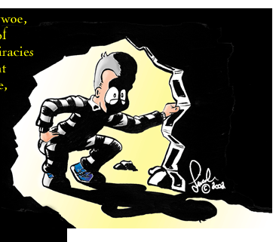
INDUCTIVE BIBLE
STUDY
study
Inductive
bible

Slide 18
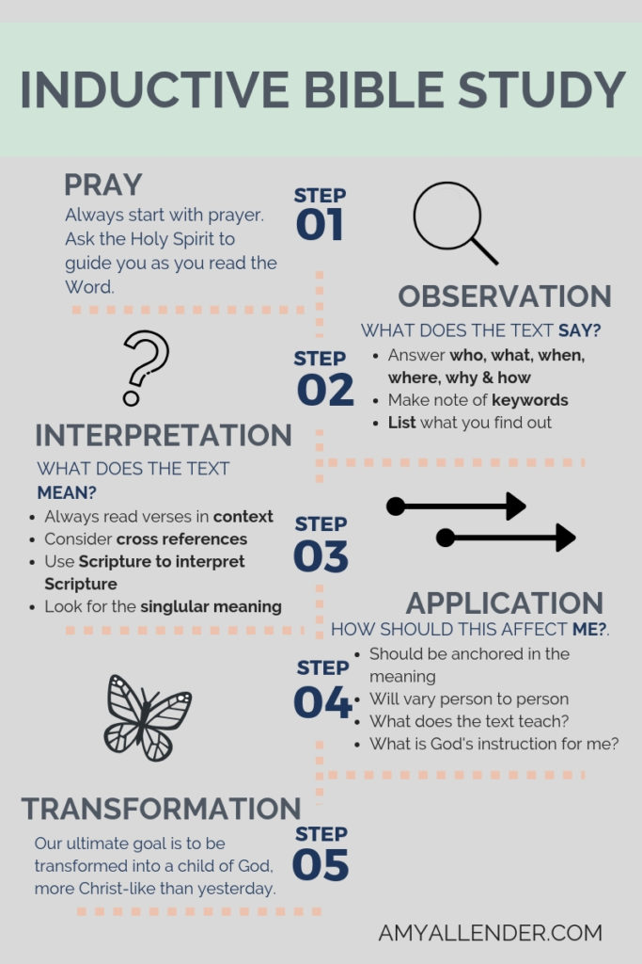

Observation: See exactly what the Bible says
Begin with prayer
Ask ‘who, what, when, where, why and how?’ questions as you read
Mark keywords and phrases
List what you have marked
Look out for and mark expressions of time and locations, terms of conclusion, contrasts and comparisons
While observation leads to an accurate understanding of what God’s Word says, interpretation goes a step further and helps you understand what it means.
Interpretation: Understand what the Bible means
Remember that context rules all interpretation
Scripture is the best interpreter of Scripture
When you understand what God is saying, it’s time to believe the truth and live by it!
Application: Apply the meaning of the text to my life
Know God deeply. Live differently. Be transformed.

Slide 19
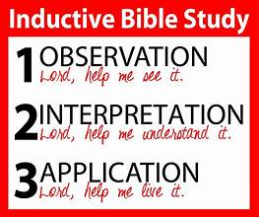
How Observation, Interpretation, and Application Relate to Each Other
Accurate interpretation and correct application rest on the accuracy of your observations. Therefore, it is vital that you develop observation skills, even if at first they seem time-consuming or you feel less than adequate and even awkward doing them. Studying inductively is a learning process that does not happen overnight. It happens by doing over and over again until the doing becomes almost a habit, and a wonderful one at that.
As you go through the inductive process, you'll sometimes find observation, interpretation, and application happening simultaneously. God can give you insight at any point in your study, so be sensitive to His leading. When words or passages make an impression on you, stop for a moment and meditate on what God has shown you. Bring the plumb line of truth against what you believe and how you are living.

Slide 20
OBSERVATION
Discover What It Says
“If you will maintain a prayerful, teachable spirit as you do you observations, you will find that the Holy Spirit will use all of this to speak to you and to reveal to you precious treasures of truth.”

Slide 21
OBSERVATION ANSWERS THE QUESTION: WHAT DOES THE PASSAGE SAY?
Robert Traina rightly concludes that the goal of observation "is to enable one to become saturated with (filled completely with so that it permeates or pervades one's entire being) the particulars of a passage so that one is thoroughly conscious of the (object being observed).
Because observation is discovering what the passage is saying, it requires time and practice. You’ll discover the more you read the more you will discover, and truths will become more discoverable and understandable.
It is the foundation which must be laid if you want to accurately interpret and properly apply God’s Word.
You’ll be awed at the depth of spiritual insights you will have discovered guided by the Holy Spirit.
You will know that you know!

Slide 22
01 Begin with Prayer Prayer is often the missing element in Bible study, and we can’t overemphasize its importance. No matter how good your method or your tools, life-change and true understanding only come from God.
02 Ask the “5 W’s and an H” As you study any passage of Scripture, train yourself to constantly ask: Who? What? When? Where? Why? How? These questions are the building blocks of precise observation, which is essential for accurate interpretation.
03 Mark key words and phrases. A key word is one that is essential to the text. Key words and phrases are repeated in order to convey the author’s point or purpose for writing. Key words can be marked using symbols, colors, or a combination of the two.
04 Make lists. Making lists can be one of the most enlightening things you do as you study. Lists reveal truths and highlight important concepts. 1 Peter 5:2,3, for example, contains a simple list regarding the role of the elder, shown by numbering the items in the text. It is also helpful to make a list of what you learn about each key word or person you mark.
05 Watch for contrasts and comparisons. Contrasts and comparisons use highly descriptive language to make it easier to remember what you’ve learned. For example, Peter compares the devil to a roaring lion in verse 8. Peter also contrasts God’s attitude toward the proud and the humble.
06 Note expressions of time. The relationship of events in time often sheds light on the true meaning of the text. Marking them will help you see the sequence or timing of events and lead to accurate interpretation of Scripture.
07 Geographic Locations. Often it’s helpful to mark geographical locations, which tell you where an event takes place.
08 Mark terms of conclusion. Words such as “therefore,” “thus,” and “for this reason” indicate that a conclusion or summary is being made.
09 Identify chapter themes. The theme of a chapter will center on the main person, event, teaching, or subject of that section of Scripture. Themes are often revealed by reviewing the key words and lists you developed. Try to express the theme as briefly as possible, using words found in the text.

Slide 23
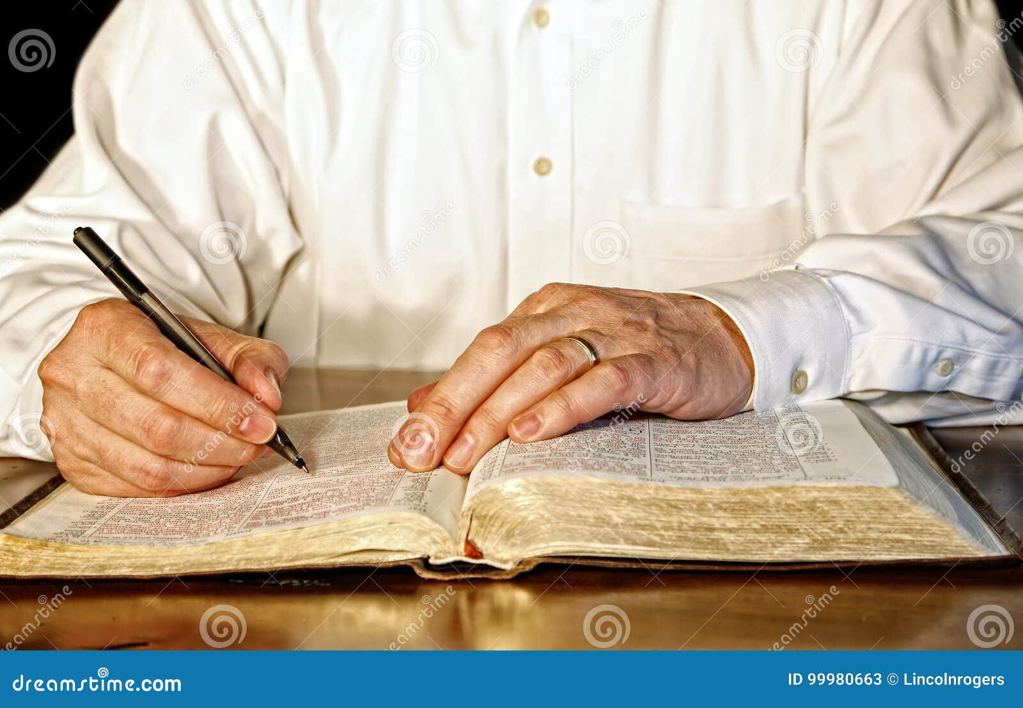
01 BEGIN WITH PRAYER AND ASK THE HOLY SPIRIT TO GUIDE YOUR STUDY – WITHOUT THE PRESENCE OF THE HOLY SPIRIT’S ANOINTING EXPECT THINGS TO REMAIN OUT OF FOCUS
GO TO THE AUTHOR OF THE BOOK BEFORE YOU GO TO THE BOOK

Slide 24
02 ASK THE “5W’S AND AN H”
The more you practice interrogating the text, the more the text will be opened to you by the illuminating ministry of the Spirit. Below are some suggestive questions, but remember to allow the text (and especially the context) to guide your specific questions...
Who is speaking? To whom and/or about whom is he speaking? Who are the main characters? Who is mentioned in the book (Why? What do we learn about them?) (In the epistles ask) Who is writing (author)? Who receiving?
Where did (or will) this happen (Why? When?)? Where was this said/written (where is the author) (Why?)?
Why was this written (What purpose?)? Why is this said? Why is he there?
When is this written (When in Biblical history - where on the timeline? When in the author's life)? When did/will this happen? When did he say/do it?
What is the author doing? What are the main events? What are the circumstances? What is the historical/cultural setting (as determined from the text)? What is the main subject of the chapter/book?
How will/did something happen? How is the truth illustrated?
As you study any passage of Scripture, train yourself to constantly ask” Who? What? When? Where? Why? How? These questions are the building blocks of precise observation, which is essential for accurate interpretation.

Slide 25

ENCOUNTER WITH A KEY WORD SHOULD STIMULATE A 5W'S AND H" QUESTION
And don't forget that each encounter with a key word (fact about author or recipient) should stimulate a 5W's and H" question. Why is this used here? How does it impact the flow of thought? Who does this relate to? When did this occur?, etc. The more you practice this valuable skill, the more "sophisticated" your questions will become and the more profound will be the insights that the Spirit illuminates. And don't worry, for you can never run out of questions for the Word of God because it is a living Word!
As you seek to establish the context of the chapter or book, continually reading with a "marking, interrogating mindset", you will find yourself engaging more and more in active (versus passive) reading. Active reading not only stimulates your thinking and interaction with the text, it also slows you down. Active reading engages you in conversation with the Author. In a sense, by reading actively you are practicing the essence of the all but lost art of meditation on the Scriptures. Yes, marking and interrogating will slow you down somewhat, but you will gain so much more from the passage than if you had simply read through it in obedience to your "read through the Bible in a year" schedule.

Slide 26

EVERY TIME YOU IDENTIFY ONE OF THE OTHER OBSERVATION "CODE WORDS" -- CONTRAST, CONCLUSION (AND TERMS OF EXPLANATION SUCH AS "FOR"), COMPARISON, CHRONOLOGY (TIME PHRASE), ETC. SHOULD STIMULATE A 5W'S AND H" QUESTION
Do not panic if you cannot ask every 5W/H question. And remember that these questions should be asked not only when you encounter key words or key phrases, but EVERY encounter with one of these "code words" is an opportunity to hone (sharpen) your skills of observation. Yes, it does take time and practice to train yourself to employ this "questioning mindset." (As an aside, questioning the text does not mean that one questions the inerrancy, plenary inspiration or authority of God's Holy Word!) As you train your eye to observe the Scriptures (this training takes some time), your enhanced ability to keenly observe and intelligently interrogate will also make you a better reader of everything you read for the rest of your life.

Slide 27
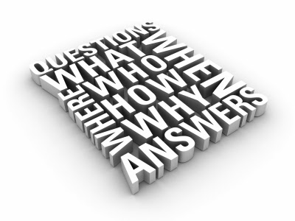
LEARNING TO INTERROGATE THE SCRIPTURE WITH THE 5W/H QUESTIONS YIELDS A NUMBER OF DIVIDENDS SUCH AS...
It will force you to slow down and will "counteract" the tendency to "speed read" the Bible. This travesty is especially common when one falls behind schedule on their "Through the Bible in a Year" reading program! It is better to let one verse "read you" then to read a hundred verses that you cannot recall. Beloved, God's desire is that His book be our real time instruction manual for living, whether we are at home, at school or at work!
It will engage your heart and mind with the text (and especially the Author of the text), forcing you to read actively, more like an "explorer," rather than passively like a "tourist". The old adage "Stop and smell the roses" surely applies to acquisitively taking in the beauty of all of our Father's "good words" (Joshua 23:14, 21:45)
It will create a "meditative mindset", as you pause and ponder the passages, chewing them like a cow chews cud, mulling them over in your mind, constantly seeking to ask the probing 5W/H questions. You will begin to gain insights into the Scriptures that you simply could not have been gleaned from a superficial, passive, unengaged reading of the Holy Word. You will begin to experience the joy of self discovery as your Teacher, the Spirit, illuminates and applies God's Truth to your life. In a very real sense, you will be learning how to meditate on the Holy Scriptures, a discipline which God promises to greatly bless.

Slide 28
PUTTING IT INTO PRACTICE AUTHOR AND RECIPIENT LIST 1 THESSALONIANS 1
AUTHOR | RECIPIENTS
Who is the author? v1 PaulWhat is Paul doing? Who is he thankful for? When does he thank God? v2 Thanks God always for all of them v2 Prays for them What is his relationship to Jesus? to God the Father? v3 Jesus is his Lord v3 God is his Father What does Paul say about the Gospel? (How did the Gospel come?) v5 Came to the Thessalonians In word (What does this mean?) - It was spoken In power (What does this mean?) - Gospel has power In the Holy Spirit In full conviction (What does this mean?) - He was convinced of its saving power What do we learn about Paul's witness? v5 Proved what kind of men (life matched their "lips") Where? - among them (the Thessalonians) Why? - for their sake What had Paul experienced as a result of the Gospel? v6 Much tribulation with the joy of the Holy Spirit How effective was the sounding forth of the Thessalonians? v8 No need for Paul to say anything | Who are the recipients? v1 Church of the Thessalonians Where are they geographically? spiritually? v1 In Thessalonica and In God the Father and the Lord Jesus Christ Why (for what?) does Paul commend the church at Thessalonica? v2 They had a … work of faith … labor of love … steadfastness of hope Where was their hope? v2 In the Lord Jesus Christ What do we learn about who the Thessalonians are to God? v4 Brethren (of Paul, Silas and Timothy) Beloved (of Whom?) of God Chosen What was their response to the Gospel that came to them? v6 Received the word What happened when they received the Gospel? (the historical context) v6 Much tribulation How did the Thessalonians respond to the tribulation? v6 With the joy of the Holy Spirit What did they become as a result of experiencing joy in midst of tribulation? v6 Imitators of Paul, et al, and the Lord And what was the result of their becoming imitators? v7 Became examples to all the believers at Macedonia and Achaia How did they prove to be examples to the believers? v8 Sounded forth the Word of the Lord in every place How effective was their sounding forth? v8 Paul had no need to say anything What was reported back to Paul? v9 Their reception What else was reported to Paul? v9 They turned to God and turned from idols What was the result of turning to God? v9-10 Serve the living God Wait for His Jesus (Whom He raised from dead) What would Jesus do for them? v10 Save them from the wrath to come

Slide 29
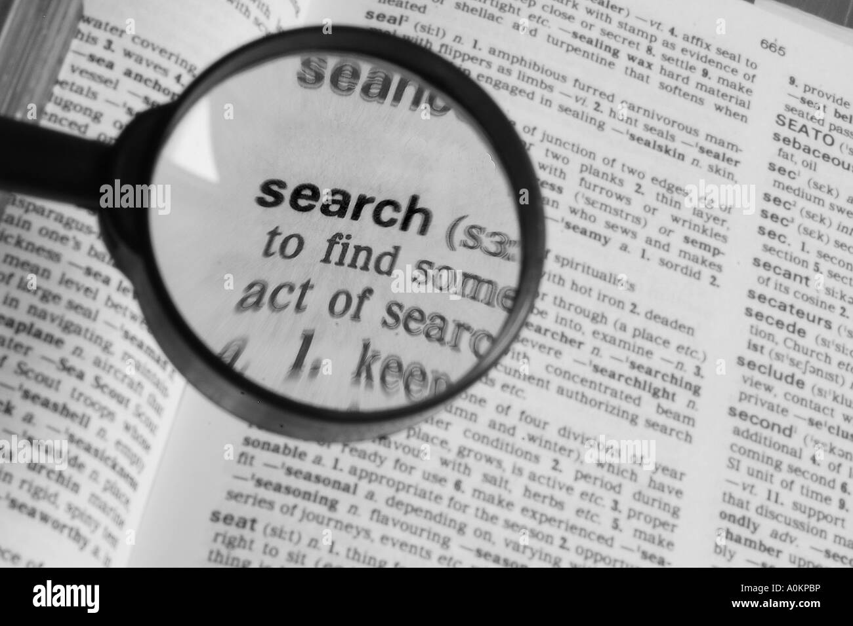
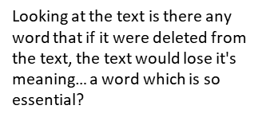
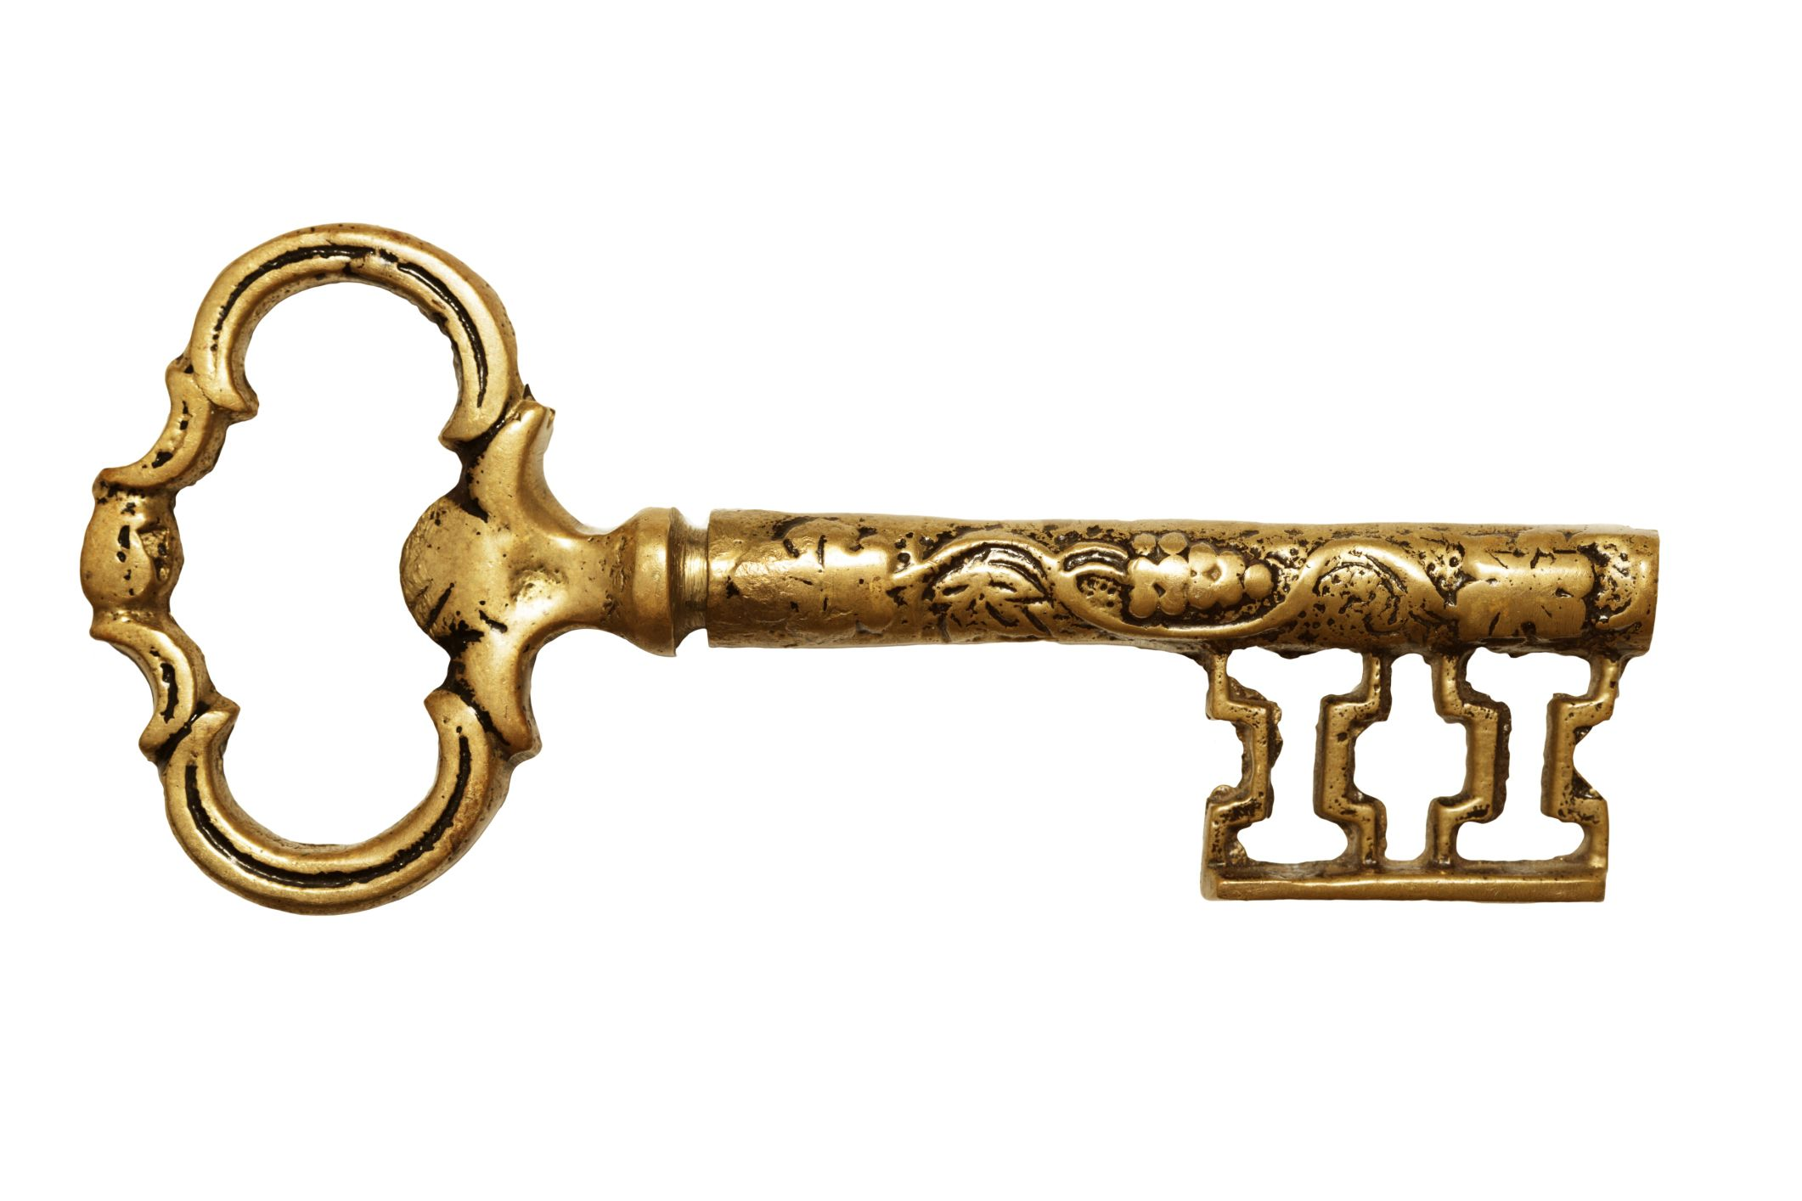
INTRODUCTION TO KEY WORDS
While we making observations and reading and re-reading other words begin to show up over and over again… We call those KEY WORDS…
Keys are ALWAYS ESSENTIAL…just think about a time you locked yourself out of your car… you couldn't get very far. By same token you can't get far in understanding the meaning of the text without an understanding of and ability to recognize KEY WORDS.
REPEATED…
What do you do when you want your children to get what you are saying? You repeat it if it's really important and that's exactly what God does.
I Thessalonians
1 Paul, Silvanus, and Timothy,
To the church of the Thessalonians in God the Father and the Lord Jesus Christ: Grace to you and peace.
² We always give thanks to God for all of you, making mention of you in our prayers;
³ constantly keeping in mind your work of faith and labor of love and perseverance of hope in our Lord Jesus Christ in the presence of our God and Father,
⁴ knowing, brothers and sisters, beloved by God, His choice of you;
⁵ for our gospel did not come to you in word only, but also in power and in the Holy Spirit and with full conviction; just as you know what kind of men we proved to be among you for your sakes.
⁶ You also became imitators of us and of the Lord, having received the word during great affliction with the joy of the Holy Spirit,
⁷ so that you became an example to all the believers in Macedonia and Achaia.
⁸ For the word of the Lord has sounded forth from you, not only in Macedonia and Achaia, but in every place the news of your faith toward God has gone out, so that we have no need to say anything.
⁹ For they themselves report about us as to the kind of reception we had with you, and how you turned to God from idols to serve a living and true God,
¹⁰ and to wait for His Son from heaven, whom He raised from the dead, that is, Jesus who rescues us from the wrath to come.
Key Word

Slide 30

03 MARK KEY WORDS/PHRASES
Like keys, these help unlock the meaning of a passage, paragraph, chapter or book.
Usually identified by repetition but not always
Key Words are vital to understanding the passage & cannot be removed w/o affecting meaning
May include pronouns, synonyms, closely related phrases (ie, judge, judgment, judging.)
God, Jesus, Spirit – always keywords.
Remember to ask the 5W&H for each key word or phrase.
Mark key words in a distinctive way – using symbols, color, make them easily to remember.

Slide 31
HOW TO DISCOVER A KEY WORD
Gospel but that specific word is only 1x
Synonym = word
Place this symbol over the word (gospel/word) or mark as you prefer (color/symbol)
v5, v6 (READ "received the word in much tribulation")
v8 (READ "for the word of the Lord has sounded forth")
What about "word" in v5?
No because it refers to the SPOKEN WORD
It explains what? How the gospel came to Thessalonica
If we took the word GOSPEL and its synonyms out of the could we understand what brought about this great change?
No it is essential, unlocks the text explaining how they came to turning FROM idols to God and to serve Him & wait for His Son.
I Thessalonians
1 Paul, Silvanus, and Timothy,
To the church of the Thessalonians in God the Father and the Lord Jesus Christ: Grace to you and peace.
² We always give thanks to God for all of you, making mention of you in our prayers;
³ constantly keeping in mind your work of faith and labor of love and perseverance of hope in our Lord Jesus Christ in the presence of our God and Father,
⁴ knowing, brothers and sisters, beloved by God, His choice of you;
⁵ for our gospel did not come to you in word only, but also in power and in the Holy Spirit and with full conviction; just as you know what kind of men we proved to be among you for your sakes.
⁶ You also became imitators of us and of the Lord, having received the word during great affliction with the joy of the Holy Spirit,
⁷ so that you became an example to all the believers in Macedonia and Achaia.
⁸ For the word of the Lord has sounded forth from you, not only in Macedonia and Achaia, but in every place the news of your faith toward God has gone out, so that we have no need to say anything.
⁹ For they themselves report about us as to the kind of reception we had with you, and how you turned to God from idols to serve a living and true God,
¹⁰ and to wait for His Son from heaven, whom He raised from the dead, that is, Jesus who rescues us from the wrath to come.

Slide 32


I Thessalonians
1 Paul, Silvanus, and Timothy,
To the church of the Thessalonians in God the Father and the Lord Jesus Christ: Grace to you and peace.
² We always give thanks to God for all of you, making mention of you in our prayers;
³ constantly keeping in mind your work of faith and labor of love and perseverance of hope in our Lord Jesus Christ in the presence of our God and Father,
⁴ knowing, brothers and sisters, beloved by God, His choice of you;
⁵ for our gospel did not come to you in word only, but also in power and in the Holy Spirit and with full conviction; just as you know what kind of men we proved to be among you for your sakes.
⁶ You also became imitators of us and of the Lord, having received the word during great affliction with the joy of the Holy Spirit,
⁷ so that you became an example to all the believers in Macedonia and Achaia.
⁸ For the word of the Lord has sounded forth from you, not only in Macedonia and Achaia, but in every place the news of your faith toward God has gone out, so that we have no need to say anything.
⁹ For they themselves report about us as to the kind of reception we had with you, and how you turned to God from idols to serve a living and true God,
¹⁰ and to wait for His Son from heaven, whom He raised from the dead, that is, Jesus who rescues us from the wrath to come.
GOD IS ALWAYS A KEY WORD
KEY WORD: GOD LIST
vv. 1,2,3,4,8,9,10
Verse | God | Jesus | Holy Ghost
V1 | The Father
V2 | always given thanks for you
V3 | our God and Father
V4 | loves the brothers and sisters; He chose you
V5
V6
V7
V8 | IS “FAITHED” -the news of your faith toward God has gone out
V9 | Thessalonians believers turned to God from idols; true and living
V10 | raised His Son from the dead

Slide 33
I Thessalonians JESUS IS ALWAYS A KEY WORD
1 Paul, Silvanus, and Timothy,
To the church of the Thessalonians in God the Father and the Lord Jesus Christ: Grace to you and peace.
² We always give thanks to God for all of you, making mention of you in our prayers;
³ constantly keeping in mind your work of faith and labor of love and perseverance of hope in our Lord Jesus Christ in the presence of our God and Father,
⁴ knowing, brothers and sisters, beloved by God, His choice of you;
⁵ for our gospel did not come to you in word only, but also in power and in the Holy Spirit and with full conviction; just as you know what kind of men we proved to be among you for your sakes.
⁶ You also became imitators of us and of the Lord, having received the word during great affliction with the joy of the Holy Spirit,
⁷ so that you became an example to all the believers in Macedonia and Achaia.
⁸ For the word of the Lord has sounded forth from you, not only in Macedonia and Achaia, but in every place the news of your faith toward God has gone out, so that we have no need to say anything.
⁹ For they themselves report about us as to the kind of reception we had with you, and how you turned to God from idols to serve a living and true God,
¹⁰ and to wait for His Son from heaven, whom He raised from the dead, that is, Jesus who rescues us from the wrath to come.
KEY WORD: JESUS LIST
vv. 1,3,6,8,10
Verse | God | Jesus | Holy Ghost
V1 | The Father | Giver of grace and peace
V2 | Always given thanks for you
V3 | our God and Father | is hoped in
V4 | loves the brothers and sisters; He chose you
V5
V6 |  | is to be imitated
V7
V8 | the news of your faith toward God has gone out | has the word; sounds forth
V9 | Thessalonians believers turned to God from idols; true and living
V10 | raised His Son from the dead | God’s Son; from heaven; raised from the dead by God; delivers the wrath to come

Slide 34
I Thessalonians
1 Paul, Silvanus, and Timothy,
To the church of the Thessalonians in God the Father and the Lord Jesus Christ: Grace to you and peace.
² We always give thanks to God for all of you, making mention of you in our prayers;
³ constantly keeping in mind your work of faith and labor of love and perseverance of hope in our Lord Jesus Christ in the presence of our God and Father,
⁴ knowing, brothers and sisters, beloved by God, His choice of you;
⁵ for our gospel did not come to you in word only, but also in power and in the Holy Spirit and with full conviction; just as you know what kind of men we proved to be among you for your sakes.
⁶ You also became imitators of us and of the Lord, having received the word during great affliction with the joy of the Holy Spirit,
⁷ so that you became an example to all the believers in Macedonia and Achaia.
⁸ For the word of the Lord has sounded forth from you, not only in Macedonia and Achaia, but in every place the news of your faith toward God has gone out, so that we have no need to say anything.
⁹ For they themselves report about us as to the kind of reception we had with you, and how you turned to God from idols to serve a living and true God,
¹⁰ and to wait for His Son from heaven, whom He raised from the dead, that is, Jesus who rescues us from the wrath to come.
KEY WORD: HOLY SPIRIT LIST
vv. 5,6
HOLY SPIRIT IS ALWAYS A KEY WORD
Verse | God | Jesus | Holy Ghost
V1 | The Father | Giver of grace and peace
V2 | Always given thanks for you
V3 | our God and Father | is hoped in
V4 | loves the brothers and sisters; He chose you
V5 |  |  | Power/conviction the gospel
V6 |  | is to be imitated | Joy
V7
V8 | the news of your faith toward God has gone out | has the word; sounds forth
V9 | Thessalonians believers turned to God from idols; true and living
V10 | raised His Son from the dead | God’s Son; from heaven; raised from the dead by God; delivers the wrath to come

Slide 35
I Thessalonians
1 Paul, Silvanus, and Timothy,
To the church of the Thessalonians in God the Father and the Lord Jesus Christ: Grace to you and peace.
² We always give thanks to God for all of you, making mention of you in our prayers;
³ constantly keeping in mind your work of faith and labor of love and perseverance of hope in our Lord Jesus Christ in the presence of our God and Father,
⁴ knowing, brothers and sisters, beloved by God, His choice of you;
⁵ for our gospel did not come to you in word only, but also in power and in the Holy Spirit and with full conviction; just as you know what kind of men we proved to be among you for your sakes.
⁶ You also became imitators of us and of the Lord, having received the word during great affliction with the joy of the Holy Spirit,
⁷ so that you became an example to all the believers in Macedonia and Achaia.
⁸ For the word of the Lord has sounded forth from you, not only in Macedonia and Achaia, but in every place the news of your faith toward God has gone out, so that we have no need to say anything.
⁹ For they themselves report about us as to the kind of reception we had with you, and how you turned to God from idols to serve a living and true God,
¹⁰ and to wait for His Son from heaven, whom He raised from the dead, that is, Jesus who rescues us from the wrath to come.
KEY WORDS: GOD, JESUS, HOLY SPIRIT COMBINED LISTS
Verse | God | Jesus | Holy Ghost
V1 | The Father | Giver of grace and peace
V2 | always given thanks for you
V3 | our God and Father | is hoped in
V4 | loves the brothers and sisters; He chose you
V5 |  |  | Power/conviction the gospel
V6 |  | is to be imitated | Joy
V7
V8 | the news of your faith toward God has gone out | has the word; sounds forth
V9 | Thessalonians believers turned to God from idols; true and living
V10 | raised His Son from the dead | God’s Son; from heaven; raised from the dead by God; delivers from wrath to come

Slide 36

04 MAKE LISTS Making lists can be one of the most enlightening things you do as you study. Lists reveal truths and highlight important concepts. It is also helpful to make a list of what you learn about each key word or person you mark
I Thessalonians
1 Paul, Silvanus, and Timothy,
To the church of the Thessalonians in God the Father and the Lord Jesus Christ: Grace to you and peace.
² We always give thanks to God for all of you, making mention of you in our prayers;
³ constantly keeping in mind your work of faith and labor of love and perseverance of hope in our Lord Jesus Christ in the presence of our God and Father,
⁴ knowing, brothers and sisters, beloved by God, His choice of you;
⁵ for our gospel did not come to you in word only, but also in power and in the Holy Spirit and with full conviction; just as you know what kind of men we proved to be among you for your sakes.
⁶ You also became imitators of us and of the Lord, having received the word during great affliction with the joy of the Holy Spirit,
⁷ so that you became an example to all the believers in Macedonia and Achaia.
⁸ For the word of the Lord has sounded forth from you, not only in Macedonia and Achaia, but in every place the news of your faith toward God has gone out, so that we have no need to say anything.
⁹ For they themselves report about us as to the kind of reception we had with you, and how you turned to God from idols to serve a living and true God,
¹⁰ and to wait for His Son from heaven, whom He raised from the dead, that is, Jesus who rescues us from the wrath to come.
Let's make a list on the GOSPEL:
What's the first thing we need to put down from the list? The Gospel came (in word, power, etc) v5
What's the next thing we see in v6? The gospel was received
What do we see about the gospel in v8? It was sounded forth
V5 did not come to you in word only, but also in power and in the Holy Spirit and with full conviction
v6 Thessalonians’ believers (church) having received the word during great affliction with the joy of the Holy Spirit
V8 word of the Lord has sounded forth
GOSPEL
09 IDENTIFY CHAPTER THEMES. The theme of a chapter will center on the main person, event, teaching, or subject of that section of Scripture. Themes are often revealed by reviewing the key words and lists you developed. Try to express the theme as briefly as possible, using words found in the text.
So what is this chapter about? The Gospel
What have you just determined?
The theme of 1Thessalonians 1 = The main thing that this chapter is talking about is the Gospel. Write this theme on your Observation Worksheet.

Slide 37
LIST
The Recipients
vv. 1,2,3,4,5,6,7,8,9,10,
v1 | the church of the Thessalonians in God the Father and the Lord Jesus Christ; are sent grace and peace
V2 | in the prayers of Paul, Silvanus, and Timothy; they are always mentioned giving God thanks for them
v3 | In the presence of God their work of faith, labor of love,, and perseverance of hope in Lord Jesus Christ is remembered
v4 | brothers, sisters, loved and chosen by God
v5 | Gospel came to them in word, power, Holy Spirit with full conviction; saw the lifestyle of Paul, Silvanus, and Timothy (PST)
v6 | Became imitators of PST and the Lord; received the word during great affliction with the joy of the Holy Spirit
v7 | became an example to all the believers in Macedonia and Achaia
v8 | word of the Lord has sounded forth from you, not only in Macedonia and Achaia, but in every place
v9 | their reception is known; turned to God from idols to serve a living and true God
v10 | Waiting for his Son; will be delivered from wrath to come
V5 the Word Came From Authors To Recipients: In Word, in power, in the Holy Spirit, with full conviction | Process: Proclaimed Received Sounded Forth
circumstances v6 Received the Word in much affliction with joy in the Holy Spirit | contrast
V8 sounded forth the word proclaimed
I Thessalonians
1 Paul, Silvanus, and Timothy,
To the church of the Thessalonians in God the Father and the Lord Jesus Christ: Grace to you and peace.
² We always give thanks to God for all of you, making mention of you in our prayers;
³ constantly keeping in mind your work of faith and labor of love and perseverance of hope in our Lord Jesus Christ in the presence of our God and Father,
⁴ knowing, brothers and sisters, beloved by God, His choice of you;
⁵ for our gospel did not come to you in word only, but also in power and in the Holy Spirit and with full conviction; just as you know what kind of men we proved to be among you for your sakes.
⁶ You also became imitators of us and of the Lord, having received the word during great affliction with the joy of the Holy Spirit,
⁷ so that you became an example to all the believers in Macedonia and Achaia.
⁸ For the word of the Lord has sounded forth from you, not only in Macedonia and Achaia, but in every place the news of your faith toward God has gone out, so that we have no need to say anything.
⁹ For they themselves report about us as to the kind of reception we had with you, and how you turned to God from idols to serve a living and true God,
¹⁰ and to wait for His Son from heaven, whom He raised from the dead, that is, Jesus who rescues us from the wrath to come.
R
E
S
U
L
T

Slide 38
Author (Paul)
vv. 1,2,3,4,5,6,8,9,10
I Thessalonians
1 Paul, Silvanus, and Timothy,
To the church of the Thessalonians in God the Father and the Lord Jesus Christ: Grace to you and peace.
² We always give thanks to God for all of you, making mention of you in our prayers;
³ constantly keeping in mind your work of faith and labor of love and perseverance of hope in our Lord Jesus Christ in the presence of our God and Father,
⁴ knowing, brothers and sisters, beloved by God, His choice of you;
⁵ for our gospel did not come to you in word only, but also in power and in the Holy Spirit and with full conviction; just as you know what kind of men we proved to be among you for your sakes.
⁶ You also became imitators of us and of the Lord, having received the word during great affliction with the joy of the Holy Spirit,
⁷ so that you became an example to all the believers in Macedonia and Achaia.
⁸ For the word of the Lord has sounded forth from you, not only in Macedonia and Achaia, but in every place the news of your faith toward God has gone out, so that we have no need to say anything.
⁹ For they themselves report about us as to the kind of reception we had with you, and how you turned to God from idols to serve a living and true God,
¹⁰ and to wait for His Son from heaven, whom He raised from the dead, that is, Jesus who rescues us from the wrath to come.
LIST
v1 | Paul, Silvanus, and Timothy,
V2 | always gives thanks to God for all of you; make mention of you (the church) in our prayers
v3 | Constantly remembers that the work of faith, labor of love, perseverance of hope is ‘ours’ – shared relationship
v4 | Knows God’s choice of his brothers and sisters in the church of Thessalonians
v5 | Have ownership of a gospel that came in word, power, HS and with full conviction; lifestyle proved them to reflect their Lord and His gospel; proved to be among them for their sakes
v6 | Are Imitated
v7
v8 | don’t need to tell of the Thessalonians’ faith because they are doing so!
v9 | (those in Macedonia and Achaia) tell about our reception about the church
v10 | will be delivered from the wrath to come

Slide 39
05 WATCH FOR CONTRASTS AND COMPARISONS. Contrasts and comparisons use highly descriptive language to make it easier to remember what you’ve learned.
Connective = in Grammar any word that connects phrases, clauses, etc
Contrasts indicate a change of direction in a passage, paragraph, book.
Contrasts depict things that are unlike or dissimilar – but, yet, etc
But is one of the most important words you’ll ever come across in your study of Scripture. Whenever you see it, always stop and ask, what is the contrast being made? (Howard Hendricks)
What should the word but encourage you to do?
Observe preceding text noting what “change of direction” author is taking
What 5W/H questions can you often ask when you see but? what, when, etc
This exercise will help establish the context.
In the Sermon on the Mount, Jesus repeatedly states…
“You have heard that it was said … but I say to you” (Matthew 5).

Slide 40

08 MARK TERMS OF CONCLUSION. Words such as “therefore,” “thus,” and “for this reason” indicate that a conclusion or summary is being made.
Always be alert for these important connecting words for they will introduce an explanation or a conclusion and beg questions like “Why is therefore, there for?”, “What is the author explaining?”, etc
FOR
BECAUSE
THEREFORE
SO THAT
FOR THIS REASON

Slide 41
CONNECTIVES:
CONCLUSION TERMS
Romans is full of therefores, as Paul works his way through a tightly structured argument.
The Old Testament prophets use therefore extensively. Over and over they state their case against the people, and then cry, "Therefore, thus says the Lord."
What’s The “Therefore” There For”?

Slide 42



The person using the inductive study method observes Scripture for what are named "hinge words," so that you begin to read the Bible more "actively" than "passively." Helpful "hinge words" to facilitate "active" (interactive) reading of the Bible include –
  for/because (explanation)
  so that/that (purpose/result)
  therefore/for this reason (conclusion)
  but (contrast)
Each "hinge word" provides an opportunity to
  ask a question (to interact with the Scripture, e.g., "What is being contrasted?", etc),
  which forces us to examine the context,
  which slows us down,
  which allows the Spirit to speak to us and illuminate the passage,
  which helps us retain or remember the Scripture (b/c we are forced to re-read it)
  in effect to practice meditating on the Scripture and receive the blessings inherent in meditation (Ps 1:2-3, Josh 1:8).
All of these effects are the result of simply practicing the discipline of observing the "hinge words." And there will be ample opportunity to hone this skill (e.g., there are over 9000 "for's" and over 4000 "but's" in the Bible)!

Slide 43


I Thessalonians
1 Paul, Silvanus, and Timothy,
To the church of the Thessalonians in God the Father and the Lord Jesus Christ: Grace to you and peace.
We always give thanks to God for all of you, making mention of you in our prayers;
³ constantly keeping in mind (1)your work of faith and (2)labor of love and (3)perseverance of hope in our Lord Jesus Christ in the presence of our God and Father,
⁴ knowing, brothers and sisters, beloved by God, His choice of you;
⁵ for our gospel did not come to you in word only, but also (1)in power and (2)in the Holy Spirit and(3) with full conviction; just as you know what kind of men we proved to be among you for your sakes.
⁶ You also became imitators of us and of the Lord, having received the Word during great affliction with the joy of the Holy Spirit,
⁷ so that you became an example to all the believers in Macedonia and Achaia.
⁸ For the Word of the Lord has sounded forth from you, not only in Macedonia and Achaia, but in every place the news of your faith toward God has gone out, so that we have no need to say anything.
⁹ For they themselves report about us as to the kind of reception we had with you, and how you turned to God from idols to serve a living and true God,
¹⁰ and to wait for His Son from heaven, whom He raised from the dead, that is, Jesus who rescues us from the wrath to come.
Term of Comparison
Term of Explanation
Contrast
circumstances
heart’s reality
RESULT
Term of Explanation
Contrast
RESULT
Contrast

Slide 44

06 Note expressions of time. The relationship of events in time often sheds light on the true meaning of the text. Marking them will help you see the sequence or timing of events and lead to accurate interpretation of Scripture.
LOOK FOR EXPRESSIONS OF TIME
Look for words like "then", "after this", "until", "when", "soon", "now"
Expressions of time identify timing or sequence of events
Of the "5W's & H" questions, time expressions answer "When?“
Mark significant time phrases in your margin with circle or clock face
Observe what you learn "When" something occurs
Ps 73:15 Until I came into the sanctuary of God; Then I perceived their end.

Slide 45
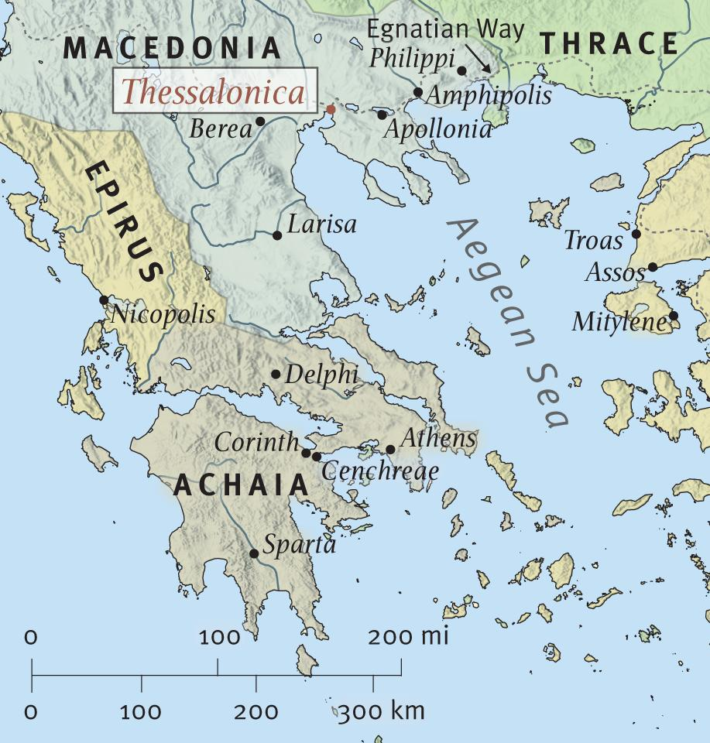
07 Geographic Locations.
Often it’s helpful to mark geographical locations, which tell you where an event takes place.
I Thessalonians
1 Paul, Silvanus, and Timothy,
To the church of the Thessalonians in God the Father and the Lord Jesus Christ: Grace to you and peace.
² We always give thanks to God for all of you, making mention of you in our prayers;
³ constantly keeping in mind your work of faith and labor of love and perseverance of hope in our Lord Jesus Christ in the presence of our God and Father,
⁴ knowing, brothers and sisters, beloved by God, His choice of you;
⁵ for our gospel did not come to you in word only, but also in power and in the Holy Spirit and with full conviction; just as you know what kind of men we proved to be among you for your sakes.
⁶ You also became imitators of us and of the Lord, having received the word during great affliction with the joy of the Holy Spirit,
⁷ so that you became an example to all the believers in Macedonia and Achaia.
⁸ For the word of the Lord has sounded forth from you, not only in Macedonia and Achaia, but in every place the news of your faith toward God has gone out, so that we have no need to say anything.
⁹ For they themselves report about us as to the kind of reception we had with you, and how you turned to God from idols to serve a living and true God,
¹⁰ and to wait for His Son from heaven, whom He raised from the dead, that is, Jesus who rescues us from the wrath to come.

Slide 46



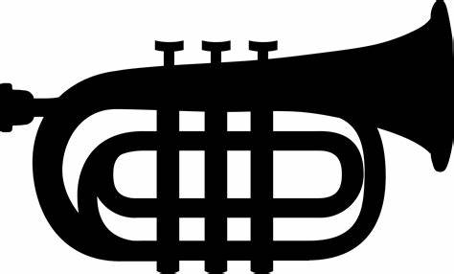
I Thessalonians TITLE_________________________________ THEME: The Gospel
1 Paul, Silvanus, and Timothy,
To the church of the Thessalonians in God the Father and the Lord Jesus Christ: Grace to you and peace.
² We always give thanks to God for all of you, making mention of you in our prayers;
³ constantly keeping in mind (1)your work of faith and (2)labor of love and (3)perseverance of hope in our Lord Jesus Christ in the presence of our God and Father,
⁴ knowing, brothers and sisters, beloved by God, His choice of you;
⁵ for our gospel did not come to you in word only, but also (1)in power and (2)in the Holy Spirit and(3) with full conviction; just as you know what kind of men we proved to be among you for your sakes.
⁶ You also became imitators of us and of the Lord, having received the Word during great affliction with the joy of the Holy Spirit,
⁷ so that you became an example to all the believers in Macedonia and Achaia.
⁸ For the Word of the Lord has sounded forth from you, not only in Macedonia and Achaia, but in every place the news of your faith toward God has gone out, so that we have no need to say anything.
⁹ For they themselves report about us as to the kind of reception we had with you, and how you turned to God from idols to serve a living and true God,
¹⁰ and to wait for His Son from heaven, whom He raised from the dead, that is, Jesus who rescues us from the wrath to come.
Term of Explanation
Term of Comparison
Contrast
circumstances
heart’s reality
Term of Result
Contrast
Term of Result
Contrast

Slide 47
# | Word/phrase | Doctrine | Next Level of Decomposition
1 | the church of the Thessalonians | Ecclesiology: The Doctrine of the Church | The True Church: A Congregation of True Believers
2 | In God the Father and the Lord Jesus Christ | Soteriology: The Doctrine of Salvation | The Perseverance of the Saints: Believers Are Objects of Divine Preservation
3 | making mentioning you in our prayers | Soteriology: The Doctrine of Salvation | Prayer
4 | your work of faith and labor of love and perseverance of hope | Soteriology: The Doctrine of Salvation | Concerning Faith The Life of Faith According to the Promises: The Need to be Exercised in Order To Grow in Grace….Sanctification
5 | His choice of you | Soteriology: The Doctrine of Salvation Theology: The Doctrine of God | The External Call: Not Extended To All Men Eternal Predestination
6 | gospel did not come to you in word only, but also in power and in the Holy Spirit and with full conviction | Soteriology: The Doctrine of Salvation | Spiritual Growth The Internal Call: a work of God’s grace
7 | received the word during great affliction with the joy of the Holy Spirit | Soteriology: The Doctrine of Salvation | Spiritual Joy: The Nature of Spiritual Joy
8 | in every place the news of your faith toward God has gone out | Soteriology: The Doctrine of Salvation | The Profession of Christ and His Truth: The Qualities of an Unwavering Witness of the Truth
9 | how you turned to God from idols to serve a living and true God | Soteriology: The Doctrine of Salvation | Distinguishing Marks of Saving Faith
10 | to wait for His Son from heaven | Eschatology: The Doctrine of Last Things | Use Their Bodies to the Glory of God
11 | He raised from the dead | Christology: The Doctrine of Christ | The State of Christ’s Exaltation
12 | Jesus who rescues us from the wrath to come | Eschatology: The Doctrine of Last Things | Concerning the Last Judgment and the End of the World:
I Thessalonians
1 Paul, Silvanus, and Timothy,
To the [ 1 church of the Thessalonians] [ 2 in God the Father and the Lord Jesus Christ]: Grace to you and peace.
² We always give thanks to God for all of you, [ 3 making mention of you in our prayers];
³ constantly keeping in mind [ 4 your work of faith and labor of love and perseverance of hope] in our Lord Jesus Christ in the presence of our God and Father,
⁴ knowing, brothers and sisters, beloved by God, [ 5 His choice of you];
⁵ for our [ 6 gospel did not come to you in word only, but also in power and in the Holy Spirit and with full conviction;] just as you know what kind of men we proved to be among you for your sakes.
⁶ You also became imitators of us and of the Lord, having [ 7 received the word during great affliction with the joy of the Holy Spirit],
⁷ so that you became an example to all the believers in Macedonia and Achaia.
⁸ For the word of the Lord has sounded forth from you, not only in Macedonia and Achaia, but [ 8 in every place the news of your faith toward God has gone out], so that we have no need to say anything.
⁹ For they themselves report about us as to the kind of reception we had with you, and [ 9 how you turned to God from idols to serve a living and true God],
¹⁰ and [ 10 to wait for His Son from heaven], whom] [ 11 He raised from the dead], that is, [ 12 Jesus who rescues us from the wrath to come].

Slide 48
A week from now you can pick up the Observation Worksheet and you can quickly recall what this chapter is about. An additional advantage of the inductive approach to Bible Study is that you will find yourself remembering whole passages of Scripture. How many times have you read chapter 1 in this simple study? About 5 - You "interviewed" this chapter with questions and then listed out your observations and summarized these findings in a short memorable phrase such as "The Gospel came, was received and was sent forth" A week from now you will remember the main thrust of 1Thessalonians 1. Now just think if you went through all 5 chapters with a similar inductive approach.

Slide 49

DEFINITIONS, VERB TENSES – KNOWING THEM SOMETIMES REALLY MAKES A DIFFERENCE!
IMPORTANCE OF CONTEXT
WHEN PERFORMING WORD STUDIES
Remember that when you are doing Greek Word studies (similar warning applies to Hebrew), many Greek words have more than one meaning as determined by the context. A word can only mean one thing at a time so we must make every effort to determine the writer's single intended meaning. You, the diligent student ,needs to be cautious when looking up definitions of a specific word in Greek lexicons and using the definition to amplify or interpret the meaning of that word in a specific verse. If the definition you choose makes the verse more difficult to understand, then you have probably chosen a definition that is not "compatible with" the context of the verse you are studying.

Slide 50
V.4 Knowing (1492) (as we do the genuineness of your election)(eido/oida) is the idea of perceiving or seeing and in the perfect tense speaks of the permanence (assurance) of Paul's (and Silas and Timothy's) knowing that the saints at Thessalonica were genuine believers. The Thessalonians response to the preaching of the Gospel by Paul, et. al, constituted indisputable proof of their salvation. Thus Paul, et. al, know that the Thessalonian believers are among the elect of God because of the unmistakable signs of new life, as elaborated on in 1 Th 1:5-9.. This knowledge enhances Paul's sense of thanksgiving to God. As someone has said Paul's knowing came from the Thessalonians doing as the Thessalonians brought forth with the fruit of true repentance. v.4 Beloved (25) (agapao) is an active love given independent of whether the recipient's deserve it and a love which seeks their best interest. The verb is perfect tense (speaks of the permanent, enduring and unchangeable nature of God's love) and passive voice (indicating that the believer is the "passive" recipient of God's unchangeable love). Note that God choice of us begins with God's love for us. It is in the cross that we see the love of God displayed.
V.4 Has chosen you/Choice of you (1589) (literally "your election") (ekloge from eklegomai) refers to a believer's election by God. The Thessalonian believers were the elect, chosen of God solely by His sovereign, loving purpose, apart from any human merit or wisdom. God in eternity past sovereignly chose them (as well as all believers) for salvation, drawing them to Himself in time, by the work of the Holy Spirit. The root word (eklegomai) is used twice by Jesus who addressed His disciples informing them that "You did not choose Me, but I chose you, and appointed you, that you should go and bear fruit, and that your fruit should remain, that whatever you ask of the Father in My name, He may give to you."

Slide 51
V.5 For (1063) (gar) is a subordinating conjunction expressing cause or explanation and thus introduces an explanation. In simple terms for is a term of explanation and its occurrence should always prompt one to pause and ponder the text and context, asking what the author is explaining, how does he explain it, etc. While not every "for" in the Bible is a term of explanation, most are and since there are over 7500 uses of for (NAS), you will have ample opportunity to observe and interrogate the text.
In this context for begins Paul's explanation of how he could state with such confidence and assurance that the Thessalonians were in fact "chosen" (elect) (1Th 1:4-note). Paul emphasizes that there is an intimate relationship between the doctrine of the choosing ("election") and the necessary proclamation of the Gospel. He elaborates in subsequent passages on the Gospel's transformative effect in the lives of these chosen saints. The elect received the preached Word and practiced the Word which served as evidence that they were of the elect. Remember, beloved, as you practice this discipline of pausing to ponder, you are establishing the context (which leads to more accurate interpretation and thus more apropos application) and you are in effect engaging in the blessed activity of Biblical Meditation
V.5 but also in power - "In" is the locative of sphere, which Wuest translates "in the sphere of power." Note that Paul uses a strong contrasting but (alla) to emphasize the three positive features of the preaching. Words were used, but the message they conveyed came "also in power, in the Holy Spirit and with full conviction." Each successive term is needed to give the whole picture.
V.5 And in the Holy Spirit and with full conviction - "In" is the locative of sphere, the "atmosphere" of the Holy Spirit. Hiebert comments on the Holy Spirit Who is "named between the "power" and the "conviction," … (and) was the agent Who empowered the message and worked the assurance in the messengers. The messengers worked in a Spirit‑wrought conviction and certainty as to the validity of their message and had unshaken confidence in its ultimate triumph.
V.5 Conviction (assurance) (4136) (plerophoria from pleres = full+ phero = bear or carry) is literally "complete carrying" and here indicates entire confidence or full assurance, indicating that one has a stronger assurance than the sense conveyed by the word "certainty" by itself.

Slide 52
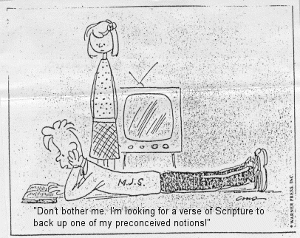
INTERPRETATION ANSWERS THE QUESTION: WHAT DOES THE PASSAGE MEAN?
Interpretation is the process of discovering what the passage means. As you carefully observe Scripture, the meaning will become apparent. However, if you rush into interpretation without laying the foundation of an accurate observation, your understanding will be shaded by what you think, or feel, or what others have written or said – not what God says.
Interpretation flows out of observation!
Interpretation can also involve separate actions or steps that go beyond observing the immediate text. FIRST AND FOREMOST, LET SCRIPTURE INTERPRET SCRIPTURE. You may also use other helps to check your conclusions or to supplement your understanding of the historical or cultural setting of the text.

Slide 53
BASIC PRINCIPLES OF BIBLICAL INTERPRETATION
PRINCIPLE: PRAYER. Read the Scriptures prayerfully, open to communication either direction (to Him or from Him) at any and all times during your inductive study.
PRINCIPLE: OBSERVE WITH A PURPOSE. Practice reading the Scriptures actively (not passively), repeatedly, interrogatively, acquisitively and purposefully.
PRINCIPLE: KEEP CONTEXT KING. Context always rules in interpretation, whether you are studying a single word, one verse or a larger section of Scripture. Always check to see who the "neighbors" are! In simple terms, context is that which goes with the text, the "neighbors" so to speak -- that which comes before and after.

Slide 54

BASIC PRINCIPLES OF BIBLICAL INTERPRETATION
PRINCIPLE: READ SCRIPTURE – LITERALLY IF POSSIBLE. If the plain sense of the Scripture you are studying makes good sense, then do not seek to make some other sense out of it or the final interpretation could be complete nonsense and totally unrelated to God's intending meaning. Take every word in its primary, ordinary, usual, literal meaning unless the facts of the immediate context, studied in the light of related passages and self-evident and fundamental truths, indicate clearly otherwise.
PRINCIPLE: COMPARE SCRIPTURE WITH SCRIPTURE. Interpret Scripture with Scripture and don't base your convictions on an obscure passage which cannot be supported by other more easily interpreted texts. Clear up problem areas with the clear teaching of other passages relating to the same subject.
(SLDS
When you seek to know what something means, ask yourself,
"Is my interpretation of a particular section of Scripture consistent with the theme, purpose, and structure of the book in which it is found?“
.
“Is my interpretation consistent with other Scriptures about the same subject or is there a glaring difference?“
"Am I considering the historical and cultural context of what is being said?"

Slide 55
While Observation Leads To An Accurate Understanding Of What The Word Of God Says, Interpretation Goes A Step Further And Helps You Understand What It Means. As You Seek To Interpret The Bible Accurately, The Following Guidelines Will Be Helpful:
Remember that context rules. If you lay the solid foundation of observation, you will be prepared to consider each verse in the light of the surrounding verses, the book in which it is found, and the entire Word of God. As you study, ask yourself: Is my interpretation of this passage of Scripture consistent with the theme, purpose, and structure of the book in which it is found? Is it consistent with other Scripture about the same subject? Am I considering the historic and cultural context? Never take a Scripture out of its context to make it say what you want it to say. Discover what the author is saying; don’t add to his meaning.
Always seek the full counsel of the Word of God. When you know God’s Word thoroughly, you will not accept a teaching simply because someone has used one or two isolated verses to support it. You will be able to discern whether a teaching is biblical or not. Saturate yourself in the Word of God; it is your safeguard against wrong doctrine.
Remember that Scripture will never contradict Scripture. Remember, all Scripture is inspired by God. Therefore, Scripture will never contradict itself. Sometimes, however, you may find it difficult to reconcile two seemingly contradictory truths taught in Scripture, such as the sovereignty of God and the responsibility of man. Don’t take a teaching to an extreme that God doesn’t. Simply humble your heart in faith and believe what God says, even if you can’t fully understand or reconcile it at the moment.

Slide 56
While Observation Leads To An Accurate Understanding Of What The Word Of God Says, Interpretation Goes A Step Further And Helps You Understand What It Means. As You Seek To Interpret The Bible Accurately, The Following Guidelines Will Be Helpful:
Don’t base your convictions on an obscure passage of Scripture. An obscure passage is one in which the meaning is unclear or not easily understood. Because these passages are difficult to understand even when proper principles of interpretation are used, they should not be used as a basis for establishing doctrine. Interpret Scripture literally.
God spoke to us that we might know truth. Therefore, take the Word of God at face value—in its natural, normal sense. Look first for the clear teaching of Scripture, not a hidden meaning. Understand and recognize figures of speech and interpret them accordingly. Consider what is being said in the light of its literary style. For example, you will find more similes and metaphors in poetical and prophetic literature than in historical or biographical books. Interpret portions of Scripture according to their literary style. Some literary styles in the Bible are: Historical—Acts, Exodus; Prophetic—Revelation, Isaiah; Biographical—Luke; Didactic (teaching)—Romans; Poetic—Psalms; Epistle (letter)—2 Timothy; Proverbial—Proverbs Look for the single meaning of the passage. 6
Always try to understand what the author had in mind when you interpret a portion of the Bible. Don’t twist verses to support a meaning that is not clearly taught. Unless the author of a particular book indicates that there is another meaning to what he says, let the passage speak for itself

Slide 57
CONTEXT UNVEILED: One or Two More Words on Context
Context is the environment in which something lives.
Context is the text that comes before and after the Biblical text we are studying.
Any time we break into the middle of a passage, we always need to examine its context.
Always remember that context is king in the realm of Biblical interpretation.
A Biblical text taken out of context can be a dangerous pretext (= an excuse given to hide real reason for doing something).
Every major cult is built upon a violation of this basic principle of interpreting Scripture in context.

Slide 58

APPLICATION ANSWERS THE QUESTION: HOW DOES THE MEANING (TRUTH) OF THIS PASSAGE APPLY TO ME?
Once you know what a passage means, you are not only responsible for putting it into practice in your own life, but accountable if you don’t. Ultimately, then the goal of personal Bible study is a transformed life, and a deep and abiding relationship with Jesus Christ.
In Bible study, application is putting truth you've discovered (through observation and interpretation) to use in your life with the ultimate goal of transformation or life change. Bible study is meant not merely to inform but to transform and renew our mind.
How does the truth of this passage apply to my life? Note that the question is not "Is this truth relevant to my life?" The truth of God's Word is always relevant to our life. The more honest question is "Am I ready and willing to believe this truth and to apply it in my life?"
The tireless runner is a picture of what Application should look like in each of our lives….

Slide 59
APPLICATION ANSWERS THE QUESTION: HOW DOES THE MEANING (TRUTH) OF THIS PASSAGE APPLY TO ME?
Righteousness in simple terms is whatever God says is right on any subject. The goal is that we live holy, in conformity to God's will in thought, purpose and action and that in so doing we are made adequate and equipped for every good ("God") work, which represents only those works He initiates and empowers.
We are His workmanship, created in Christ Jesus for good works, which God prepared beforehand, that we should walk in them. Application brings us into this sphere of abundant life in the Spirit.
The basis for application is 2 Timothy 3:16, “All Scripture is inspired by God and profitable (useful, advantageous, helpful,) for teaching, for reproof, for correction, for training in righteousness” (2 Timothy 3:16-17)
Teaching shows us what is right. Like a compass, the Bible always points you in the right direction. (Dt 28:13, 14, Joshua 1:7, 8, 9)
Reproof shows us where we are wrong. When we look into the mirror of God's Word, we see ourselves more clearly. (James 1:23, 24, 25+)
Correction shows us how to get right.
Training in righteousness develops discipline to live right.
The tireless runner is a picture of what Application should look like in each of our lives….

Slide 60
APPLICATION ANSWERS THE QUESTION: HOW DOES THE MEANING (TRUTH) OF THIS PASSAGE APPLY TO ME?
Take some of the things you have observed and turn them into questions.
HAVE YOU RECEIVED THE GOSPEL SO AS TO TURN & SERVE GOD?
Jesus died on the Cross for your sins and He was raised. If He had not been raised you would not be justified… you'd have no hope. Have you received the gospel as shown by your turn from idols to serve the living & true God (by genuine repentance)?
DO YOU PRESENT THE GOSPEL WORD, IN POWER, IN THE HOLY SPIRIT, WITH FULL CONVICTION, & BY EXAMPLE - with a lifestyle that others should imitate… one like Christ?
ARE YOU SOUNDING FORTH THE GOSPEL IN EVERY PLACE THAT YOU GO?
IS YOUR EARNEST EXPECTATION (YOUR STEADFAST HOPE) OF JESUS' RETURN AFFECTING THE WAY YOU LIVE TODAY? Think back on this last week… did you live each day as if it might be the day the Lord might return?
DO YOU HAVE A WORK OF FAITH, A LABOR OF LOVE & A STEADFASTNESS OF HOPE THAT IS OBVIOUS TO THOSE AROUND YOU BE THEY BELIEVERS & UNBELIEVERS?
This is the goal of all Bible study… you have been confronted with God's Truth, and now you need to respond.

Slide 61

THOUGHT – “just as you know what kind of men we proved to be among you for your sake…”Does my daily conduct at home, work, school give others an indisputable glimpse into the transforming power of the Gospel of God's grace?
THOUGHT - Do I have any worthless idols that I am hiding in your heart? If I do then I must turn to God and confess them one by one so that by His grace and power I am enabled to turn away from them (to repent)?
v.7 “You became an example” - It is worth noting that the only church Paul ever called an example was the church at Thessalonica, for he felt it gave a pattern for what churches ought to be both in spiritual growth and ministry. What was their example? They had a work of faith, a labor of love and a steadfastness of hope in our Lord Jesus Christ and manifested joy in the midst of tribulation which undoubtedly was a source of great encouragement to other believers, for often the most powerful testimony of an individual believer or church is during times of trial, pain, and persecution.
THOUGHT - How does my church compare to their example? What needs to change to emulate their example?
THOUGHT - Who am I looking for today? Remember Jesus could come back today! Am I ready to meet Him in the clouds?

Slide 62
Application The first step in application is to find out what the Word of God says on any particular subject through accurate observation and correct interpretation of the text.
Once you understand what the Word of God teaches, you are then obligated before God to accept that truth and to live by it.
Scripture will always teach what is right, show us where we are wrong, how to correct, and train us in right living; so that we are complete, fully equipped for every good work. 2 Timothy 3:16-17

Slide 63
OBSERVATION, interpretation, and application lead to transformation. This is the goal of our study of the Word of God. Through it we are changed from glory to glory into the image of the Lord Jesus Christ.

Slide 64









AND DO NOT BE CONFORMED TO THIS WORLD, BUT BE TRANSFORMED BY THE RENEWING OF YOUR MIND Ro.2:2

Slide 65
IN HIS WORD, He shows me His eyes, able to see me in my valleys and on my mountaintops. I find powerful arms, capable of holding me secure in the fiercest of spiritual storms and as gentle to the touch as the breeze upon my face. I see a smile that welcomes me to green pastures, and to the shadows, and makes all grace abound toward me, fingers that knitted me together in my mother’s womb, and hands that provide me discipline, provision, power and protection through circumstances seen and unseen. His ears hear my laments and my shouts of praise that are silent to others, and He is always bent in my direction to listen to me. His nose inhales the savor of my sacrifices. He loves me with a heart whose desire is toward me.
Perhaps, herein lies God’s motive for making Himself known to us. It is to invite us to know Him intimately, to see Him as ultimately approachable, reachable, touchable, and accessible.
God’s
Motive

Slide 66
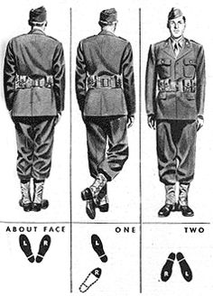
The command "About Face" is describes the act of pivoting 180 degrees, especially in a military formation (see diagram above). Another English definition says it is "a reversal of direction, of attitude, behavior, or point of view." This is a good picture of repentance that Jesus commands. Jesus continues the call to repentance made by John in Mark 1:4+.
Turned from idols to the living and true God - It is interesting that in the OT one of the Hebrew words that conveys the abstract idea of idol is "awen" (Isa 66:3) which conveys the idea of emptiness, nothingness, as of breath or vapor! It is that which is vain or false (not true). In short, Paul's readers had repented, turning from belief in "nothing" to belief in the ultimate Truth (Jn 14:6)!
To God from idols - Note the order, as it is not "accidental". First = To God. Then = From idols. When our eyes of faith are opened to see the true and living God, the vain, dead so called gods are seen for the empty unsatisfying worthless created things they are.
REPENT AND BELIEVE
A PICTURE OF REPENTANCE:
A TURN FROM THE LIE TO THE TRUTH

Slide 67
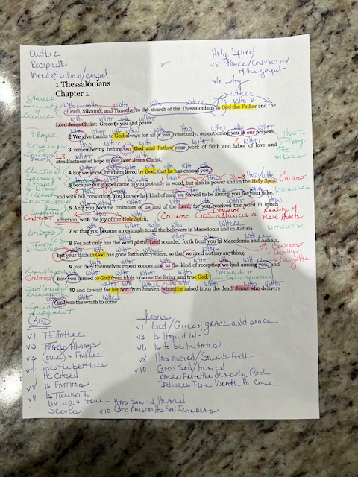

THIS IS WHAT A REAL
OBSERVATION WORKSHEET
LOOKS LIKE WHEN YOU ARE
FIINSHED WITH IT!
ALL YOU NEED IS THE TEXT OF
SCRIPTURE, COLORED PENCILS
OR MARKERS, AND SEMI-READABLE
HANDWRITING.

Slide 68
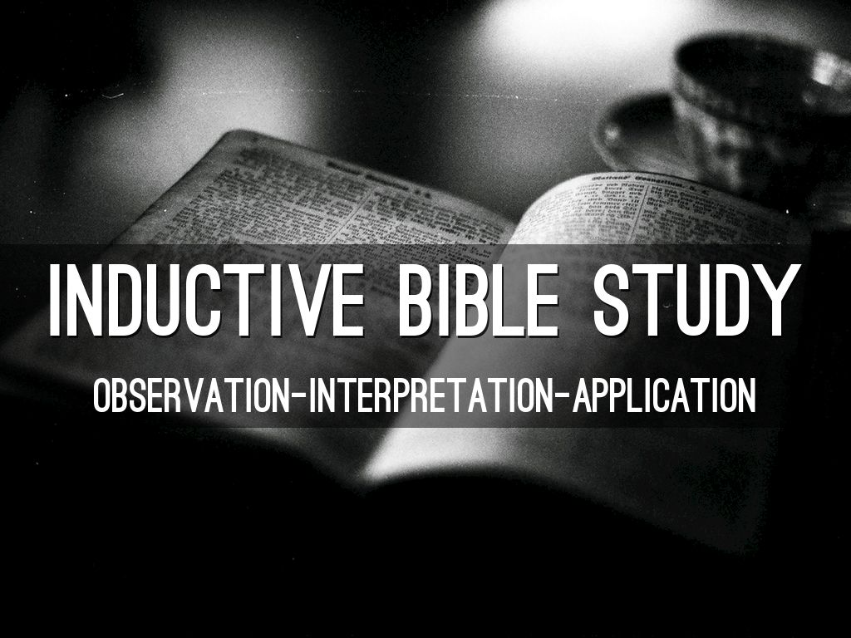

Slide 69
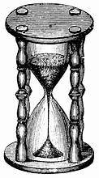
IT’S GOT TO BE AT LEAST TEN MINUTES OFF
I DON’T THIS SAND GLASS MECHANISM IS REFLECTING THE RIGHT TIME
FORGIVE ME IN ADVANCE!
THE PACE QUICKENS DURING OUR LAST CLASS TOGETHER.

Slide 70
v.6 You is emphatic (first in the Greek sentence) marking the change of subject from the writers to the readers. Paul does not begin with the readers' personal acceptance of the gospel, but with the external manifestation demonstrating that reception.
v.6 Became (1096) (ginomai) means to come into existence and the aorist tense indicates a completed action in the past, specifically at the time of their new birth into God's family. A definite, observable change became evident in the Thessalonian's lives. Their conversion had taken place at a point in time and that conversion was not a gradual process but an act (1Th 1:9, 10-note where turned is also aorist tense indicating at a point in time they took a definite turn not just "for the better" but "for the best!".)
v.7 So that - Explains purpose or result. In this case it is the result of their Spirit filled lives of joy in a situation one would not expect joy (tribulation). That can only speak of the supernatural power of God in their lives. Who wouldn't want to pattern their lives after such individuals?
v.8 For (1063) (gar) signifies an explanation (See discussion of value of observing and interrogating this term of explanation) of something previously stated. It is a good practice when you encounter a "for" at the beginning of a verse to ask "what is the author explaining?". What would Paul be explaining in present context? Clearly he is describing how the Thessalonians became "imitators" and "examples", the information that follows providing the details.
v. 8 Sounded forth (1837) (execheo from ex = out + echo = hold; in Lxx only in Joel 3:14+) means literally to sound out (the verb is found in ancient secular Greek manuscripts describing the sound of a trumpet or the sound of rolling thunder), reverberating (continuing as if in a series of echoes) or bouncing off objects (in this case the hearts and minds of lost men and women) like an echo. The picture is that of clearly audible, unmistakable proclamation. The perfect tense indicates that their message began at a point in time in the past (their new birth) and continued effects were still reverberating. It had sounded, and still it sounds, reaching far and wide with its penetrating tones. It's sound in fact has reverberated down to our day in their written testimony in this divinely inspired epistle. Now that's reverberation! The perfect tense indicates the abiding effect of the blast; "the blast hangs on the air as the result of the trumpet having been blown."

Slide 71
v.8 Your faith (4102) (pistis) (the faith of you) The repeated article ("the") in the original Greek makes it clear that their faith is now directed toward the true God and not toward the idols from which they had turned. The Thessalonian saints expressed their fidelity toward God, showing that they had a true belief in God and in the truth which He had revealed by their changed lives.
v.8 Toward (4314) is pros, the preposition of direction, indicating forward to, toward," or "facing," and indicates that their faith was directed toward and had as its object the God, the one true God whom they had come to know and serve, in contrast to their former idols. Their faith had experienced a change of direction, bringing them into a face‑to‑face relationship with the living God.
v.8 Gone forth (1831) (exerchomai) means literally to to go out with the use of the perfect tense (like "sounded forth" above) indicating that the "going forth" was a state of completion and was exerting a continuing effect. This pictures their faith like travelers having gone out in all directions.
v.9 You turned (1994) (epistrepho from epi = motion toward + strepho = turn) means to turn about, around or toward and then to convert, so that it frequently refers to a sinner’s conversion to God as in the current use. Turned is aorist tense pointing to a definite crisis experience and indicative mood indicates that such a change had truly taken place. The active voice indicates that the conversion was the consequence of a deliberate choice on their part and was not an act forced upon them. Their turning was voluntary. It was evidence of their faith and love mentioned.
v.9 To serve (1398) (douleuo from doulos = bondservant in turn from deo = to bind so one who is bound to another) means to be a slave to God and to act accordingly. The present infinitive denotes that it was a life of continual, complete, and wholehearted service to God. The Thessalonians had completely yielded their wills to continuously (present tense) carry out the will of their heavenly Master. A doulos conveys the idea of one closely bound with his master, belonging to him, obligated and desirous to do his will, in a permanent relation of servitude and having his will be altogether consumed by the will of the master. Doulos and douleuo emphasize that one is no longer their own but that they have been bought at great price and therefore willingly commit to serve their master whom they love and respect.
v.9 Living (2198) (zao) means to have life and existence as opposed to death and nonexistence. Zao is in the present tense which is more literally translated "the continuously living God". He is a living God, having life and power in Himself as "the author and preserver of life unto others" and He stands in contrast to the dead idols that are impotent to help their worshipers.

Slide 72
v.3 remembering/Bearing in mind (3421) (mnemoneuo from mimnesko = recall to one's mind) means to keep in mind, exercise memory, call something to mind or recollect. The present tense signifies that this was their lifestyle. The meaning is not that this memory occupied the missionaries to the exclusion of everything else but rather that their remembrance of it constantly recurred.
v.3 Faith (4102) (pistis) is synonymous with trust or belief and is the conviction of the truth of anything, but in Scripture usually speaks of belief respecting man's relationship to God and divine things, generally with the included idea of trust and holy fervor born of faith and joined with it. The faith of the Thessalonians was no mere speculative belief; it was energetic and productive.
v.3 Labor (2873) (kopos from kopto = chop, hew, cut down, strike; figuratively to lament which apparently came from the idea of striking one's breast) Kopos referring to labor conveys the sense that the labor involves toil, fatigue, suffering, weariness and sorrow. It thus speaks of an intense effort which can be united with trouble. In short kopos conveys the idea of arduous toil involving sweat and fatigue and emphasizes the weariness which follows as a result of the straining of all of one's powers to the utmost. Your labor prompted by love is the toilsome, laborious activity that is prompted and sustained by love when the going gets hard. Vine sums up labor of love writing that first in 1Th 1:9 it is expressed as service to God ("to serve a true and living God").
v.3 Steadfastness (5281) (hupomone from hupo = under + meno = abide) is literally abiding under pressure. Trench says that hupomone "does not mark merely endurance, or even patience, but the perseverance, the brave patience with which the Christian contends against the various hindrances, persecutions, and temptations that befall him in his conflict with the inward and outward world." He adds that hupomone is "that temper of spirit in which we accept God's dealings with us as good, and therefore without disputing or resisting. (Trench, R. C. Synonyms of the New Testament. Hendrickson Publishers. 2000)
v.3 Hope (1680) (elpis) is the desire for some good with the expectation of obtaining it. Hope in Scripture is the absolute certainty of future good. Of hope describes the steadfastness as being characterized by hope, inspired by hope and sustained by hope in spite of set-backs and difficulties. Where is that hope derived from? From the good news, the Gospel, the truth which turns an upside down world right side up and provides the assurance that true life is far more that this world calls "life".

Slide 73
v.10 Wait (362) (anameno from ana = upon, Vine says ana intensifies meaning of meno + meno = abide, remain) conveys the meaning of expectant waiting—sustained, patient, trusting waiting. It pictures an eager looking forward to the coming of one whose arrival was anticipated at any time, waiting for one whose coming is expected. The fact that the saints are actively, eagerly awaiting the Second Coming is a reflection of their steadfastness of hope in (1Th 1:3-). The present tense can be rendered "keep on waiting". Waiting for the return of their Lord and King was their lifestyle, the habit of their life, the truth that colored all their daily activities and afflictions.
v.10 His Son from heaven - this is the only description of Jesus as the Son of God in the letters to the Thessalonians. Heaven is in the plural here so more literally reads "from the heavens"
v.10 Delivers (4506) (rhuomai from rhúo = to draw, drag along the ground) (Click in depth study on rhuomai) means to draw or snatch to oneself (drawing us to Himself!) from danger, evil or an enemy. The thought of deliverance by power is apparently always associated with rhuomai.
Rhuomai is in the present tense indicating that is our Savior continually delivers us. The tense is not past, “Who delivered us,” namely, by his death (which He did do); nor future, “Who shall deliver us,” (which He will do), but present, “Who delivers us” which emphasizes that in one sense the deliverance is ongoing (we are daily delivered from the power of sin, the lure of the world and the temptation of the devil by our Strong Deliverer!
he middle voice is reflexive ("He Himself rescues us") and emphasizes His personal involvement in the rescue. He initiates the and participates in the carrying out of the rescue.
v.10 From the wrath to come - Note the significant preposition from (1537) which means out of. Although believers fully recognize the seriousness of God's wrath against sin, they rest in the glorious truth of the gospel that Christ delivers His own from (ek) or out of the coming wrath. Milligan remarks that in either case (whether from or out of) the preposition ek emphasizes the completeness of the deliverance and adds that…He brings us altogether out of the reach of future judgment.

Slide 74
v.1 Church (1577) (ekklesia from ekkaléo = call out in turn from ek = out + kaleo = call, English > ecclesiastical) is literally "the called out ones" or "a company called out".
v.1 W E Vine comments that the preposition in "is frequently used by Paul to express intimacy of union, and is not readily explained by any simpler term. Here it introduces the spiritual description and may be paraphrased thus: "in relationship with God, as Father, and with Jesus Christ as Lord. (Collected writings of W. E. Vine)
v.2 Always (3842) (pantote) means at all times and all occasions which indicates that their thanksgiving was continual and regularly repeated, not sporadic or occasional.
v.2 Making mention (3417) is two separate Greek words which more literally is rendered "making remembrance" and in the present tense indicates that it was the habit of their life to "pray without ceasing"
v.2 Constantly (89) (adialeiptos from a = negative + dialeipô = leave off, cease, leave an interval whether of space or time) means uninterruptedly, without omission, without ceasing and was a word used to describe that which was done continuously.

Slide 75

DO YOU OBSERVE LIKE
DR WATSON OR
SHERLOCK HOLMES?
Holmes: “You see, but you do not observe. The distinction is clear. For example, you have frequently seen the steps which lead up from the hall to this room.”
Watson: “Frequently.”
Holmes: “How often?”
Watson: “Well, some hundreds of times.”
Holmes: “Then how many are there?”
Watson: “How many? I don’t know.”
Holmes: “Quite so! You have not observed. And yet you have seen. That is just my point. Now, I know that there are seventeen steps, because I have both seen and observed”
From: “A Scandal in Bohemia” in The Complete Sherlock Holmes [New York: Doubleday, 1927]

Slide 76
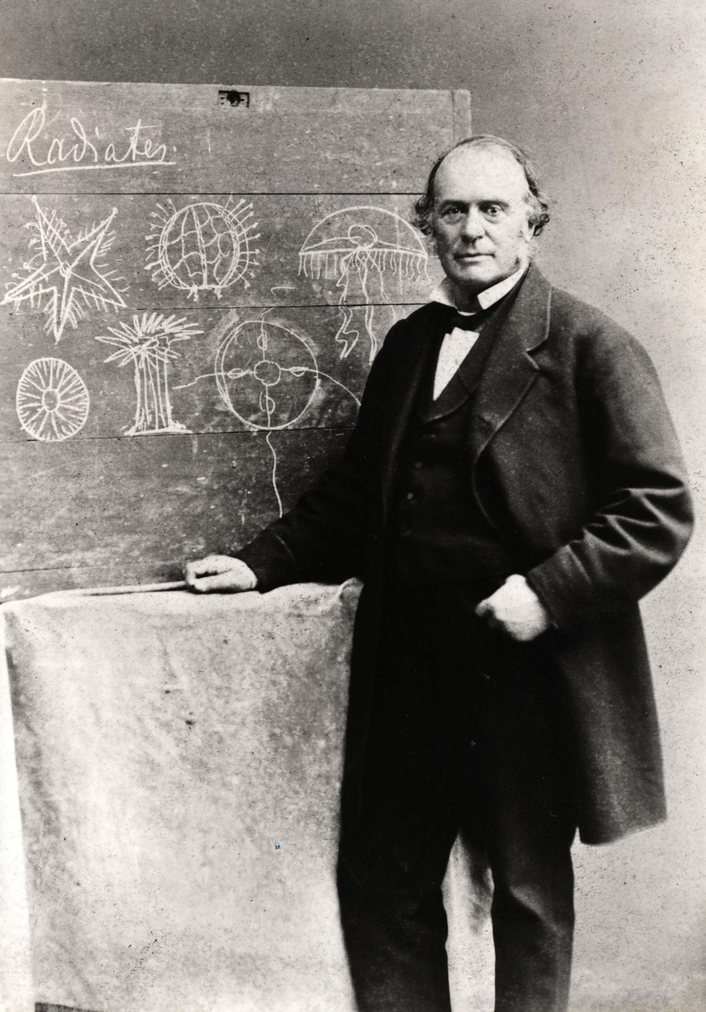
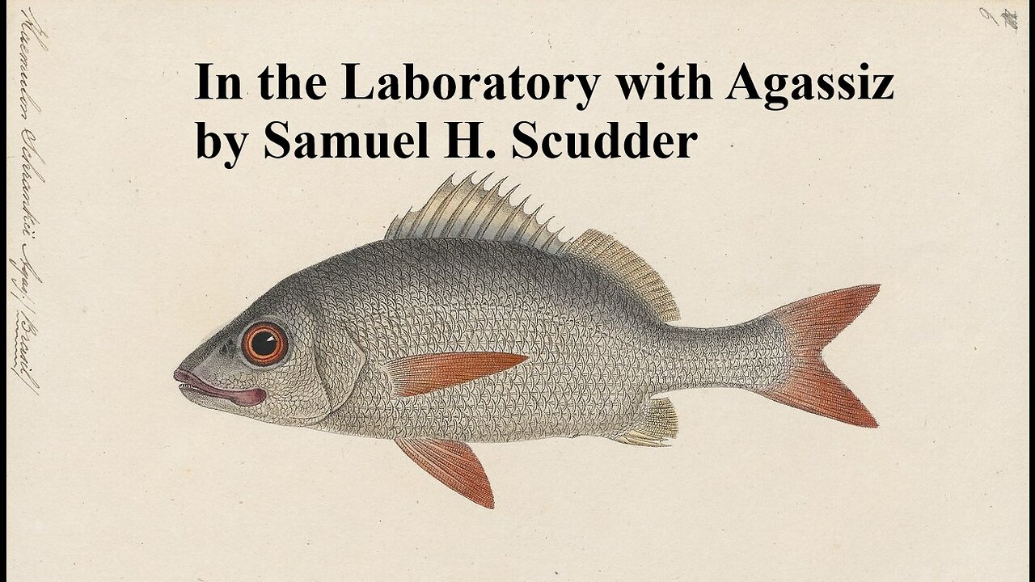
Professor Agassiz & The Haemulon
The essence of the inductive method was aptly illustrated by the experience of a student at Harvard who took a zoology course under professor Louis Agassiz, the renowned nineteenth-century naturalist. For the assignment Agassiz gave the student a pickled fish, a haemulon, which was to be the sole source of his observations over the next several days. For three full days the student observed the Haemulon in order to gain a thorough understanding of the fish. And what did Professor Agassiz's advise him to do? LOOK! LOOK! LOOK! How else would the student master his subject? He was also instructed to draw out what he saw (Cf Marking the Text, Making Lists, Recording observations) for as Agassiz reminded him that the pencil is one of the best eyes!
Finally, he was instructed to recognize the parts of the haemulon in their orderly arrangement and relations to each other, for "facts are stupid things until brought into connection with some general law."
Was Agassiz's inductive method successfully inculcated into his student? By the student's own testimony "To this day, if I attempt [to draw] a fish I can draw nothing but haemulons."
Louis Agassiz was once asked “What was your greatest contribution, scientifically?” to which he replied "I have taught men and women to observe."
The ability to correctly observe is a skill which must be perfected by practice and perseverance as illustrated in this "fish story."

Slide 77
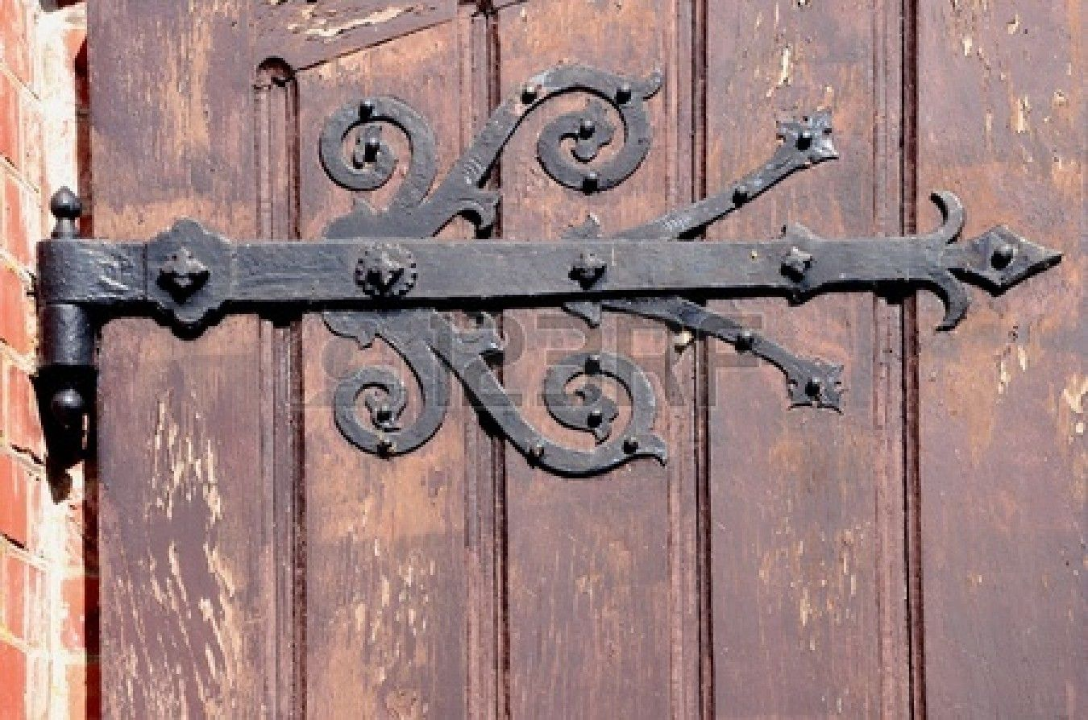
“Bible Code” words are like hinges of a door – enabled by the Spirit, they help “open up” the meaning of the text. In Luke 24:45 Jesus “opened their minds to understand the Scriptures.”

Slide 78
DON’T FORGET THE LITTLE CONNECTIVE WORD“AND”
AND can be just as crucial & clarifying as “but, etc”
John 15:4 Abide in Me, AND I in you
James 4:8 Draw near to God AND He will draw near to you
Psalm 37:4 Delight yourself in the Lord; AND He will give you the desires of your heart

Slide 79
OBJECTIVES IN STUDYING THIS CHAPTER
1) To understand how the virtues of faith, hope, and love should express themselves
2) To notice the potential a new congregation has for spreading the good news of the gospel of Christ,
and being a positive example to all believers
SUMMARY
Joined by Silvanus and Timothy who had been with him when the gospel was first preached in
Thessalonica, Paul offers his salutation along with a petition for grace and peace. He follows with an
expression of thanksgiving for their work of faith, labor of love, and patience of hope, knowing their
election by God (1-4).
His assurance of their election is bolstered by the manner in which they received the gospel. It had
come to them not only in word, but in power, in the Holy Spirit, and in much assurance. Having
imitated Paul and the Lord by receiving the word in much affliction and joy, they in turn had become
examples to all the believers in Macedonia and Achaia. From them the word had sounded forth in every
place, and the news of their own faith toward God had so spread that Paul did not need to tell others
about them. Indeed, others were telling Paul of the Thessalonians' conversion from idols to serve the
true God, and how they were waiting for the resurrected Jesus to return from heaven who would deliver
them from the wrath to come (5-10).

Slide 80
OUTLINE
I. INTRODUCTION (1-4)
A. SALUTATION (1)
1. From Paul, Silvanus, and Timothy (1a)
2. To the church of the Thessalonians in God the Father and the Lord Jesus Christ (1b)
3. Grace and peace from God and Jesus (1c)
B. THANKSGIVING (2-4)
1. Offered to God in their behalf, making mention of them in his prayers (2)
2. Mindful always of their:
a. Work of faith
b. Labor of love
c. Patience of hope in the Lord Jesus Christ
...in the sight of our God and Father (3)
4. Knowing their election by God (4)
Mark A. Copeland
The First Epistle To The Thessalonians 7

Slide 81
II. REFLECTIONS REGARDING THEIR CONDITION (1:5-10)
A. THEIR RECEPTION OF THE GOSPEL (5-7)
1. The gospel came to them not only in word, but...
a. In power
b. In the Holy Spirit
c. In much assurance
...for they knew what kind of men Paul and his companions had been for their sakes while
with them (5)
2. They had become followers of Paul and of the Lord, having received the word...
a. In much affliction (6a)
b. With joy of the Holy Spirit (6b)
3. They had became examples to the believers in Macedonia and Achaia (7)
B. THEIR REPUTATION IN EVERY PLACE (8-10)
1. From them the word of the Lord sounded forth in Macedonia, Achaia, and beyond (8a)
2. Their faith toward God had gone out, so Paul did not need to say anything (8b)
3. Others were telling Paul...
a. What manner of entry Paul had to them (9a)
b. How they had turned from idols to serve the living and true God (9b)
c. How they were waiting for the resurrected Jesus to return from heaven, who delivers
from the wrath to come (10)

Slide 82
1) What are the main points of this chapter? - Introduction (1-4) - Reflections regarding their condition (5-10) 2) Who joined Paul in the salutation of this epistle? (1) - Silvanus and Timothy 3) How did Paul address the church? (1) - The church of the Thessalonians in God the Father and the Lord Jesus Christ 4) What three things was Paul especially thankful for regarding the Thessalonians? (3) - Their work of faith - Their labor of love - The patience of hope in our Lord Jesus Christ 5) What did Paul know concerning the Thessalonians? (4) - Their election by God 6) How had the gospel come to the Thessalonians? (5) - In Word, in power, in the Holy Spirit, in much assurance7) How had they become followers of Paul and the Lord? (6)
- By receiving the word in much affliction, with joy of the Holy Spirit
8) For whom had they became examples? (7)
- All the believers in Macedonia and Achaia
9) What two things had sounded forth, or gone out, from the Thessalonians? (8)
- The word of the Lord
- Their faith toward God
10) What two things describe the manner in which they received Paul? (9-10)
- Their turning from idols to serve the living and true God
- Their waiting for Jesus from heaven
What are the main points of this chapter?
Who joined Paul in the salutation of this epistle? (1)
How did Paul address the church? (1)
What three things was Paul especially thankful for regarding the Thessalonians? (3)
What did Paul know concerning the Thessalonians? (4)
How had the gospel come to the Thessalonians? (5)
How had they become followers of Paul and the Lord? (6)
For whom had they became examples? (7)
What two things had sounded forth, or gone out, from the Thessalonians? (8)
What two things describe the manner in which they received Paul? (9-10)
<< Previous Index Next >>

Slide 83
I Thessalonians
1 (1)Paul, (2)Silvanus, and (3)Timothy,
To the church of the Thessalonians in God the Father and the Lord Jesus Christ: Grace to you and peace.
² We always give thanks to God for all of you, making mention of you in our prayers;
³ constantly keeping in mind your (1)work of faith and (2)labor of love and(3) perseverance of hope in our Lord Jesus Christ in the presence of our God and Father,
⁴ knowing, brothers and sisters, beloved by God, His choice of you;
⁵ for our gospel did not come to you (1)in word only, but also (2)in power and (3)in the Holy Spirit and (4)with full conviction; just as you know what kind of men we proved to be among you for your sakes.
⁶ You also became imitators of us and of the Lord, having received the word during great affliction with the joy of the Holy Spirit,
⁷ so that you became an example to all the believers in Macedonia and Achaia.
⁸ For the word of the Lord has sounded forth from you, not only in Macedonia and Achaia, but in every place the news of your faith toward God has gone out, so that we have no need to say anything.
⁹ For they themselves report about us as to the kind of reception we had with you, and how you turned to God from idols to serve a living and true God,
¹⁰ and to wait for His Son from heaven, whom He raised from the dead, that is, Jesus who rescues us from the wrath to come.
Simple Lists
vv. 1,3,5

Slide 84
I Thessalonians
1 Paul, Silvanus, and Timothy,
To the church of the Thessalonians in God the Father and the Lord Jesus Christ: Grace to you and peace.
² We always give thanks to God for all of you, making mention of you in our prayers;
³ constantly keeping in mind your work of faith and labor of love and perseverance of hope in our Lord Jesus Christ in the presence of our God and Father,
⁴ knowing, brothers and sisters, beloved by God, His choice of you;
⁵ for our gospel did not come to you in word only, but also in power and in the Holy Spirit and with full conviction; just as you know what kind of men we proved to be among you for your sakes.
⁶ You also became imitators of us and of the Lord, having received the word during great affliction with the joy of the Holy Spirit,
⁷ so that you became an example to all the believers in Macedonia and Achaia.
⁸ For the word of the Lord has sounded forth from you, not only in Macedonia and Achaia, but in every place the news of your faith toward God has gone out, so that we have no need to say anything.
⁹ For they themselves report about us as to the kind of reception we had with you, and how you turned to God from idols to serve a living and true God,
¹⁰ and to wait for His Son from heaven, whom He raised from the dead, that is, Jesus who rescues us from the wrath to come.

Slide 85
I Thessalonians
1 Paul, Silvanus, and Timothy,
To the church of the Thessalonians in God the Father and the Lord Jesus Christ: Grace to you and peace.
² We always give thanks to God for all of you, making mention of you in our prayers;
³ constantly keeping in mind your work of faith and labor of love and perseverance of hope in our Lord Jesus Christ in the presence of our God and Father,
⁴ knowing, brothers and sisters, beloved by God, His choice of you;
⁵ for our gospel did not come to you in word only, but also in power and in the Holy Spirit and with full conviction; just as you know what kind of men we proved to be among you for your sakes.
⁶ You also became imitators of us and of the Lord, having received the word during great affliction with the joy of the Holy Spirit,
⁷ so that you became an example to all the believers in Macedonia and Achaia.
⁸ For the word of the Lord has sounded forth from you, not only in Macedonia and Achaia, but in every place the news of your faith toward God has gone out, so that we have no need to say anything.
⁹ For they themselves report about us as to the kind of reception we had with you, and how you turned to God from idols to serve a living and true God,
¹⁰ and to wait for His Son from heaven, whom He raised from the dead, that is, Jesus who rescues us from the wrath to come.

Slide 86
HOW TO STUDY
YOUR BIBLE
OBSERVATION
What Does The Passage Say?
INTERPRETATION
What Does This Passage Mean?
APPLICATION
How Does The Truth Of This Passage Apply To Me
↓
↓
THE MORE TIME IN OBSERVATION
The more accurate the interpretation
OUR GREAT NEED…
LEARN WHAT
TO LOOK FOR
➔
➔


⬅
⬅
THE GOAL
Changed Lives
THAT
Change Lives
As we all “grow in the grace and knowledge of our Lord and Savior Jesus Christ. To Him be the glory, both now and to the day of eternity. Amen.” (2Peter 3:18)

Slide 87
Watch for contrasts and comparisons Contrasts and comparisons use highly descriptive language to make it easier to remember what you’ve learned. For example, Peter compares the devil to a roaring lion in verse 8. Peter also contrasts God’s attitude toward the proud and the humble. Note expressions of time The relationship of events in time often sheds light on the true meaning of the text. Marking them will help you see the sequence or timing of events and lead to accurate interpretation of Scripture. Geographic Locations Often it’s helpful to mark geographical locations, which tell you where an event takes place. Mark terms of conclusion Words such as “therefore,” “thus,” and “for this reason” indicate that a conclusion or summary is being made. Identify chapter themes The theme of a chapter will center on the main person, event, teaching, or subject of that section of Scripture. Themes are often revealed by reviewing the key words and lists you developed. Try to express the theme as briefly as possible, using words found in the text.

Slide 88
I Thessalonians
1 Paul, Silvanus, and Timothy,
To the church of the Thessalonians in God the Father and the Lord Jesus Christ: Grace to you and peace.
² We always give thanks to God for all of you, making mention of you in our prayers;
³ constantly keeping in mind your work of faith and labor of love and perseverance of hope in our Lord Jesus Christ in the presence of our God and Father,
⁴ knowing, brothers and sisters, beloved by God, His choice of you;
⁵ for our gospel did not come to you in word only, but also in power and in the Holy Spirit and with full conviction; just as you know what kind of men we proved to be among you for your sakes.
⁶ You also became imitators of us and of the Lord, having received the word during great affliction with the joy of the Holy Spirit,
⁷ so that you became an example to all the believers in Macedonia and Achaia.
⁸ For the word of the Lord has sounded forth from you, not only in Macedonia and Achaia, but in every place the news of your faith toward God has gone out, so that we have no need to say anything.
⁹ For they themselves report about us as to the kind of reception we had with you, and how you turned to God from idols to serve a living and true God,
¹⁰ and to wait for His Son from heaven, whom He raised from the dead, that is, Jesus who rescues us from the wrath to come.
Key Word: Gospel
vv. 5,6,8,
Verse | Gospel
v5 | did not come to the Thessalonian believers in word only; but also in power and in the Holy Spirit and with full conviction;
v6 | received the gospel during great affliction with the joy of the Holy Spirit
v8 | gospel has sounded forth from you, the Thessalonians believers
What does the phrase "the Word of the Lord" (the Word of which the Lord is the Author) refer to in context? Clearly this is a reference to the Gospel. It can be understood both as that Word of which the Lord is the Author and as the Word with the Lord as the object (e.g., "the gospel of God" and the "gospel of Jesus Christ" are both the Word about God and about Jesus, Who are both the object or focus of the message).

