Slide 1
TACTICS
A Gameplan for Discussing Your Christian Convictions
Notes:
*ADVANCE as you start*
Good morning. I’d like you imagine a scenario for a moment.
Imagine that you’re at a family gathering over Thanksgiving.
Your whole extended family is there – siblings, aunts, uncles, cousins, and everyone’s having a good time talking.
Your sister and her husband are Christians,
and their oldest son has is just finishing his first semester at a state university.
You chat with him a bit, ask him how the semester has been going,
and in the course of the conversation you ask him whether he’s been able to find a good church near the college.
His expression turns hard, and he raises his voice as he tells you

Slide 2
Notes:
Good morning. I’d like you imagine a scenario for a moment.
Imagine that you’re at a family gathering over Thanksgiving.
Your whole extended family is there – siblings, aunts, uncles, cousins, and everyone’s having a good time talking.
Your sister and her husband are Christians,
and their oldest son has is just finishing his first semester at a state university.
You chat with him a bit, ask him how the semester has been going,
and in the course of the conversation you ask him whether he’s been able to find a good church near the college.
His expression turns hard, and he raises his voice as he tells you
“No. I don’t believe that stuff anymore.” And as you look at him in astonishment, he announces. “College has really been eye-opening for me. I’ve learned that there’s no evidence for the existence of God. The only reason people believe in God is because they can’t handle the real world and they need a crutch to get through life.”
The conversation around you gets quiet. You can tell that his parents, and in fact indeed everyone sitting nearby are uncomfortable and feeling awkward. The boy is glaring at you, daring you to respond. What could you possibly say in a situation like that?
But let’s put that aside for a moment.
*ADVANCE*
And let’s imagine another scenario.

Slide 3
Notes:
And let’s imagine another scenario. Let’s say that you’re a student yourself, and you’re in a bus on your way from your dorm to your morning classes. There’s a girl sitting beside you, and she notices that you’ve got a Bible tucked into the front pocket of your bookbag and strikes up a friendly conversation with you. You ask her if she’s a Christian and she tells you:
“Well… sort of? But not really. I grew up in a Christian home, and, y’know, I think Christianity is fine, and I think Jesus taught a lot of great things. But I’ve been learning a lot about other religions too. There’s a couple of Muslim and Hindu girls on my hall, who are really serious about their faith too. There’s people like that all over campus. So, who am I to tell them that Christianity is better their religions? I think the essence of Jesus’s teaching was about love, which is what other religions teach too. I think people connect to God in lots of different ways, don’t think it’s our place to tell other people how they should live and what they should and shouldn’t believe.”
Now you’ve only got a few minutes before your bus gets to the center of campus and everyone gets off. So, with what little time you have, what can you say to that young woman?
*ADVANCE*
Well, welcome to Apologetics Week #4! This is a series of classes that Scott, Dana, Jeff Johnston and I will be teaching on a variety of topics, and I appreciate the introduction Scott has given us to apologetics and worldviews over the last couple of weeks.

Slide 4
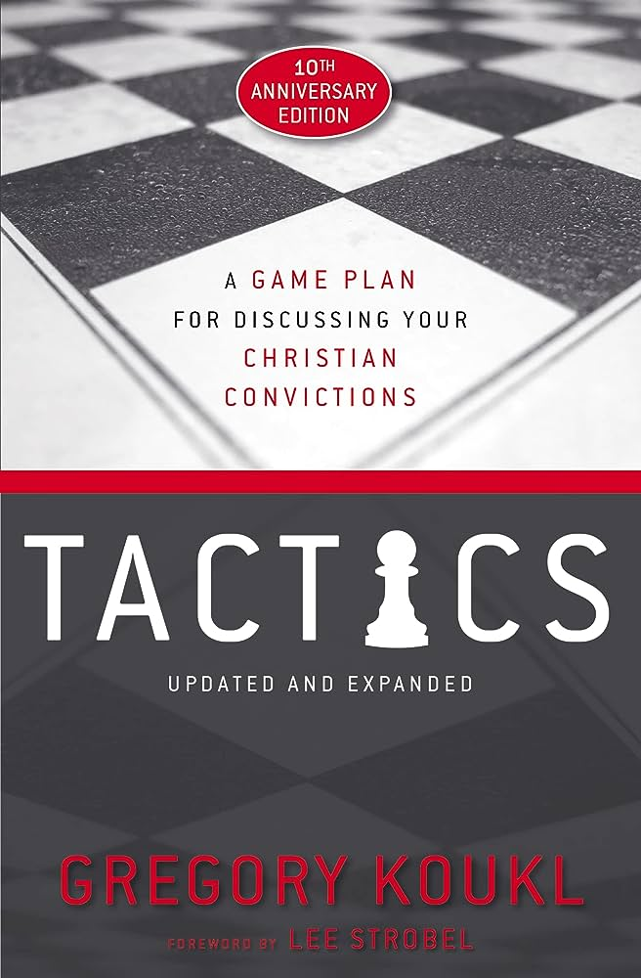
Apologetics Week 4
Today’s class will be a bit unusual
We’ll be looking at tactics rather than strategies
This class is based on Greg Kokul’s book…
…but we can only scratch the surface. 😞
Buy it or get it from our library! 😄
“I am going to teach you how to navigate in conversations so that you stay in control — in a good way — even though your knowledge is limited.”
“I am going to introduce you to a handful of effective maneuvers — I call them tactics — that will help keep you in the driver’s seat.”
Notes:
** 9:33 **
Well, welcome to Apologetics Week #4! This is a series of classes that Scott, Dana, Jeff Johnston and I will be teaching on a variety of topics. We’ve been talking about the Christian worldview and the authority of God’s word over the last three weeks, and we’re starting now to transition to the practical side of apologetics, answering objections and giving a defense for the faith.
*CLICK*
As you can see, we’re just diving straight in today. This class is going to be a bit unusual. We’re not going to be spending time a lot of time today answering objections, or giving strategies on how to defend the faith. We’re going to be talking about something even more fundamental than that. We’re going to be talking about TACTICS you can use to help guide the conversation in ways you want it to go EVEN IF you don’t have an answer for the objection or arguments your opponent is raising.
*CLICK* And our textbook for the class today is going to be this book, called TACTICS, written by Christian apologist and radio host Greg Kokul
*CLICK*
Now most of Christian apologetics is focused on the overall strategy of promoting the gospel – and rightly so!
We’re going to have classes this semester talking about the defensive strategy of apologetics, where you answer questions and challenges that are intended to undermine or disprove Christianity.
And we’ll be talking about proactive strategies, where you make a positive case for Christianity.
That’s the strategy of apologetics – the big picture and the overall goal
TACTICS, on the other hand,
are the tools you use to accomplish your strategy,
and to deal with the situation immediately at hand,
so that you can navigate the conversation you’re in and stay in control of it.
And when I say “stay in control of it”, I’m not talking about using tricks to confuse the other person, or coming up with some “gotcha moments” that you can use to manipulate or humiliate the other person. Instead, what we’re going to look at today can be summarized with a couple of quotes from Greg Kokul.
He says this:
*CLICK*
"I am going to teach you how to navigate in conversations so that you stay in control—in a good way—even though your knowledge is limited.
“You may know nothing about answering challenges people raise against what you believe. You may even be a brand-new Christian. It doesn’t matter. *CLICK* I am going to introduce you to a handful of effective maneuvers—I call them tactics—that will help keep you in the driver’s seat.“
*CLICK*
That quote comes from Greg Kokul’s book TACTICS.
*CLICK*
Unfortunately, we’re only going to be able to scratch the surface of the book, and look at the very first tactic that he covers (though it’s foundational to everything else he teaches in the book). My hope for this class is not that you get everything there is to know about this book, but that by covering just a portion of the book, it will make you say “Hey, that stuff’s pretty interesting, and it’s not nearly as intimidating as I thought! I wonder what else the book teaches?”
*CLICK*
And then maybe you’ll go get read the book yourself. You can get it for $14 off Amazon, plus we have a copy of the book in our library AND ALSO a teaching series on DVD that Greg Kokul did based on the book. So, if this class piques your interest and you’d like to know more about what’s in the book, and if you’re the first one to the library after church this morning, you can read it for free or get the DVD and watch it.
Well, before we get going on this class, let’s open with prayer.
(PRAY)
*ADVANCE*
Now I mentioned that the tactics Greg Kokul covers in this book are meant to be non-intimidating, the sort of things that anyone can do. Let me give you a quote from near the start of the book. Kokul says this.

Slide 5
A Modest Goal
“All I want to do is put a stone in someone’s shoe. I want to give that person something worth thinking about, something he can’t ignore because it continues to poke at him in a good way.
Notes:
** 9:38 **
Now I mentioned that the tactics Greg Kokul covers in this book are meant to be non-intimidating, the sort of things that anyone can do. Let me give you a quote from near the start of the book. Kokul says this.
"It may surprise you to hear this, but I never set out to convert anyone. My aim is never to win someone to Christ. I have a more modest goal, one you might consider adopting as your own. *CLICK* All I want to do is put a stone in someone’s shoe. I want to give that person something worth thinking about, something he can’t ignore because it continues to poke at him in a good way.
*CLICK*
“Think of it this way [he goes on]. When a batter gets up to the plate, his goal isn’t to win the ball game. That’s an extended process that takes a team effort. He just wants a chance to get a hit. If he connects, he might get on base and into scoring position. Or he may drive another batter home even if he never makes it to first. In the same way, I never try to hit the winning run. I just want to get up to bat. That’s all.“
Now why might that be? Why is it that it may not be necessary to give a gospel presentation in every conversation we have with an unbeliever? (POSSIBLE QUESTION TO AUDIENCE) Well, there may be several reasons, but one big reason is that it may not always be the right time to give the gospel. Think about the conversations that Jesus had with unbelievers. It’s remarkable how many of them did not include a call for them to repent and believe on him.
The 10 lepers that he healed,
the man in the synagogue with a withered hand,
the lame man at the pool of Bethesda,
the rich young ruler,
the lawyer who questioned him about who his neighbor was…
Jesus didn’t give what we would call the “gospel” to any of these men. Now, did any of them come to faith later? Well, some of them did, but for most of them, the day that Jesus spoke with them was not their “day of salvation”.
Let’s look at something Jesus said to his disciples, in John chapter 4 if you’d like to turn there.
*ADVANCE*
This it the passage where Jesus meets the woman at the well, but I’m calling this section “Jesus and the Samaritans”, for reasons that should become clear.

Slide 6
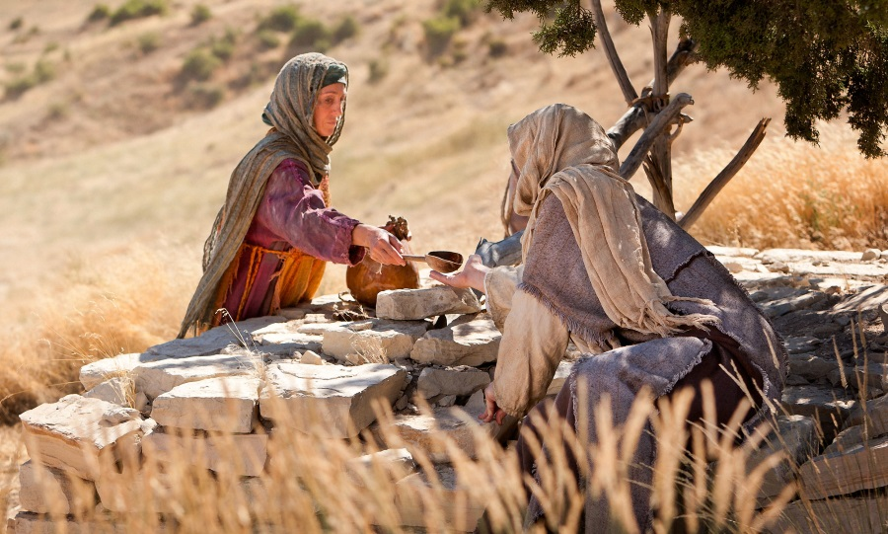
Jesus and the Samaritans
(John 4:35–38) Look, I tell you, lift up your eyes, and see that the fields are white for harvest. Already the one who reaps is receiving wages and gathering fruit for eternal life, so that sower and reaper may rejoice together. For here the saying holds true, ‘One sows and another reaps.’ I sent you to reap that for which you did not labor. Others have labored, and you have entered into their labor.
Notes:
** 9:40 **
This it the passage where Jesus meets the woman at the well, but I’m calling this section “Jesus and the Samaritans”, for reasons that should become clear.
You’re all probably familiar with how Jesus spoke to the woman, convicted her of her sins, and identified himself as the Messiah who would save both Jews and Samaritans. And after that, the woman runs back to her village to tell everyone about Jesus, and it says in verse 30 of John chapter 4, “[the Samaritan people] went out of town and were coming to him.”
And while that’s happening, the disciples talk to Jesus for a few moments, and then picking up in verse 35, Jesus says this:
Do you not say, ‘There are yet four months, then comes the harvest’?
*CLICK*
Look, I tell you, lift up your eyes, and see that the fields are white for harvest. [And here, it’s very possible that Jesus was pointing literally at the people who were coming out of the town to meet him] Already the one who reaps is receiving wages and gathering fruit for eternal life, so that sower and reaper may rejoice together. For here the saying holds true, ‘One sows and another reaps.’ I sent you to reap that for which you did not labor. Others have labored, and you have entered into their labor.”
*ADVANCE*
Jesus tells us in this passage that there’s a time to sow and a time to reap. Someone had already sown seeds in the life of this woman – there were things she already knew that Jesus didn’t have to go over with her.

Slide 7
A time to sow, a time to reap
(John 4:35–38) Look, I tell you, lift up your eyes, and see that the fields are white for harvest. Already the one who reaps is receiving wages and gathering fruit for eternal life, so that sower and reaper may rejoice together. For here the saying holds true, ‘One sows and another reaps.’ I sent you to reap that for which you did not labor. Others have labored, and you have entered into their labor.
Notes:
Jesus tells us in this passage that there’s a time to sow and a time to reap. Someone had already sown seeds in the life of this woman – there were things she already knew that Jesus didn’t have to go over with her.
She knew what the Old Testament recorded about Jacob. She knew that there was a God who deserved to be worshiped. She had been taught that a Messiah was coming. So when Jesus tells he that he is the Messiah, the seed comes to life and grows and produces fruit, and the time for harvest arrives.
And it’s interesting that Jesus says not JUST that there’s a time for sowing and for reaping. He also says that there are *CLICK* two different roles that people on his team take: “One sows” he says, “and another reaps”.
But the end result is that both the sower and the reaper will rejoice and both of them will be rewarded.
*ADVANCE*
At my old house, we used to have a plum tree in our front yard. And when June or July would roll around, I could walk out to that tree and just bump it with my shoulder, and it would drop a dozen plums. All of them ripe, all of them ready to make into jam.

Slide 8
A time to sow, a time to reap
(John 4:35–38) Look, I tell you, lift up your eyes, and see that the fields are white for harvest. Already the one who reaps is receiving wages and gathering fruit for eternal life, so that sower and reaper may rejoice together. For here the saying holds true, ‘One sows and another reaps.’ I sent you to reap that for which you did not labor. Others have labored, and you have entered into their labor.
“Since the harvesting is easy when the fruit is ripe, and since the lion’s share of the labor is in the gardening, I suspect we need more gardeners than harvesters. That means there is a place for you, even if you do not fancy yourself a good [harvester].”
Notes:
** 9:43 **
At my old house, we used to have a plum tree in our front yard. And when June or July would roll around, I could walk out to that tree and just bump it with my shoulder, and it would drop a dozen plums. All of them ripe, all of them ready to make into jam.
But if I had gone up to that tree in May and bumped it, nothing would have happened. You could see the fruit on the tree, but it wouldn’t have been ripe yet. It wasn’t time for harvest. And if I started trying to force the harvest, and grabbed a branch and started shaking it, the fruit that would have dropped to the ground would have been unripe, worthless fruit. There was no way to force a harvest before harvest time came.
Well, it’s the same with people when it comes to conversion. Most people are not saved the first time they hear the gospel. Most of us weren’t converted the first time we heard the gospel… or the second… or the tenth. For some of us there may have been years of sowing in our lives – maybe from parents, or pastors, or Sunday school teachers, or maybe your coach, or your teammates, or your friends.
And you never paid much attention to any of that. But then one day someone says something about Jesus, or you remember something about Jesus you heard long ago., and it hits you in a way it never had before. All that sowing and watering from dozens of people finally produces growth, and then a season for harvesting comes.
So it would be a mistake (and this is where we get back to the central point of this class) for you to think that if all you did was put a stone in someone’s shoe and gave them just a little something to think about during a conversation even though you didn’t answer all their objections or give a full gospel presentation… it would be a mistake to think that you had failed in your witnessing. Not at all! Here’s what Greg Kokul says:
*CLICK*
“Since the harvesting is easy when the fruit is ripe, and since the lion’s share of the labor is in the gardening, I suspect we need more gardeners than harvesters. That means there is a place for you, even if you do not fancy yourself a good [harvester]. I am convinced [he goes on] that most Christians—including me—are not harvesters. Instead, we are ordinary gardeners, tending the field so others can bring in the crop in due season. Some Christians, aware of their difficulty in harvesting, get discouraged and never go into the field at all. If this describes you, then you need to know it’s okay to sow, even if you don’t reap. There’d be no harvest at all without sowers like you.”
*ADVANCE*
So, not every conversation with an unbeliever will lead to a conversion - maybe not even a presentation of the gospel. Sometimes what’s needed is just some sowing work.

Slide 9
A Tough Spot
“What if I told you there was an easy escape from the challenge that each situation presents, a way to minimize the awkwardness and engage the other person productively and gracefully?
What if you had a simple plan in place that would guide you in your next move?”
Colossians 4:5–6
Walk in wisdom toward outsiders, making the best use of the time. Let your speech always be gracious, seasoned with salt, so that you may know how you ought to answer each person.
Notes:
** 9:46 **
So, not every conversation with an unbeliever will lead to a conversion – it may not even a presentation of the gospel. Sometimes what’s needed is just some sowing work.
*CLICK*
But that still leaves us in a tough spot sometimes.
If we have situations like the ones I described earlier, how can we go about sowing? How do we put a stone in someone’s shoe?
After all, you may only have limited amount of time to answer, and you may never see these people again.
And you want to be gracious in your response *CLICK* as Colossians 4:5-6 says (READ). You want to speak in a way that’s productive, and maybe even challenging, and yet courteous and friendly.
Well here’s what Greg Kokul says:
*CLICK – READ* ““What if I told you there was an easy escape from the challenge that each situation presents, a way to minimize the awkwardness and engage the other person productively and gracefully? What if you had a simple plan in place that would guide you in your next move?”
Well, we’re going to spend the rest of our class looking at that plan that’ll get us started.
The way we’re going to do our sowing
*ADVANCE*
is by ASKING QUESTIONS.
And the way we do THAT is using the first and most foundational tactic in this book, a method that Greg Kokul calls
*CLICK*
The COLUMBO TACTIC.

Slide 10
The Columbo Tactic:
Asking Questions
“The key to the Columbo tactic is to go on the offensive in an inoffensive way with carefully selected questions that advance the conversation. Never make a statement, at least at first, when a question will do the job.”
Notes:
The way we’re going to do our sowing is by ASKING QUESTIONS.
And the way we do THAT is by using the first and most foundational tactic in this book, a method that Greg Kokul calls
*CLICK*
The COLUMBO TACTIC.
How many of you know who Lieutenant Columbo is?
Lieutenant Columbo was the star of the detective TV show "Columbo" in the 70's and 80’s,
and it was a unique detective show, because the audience got to watch the crime take place at the beginning of the show, so they knew exactly who the criminal was.
And then this bumbling-detective, Columbo, would come onto the scene, and he looked ridiculous –
always wearing this rumpled raincoat,
always forgetting things,
losing his pencil,
telling stories that would bore you tears.
And the criminal would relax, because there was no way this guy would ever figure it out.
And Columbo would look around at a crime scene, and scratch his head, and tell the suspect “You know, something about this bothers me – it’s just these little things that don’t make sense. You’re a smart guy – can you help me out with this?”
And he’d ask the suspect a question, and then say "Oh, yeah, you're probably right - thanks for the help".
But then a moment later he'd “oh, sorry just one last question.”
But then that question would lead to another question , and then another, and another,
until eventually the criminal realized that Columbo was a lot smarter than he looked, and he'd sprung a trap on him and now the jig was up.
It was a great TV series.
And Greg Kokul says this:
*CLICK – READ*
“The key to the Columbo tactic is to go on the offensive in an inoffensive way with carefully selected questions that advance the conversation. Never make a statement, at least at first, when a question will do the job.”
*ADVANCE*
And one of the great things about asking questions instead of making statements is that they keep you safe, in several different ways

Slide 11
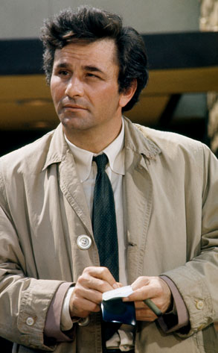
How Questions Keep You Safe
Keep you out of the hot seat, because you have nothing to defend
Draw the other person out
Sincere questions are flattering when they’re a genuine invitation to a person to talk about their own views and opinions
Free education for you
Let you make progress without being pushy
Put you in the driver’s seat, letting you control the conversation
Notes:
** 9:49 **
And one of the great things about asking questions instead of making statements is that they keep you safe, in several different ways
*CLICK*
First of all, questions keep you out of the hot seat, because you have nothing to defend. If you had made a statement of your own, like “Of course there’s clear evidence God exists” or “I believe Jesus is the only way of salvation”, now you’re on the hook to back your statements up with evidence. But when you ask a question, the ball is in the other person’s court.
*CLICK*
It also draws the other person out, hopefully in a friendly and engaging way. Sometimes questions are just used as weapons in a debate – they can be used in sarcastic or belittling or contemptuous way.
*CLICK* But sincere questions are flattering when they’re a genuine invitation to a person to talk about their own views and opinions. People love being asked about what their opinion is, and if they see you’re genuinely interested in what they have to say, that can defuse hostility right from the start.
*CLICK*
Plus, you get a free education out of it. Maybe you genuinely don’t know much about the religion or political ideology or worldview this person follows – well, rather than read a book about it, here’s your chance to learn about it firsthand from someone who believes it.
*CLICK*
Questions also let you make progress without being pushy. If the other person makes a statement, and you counter with a statement of your own, and then he pushes back and YOU push back, then conversation can get heated pretty quickly. But questions let you move the conversation forward without the risk of YOU looking aggressive or overbearing.
*CLICK*
And finally, questions keep you in the driver’s seat, letting you control which way the conversation goes.
So this is what the book calls THE COLUMBO TACTIC, the first and most important of all the tactics
*ADVANCE*
And we’re going to spend the rest of the class looking at this one tactic, which can be divided up into three parts.

Slide 12
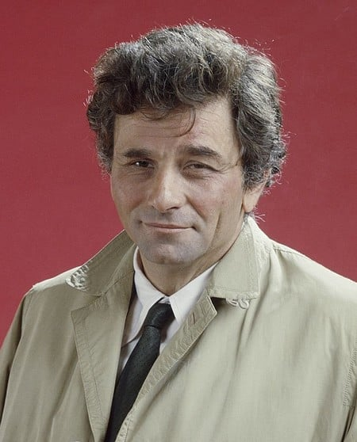
Three Steps in the Columbo Tactic
Gathering information
Reversing the burden of proof
Using questions to make a point or expose flawed thinking
Notes:
** 9:52 **
And we’re going to spend the rest of the class looking at this one tactic, which can be divided up into three parts.
*CLICK*
The first part of the Columbo tactic is simply gathering information, and we’ll look at that in just a moment.
*CLICK*
After that, the second part of the Columbo tactic is reversing the burden of proof.
*CLICK*
Finally, the last step is using questions to make a point or expose flawed thinking in your opponent.
(And before we go any further, let me just pause for a moment and say that I’m using the word “opponent” in this class as a label for the person you’re having a conversation with, just for lack a better word. Of course, that person isn’t your enemy – it may be a stranger, but it could also be family member or a close friend. I’m just using the word “opponent” to refer to the person who challenges your faith and worldview.)
*CLICK for green circles*
Now, unfortunately we’re only going to have time to look at the first two steps in this tactic. The third one, I’ll touch on just briefly at the end, but it’s a more advanced step in the process. Again, my hope in this class is that I get you interested enough in what Greg Kokul writes about that you’ll go get his book and read it for yourself.
*ADVANCE*
So let’s take a look now at step number ONE of the Columbo Tactic, Gathering Information

Slide 13
Columbo Tactic Step 1:
Gathering Information
A Model Question:
“What do you mean by that?”
I’m a little confused by what you said. What exactly do you mean by that?
I’m not sure I understand you. Can you clear this up for me?
What specifically are you getting at?
How so? Can you give me more detail?
Tell me more.
Notes:
** 9:53 **
So let’s take a look now at step number ONE of the Columbo Tactic, Gathering Information
This is how we’re going to start off when answering the atheist who doesn’t believe in God, or the person who believes all religions are basically the same, or whatever their argument against your faith may be.
Your goal here is not to
answer the objection,
or to give evidence for Christianity,
or even to share the gospel. You may get that opportunity, but in many cases, it would be premature to do that at the start of the conversation.
Instead, your goal here is just to get the lay of the land, and gather intel on what your opponent’s objection or assertion is.
So we’re going to use questions in order to gather information here at the start of the conversation,
*CLICK*
and the model question that we’re going to start with is:
*CLICK*
“What do you mean by that?”
So, when the atheist says that religion is just a crutch for weak people, or a girl tells you that Christians shouldn’t say that other religions are wrong, you might say, for example,
*CLICK* “I’m a little confused by what you said. What exactly do you mean by that?” And you pick something in their statement that you’d like them to elaborate on
*CLICK* “I’m not quite sure I understand you. Can you clear this up for me?”
*CLICK* What specifically are you getting at in what you said?”
*CLICK* “How so? Can you give me more detail about what you mean?”
*CLICK* Or you can simply say, “Tell me more.”
*ADVANCE*
Now starting your response with a question like one of these has several advantages:

Slide 14
Columbo Tactic Step 1:
Gathering Information
“What do you mean by that?”
Safe entry point that puts you in the driver’s seat
Puts the ball back in your opponent’s court
Gives you more information about what your opponent is specifically arguing
Turns the conversation into a dialogue instead of a monologue
Notes:
** 9:55 **
Now starting your response with a question like one of these has several advantages.
*CLICK*
First of all, like we’ve said before, it’s a safe entry point into the conversation. Since you’re the one who’s asking the questions, you’re in the driver’s seat, and you have the ability to steer the conversation in the way you want it to go.
*CLICK*
And now you’ve put the ball back in your opponent’s court. You’re not on the hook to advance your own point of view or defend anything.
*CLICK*
And asking “what do you mean by that” allows you to get more information and clarification about what your opponent is specifically arguing.
And sometimes it’s not just you who gets more clarification.
Sometimes, you might ask your question and just get silence back.
Because maybe your opponent hasn’t fully thought through the point he’s making, either.
It could just be a slogan he’s heard from other atheists, or something their college professor said in class, and it sounded good at the time.
Maybe he hasn’t actually thought through how to defend his own position.
Asking this kind of question forces him to be more specific as to what his actual challenge is.
And finally, it turns the conversation into a dialogue, instead of making it a monologue. If someone says “I don’t believe in God,” and you immediately jump into all kinds of arguments and evidences that prove that God exists, it just turns into a monologue. Or even worse, it turns the conversation into two monologues. He says what he believes, you say what you believe, he raises his voice and says why all your arguments are wrong, you tell him why all HIS beliefs are wrong, and both of you just end up getting mad at each other. But asking “what do you mean by that? Can you explain what you believe a bit more?” invites a dialogue. You’re not getting into the other person’s face and saying “Whaddya mean by that??”
Instead you’re saying, “Hey, I’m interested in what you just said there, but I’m not sure I quite understood everything. Can you tell me what you mean when you say… <whatever it is they said>”
If it’s done with genuine interest, it can cause people to let their guard down. People like to talk about their own opinions. And now you’re on your way to a genuine dialogue, not an argument.
*ADVANCE*
And in the spirit of being genuine with your questions, don’t forget to actually listen to their answers!

Slide 15
Columbo Tactic Step 1:
Gathering Information
“What do you mean by that?”
Don’t forget to listen to their answers!
Be courteous
Don’t attack a straw man
Listen for more ambiguities or contradictions you can follow up on
Notes:
** 9:58 **
*ADVANCE*
And in the spirit of being genuine with your questions, don’t forget to actually listen to their answers!
*CLICK*
For one thing, that’s just being courteous. Nobody likes it when they’re asked a question, but it’s obvious the person asking the question really isn’t interested in what they have to say.
*CLICK*
But also, you don’t want to misrepresent them! Imagine if the girl on the bus told you “I think all religions are pretty much the same” and you responded by saying “Oh, ok, so I guess according to you, Christians who build hospitals and run food banks and homeless shelters are exactly the same as the kind of Muslims who flew the planes into the Twin Towers and killed 3000 people - is that what you believe?”
Well no, that’s not what she believes and not what she were trying to convey. If you misrepresent her beliefs, and then proceed to attack her on the basis of that misrepresentation, you’re only to make her angry and frustrated, and she won’t have any reason to listen to anything you have to say after that.
So, ask your questions, but be sure you’re listening to the answers, so that your followup questions demonstrate that you really are trying to understand what they’re saying and represent their point of view accurately.
*CLICK*
And by carefully listening, you may discover more ambiguities or contradictions in their thinking that will present followup-questions for you, where you can say something like “OK, I think I understand the first part of what you’re saying, but this other thing you mentioned isn’t quite clear to me. What did you mean by that?")
*ADVANCE*
So that’s step 1 in the Columbo tactic: gathering information.
Now, as this conversation is starting out, one thing you should keep in mind is that your opponent may be assuming that he gets a free ride

Slide 16
Free Rides?
“Here is the basic 'burden of proof’ rule: the one who makes the claim bears the burden.
If a critic says something is true, then it’s his obligation to provide reasons why anyone should take his claim seriously.”
Notes:
** 10:00 **
So that’s step 1 in the Columbo tactic: gathering information.
Now, as this conversation is starting out, one thing you should keep in mind is that your opponent may be assuming that he gets a free ride
For instance if he says “There is no God,” he may believe that the burden is now on you to prove him wrong. (And often we as Christians may respond as if that the burden is indeed on us at that point.)
Or if a girl says “I believe all religions teach fundamentally the same thing”, she may believe that it’s now your responsibility to give a counter-argument. Otherwise, she wins the debate.
But that’s backwards. And this is why it’s so helpful that you’re in the driver’s seat asking the questions. Because you’re asking questions, you don’t have the burden of proof.
Here’s how Greg Kokul puts it:
*CLICK* READ
Here is the basic burden of proof rule: the one who makes the claim bears the burden.
If a critic says something is true, then it’s his obligation to provide reasons why anyone should take his claim seriously.”
Think about the statement “there is no God”. That’s not an argument. That’s just an assertion, with no arguments to back it up. There’s no reason you should give your opponent a free ride, and a pass on having to defend his view. Or suppose you’re discussing creation vs. evolution with someone and you ask them how life could have originated from non-life, and they say
“Well, it’s possible that in the early days of the earth when there was a primordial soup that certain amino acids were generated by radiation or lightning strikes, and that afterwards organic compounds came together, and that over billions of years molecular self-replication mechanisms developed until the first single-celled organism emerged. And from that first instance of life, more complex life forms evolved.”
Is that something you now have to refute? Because that may SOUND scholarly and potentially reasonable… but your opponent has given no evidence whatsoever that that actually took place. If you start your sentence with “It’s possible that… such and such could have happened”, then there’s literally no end of things you can imagine. But it’s not your job to disprove those stories. It’s the job of your opponent to give evidence that what he’s saying is true.
So, when you ask your opponent “what do you mean by that”, and they give you back an assertion with no arguments to back it up, don’t give them a free ride. It’s not your job to step in and start refuting assertions that they haven’t bothered to defend.
So in a case like that, what should do instead?
*ADVANCE*
Well, it’s time to go on to step 2 of the Columbo tactic, where you reverse the burden of proof and put it back on them.

Slide 17
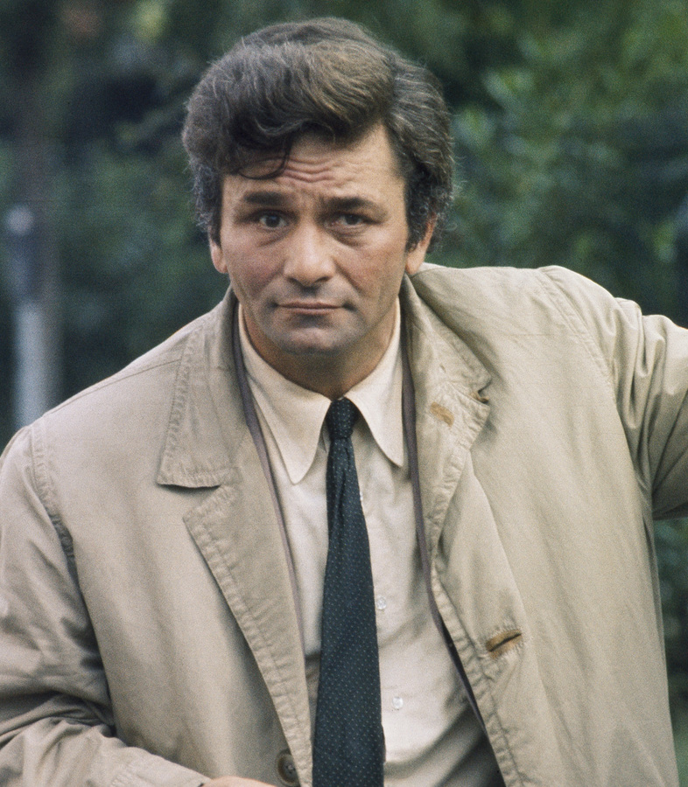
Columbo Tactic Step 2:
Reversing the Burden of Proof
A Model Question:
“How did you come to that conclusion?”
I'm curious - what are you reasons for thinking that?
What makes you confident that your view is true?
How exactly does that work?
Why do you think that's the way it happened (or the way it works)?
Notes:
** 10:03 **
Well, it’s time to go on to step 2 of the Columbo tactic, where you reverse the burden of proof and put it back on them.
*CLICK*
And it’s also going to have a model question. (*DON’T CLICK*”)
Greg Kokul says this:
So here’s our rule for Columbo #2: No more free rides. Every time someone makes a contentious claim—and after you get clarification on what he means by his assertion (Columbo #1)—you are going to ask your second Columbo question, *CLICK* “How did you come to that conclusion?”
Now this question, just like the first one, can take many forms. You might ask
*CLICK* I'm curious - what are you reasons for thinking that?
*CLICK* Or, What makes you confident that your view is true?
*CLICK* Or, How exactly does that work?
*CLICK* Or, Why do you think that's the way it happened (or the way it works)?
Now at this point, there’s still no pressure on you. You haven’t stated your own view, so you don’t have to defend anything. You’re simply now asking the other person to backup what they’re saying with evidence.
And again, you may discover that their response to this second Columbo question is silence. There are many, many people who have strong opinions on things who have never actually gone to the effort to formulate reasons why they believe that. Putting the burden of proof back on them, and asking them what evidence they have for their view may very well be the stone in their shoe that will irritate them (in a good way) in the days and weeks to come.
*ADVANCE*
So that’s the first two parts of the Columbo tactic – gathering information, and reversing the burden of proof. Let’s take them for a test drive now, and see how we might use them in real-life conversations.

Slide 18
Three Steps in the Columbo Tactic
Gathering information
Reversing the burden of proof
Using questions to make a point or expose flawed thinking
Notes:
So that’s the first two parts of the Columbo tactic – gathering information, and reversing the burden of proof. Let’s take them for a test drive now, and see how we might use them in real-life conversations.
*ADVANCE*
Let’s revisit the two scenarios we started the class with. Let’s go first of all back to our family dinner, where your nephew has just announced

Slide 19
“Believing in God is irrational. There’s no evidence that God exists.”
1
“What do you mean by that?”
Notes:
** 10:05-10:09 **
Let’s revisit the two scenarios we started the class with. Let’s go first of all back to our family dinner, where your nephew has just announced that he no longer believes in Christianity, or in any religion at all.
*CLICK*
“Believing in God is irrational,” he says. “There’s no evidence that God exists.”
So, beginning with that statement of his,
*CLICK*
What would be an example of how we could get this dialogue off the ground. (And this is a question for everyone! It’s audience participation time!) How can we get started here? Let’s not begin by immediately telling him that he’s dead wrong and start pulling out all the evidence we have that God really does exist. Can you think of a “What do you mean by that” type of question that can help us gather more information or clear up some ambiguities in his statement?
Can you tell me what you mean when you say belief in God is irrational? (you’re not even asking why he thinks belief in God is irrational – at this point you just want to know “what do you mean by the word ‘irrational’?”)
You said there’s no evidence that God exists. What kind of evidence do you think would be acceptable to demonstrate that God exists?
(before you start offering evidence, you want to know what he finds acceptable, and whether he's consistent with his standards when it comes to other things he also believes)
*ADVANCE*
So let’s assume you ask a question like that and he gives you further details.
*CLICK*
He says “When I say there’s no evidence for God, I mean you can’t see him, hear him, touch him. And when I say it’s irrational to believe I God, I mean that there’s no REASON you should believe in some all-powerful deity you can’t see or hear. There’s nothing in the universe whose existence can only be explained by God. Science is proving that you don’t need God to explain the way the universe works. People who believe in God have turned off their brains, and rejected science, and they’ve chosen blind faith instead.”

Slide 20
“It’s irrational to believe in an all-powerful deity you can’t see or hear. Science explains how the universe works, so belief in God is blind faith and anti-science.”
1
“What do you mean by that?”
2
“How did you come to that conclusion?”
Notes:
So let’s assume you ask a question like that and he gives you further details.
*CLICK*
He says “When I say there’s no evidence for God, I mean you can’t see him, hear him, touch him. And it’s irrational - it goes against REASON AND LOGIC to believe in some all-powerful deity you can’t see or hear. Science is proving that you don’t need some kind of “god” to explain the way the universe works. People who believe in God have turned off their brains, and rejected science, and they’ve chosen blind faith instead.”
Now at this point you might be tempted to launch into refuting his statements, but instead of doing that, let’s go on to
*CLICK*
step 2, reversing the burden of proof. What kind of “how did you come to that conclusion” statements could you use here?
What is it about a belief in God’s existence that is irrational specifically? (here, you want some specifics from him about why he thinks belief in God is nonsensical and irrational, not just generalizations. What laws of logic are being violated by believing in God? What makes that an unreasonable idea?)
Maybe you go on with, how did you come to the conclusion that anyone who believes in God is following a blind faith? (Perhaps you’re wanting to lead him here to the idea that true Christian faith is never presented in the Bible as a blind exercise of the will where you just leap-into-the-dark – biblical faith is a strong confidence based on reasonable, rational conclusions)
So you said there are no arguments for the existence of God. What arguments have you considered, and what did you find wrong with them? (If the person admits “I don’t really know what those arguments are”, or even worse if he says “there aren’t any”, you can followup with something like “I’m confused. You seem very confident that there are no arguments for God, but Christians have been making for arguments for God for centuries. If you haven’t actually looked at their arguments, why should I accept what you say?”)
Now one thing to notice is that, up to this point, you’ve been able to steer the conversation in productive ways without talking about your own beliefs. It may be that you don’t have a clear way in your own mind to explain the reasons why you believe God exists. Maybe you read some articles on the subject or heard some sermons about it, but in the heat of the moment, nothing’s immediately coming to mind. But that’s OK – you can ask these questions even if you don’t have a positive case for the existence of God to present.
Now, as you listen to what your opponent says, it may be that some things start coming to mind. In Columbo step 3, we’ll start using questions to expose specific flaws that you’ve noticed in your opponent’ thinking.
But if not, that’s OK - at least you can use these first two questions to begin gently pushing back on your opponent, and force him to defend his statements.
IS belief in God really irrational? What laws of logic does it violate specifically to believe in a supernatural deity?
Is it REALLY TRUE that there really isn’t any evidence for the existence of God? And if you don’t know what kind of evidence Christian’s put forward, how can you be sure that evidence isn’t valid?
Are you demanding evidence for God that you don’t demand for other things? You can’t see atoms. You can’t see distant galaxies. You’ve never seen Abraham Lincoln, or Julius Caesar. If you reject God because you can’t see him or hear him, do you reject the existence of everything and everyone else you can’t see or hear?
So, before you launch into arguments, make things easy on yourself and start with questions.
*ADVANCE*
How about the second scenario we looked at?

Slide 21
“Christianity is no better than other religions. They all teach about love, which was Jesus’ main point. We shouldn’t tell people what to believe.”
1
“What do you mean by that?”
Notes:
** 10:12-10:16 **
How about the second scenario we looked at? So you’re talking with someone on your way to school, and they tell you that they don’t think Christianity is any better than any other religion. After all, all religions teach about love, and that was Jesus’ main point as well. We shouldn’t be telling people what to believe.”
*CLICK* How could we start this conversation off? What’s a good “What do you mean by that” type of question?
When you say that “all religions teach about love”, what do mean by that? What type of “love” do they teach?
Can you tell me a little more about what you mean by “the main point of Jesus’ teaching”? What was the central message that Jesus taught?
When you say we shouldn’t tell people what to believe, what do you mean? Do you mean we shouldn’t try to persuade people that what we believe is right, and they should believe that as well?
Again, at this point you’re just trying to gather details and be clear in your own mind exactly what the other person is saying. And it may be that you’re forcing the other person to become more clear about what they’re saying in their own mind as well!
*ADVANCE*
So let’s say the person says
*CLICK*
“The central message that Jesus taught was stuff like:
The golden rule, that we should do unto others as we would have them do unto us
And to love your neighbor as yourself.
And that we should keep our religion and beliefs to ourselves, not praying out in the streets so that everyone can hear us

Slide 22
“Religions teach us to worship God and love each other. They’re superficially different but fundamentally the same. It’s arrogant to say we’re right and everyone else is wrong.”
1
“What do you mean by that?”
2
“How did you come to that conclusion?”
Notes:
So let’s say the person says “The central message that Jesus taught was stuff like:
The golden rule, that we should do unto others as we would have them do unto us
And to love your neighbor as yourself.
And that we should keep our religion and beliefs to ourselves – like Jesus told people not to be praying out in the streets so that everyone could hear them.
*CLICK*
In the end, I think all religions are telling us to worship God and love each other, and I think they’re all fundamentally the same even if they have some superficial differences, and it’s arrogant of Christians to say that they’ve got the only true religion, and everyone else’s religion is false. I think all religions contain at least part of the truth, and they may follow different paths but they all lead to God in the end.
*CLICK*
Ok, how can we go on to some other questions? Give me some “how did you come to that conclusion?” questions?
So you said that all religions teach us to love God and love one another. How much have you studied other religions to determine what their central message is? (behind this question is the idea that love is NOT a central unifying theme in all religions)
So, you said that all religions have similarities and differences… but why would you say that the similarities that religions have to each other are more significant than their differences? (and you might even go on to say “If you see three pills on the table, and one is a Tylenol, one is an antibiotic, and one of them is an antidepressant like Prozac, would you say “Well, they’re all white pills and oval shaped with numbers stamped on them, so they’re pretty much all the same and it doesn’t matter which one you take”? No! The differences between the pills are far more important than their similarities. Why wouldn’t you say that about religions as well?”
You said that Jesus’ message about love was pretty much the same that every other religion teaches. What was Jesus’ attitude about other religions? Did he think all religions were equal?
If you’re say that we should just be loving people and not telling them what to believe, isn’t that kind of a simplified religion itself? And if that’s something you believe and something you think others should believe, aren’t you doing exactly what you said people shouldn’t be doing – telling them what to believe?
And again, as this process goes on and they give you more answers and more insight into their beliefs, you may find that other questions occur to you as you begin to see more inconsistencies and confusing things in their responses.
-----------------------
Well, I hope those examples are helpful. And hopefully it helps you see how this kind of thing doesn’t have to be ugly, or confrontational, but it also keeps you from having to do the hard work in the conversation. At no point in these three scenarios did we actually launch into an explanation of what we believed. That may come later, but up to this point, all you’re doing is asking the other person questions, and maybe making them stop and think whether their assertions and beliefs are actually well-founded or not.
*ADVANCE*
So, that brings us pretty much to the end of our look at the first tactic in the book, The Columbo Tactic.
*CLICK*
Now, like I mentioned at the start of the class, we’ve only had time today to look at the first two parts of this tactic.

Slide 23
Three Steps in the Columbo Tactic
Gathering information
Reversing the burden of proof
Using questions to make a point or expose flawed thinking
Notes:
** 10:18-10:22 **
So, that brings us pretty much to the end of our look at the first tactic in the book, The Columbo Tactic.
*CLICK*
Now, like I mentioned at the start of the class, we’ve only had time today to look at the first two parts of this tactic.
So what happens after that? What happens after you’ve asked some clarifying questions, and have gotten a clearer picture about what your opponent actually believes, and you’ve (hopefully) gotten him to explain how he came to hold those beliefs and why he think’s they’re true.
Now what? Well, at this point in the conversation, you have a choice.
if you don’t know how to move it forward, then it’s fine to just let the conversation end.
Maybe your opponent’s arguments sound very convincing, and while you know that he’s wrong based on what the Bible teaches, you can’t quite figure out how to demonstrate that to him, right at this moment on the spot.
Or maybe the things he’s brought up are brand new to you, and you need some time to digest what he’s said.
And that’s ok – it’s OK to let a conversation come to a natural conclusion. You can treat it as a learning experience for you. (And maybe you’ve put a stone in their shoe. It may be that God will take something you said and use it for their good, even weeks or months later.)
That’s one option. Or, you can go on to Columbo step 3, and begin challenging their beliefs by asking more questions – this time, questions that highlight some inconsistency with their thinking, or questions that help them to see some flaw in their reasoning.
This is a more advanced step in the Columbo tactic,
*ADVANCE*
and like I say, it’s not something we can cover today.

Slide 24
What We Couldn’t Cover
Suicidal Views
Sibling Rivalry
Taking the Roof Off
Steamroller
Notes:
** 10:20-10:24 **
and like I say, it’s not something we can cover today.
But I would again encourage you to pick up the book or the DVD to learn more about that step, and also some of the other tactics Greg Kokul writes about. Let me give you just a sample of what else is in the book. Some of the other tactics include:
*CLICK* The Suicide tactic: discovering views that your opponent holds that self-destruct on their own once you examine them
*CLICK* Sibling rivalry, when someone holds two different views that are self-contradictory. (These days, that might happen when someone believes a belief that “Women need greater recognition and representation in academia and the corporate world”, and they ALSO believe “It’s impossible to define what a woman is except that a woman is someone who self-identifies as a woman”). Those views are in conflict with each other, and you can use questions to help expose that rivalry to your opponent.
*CLICK* Taking the roof off: which is taking your opponent’s belief for a test drive and driving it to its logical conclusion, and seeing if that logical conclusion is bizarre or absurd or offensive, and something your opponent doesn’t want to accept.
*CLICK* Steamroller, what to do when someone won’t dialogue with you in good faith but just keeps interrupting, ignoring your points, slamming you with questions without waiting for an answer, etc. What do you do when someone doesn’t want a discussion – they just want to beat you up with their views.
And there many others. This is an easy-to-read book, and I highly recommend it.
And just before we wrap up this morning, I want to give you one last mini-tactic that Greg Kokul lays out, because this is something that will probably happen at some point if you’re witnessing to someone.
*ADVANCE*
and that is “what do you do if you’re in the hotseat”

Slide 25
What do you do if you’re in the hotseat?
Shift from persuasion mode to fact-finding mode
This takes the pressure off – you no longer have an obligation to answer them
You can always end with:
“Let me think about it”
Notes:
** 10:22-10:26 **
and that is “what do you do if you’re in the hotseat”.
Maybe you’ve been asking questions, but your opponent is coming back with a ton of responses,
*CLICK* and he seems very intelligent and educated, and he’s throwing facts at you that you’ve never heard, and you realize you’re in over your head. Now HE’S in the driver’s seat, not you, and maybe he’s asking YOU questions and making you squirm. And you’re overwhelmed, and you don’t know how to answer him. What do you do now?
Well, here’s a way to get out of the hotseat.
*CLICK*
You immediately shift from PERSUASION mode to FACT-FINDING mode. Maybe you say something like this:
“Hey, it sounds like you know a lot more about this than I do. Can you do me a favor? Let’s go over what you said again, and this time slow down a bit because I really want to understand what you’re saying. Tell me exactly what you believe, and the reasons for it, and I’ll make some notes (or whatever) so I can be sure that I get it right.”
*CLICK*
Now this reverses the situation, and takes the pressure off of you. You don’t have any obligation anymore to respond to what they were saying – you’ve already admitted “Hey, I’m the dummy here and I need the education”
And now, the burden once again is on them to explain to you what they believe, and why they believe it.
And if they do that, and you find that you still can’t see a way forward, and you can’t think of any other questions that can help move the conversation in a fruitful direction,
*CLICK*
you can always end the conversation with just
“Let me think about it”.
And again, you have no obligation to the other person at this point. You don’t have to answer their challenges, because you’re going to think about it.
And then, later, you can think about what they said and research their facts and their arguments at your own leisure when the pressure is off.
And then you’ll be ready for the next time, with more experience under your belt and maybe some new ideas of what to do in the future if you talk to someone raises those arguments and those facts again.
*ADVANCE*
And that brings us to the end of the class.

Slide 26
“All I want to do is put a stone in someone’s shoe… something he can’t ignore because it continues to poke at him in a good way.
“What do you mean by that?”
“How did you come to that conclusion?”
Notes:
** 10:24-10:27 **
And that brings us to the end of the class.
We’ve only covered a little bit of the book, and we’ve only just scratched the surface on how we might maneuver in the kinds of witnessing situations we’ve talked about today.
But if you get anything out of the class, remember what we see from the example of Christ and the Samaritan woman. There is a time for sowing, and a time for harvesting. Planting season is not when you get the fruit, and someone else may have the pleasure of coming up to a tree was planted long ago and bumping it, and having the fruit drop right into their hand. But the sower and the harvester both play a critical role in evangelism, and God is pleased by both groups.
Greg Kokul says that he thinks of himself much more as a sower than a harvester, and he believes that’s probably true of most of us as well.
““All I want to do is put a stone in someone’s shoe.” he says. “I want to give that person something worth thinking about, something he can’t ignore because it continues to poke at him in a good way.”
So remember the two questions that start off the Columbo tactic, and see if they can help you get started. Asking someone “what do you mean by that” and “how did you come to that conclusion” can be an easy, low-stress way to engage an unbeliever.
And if the Holy Spirit is pleased to work in them,
then that ten minutes you have with them
and the simple questions you ask
might be one of the things that God uses days later or years later to open their eyes.”
And one day…
in heaven if not sooner:
you who sowed the seed, even if it was just a small seed in a 10-minute conversation,
and the one who reaped the fruit years later, will be able to rejoice together.

