Slide 1
Notes:
Well, good morning. It’s good to see y’all. The topic we’re covering today was originally the third one I taught in a trilogy of classes I taught on THE AUTHORITY AND RELIABILITY OF SCRIPTURE. The first two, which now get taught in the Systematic Theology 1 class, cover the topics of how the Bible was transmitted to us over the course of 2000 years of copying, and how the canon of 66 books of the Bible was formed. But in this class, we’re dealing with more fundamental question – is the Bible actually the word of God? How do we know whether these words are true, or trustworthy, or authoritative over us. How do we justify our belief in this book? How do we demonstrate that a collection of 66 ancient books written thousands of years ago to people halfway around the world has any authority over us, today, whatsoever?
That’s what we’ll be covering today. So, before we get started, let’s pray and ask God to make it plain to us.
*ADVANCE*
Well, before we get started, I just want to acknowledge the help I’ve gotten from all three of these things I've got listed here.

Slide 2
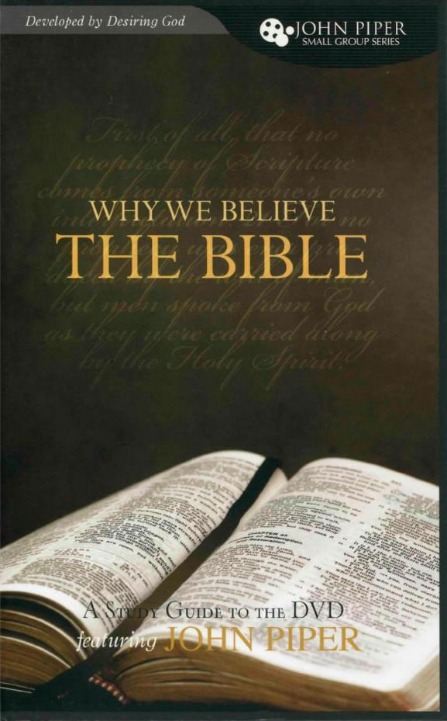
Acknowledgements
Notes:
Well, before we get started, I just want to acknowledge the help I’ve gotten from all three of these things I've got listed here.
Up there on the left is a DVD series by John Piper on “Why We Should Believe the Bible”. It’s an excellent series, presented in a way that’s very easy to understand, and that DVD is available in our church library.
The introduction to Sam Waldron’s Systematic Theology class at Reformed Baptist Seminary, and his doctrine of the Word class was very useful as well.
And I got a lot of help from a lecture by Dr. James Anderson from RTS Charlotte on the self-attestation of scripture. I’ll be happy to share that link if you’d like to hear it yourself.
So I just want to acknowledge those resources.
*ADVANCE*
Let me give you an idea of where we’re going today in this class.

Slide 3
Where we’re going
Why should we be concerned about the authority of the Bible?
What makes the Bible authoritative?
Is there any evidence for this?
An objection
Summary and Applications
Notes:
Let me give you an idea of where we’re going today in this class.
*CLICK*
We're going to start just by asking the question, why should we be concerned about the authority of the Bible in the first place?
*CLICK*
And then we'll ask the question, what is it that actually makes the Bible authoritative? Where does it derive its authority from?
*CLICK*
And having given an answer to that, we'll then ask “Well, is there any evidence for this?” And we'll try to demonstrate from the Bible the evidence for what I'm going to lay out.
*CLICK*
And then most of our time will be spent on a big objection to the doctrine of how the Bible derives its authority, an objection that may occur to you as we're going through this discussion. And we’ll talk about how we can answer that objection.
*CLICK*
And then finally, we'll wrap up with a summary and some applications.
So, let’s begin by asking ourselves,
*ADVANCE*
“Why should we be concerned about the authority of the Bible?”

Slide 4
Why should we be concerned about the authority of Bible?
Because the Bible claims divine inspiration and authority for itself.
2 Timothy 3:16-17
All Scripture is breathed out by God and is profitable for teaching, for reproof, for correction, and for training in righteousness, that the man of God may be complete, equipped for every good work.
Notes:
** 9:34 **
So, let’s begin by asking ourselves, “Why should we be concerned about the authority of the Bible?”
Here’s what I’m getting at. Many of us who have been Christians for a long time, and have been in churches like this for a long time, have grown up with a reverence and respect for the Bible. We hear the Bible preached, we read the Bible, and we treat it as God’s word, which is exactly what we should do
But sometimes it can be helpful to step back and look at this book and ask ourselves “Why this book? Why have I invested my life, and committed the eternal destiny my soul, to the teachings of this book? I’m treating this book as though it has authority over me – why am I doing that?”
*CLICK*
First of all, it’s because the Bible CLAIMS divine inspiration and authority for itself.
*CLICK and read 2 Tim 3:16-17*
The Bible claims to be the revelation of God, not just the words of men. Obviously, we need to figure out whether that’s right or not.
*ADVANCE*
Another reason to be concerned about the authority of the Bible is because the secular world claims that the Bible is full of errors.
4

Slide 5
Why should we be concerned about the authority of Bible?
Because we are a confessional church.
1689 BCF 1.5
The Old Testament in Hebrew and the New Testament in Greek were inspired directly by God, and were kept pure throughout the ages by his particular care and providence. They are therefore authentic, so that in all religious controversies the church must appeal to them as final.
1689 BCF 1.1
The Holy Scriptures are the only sufficient, certain and infallible rule for saving knowledge, faith, and obedience.
Notes:
This is what we say we believe – this is our statement to the world about our opinion as a church about the Bible. And it’s the testimony of thousands of other churches throughout the world, and countless thousands of churches throughout history. So we need to know whether our beliefs as a church as true.

Slide 6
Why should we be concerned about the authority of Bible?
Because many deny the existence of truth.
“There is no such thing as truth,” they teach even the little ones. “Truth is bondage. Believe what seems right to you. There are as many truths as there are individuals. Follow your feelings. Do as you please. Get in touch with yourself. Do what feels comfortable.” Those who speak this way prepare the jails of the twenty-first century. They do the work of tyrants.
– Michael Novak

Slide 7
Why should we be concerned about the authority of Bible?
Because the secular world claims that the Bible is full of errors.
“Knowledge of the Bible is hindered by the informal censorship imposed by religious leaders who would rather their followers didn’t know what’s in it – the innumerable contradictions, historical errors, plagiarism, absurdities, meaningless prophecies, myths presented as historical fact, and countless instances of divinely ordered or approved atrocities.”
Notes:
** 9:35 **
Another reason to be concerned about the authority of the Bible is because the secular world claims that the Bible is full of errors.
Our beliefs in the reliability and authority of Scripture are not going to go unchallenged. The vast majority of the world does not believe that the Bible is accurate, or compelling, or authoritative. As John Piper talks about this point in the DVD I mentioned earlier, he gives this quote from a group of Minnesota atheists which is very typical of the dismissive attitude of unbelievers towards the Bible.
*CLICK*
“Knowledge of the Bible is hindered by the informal censorship imposed by religious leaders who would rather their followers didn’t know what’s in it – the innumerable contradictions, historical errors, plagiarism, absurdities, meaningless prophecies, myths presented as historical fact, and countless instances of divinely ordered or approved atrocities.”
How are we going to respond to assertions like this from the increasingly militant secularists of our nation?
But it’s not just the atheists and agnostics and secularists who attack the authority of the Bible.
*ADVANCE*
We need to deal with other competing religions, who have their own competing holy books.

Slide 8
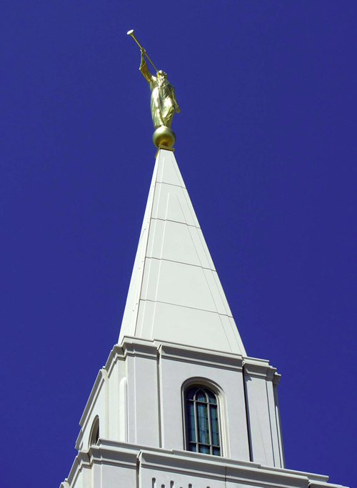
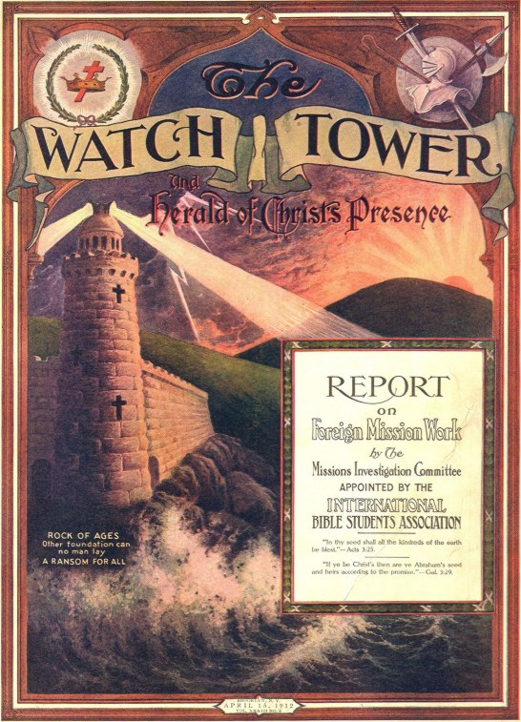
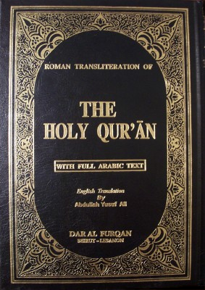
Why should we be concerned about the authority of Bible?
Because the competing holy books of other religions are increasingly close.
Notes:
** 9:36 **
We need to deal with other competing religions, who have their own competing holy books.
*CLICK*
Mebane has both a Mormon church, and a Kingdom Hall of the Jehovah’s Witnessess. There’s a mosque just 20 minutes away in Bulington. And each of these religions have their own teachings, and their own holy books that ALSO claim authority, and claim to provide the truth about God, and the true way of salvation, in direct opposition to the Christian message. How can we demonstrate the Bible is authoritative, and these other holy books are merely the work of men?
And actually this question applies much more broadly than just questions about other religions.
*ADVANCE*
In fact, every single issue in apologetics eventually comes back to this question of authority.

Slide 9
Why should we be concerned about the authority of Bible?
Because every single issue in apologetics eventually comes back to this question
Notes:
In fact, every single issue in apologetics eventually comes back to this question of authority.
Why do we believe abortion is wrong?
Why can we not accept homosexuality or transgenderism as valid lifestyle choice?
Why are we opposed to pornography and adultery?
Why do we insist that those who practice Islam are making a terrible mistake?
If you get into discussions about these or any other moral issues with unbelievers, eventually your answer as a Christian is going to come back to “I believe these things, because that’s what the Bible teaches”. And when the unbeliever says “Why in the world should I care what the Bible says?” how are we going to answer them?
*ADVANCE*
And another reason to be concerned about the authority of scripture is because simply we don't want to stake our lives on a lie, do we?

Slide 10
Why should we be concerned about the authority of Bible?
Because we don’t want to stake our lives on a lie.
1 Corinthians 15:19
If in Christ we have hope in this life only, we are of all people most to be pitied.
Notes:
And another reason to be concerned about the authority of scripture is because simply we don't want to stake our lives on a lie, do we?
Paul himself says in 1 Corinthians 15,
*CLICK*
If in Christ we have hope in this life only, we are of all people most to be pitied.
We don't want to be wrong about this. We don't want to live and die on the Bible if the Bible does not carry divine authority. That would be a tragic mistake.
And closely related to that,
*ADVANCE*
we should be concerned because if the Bible is true, then it is the only way of eternal life.

Slide 11
Why should we be concerned about the authority of Bible?
Because if the Bible is true, then it is the only way of eternal life.
Jesus said to him, “I am the way, and the truth, and the life. No one comes to the Father except through me.” (John 14:6)
“And there is salvation in no one else, for there is no other name under heaven given among men by which we must be saved.”
(Acts 4:12)
Notes:
** 9:38 **
We should be concerned because if the Bible is true, then it is the only way of eternal life.
Now, this is intolerably offensive to our culture and to followers of other religions. To say to someone that if you do not find reconciliation with God through repentance and faith in Jesus, that you will go to hell if you die – that is incredibly offensive.
But the Bible insists that that is true.
*CLICK and read both*
In John 14:6, Jesus says to Thomas, “I am the way, and the truth, and the life. No one comes to the Father except through me. “
And in Acts 4:12,
*CLICK*
the apostle Peter tells the council of elders and scribes who have put him on trial “There is salvation in no one else, for there is no other name under heaven given among men by which we must be saved.”
So are we sure about this? What authority do we have to tell people that Jesus represents the only hope of salvation that exists, and that any other hope they may have is an unwarranted, false hope?
Well, these are the reasons we’re taking up this topic today. If you’re a faithful Christian, it is not an over-exaggeration to say that you are staking everything on this question. If the Bible is not the authoritative Word of God, your life is being wasted and your eternal future happiness is in jeopardy.
*ADVANCE*
So let’s take up the question now “HOW IS THE BIBLE AUTHORITATIVE”? It claims to be authoritative – but how can we really be sure?

Slide 12
How is the Bible authoritative?
The Roman Catholic View
The Bible is authoritative because the church says that it is.
Notes:
** 9:39 **
So let’s take up the question now “HOW IS THE BIBLE AUTHORITATIVE”? It claims to be authoritative – but how can we really be sure?
Well, this is a fundamental question among all of Christendom, and I want to give you several views that have been proposed for how we can explain the authority of the Bible. And here I’m borrowing from the work of James Anderson, professor of theology and philosophy at Reformed Theological Seminary in Charlotte.
*CLICK*
And the first of these is the Roman Catholic view, which says the Bible is authoritative because the church says so.
So in this view, the leadership of the Roman Catholic church in the form of the pope and the magisterium council of bishops have been given authority by God to interpret the Bible and to declare that the Bible is the true word of God.
That’s the Roman Catholic view of the Bible’s authority
*ADVANCE*
Another view is what we could call the LIBERAL PROTESTANT VIEW

Slide 13
How is the Bible authoritative?
The Liberal Protestant View
The Bible is authoritative insofar as it fits with our experiences.
Notes:
** 9:41 **
Another view is what we could call the LIBERAL PROTESTANT VIEW which says “The Bible is authoritative insofar as it fits with our experiences”
So when we have some kind of religious experience, and we find that the Bible’s teaching fits our experience, then that makes the Bible authoritative for us.
But is that really how scripture derives its authority? Does the Bible only have authority when it matches our experiences in life? What if the Bible tells you something is wrong, but it just feels so right? Does that make the Bible non-authoritative in that area?
Well, another possible view that is far more sturdy
*ADVANCE*
is what we might call the EVANGELICAL EVIDENTIALIST VIEW

Slide 14
How is the Bible authoritative?
The Evangelical Evidentialist View
The Bible is authoritative because it has been verified by historical, archeological, and scientific evidence, and has been vindicated by scholarly authorities.
But…
Historians, archaeologists, scientists, and scholars are not infallible.
These evidences are not accessible to most Christians
Notes:
** 9:41 **
is what we might call the EVANGELICAL EVIDENTIALIST VIEW. This says that “The Bible is authoritative because it has been verified by historical, archeological, and scientific evidence, and has been vindicated by scholarly authorities.”
Now, this can be good and helpful.
When old manuscripts are found that show the text of the Bible hasn’t changed,
or archeological digs turn up some new evidence that fits with the stories of the Old Testament,
or some scholarly research proves that the Bible was accurate in some historical claim, that can be very helpful for our faith.
So this view, this type of evidence can be very useful. And in fact many good and godly scholars and teachers hold to this view – the view that the Bible CLAIMS to be the word of God, and the way we know that claim is true is the evidence of history, and science, and research, all of which have demonstrated the Bible to be true and reliable.
*CLICK* (BUT) as helpful as this view may be, there are a few weaknesses with it:
*CLICK AND READ*
First of all, historians, archaeologists, scientists, and scholars are not infallible.
Sometimes people make mistakes. Sometimes people make claims about new evidence or discoveries that confirm the truth of the Bible, but then those claims have to be walked back later when it turns out the evidence isn't that compelling after all. Just to take a single example, there's been more than one occasion where someone has reported discovering Noah's Ark, and the evangelical world has gotten really excited for a while, and then it turns out that those claims were disputable, or over-exaggerated, and they really hadn't discovered Noah's Ark.
So if the authority of the Bible is based on the strength of the scientific and historical evidence for it, is that authority going to be reduced if the evidence is disputed and doesn't always seem to give clear-cut proof?
Or what's it going to do your faith when someone claims to have found evidence that actually disproves the truth of the Bible? For example, there were historians a few years ago who claimed to have discovered the coffin and the physical remains of Jesus body. When unbelieving experts tell you they have evidence proving that the resurrection of Jesus was just a myths, is your faith going to wobble?
*CLICK*
Another big problem is that a lot of this kind of evidence isn’t accessible to most Christians. Most of us don’t’ have the time or ability to do the kind of historical or scientific or archaeological research that would be necessary for us to accumulate the facts we need to build up a strong evidence-based faith. And there are huge segments of the world that don’t have access to the literature, or lectures, or videos, or publications that gives the historical and scientific evidence for the Bible. So will they just have to settle for a faith that’s less-certain?
Is that really what God expects? Does God really intend that we become experts in all these different areas of academic disciplines before we can come to sure, well-grounded faith that this Bible really is authoritative?
And there’s one other big problem with this view,
*ADVANCE*
and in fact it’s a problem that is shared by EACH OF THESE 3 views, even if they’re all different.
In EACH CASE, with each of these views, there is something OTHER than the Bible that is declaring the Bible to be authoritative, and we ground our faith in the Bible on the basis of that other thing. Either the church, or your own personal experiences, or scholarly authorities – that other thing becomes the source of authority.
And when you have some one or some other thing that ultimately attests to the authority of scripture, then that PERSON or that THING has become functionally your ultimate authority.
*ADVANCE*
Well
In contrast, the reformed view is that the Bible is self authenticating – it is the ultimate authority for itself.

Slide 15
Another problem with these views…
The Roman Catholic View
The Bible is authoritative because the church says that it is.
The Liberal Protestant view
The Bible is authoritative insofar as it fits with our experiences.
The Evangelical Evidentialist View
The Bible is authoritative because it has been verified by historical, archeological, and scientific evidence, and has been vindicated by scholarly authorities.
Notes:
** 9:45 **
And there’s one other big problem with this view,
and in fact it’s a problem that is shared by EACH OF THESE 3 views, even though they’re all different.
In EACH CASE, with each of these views, there is something OTHER than the Bible that is declaring the Bible to be authoritative, and we ground our faith in the Bible on the basis of that other thing. Either the church, or your own personal experiences, or historical and scientific evidence – that other thing becomes the source of authority, that testifies to the reliability of scripture.
And when you have some one or some other thing that ultimately attests to the authority of scripture, then that PERSON or that THING has become functionally your ultimate authority.
So, these three views are somewhat helpful (some more than others), but none of them seem to provide us with a robust, objective ground for the authority of the Bible. Is there any other solution?
Well, we can be grateful that godly men of past centuries have wrestled with this very question, recognizing that the question of the authority of scripture is of paramount importance. And thanks to the work of the reformers of the 17th century, we now have confessional statements which give us very well-grounded statements about the nature of Scripture’s authority.
*ADVANCE*
So In contrast to the previous three views, let’s take a look a the reformed view, which is that the Bible is self authenticating – it is the ultimate authority for itself.

Slide 16
How is the Bible authoritative?
The Reformed View
The Bible is self-authenticating. It is the ultimate authority for itself.
1689 Baptist Confession of Faith, chapter 1, paragraph 4 The authority of the Holy Scriptures obligates belief in them. This authority does not depend on the testimony of any person or church but on God the author alone, who is truth itself. Therefore, the Scriptures are to be received because they are the Word of God.
Notes:
** 9:47 **
So In contrast to the previous three views, let’s take a look a the reformed view, which is that the Bible is self authenticating – it is the ultimate authority for itself.
To put it in another way, our ultimate authority for believing that the Bible IS the word of God is that it SAYS that it is the word of God.
*CLICK*
Here’s how the reformers put it in our confession, the 1689 Baptist Confession of Faith, in ch.1 paragraph 4, and I’m reading from a modern English version
(READ) “The authority of the Holy Scriptures obligates belief in them. This authority does not depend on the testimony of any person or church but on God the author alone, who is truth itself. Therefore, the Scriptures are to be received because they are the Word of God.”
So let’s follow the logic from this paragraph. If the Bible really is what it claims to be, the word of God, then it has the authority of God. But if scripture has the authority of God, then it already has the highest possible authority that it can have, and there can be no higher authority that can attest to it. Therefore, the Bible must be self-authenticating.
The self-authenticating nature of Scripture flows from the divine inspiration of scripture.
Now, is there any Biblical evidence to this? Is there any reason to think that scripture is self-authenticating from the words of scripture itself?
*ADVANCE*
Well, there is. Let’s look at several passages on this:

Slide 17
Is there Biblical evidence for this?
2 Timothy 3:16
All Scripture is breathed out by God and is profitable for teaching, for reproof, for correction, and for training in righteousness
Notes:
** 9:49 **
Well, there is. And for the sake of time, let’s just look at two passages that assert this:
*CLICK*
In 2 Timothy 3:16, Paul says “All Scripture is breathed out by God and is profitable for teaching, for reproof, for correction, and for training in righteousness”
Scripture is called “god-breathed” here. There is no other source of truth that is called “god-breathed”, which means that the Bible claims that it, and it alone, has the highest possible authority.
*ADVANCE*
And in 1 Thessalonians 2:13, Paul says this

Slide 18
Is there Biblical evidence for this?
2 Peter 1:21
For no prophecy was ever produced by the will of man, but men spoke from God as they were carried along by the Holy Spirit.
Notes:
When men spoke and wrote the words of scripture, they were writing the word of God. Our Bible’s claim authority, because they have God’s authority, and there can be no higher authority.

Slide 19
Is there Biblical evidence for this?
1 Thessalonians 2:13
We also thank God constantly for this, that when you received the word of God, which you heard from us, you accepted it not as the word of men but as what it really is, the word of God, which is at work in you believers.
Notes:
And in 1 Thessalonians 2:13, Paul says this:
“We also thank God constantly for this, that when you received the word of God, which you heard from us, you accepted it not as the word of men but as what it really is, the word of God, which is at work in you believers.”
Paul here is thankful to God that the Thessalonians recognized the words that he wrote to them were not just coming with the authority of Paul, but with the authority of God. They received Paul’s words because they perceived God’s authority in what he wrote.
*ADVANCE*
So what the reformers of the 17th century argued, and what I’m arguing for here, is that the BEST and HIGHEST evidence for scripture being the authoritative word of God is scripture itself. Because scripture comes from God, it has the authority of God in whatever it speaks to, and there cannot be any higher authority than that.

Slide 20
How is the Bible authoritative?
The Reformed View
The Bible is self-authenticating. It is the ultimate authority for itself.
1689 Baptist Confession of Faith, chapter 1, paragraph 4 The authority of the Holy Scripture, for which it ought to be believed, depends not upon the testimony of any man or church, but wholly upon God (who is truth itself), the author thereof; therefore it is to be received because it is the Word of God.
Notes:
So what the reformers of the 17th argued, and what I’m arguing for here, is that the BEST and HIGHEST evidence for scripture being the authoritative word of God is scripture itself. Because scripture comes from God, it has the authority of God in whatever it speaks to, and there cannot be any higher authority than that.
*ADVANCE*
Now, if you’re tracking with this argument, it’s very possible that an objection to this idea of scripture being self-authenticating has come to your mind.

Slide 21
How is the Bible authoritative?
The Reformed View
The Bible is self-authenticating. It is the ultimate authority for itself.
1689 Baptist Confession of Faith, chapter 1, paragraph 4 The authority of the Holy Scriptures obligates belief in them. This authority does not depend on the testimony of any person or church but on God the author alone, who is truth itself. Therefore, the Scriptures are to be received because they are the Word of God.
Notes:
So what the reformers of the 17th century argued, and what I’m arguing for here, is that the BEST and HIGHEST evidence for scripture being the authoritative word of God is scripture itself. Because scripture comes from God, it has the authority of God in whatever it speaks to, and there cannot be any higher authority than that.
*ADVANCE*
Now, if you’re tracking with this argument, it’s very possible that an objection to this idea of scripture being self-authenticating has come to your mind.

Slide 22
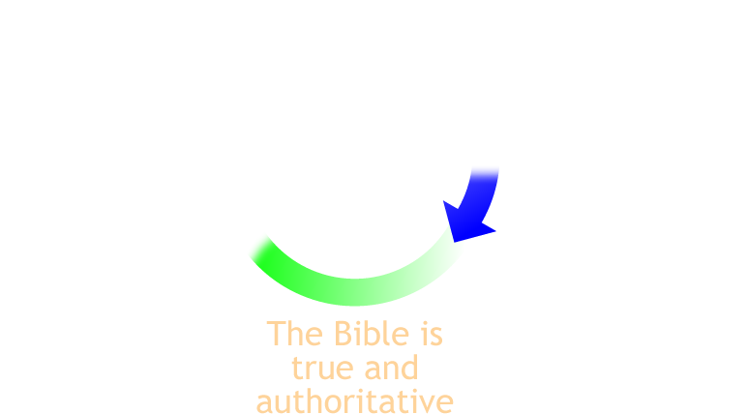
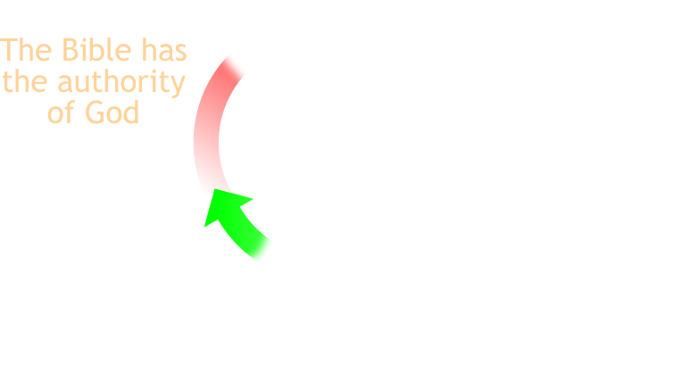
An Objection:
Isn’t this a circular argument?
Notes:
** 9:51 **
Now, if you’re tracking with this argument, it’s very possible that an objection to this idea of scripture being self-authenticating has come to your mind.
*CLICK*
Isn’t this a circular argument?
Because, how do we know the Bible is the word of God?
*CLICK* (top right)
Well the Bible claims to be the word of God
HOW DO WE KNOW THAT CLAIM IS TRUE?
*CLICK* (bottom center)
Well, we know it’s true, because the Bible is true and authoritative in everything it says
HOW DO WE KNOW THAT?
*CLICK* (top left)
Well, we know the Bible is true and authoritative, because the Bible is the word of God, and has the authority of God, which means it HAS to be true and authoritative
HOW DO WE KNOW IT HAS THE AUTHORITY OF GOD?
*CLICK* (top)
Because the Bible claims to be the word of God, and that must be true because we know that the Bible is true and authoritative!
So we’ve got a circular argument – you have to ACCEPT the authority of scripture in order to accept its claim that it has authority.
And Isn’t that a big, logical problem for our argument??
*ADVANCE*
Well there is circularity built into this argument,

Slide 23
An Objection:
Isn’t this a circular argument?
Yes – there is circular reasoning when the Bible declares itself to be authoritative…
…but any ultimate authority has to be self-authenticating
Notes:
** 9:52 **
Well there is circularity built into this argument. You DO have to accept the authority of the Bible in order to accept its authority.
And it may surprise you, but I’m going to argue that this is not a problem. It’s not a logical fallacy. In fact I’m going to assert that this type of circularity is not only a valid way to argue – it is a necessary and unavoidable way to argue for the Bible’s authority.
Now, that’s a big claim!
But let me give you a couple of reasons why this type of argument is not really problematic.
The first one is this:
*CLICK*
ANY ultimate source of authority has to be self-authenticating.
Everyone in the world has an ultimate authority of some kind that takes precedence over every other authority, and that authority (whatever it is) has to be self-authenticating. Because if it’s not – if it relies on the testimony of some other authority, then that OTHER authority would actually be a higher, and the ultimate authority wouldn’t be the ultimate authority after all.
And that’s true whether your ultimate authority is the Bible, or the pope, or a church council, science, or your perceptions and experiences. Whatever your ultimate authority is, it must be self-authenticating.
Let me give you an example.
*CLICK*
Suppose I told you that on the screen behind me was a picture of a squirrel. I’ve just made an authoritative statement? Is it true?
Well yes, you might say, that is a true statement. Well suppose you had a friend who said to you “how do you know?” And you might say “Well, I know it’s a true statement because I can see the screen from where I’m sitting, and there is definitely a picture of a squirrel up there. “
“Ah!” says your friend, “but wait! What if your senses are lying to you? What if something is wrong with your eyes and it’s actually a picture of a bird and not a squirrel? Or what if your brain is misinterpreting your eyes and you think you see a squirrel, but there really isn’t anything up there at all?”
“Well”, you say, “That’s a very strange idea, but if you like I could confirm that it really is a squirrel by asking other people around me if they see a squirrel up there.”
“Wait a minute”, your friend says, “you’re just relying on your senses again? You might THINK you hear other people telling you that they see a squirrel, but what if something is wrong with your brain and it’s hearing phantom voices? How do you REALLY KNOW your brain is really seeing and hearing properly? You THINK you can hear and see and think just fine, but how can you really be sure?”
You see, your brain, your senses, your experiences become your ultimate authority in that example. There is no higher authority you can appeal to. Any questions you have about whether your brain is working properly can only be answered by using your brain and assuming that it’s working properly.
Every ultimate authority has to be self-authenticating if it is an ultimate authority, and that’s true for the Bible as well.
That’s the first way that we might defuse this objection that we’re using circular reasoning. But there’s another point about Scripture authenticating itself that I’d like to make, and it is this:
*ADVANCE*
If the Bible is not self-authenticating, then not even additional divine revelation will be sufficient to authenticate it.

Slide 24
An Objection:
Isn’t this a circular argument?
Yes – there is circular reasoning when the Bible declares itself to be authoritative…
…but any ultimate authority has to be self-authenticating
…and if the Bible is not self-authenticating, then not even additional divine revelation will be sufficient to authenticate it.
Notes:
* 9:56 *
If the Bible is not self-authenticating, then not even additional divine revelation will be sufficient to authenticate it.
Now that seems like a rather startling thing to say, but let me explain what I mean. Let’s assume for a moment that the Bible is NOT self-authenticating, but instead it relies on some form of external testimony in order to authenticate it. What’s the BEST POSSIBLE evidence you can think of for the Bible to have in that case?
Well, it would be some form of revelation from God himself, right? So let’s suppose that this morning, during our worship service, suddenly Christ himself appears in this room, right up here, in front of us all . After all we all pick ourselves up from the ground, he says “I have come to testify to you, Grace Reformed Baptist Church”, that this Bible that you have is my inerrant word, and because it is the word of God you are responsible to know it, believe it, obey it, and submit to it.” And then, after giving us that revelation, he disappears.
Now that would be incredibly compelling to us! It would make a serious impact on us, and our view of the Bible.
But what impact would that visitation of Christ make on the members of our church who aren’t here today? Would it be just as compelling to them if they heard second-hand reports about it next week from us?
Well, what if we documented it? We kept the YouTube video of the service, and we had a historian interview our congregation and document the incident? Well, in 150 years from now someone watches the video or pulls out a book about the event, and says “Well…. I don’t know for sure what happen in that church that day, but there are a lot of possible explanations. Maybe the pastors were trying to fool their congregation. If you have enough money you can pull off some really impressive hoaxes. And this video is the kind of thing someone could stage easily.” Is that visitation of Jesus Christ in 2024 going to be compelling to people in 150 years?
And if not, how are people be convinced then? Well, you’re going to need another divine revelation, aren’t you? And then in a few years it will have to be done again. And again. And so on, for the rest of human history. So not even a divine revelation here in our sanctuary in 2024 will be enough – there will have to be more revelations, and there will always be people who didn’t witness it who believe it’s a trick of some kind. So how do escape that never ending chain of additional revelations, additional testimonies to the authority of scripture?
The only way to do it is if scripture’s authority is ultimately anchored IN SCRIPTURE itself.
And so those are a couple of reasons why the idea of scripture being self-authenticating is critical, if we are going to be able to put our full confidence in the word of God.
But that still leaves us with a question
*ADVANCE*
How do we get into this circle in the first place?
Maybe it’s not a logical fallacy that this is a circular argument – and as I’ve argued, it’s unavoidable if the Bible is going to be our ultimate authority.

Slide 25
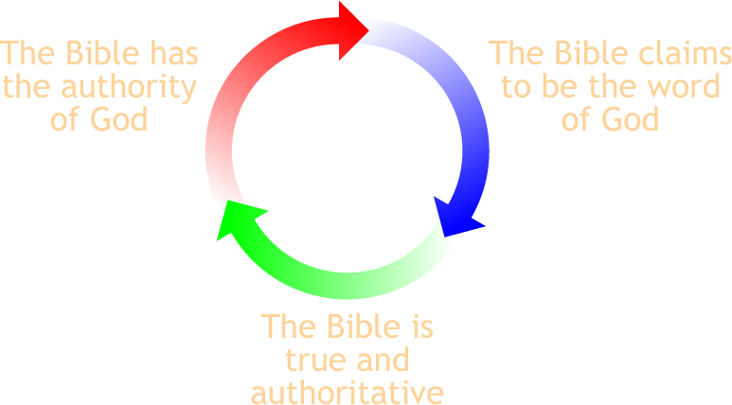
How can we get into this circle?
Notes:
** 10:00 **
How do we get into this circle in the first place?
Maybe it’s not a logical fallacy that this is a circular argument – and as I’ve argued, it’s unavoidable if the Bible is going to be our ultimate authority.
But how can we get into this circle in the first place?
That is, “the Bible CLAIMS to be the word of God”, but why should anyone believe that in the first place?
If you were to go up to someone and tell them "you should believe the Bible is the word of God simply because it says it is the word of God", they probably wouldn’t be impressed by that argument
After all, there other other religions who claim that THEY have the word of God, and that what we Christians call the word of God is just the words of ordinary men.
I could write my own religious book and say “This is the word of God delivered through me, and you should believe it because I’m testifying that this is the word of God”. I doubt anyone would take that very seriously.
So how can we get into this circle? Are there any rational, sensible reasons for accepting that the Bible is the word of God in the first place?
Well, once again the reformers of the 17th century thought through this issue carefully and have provided us with a well-grounded basis for trusting in the authority of scripture.
*ADVANCE*
Let’s go back to our confession again, this time looking at the start of paragraph 5 in chapter 1.

Slide 26
How do we discover the Bible’s self-authentication?
1689 Baptist Confession of Faith, chapter 1, paragraph 5 We may be influenced and persuaded by the testimony of the church of God to hold a high and reverent regard for the Holy Scriptures. Moreover the glory of its contents, the efficacy of its doctrine, the majesty of its style, the agreement among all its parts, the expanse of the whole (which is to give all glory to God), the full revelation it gives of the only way for human salvation, together with many other incomparable characteristics and its complete perfection—all these arguments provide abundant evidence that it is indeed the Word of God…
Notes:
** 10:01 **
Let’s go back to our confession again, this time looking at the start of paragraph 5 in chapter 1.
And I’m going to read this out loud – I don’t usually like giving you a wall of text like this and just reading out loud, but I’d like to walk through several parts of this in detail, so in order to get the context, we’re going to go through the whole paragraph. So read along with me as we go through the start of paragraph 5.
“We may be influenced and persuaded by the *CLICK* testimony of the church of God to hold a high and reverent regard for the Holy Scriptures. Moreover *CLICK* the glory of its contents, the efficacy of its doctrine, the majesty of its style, *CLICK* the agreement among all its parts, the expanse of the whole (which is to give all glory to God), the full revelation it gives of the only way for human salvation, together with many other incomparable characteristics and its complete perfection—all these arguments provide abundant evidence that it is indeed the Word of God…”
So, we’re trying to answer the question, how do we get into this circle, and discover the Bible’s self-authenticating nature?
Let’s take a look at a few of the ways that this paragraph in our confession lists. There are several ways listed, but for the sake of time we’re just going to look at the three that I’ve circled.
First of all, the TESTIMONY OF THE CHURCH counts for something. Many of us will have experienced this as children – we first come to have a high and reverent regard for Scripture on the basis of the testimony of God’s people – perhaps by our parents, or Sunday school teachers, or pastors. This is one of the ways that God uses to persuade people that this is his word, and it is to be revered and respected.
Another evidence that the Bible really is God’s Word is what the reformers call “the glory of its contents”
*CLICK*
And again I have to apologize that we’ve got a big slide of text here,

Slide 27
What does Scripture claim for itself?
That it is the divine, authoritative Word of God
Galatians 1:8
But even if we or an angel from heaven should preach to you a gospel contrary to the one we preached to you, let him be accursed.
Notes:
We saw earlier 2 Tim 3:16-17. Let’s look now at Gal. 1:8-9
Obviously put, Paul believed the words he was writing had a level of authority that even exceeded the authority of angels themselves. No man could ever say that, unless he was convinced that what he was writing was God’s words and not his own.
Simply put, the Bible claims to be the authentic, true, and infallible word of God, and it demands the reverence and attentiveness that is due to God himself.
(transition: So that is the claim of the Bible. Now, for most of the rest of the class we want to answer the question “How can we justify the Bible’s claim that it is the word of God”?)

Slide 28
How can we justify the Bible’s claim that it is the word of God?
Perhaps with historical evidence?
Maybe by the testimony of the church?
Possibly using the testimony of religious experience?
None of these are invalid. In fact, they can be extremely helpful. But these are not the best evidences.
Notes:
In light of the the claims that the Bible is full of errors, and the claims of divine authority made by competing holy books... how can we be sure the Bible is truly God's Word?
Different ways to do this – even good men will disagree. Here are possible ways to approach the issue.
(before last paragraph)
Now I’m going to argue that these are not the best ways to do it
(as I transition to next slide…) but why? Why are these not the best evidences?

Slide 29
How can we justify the Bible’s claim that it is the word of God?
None of these are invalid. In fact, they can be extremely helpful. But these are not the best evidences. Why not?
History, archaeology, science, church councils, confessions & personal experiences are not infallible.
Fallible men cannot produce infallible evidence that the Bible is the Word of God.
These evidences are not accessible to most Christians

Slide 30
The ultimate proof of the Bible
Scripture itself is self-authenticating.
It possesses the very authority of God within itself.
Notes:
(short slide)
(read all slide phrases)
That is, I am arguing that the ultimate proof for the divine origin of the Bible is an INTERNAL proof, coming from within the Bible itself, rather than the EXTERNAL evidence that history, science, church councils etc. can provide.
So lets unpack this idea of self-authentication a bit (next slide). What do we mean when we say that the Bible is self-authenticating?

Slide 31
What does it mean that the Bible is self-authenticating?
1. It has objective authority.
Because the Bible comes from God, it must be true, accurate, trustworthy, and authoritative whether we believe it or not.
The Bible does not derive its authority from our consent.
Notes:
(after the “That is” section)
IF the Bible did come from God, then it has authority regardless of whether we acknowledge it. (onto last paragraph)
(Advance to verse heb 4:12)

Slide 32
What does it mean that the Bible is self-authenticating?
1. It has objective authority.
For the word of God is living and active, sharper than any two-edged sword, piercing to the division of soul and of spirit, of joints and of marrow, and discerning the thoughts and intentions of the heart. (Hebrews 4:12)
Since God has spoken and the Bible is itself the living Word of God, the highest possible authentication is the Bible's own witness
to itself.
– Sam Waldron
Notes:
After verse, before waldron
The fact that the Bible is living and active… doesn’t depend on whether we AGREE that it’s living and active. That is simply an objective attribute of the Bible. It cuts, pierces, divides and discerns the thoughts and intentions of the hearts of men whether they acknowledge its authority or not. Why? Because it’s from God. And so it has power simply by reason of having come from God, not because we decided it has power.
After waldron quote,
before the transition, hint at circular reasoning:
“You may not be entirely comfortable with this starting point. Don’t we have to prove that the Bible is God’s word before we start trusting it and treating it as God’s word? )
“Well, before I answer that, let’s consider this: (next slide)” Why is it important that the Bible has objective, internal authority? I’m going to give you two reasons why this is our starting point.

Slide 33
Why is it important that the Bible has objective, internal authority?
Any external evidence that proves the Bible’s authority would have to have more authority than the Bible.
Example: the police
If the ultimate proof of the Bible’s authority is not found within the Bible itself, then even additional divine revelation will not be sufficient.
Notes:
2. if we think that some further verification is needed, then the highest conceivable such verification would be a another divine revelation….
But if we take this alternative, there is no place to stop. This second revelation would require a third revelation to confirm it as God's Word and so on without end. We are doomed to the problem of infinite
regression. If the Bible as God's voice or word from heaven does not attest itself, no amount of voices or words from heaven will ever be sufficient to attest it.
(transition: And so we take as our presupposition that 1) God exists, 2) God has revealed himself through His Word, and that therefore 3) Scripture has authenticity and authority because it comes from God himself, and that authority is real, whether we acknowledge it or not.)
(Now… we’re back to the problem we mentioned earlier – Don’t we need to prove this?)

Slide 34
Why is it important that the Bible has objective, internal authority?
The only concrete form in which that authentication can come, if it is not to be derived from another objective revelation from the Lord of heaven, must be nothing other than the voice of Scripture itself.
– N.B. Stonehouse, The Infallible Word

Slide 35
Don’t we need to prove this first?
No. God expects all people to recognize the authority of His word when they encounter it.
How do we know? Because He judges them when they don’t.
Notes:
A problem – we’re saying that we believe the Bible has the authority of the Word of God because… it IS the word of God. That is, when the Bible claims to be the word of God, we’re just trusting it. Don’t we have to prove that first? Surely it’s not fair to simply TELL people that the Bible is God’s word, and use it as if it’s God’s word, before we prove it to them, right?
No. God expects people to see the authority of His word when they encounter it. How do we know? Because He judges them when they don’t.

Slide 36
God holds men responsible to believe His word.
And if anyone will not receive you or listen to your words, shake off the dust from your feet when you leave that house or town. Truly, I say to you, it will be more bearable on the day of judgment for the land of Sodom and Gomorrah than for that town.
(Matthew 10:14-15 ESV)
Notes:
Why does Sodom and Gomorrah get off more lightly here? Because they didn’t have divine revelation. It never came to them, and so although they were guilty before God for their rejection of natural revelation, and what they knew about God in their hearts (Rom. 1), they are not judged for the rejection of specific, divine revelation.
The cities that reject the words of the Apostles won’t get off so easily. The people won’t be able to say “But Jesus, I didn’t know that your disciples were preaching the word of God! I thought they were just making it up, teaching us some new religion. I was a good Jew, and I thought they were blaspheming God. I DIDN’T KNOW!” Jesus will say “You SHOULD have known. When you heard my disciples preaching, you SHOULD have known that their words were my words, and that my words were God’s words. And now you’re going to pay a price much higher than Sodom and Gomorrah had to pay.
Now, am I saying that all men who have access to the Bible have full, unmistakable, irresistable knowledge that they’re encountering the word of God? No. But passages like this assume that they know it to SOME degree – enough to make them culpable for rejecting it.

Slide 37
God holds men responsible to believe His word.
And he said, ‘Then I beg you, father, to send him to my father's house—for I have five brothers—so that he may warn them, lest they also come into this place of torment.’ But Abraham said, ‘They have Moses and the Prophets; let them hear them.’ And he said, ‘No, father Abraham, but if someone goes to them from the dead, they will repent.’ He said to him, ‘If they do not hear Moses and the Prophets, neither will they be convinced if someone should rise from the dead.’” (Luke 16:27-31)
Notes:
In essence, he’s saying, “Father Abraham, the Scriptures are not enough. My brothers need proof. They need evidence. They need a miracleto authenticate Moses and the
Prophets. Dear Father Abraham, you need to demonstrate to them that the Bible really is God’s word before you can expect them to believe.””
What do we conclude from Abraham’s response?
That he is assuming that God’s voice can be recognized in the Bible. External evidence and proof is not necessary.
That the problem is not a lack of evidence. The problem is a sinful heart. Men see the authority of God in the Bible but do not want to acknowledge it, and no amount of miracles is going to change that.
(this hearkens back to my “second revelation” illustration with Jesus appearing – it’s not enough.

Slide 38
How do we discover the Bible’s self-authentication?
1689 Baptist Confession of Faith, chapter 1, paragraph 5 We may be influenced and persuaded by the testimony of the church of God to hold a high and reverent regard for the Holy Scriptures. Moreover the glory of its contents, the efficacy of its doctrine, the majesty of its style, the agreement among all its parts, the expanse of the whole (which is to give all glory to God), the full revelation it gives of the only way for human salvation, together with many other incomparable characteristics and its complete perfection—all these arguments provide abundant evidence that it is indeed the Word of God. Yet, not withstanding this, our full persuasion and assurance of its infallible truth and divine authority comes from the inward work of the Holy Spirit bearing witness by and with the Word in our hearts.
Notes:
Ok, we’ve asserted that God’s word has authority, and that God holds men accountable when they do not submit to the Bible’s authority. But now our question is “How do we come to see the Bible’s self-authentication? How is that revealed to us?”

Slide 39
The glory of its contents
1 Corinthians 2:6-10
Yet among the mature we do impart wisdom, although it is not a wisdom of this age or of the rulers of this age, who are doomed to pass away. But we impart a secret and hidden wisdom of God, which God decreed before the ages for our glory…
“What no eye has seen, nor ear heard, nor the heart of man imagined, what God has prepared for those who love him”— these things God has revealed to us through the Spirit. For the Spirit searches everything, even the depths of God.
Notes:
** 10:03 **
And again I have to apologize that we’ve got a big slide of text here, but please indulge me one more time as read this passage from 1 Corinthians 2:6-10.
Paul says (READ – yet among the mature we do impart wisdom)
Now if this is true – if the infinitely intelligent and wise God of the universe has put *CLICK* secret and hidden wisdom within the pages of Scripture, and then revealed it to us – then we should EXPECT to find glorious things when we read it.
We should expect to find things in scripture that MEN DON’T COME UP WITH – as verse 9 says, there will be things that haven’t been SEEN by men or heard by men, and thing that men don’t even IMAGINE when they are writing and creating. There should be something in scripture that is outside the realm of human experience and human ingenuity, so that when we get the message, it can’t be explained by the imagination of men.
What am I talking about? I mean that there are times that you’ll read the gospels or you’ll read the epistles and you’ll experience something that maybe you have a hard time articulating. But you encounter a message about
human sinfulness,
and the greatness of God, and absolute holiness of God
and his hatred of sin,
and yet his desire to rescue pitiful men,
men who hate him,
and the idea that the only way this can possibly happen is if God himself becomes the sacrifice for men’s sin,
and he offers himself up in the form of His own Son to pay the debt that men owe,
so that he can forgive them without violating his own justice,
and adopt them,
and bring them into the experience of the perfect inter-trinitarian love that the persons of God have for each other…
and you say “There is no way that any man could have come up with this. This is not the kind of thing that men dream up.”
Something inside just clicks! And you realize you’re reading something from the very mind of God.
Now, one of the implications of this is that our faith can sometimes be attacked because it can be hard to articulate exactly how this happens. You don’t have a nice list of 10 reasons why you believe the Bible is true. Instead, scripture sometimes comes to bear on us with the force of its own divinity and self-authenticity such that if someone came up and demanded “Tell me why you believe these are God’s words”, you might fumble around and want to say “WELL, JUST READ IT!”
And I want to reassure you that that’s not a bad way of thinking of it.
Now, is that subjective? Well, yes - scripture comes to bear in different ways on different believers. But it’s still a valid testimony, because it’s based in the OBJECTIVE reality that this is God’s word. You are encountering real OBJECTIVE truth when this happens to you.
So I think that’s what the reformers meant when they spoke of “the glory of scripture’s contents” being one of the ways God persuades us that the Bible truly is his word.
*ADVANCE*
Another way is what our confession calls “the agreement among its parts”

Slide 40
The glory of its contents
Psalm 119:129
Your testimonies are wonderful; therefore my soul keeps them.

Slide 41
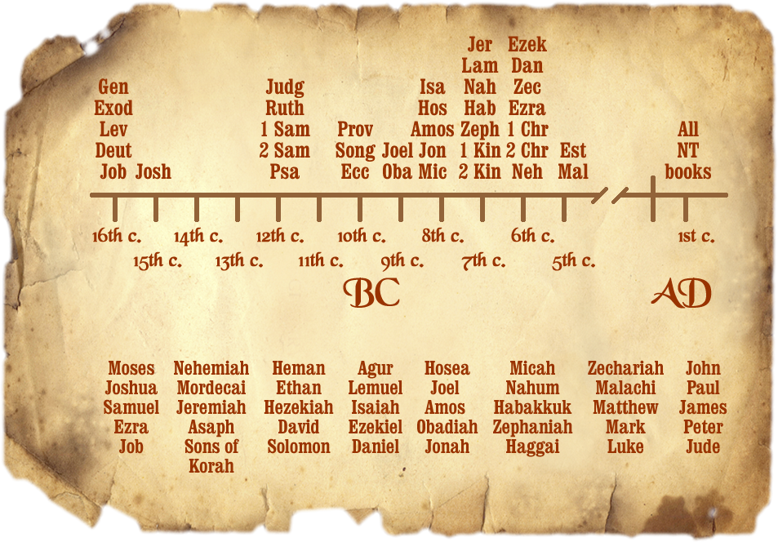
The agreement among its parts
Notes:
** 10:08 **
Another way is what our confession calls “the agreement among its parts”
The Bible was written over the span of about 1500 years, and had at least 40 authors who are named. If this was not a divinely inspired book, what kind of message would you expect a book like to give? Would you expect a book written by 40 people over the course of 1500 years to have any kind of single, consistent message?
And then add to that the wide diversity of people who wrote this book. Look just at their professions alone. Some books are written by prophets. One was written by a professional tax-collector. One author was a highly-trained scholar of the Pharisees. Another was an untrained fishermen. Some books were written by the greatest kings in the history of the nation of Israel, and other were written by shepherds.
The fact that such diverse men living in different places writing over the span of 1500 years could produce such a coherent, unified book is astounding. When you have a single story, which starts on a cosmological scale, and then narrows down to a group of people, and then a single tribe, and keeps narrowing down until it zeroes in on a single focal point, a single man, and then begins to spread out again from that focal point and expands and expands until THAT MAN becomes the central focus of attention of the entire universe… then you’ve got a book that is like no other book in all of human history. You will not find ANYTHING like this, in any Greek or Roman mythology, or in anything else man has imagined.
The consent and unity of the parts of the Bible – the fact that you have dozens of books in the Bible written by dozens of men spread out over centuries, and they ALL part of the same redemptive story and they ALL point forward or backwards to Jesus Christ – that is testimony to its divine origin.
So those are some of the incomparable excellencies that our confession points to in order to demonstrate how God’s word provides its own evidence that it really is God’s word. There are others, but for the sake of time we won’t look at them.
Instead, what I want to do now
*ADVANCE*
is look at a problem with this.

Slide 42
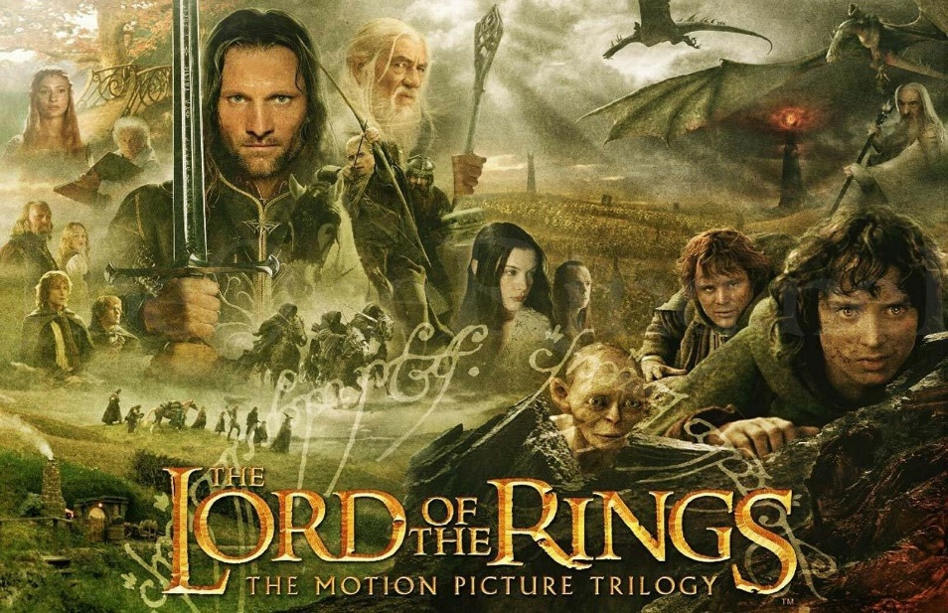
Notes:
Let’s just take something more modern as an example.
*CLICK*
J.R.R. Tolkien wrote The Lord of the Rings trilogy in 1954 and 1955.
It’s been adapted into countless films, television shows, comic books, songs, video games, perhaps most notably
*CLICK*
as a trilogy of movies made by Peter Jackson starting in 2001. They were and are great movies, but a lot of fans of the books really do not like the movies because of all the liberties it took with Tolkien’s original stories. Some of the characters who are noble and honorable in the books and turned them into flawed, scheming characters in the movie. Some of the characters who are deeply loyal to each other in the books are portrayed as disloyal in the movies. And in some cases it took ordinary characters and turned them into villains.
And a few years later,
*CLICK*
when another trilogy of movies came out based on the Hobbit, the screenwriters further altered the Tolkien’s story by inserting romances between characters that didn’t happen in the book, and inserting popular characters from The Lord of the Rings movies into the Hobbit movies, when those characters weren’t in the book at all.
And because the first movies were a smash hit, a whole slew of new Lord of the Rings material started coming out, and the authors and screenwriters and creative designers of this new content merrily changed the source material in whatever way they thought would make their product sell. My least favorite one was the video game “Middle-Earth: Shadow of War”, where Shelob is changed from an ancient, unrepentantly evil spider who drinks the blood of men and elves (which is how Tolkien wrote her) and turned into an attractive woman who wants to defeat the evil Sauron and save Middle Earth.
The point is, in less than 70 years, we’ve seen people take an original story by one man, and alter it significantly, either by retelling his story but changing parts of it around, or by making up new stories in his world that contradict the things that Tolkien wrote, because the newer authors wanted something different.
So let’s go back to our question about the Bible.
*ADVANCE*
If you’ve got a collection of books that was written by at least 40 people over the span of 1500 years, would you expect it to have any kind of single, consistent message?

Slide 43
The agreement among its parts
Notes:
If you’ve got a collection of books that was written by at least 40 people over the span of 1500 years, would you expect it to have any kind of single, consistent message?
And then add to that the wide diversity of people who wrote this book. Look just at their professions alone. Some books are written by prophets. One was written by a professional tax-collector. One author was a highly-trained scholar of the Pharisees. Another was an untrained fishermen. Some books were written by the greatest kings in the history of the nation of Israel, and other were written by shepherds.
The fact that such diverse men living in different places writing over the span of 1500 years could produce such a coherent, unified book is astounding. When you have a single story, which starts on a cosmological scale, and then narrows down to a group of people, and then a single tribe, and keeps narrowing down until it zeroes in on a single focal point, a single man, and then begins to spread out again from that focal point and expands and expands until THAT MAN becomes the central focus of attention of the entire universe… then you’ve got a book that is like no other book in all of human history. You will not find ANYTHING like this, in Greek mythology or Roman mythology, or in anything else ever written by men.
The consent and unity of the parts of the Bible – the fact that you have 66 books written by at least 40 men that ALL tell the same redemptive story and ALL point forward or backwards to Jesus Christ – that is testimony to its divine origin.
So those are some of the incomparable excellencies that our confession points to in order to demonstrate how God’s word provides its own evidence that it really is God’s word. There are others, but for the sake of time we won’t look at them.
Instead, what I want to do now is look at a problem with this.
*ADVANCE*

Slide 44
The expanse of the whole, which is to give all glory to God
John 7:14-18
About the middle of the feast Jesus went up into the temple and began teaching. The Jews therefore marveled, saying, “How is it that this man has learning, when he has never studied?” So Jesus answered them, “My teaching is not mine, but his who sent me. If anyone's will is to do God's will, he will know whether the teaching is from God or whether I am speaking on my own authority. The one who speaks on his own authority seeks his own glory; but the one who seeks the glory of him who sent him is true, and in him there is no falsehood.
Notes:
- It should have been a clue to the Jews, watching this unlearned carpenter and his unlearned
followers speaking such extraordinary things, that His teaching had a divine origin. But
Jesus goes on to give more evidence.
- (Of course Jesus DOES have authority and at times He spoke with His authority. But here he is
speaking as a man, the perfect model of a man, and the question is... is He going through His
life and His public ministry on His own authority in order to glorify Himself, or is He doing
everything He does in order to glorify God, His Father?)
- So how do we know Jesus' teaching is true? He's CLAIMING divine teaching, and everything in
all of Christianity hangs on that claim. How does Jesus prove it?
- "If anyone's will is to do God's will, HE WILL KNOW..."
- so if your will is to do God's will, you will know that Jesus is true.
- sound judgment about the whether or not Jesus words, or Paul's words are divine will flow
from reverance to God.
- But how??
- "The one who speaks on his own authority seeks his own glory; but the one who seeks the glory
of him who sent him is true, and in him there is no falsehood."
- if your desire is to do God's will, then Jesus' arumuent is that when He talks and teaches
you will see that He is from God and His words are from God, because His life is completely
devoted to "May God get glory from my sufferings"
- and evidently, that is self-authenticating.
- if a person's teachings are all about ego-gratification and not God’s honor, you
don't need to listen to him. But if a person is totally angled to God getting glory
and not himself, you'd better listen.
(Back to the catechism – it says that one of the internal evidences the Bible gives is “the expanse of the whole, which is to give all glory to god”
- So can we look at Paul's writings and hear him saying "This teaching is not mine, but His who sent me?"
Is Paul just writing the words of a man, or is he writing divine truth?
- the argument is that if we want to do God's will, we will know, because we will see those
Bible books glorifying God and downplaying man as sinful and needing to be humble.

Slide 45
A problem
If Scripture is self-authenticating, why do so many people reject it?
The answer: Sin
1 Corinthians 2:14
The natural person does not accept the things of the Spirit of God, for they are folly to him, and he is not able to understand them because they are spiritually discerned.
Notes:
** 10:11 **
Instead, what I want to do now is look at a problem with this.
We’ve look at some of the ways that we enter into the circle, and discover that the Bible is self-authenticating. But that raises a question:
*CLICK*
If Scripture is self-authenticating, why do so many people reject it?
Why do atheist professors and atheist scientists read the same book that I read, and put it down and say “That’s all nonsense. Those are made-up fairy tales about a big invisible man in the sky, invented by religious zealots in order to control people through fear.” These people don’t see majesty or glory in the Bible, and neither do millions of people on the globe. Why not?
*CLICK*
The simple answer to that is SIN.
Sin has ruined our minds, and corrupted our intellect, and our will, and has blocked our ability to see spiritual glory, in the same way that a blindfold over a man’s eyes blocks his ability to see the sun, no matter how hard it shines on him.
*CLICK*, READ
1 Corinthians 2:14 says “The natural person does not accept the things of the Spirit of God, for they are folly to him, and he is not able to understand them because they are spiritually discerned.”
So although Scripture itself IS objectively the word of God, because it really did come from God, these evidences we have talked about are still not enough to bring men to faith, and to bring them to submission to the Bible as the word of God. Something else is still needed.
*ADVANCE*
So let’s go back to chapter 1 and paragraph 5 in our confession that we were looking at earlier

Slide 46
The solution to the problem
1689 Baptist Confession of Faith, Chapter 1, paragraph 5 We may be influenced and persuaded by the testimony of the church of God to hold a high and reverent regard for the Holy Scriptures. Moreover the glory of its contents, the efficacy of its doctrine, the majesty of its style, the agreement among all its parts, the expanse of the whole (which is to give all glory to God), the full revelation it gives of the only way for human salvation, together with many other incomparable characteristics and its complete perfection—all these arguments provide abundant evidence that it is indeed the Word of God. Yet, not withstanding this, our full persuasion and assurance of its infallible truth and divine authority comes from the inward work of the Holy Spirit bearing witness by and with the Word in our hearts.
Notes:
** 10:13 **
So let’s go back to chapter 1 and paragraph 5 in our confession that we were looking at earlier
and this time, let’s look at the very last part that we skipped over.
*CLICK AND READ*
“Yet, not withstanding this, our full persuasion and assurance of its infallible truth and divine authority comes from the inward work of the Holy Spirit bearing witness by and with the Word in our hearts.”
So in order to enter the circle, and accept the word of God AS the word of God, it’s going to take the persuasive power of the Holy Spirit Himself.
Now, what does this look like? Well it means that the Holy Spirit takes the OBJECTIVE truth that the Bible is God’s word and has the very authority of God himself, and then he gives us a SUBJECTIVE experience of that truth.
How does that work in practice?
*ADVANCE* Well let’s look at 2 Cor. 4:4 and 6. Paul is speaking here of unbelievers – people for whom the gospel is veiled.

Slide 47
The testimony of the Spirit
2 Corinthians 4:4,6
In their case the god of this world has blinded the minds of the unbelievers, to keep them from seeing the light of the gospel of the glory of Christ, who is the image of God.
For God, who said, “Let light shine out of darkness,” has shone in our hearts to give the light of the knowledge of the glory of God in the face of Jesus Christ.
Notes:
Well let’s look at 2 Cor. 4:4 and 6. Paul is speaking here of unbelievers – people for whom the gospel is veiled.
READ
“In their case the god of this world has blinded the minds of the unbelievers, to keep them from seeing the light of the gospel of the glory of Christ, who is the image of God.”
“For God, who said, “Let light shine out of darkness,” has shone in our hearts to give the light of the knowledge of the glory of God in the face of Jesus Christ. “
So Satan is trying to prevent people from seeing a light - not a physical light, but the light of the gospel, the gospel of the radiance of Christ as the image of God.
So when the gospel is faithfully preached - when we tell the story of Christ, the God-man dying in the place of sinners, rising again, conquering sin and Satan and death, being exalted to heaven where he now rules over all creation, Paul is saying there is a light of magnificent person that shines out, and the heart will SEE it, unless Satan is blinding the heart.
But if you see it, you know it's real light and it's true, just like you know if you look up that a real light is shining on you.
And so when God causes the light of the knowledge of the glory of God to shine on you, you give credence and credibility to the Bible. The Bible is authenticating itself in that way. The gospel is preached to a sinner, the Spirit shines into the sinner’s heart and gives them light.
And this faith that we have is RATIONAL faith, for although it is subjective and not easily defined, we SEE that the gospel is true, and not the work of man
When we go outside and see the sun shining down on us, we don’t have to gather a bunch of different proofs and do other scientific tests in order to conclude that there is a real light there shining on us.
Our eyes are DESIGNED to see light shining on us, and in the same way, the eyes of our hearts are DESIGNED to see the glory of God found in scripture, and they WOULD, if they weren't blinded by Satan and our own sin.
So when our hearts are regenerated by the Holy Spirit, one of the miracles that happens is that we see the spiritual light shining out of scripture that was ALWAYS THERE, ALL ALONG, but we hadn't seen before. And when that happens, we embrace the truthfulness of God's word
*ADVANCE*
So when our confession speaks of the “inward work of the Holy Spirit bearing witness by and with the Word in our hearts”,

Slide 48
The testimony of the Spirit
1689 Baptist Confession of Faith, Chapter 1, paragraph 5 We may be influenced and persuaded by the testimony of the church of God to hold a high and reverent regard for the Holy Scriptures. Moreover the glory of its contents, the efficacy of its doctrine, the majesty of its style, the agreement among all its parts, the expanse of the whole (which is to give all glory to God), the full revelation it gives of the only way for human salvation, together with many other incomparable characteristics and its complete perfection—all these arguments provide abundant evidence that it is indeed the Word of God. Yet, not withstanding this, our full persuasion and assurance of its infallible truth and divine authority comes from the inward work of the Holy Spirit bearing witness by and with the Word in our hearts.
Notes:
** 10:17 **
So when our confession speaks of the “inward work of the Holy Spirit bearing witness by and with the Word in our hearts”,
It doesn’t mean that the Spirit takes scripture which was not authoritative before and MAKES it authoritative. No, the scripture was authoritative all along simply by reason of being God-breathed.
It’s also not saying that the Spirit gives us some kind of NEW revelation, that we didn’t have before. An unbeliever does not read the Bible, then close it and raise their hands and pray “God, please reveal to me whether or not is truly your word”, and then experience this sudden revelation from the Spirit that what they have just read is of divine origin. That’s not what the confession means by the “inward work of the Holy Spirit”.
Instead, the Spirit removes the spiritual blindfold off our spiritual eyes, so we are able to see what was there in scripture ALL ALONG, that we just couldn’t see before.
*ADVANCE*
So, as we start to bring this class to a close, let me summarize what I’ve been saying.

Slide 49
Summary
Scripture is authoritative in itself simply because it is God-breathed. That is objective reality.
We have subjective experiences of Scripture’s authority by means of various indications and evidences found within Scripture itself.
The full persuasion of Scripture’s inherent authority comes to us when the Spirit regenerates our heart and removes our blindness.
Notes:
** 10:19 **
So, as we start to bring this class to a close, let me summarize what I’ve been saying.
*CLICK*
Scripture is authoritative in itself simply because it is God-breathed. That is objective reality.
*CLICK*
But we have subjective experiences of Scripture’s authority by means of various indications and evidences found within Scripture itself.
God has put evidence that he is the author of the Bible in the pages of scripture itself.
The glory of its contents, the majesty of its style, the agreement among all its parts, and so on. This is part of the way that scripture is self-authenticating, and proves itself to be the word of God. And the way that that objective truth impacts us will be subjective – it will differ from person to person.
*CLICK*
And number 3, the full persuasion of Scripture’s inherent authority comes to us when the Spirit regenerates our heart and removes our blindness.
So let me close with just a few applications.
*ADVANCE*
First of all, This doctrine reminds us that man’s real problem is not intellectual, but spiritual.

Slide 50
What the testimony of the Holy Spirit is
The removal of our spiritual blindness.
1 Thessalonians 1:4-5
For we know, brothers loved by God, that he has chosen you, because our gospel came to you not only in word, but also in power and in the Holy Spirit and with full conviction. You know what kind of men we proved to be among you for your sake.
Notes:
The truths of God are THERE in the Bible – they’ve always been there. But we need the Spirit to open our eyes and regenerate our hearts so that we will be able to recognize God’s voice in the scriptures.

Slide 51
Isn’t this idea dangerously subjective?
No. The fact that we experience the testimony of the Holy Spirit subjectively does not mean we are simply saying “I know this is God’s word because I just feel it.”
Why not? Because the work of the Spirit is to point us to the objective divine qualities of God’s word.
Notes:
(maybe explain subjectivity more, talking about how different aspects of the evidences we’ve discussed will hit different believers at different times. These are subjective and vary from believer to believer, but they are the result of the Spirit awakening us to see the OBJECTIVE excellencies of God’s word.)

Slide 52
Applications
This doctrine reminds us that man’s real problem is not intellectual, but spiritual.
It is legitimate to use the Bible when making arguments in the public sphere.
Notes:
** 10:20 **
First of all, this doctrine reminds us that man’s real problem is not intellectual, but spiritual.
And brothers and sisters, we need to remember this again and again, because it can be so frustrating when the evidence is so clear to us about the authority of scripture or some other biblical truth, and we just can’t understand why unbelievers can’t see what is so blindingly obvious. We have to remember that we’re trying to convince blind men that a light is shining on them. If they can’t see it, they won’t believe, no matter how much evidence we pile on. We want an ironclad, irrefutable proof that no unbeliever can deny… but the reality is that the greatest proof that scripture is God’s word – which is the testimony of the Holy Spirit - is inaccessible to unbelievers.
Romans 1 tells us that all men HAVE sufficient evidence, even in just the natural world, enough to be blameworthy when they don’t believe in God. But they take that evidence and suppress it in unrighteousness. And if you give the unbeliever more evidence, you just give more truth to suppress. Now, does that mean we SHOULDN’T try to explain to men why we believe the Bible, and shouldn’t preach to them the truth of the Bible because they’re blind to it? Not at all! But we do so, recognizing that unless the Holy Spirit removes the spiritual blindfold that blinds their heart and mind and intellect, they will not see.
But having said that, I’m going to make another application that may seem to be in conflict with what I just said.
The doctrine of the self-authenticating nature of scripture
*CLICK*
Means that it is legitimate to use the Bible when making arguments in the public sphere.
There are good, conservative, godly theologians, who argue that we should never appeal directly to the Bible when we are debating social issues in the public sphere, whether that’s abortion, or marriage, or homosexuality or transgenderism. They would say that we should appeal only to natural law, the things we can know about God and man through creation, or we should use reason and intellect, or that we should appeal simply to men’s consciences, but that we should not directly appeal to scripture, because most people don’t accept the authority of God’s word.
But that argument ignores the fact that God’s word has intrinsic authority in and of itself, by reason of being written by God himself. And that means that scripture has authority in this world, whether or not men acknowledge it or believe it.
To give an example, suppose you were a police officer here in Mebane, and you had just pulled over a car here on Third street driving 55MPH. And suppose that as you handed the driver a ticket for speeding, the driver told you “I’m not going to accept this. I do not recognize your authority over me. I do not recognize that the city of Mebane or the state of North Carolina has any authority to tell me what I can and cannot do with my car. I reject your authority.”
Now, are you as a police officer going to suddenly lose your authority? Are you going to say to yourself “Oh no, this man is rejecting my authority! How can I convince him? I can’t appeal to the laws of the city or the laws of the state because he rejects them! I’ll have to come up with some other way of persuading him that he shouldn’t be driving so fast!”
Well, no. Your authority as a police officer is intrinsic to who you are, because the authority you have is the objective authority of the city of Mebane and the state of NC. It doesn’t require the driver to acknowledge your authority before you can use your authority.
The same is true for the Bible.
It is legitimate to appeal to natural law, and to the conscience of the unbeliever, and to argue for makes for a good, orderly society but we should never exclude direct appeals to the Bible as if that’s not a legitimate way of making our case.
The Bible has authority whether an unbeliever acknowledges it or not. So it is legitimate to use the Bible even in the public sphere.
And very closely related to that
*ADVANCE*
is this 3rd application, YOU CAN USE THE BIBLE WITH CONFIDENCE IN EVANGELISM.

Slide 53
Applications
You can use the Bible with confidence in evangelism.
2 Timothy 2:24–26
And the Lord's servant must not be quarrelsome but kind to everyone, able to teach, patiently enduring evil, correcting his opponents with gentleness. God may perhaps grant them repentance leading to a knowledge of the truth, and they may come to their senses and escape from the snare of the devil, after being captured by him to do his will.
Notes:
* 10:25 *
is this 3rd application. YOU CAN USE THE BIBLE WITH CONFIDENCE IN EVANGELISM.
It’s perfectly legitimate to use scientific and historical evidence when you evangelize, or to use logical arguments, or appeal to men’s consciences.
But we should keep in mind that our words and our arguments don’t carry any intrinsic authority… in the way that God’s word does.
And furthermore, we recognize that NONE of the arguments we make will remove the spiritual blindfold off an unbeliever’s eyes if the Holy Spirit does not intervene. So we should use the words that carry God’s authority, while praying that the Spirit of God will take that objective truth and make it visible and comprehensible to the unbeliever for the first time.
*CLICK*
Here’s what 2 Timothy 2:24-26 says. (READ – and the Lord’s servant must not be quarrelsome…)
We preach and we teach and we evangelize with the hope the God just might grant repentance to our listeners, and they might come to their senses and escape. Only God can do that. And since faith comes by hearing, and hearing by the word of Christ, we can and should make direct appeals to the word of God, which is living and powerful and sharp and cuts right to the heart.
And we don’t just pray for this illumination to come upon unbelievers:
*ADVANCE*
We should pray that the Spirit will continue to help us hear, understand, and proclaim God’s word.

Slide 54
Applications
You can use the Bible with confidence in evangelism.
We should pray that the Spirit will continue to help us hear, understand, and proclaim God’s word.
Psalm 119:18
Open my eyes, that I may behold wondrous things out of your law.
Notes:
And we don’t just pray for this illumination to come upon unbelievers.
We should pray that the Spirit will continue to help us hear, understand, and proclaim God’s word.
Because we still need the Spirit to help us with this, don’t we? Because if you’re like me, sometimes you’ll be having your devotions and you read through the passage for that day, and nothing really happens, and so you read it again, and it’s just not clicking.
It’s not the fault of the Bible – Scripture hasn’t changed. It’s still the authoritative word of God. But even though we’re Christians and we have regenerated hearts, we’re still sinners, and our hearts still have cobwebs in them that need to be cleared away by the Spirit. So we need to pray that the Spirit will continue to give us that grace
*CLICK*
that David prayed for – “Open my eyes that I may behold wondrous things out of your law”. Even as believers, we still need the Spirit’s help to see the light and the glory shining in the person of Christ who is revealed to us in the words of Scripture. And so, we should pray that he will give us that grace every day of our lives.
Let me leave you with one final thought, and I’m indebted again to Dr. James Anderson for this application:
When Jesus started his earthly ministry, one of the first things that happened to Him was that the Spirit drove him into the wilderness. And after he had been there for weeks, when he had grown weak from lack of food and water, Jesus came face to face with Satan, who tempted him in several ways to sin. And each time, Jesus responded to the devil in exactly the same way, by quoting scripture.
Now Jesus was God, and he could have spoken to Satan in the way he spoke to other demons with the full authority of God. He could have commanded Satan to depart, or simply declared that what the devil was proposing was sinful and rebuked him. But instead, each time he was tempted, Jesus used the words of scripture to deflect and defeat the devil’s temptations.
And if Jesus, the man who had the very authority of God in himself, had that much confidence in the power and authority of Scripture, then so should we.

