Slide 1
Updated February 6, 2024
PLEASE READ
If you have any questions regarding the slides or the student handouts, please contact me by phone, 757- 570-1654, or via email: ronaldvandiver6@gmail.com
There is no narrative because between the slides, the student handouts and the primary sources none is needed. To maximize learning the handouts include everything I would include in an narrative.
At a minimum you need to read: God’s Battle Plan For The Mind, The Puritan Practice of Biblical Meditation, David W. Saxton; habits of grace, Enjoying Jesus Through The Spiritual Disciplines, David Mathis; Spiritual Disciplines For The Christian Life, Donald S. Whitney, How To Study Your Bible, Discover The Life-Changing Approach To God’s Word, Kay Arthur, David Arthur, Pete DeLacy; Living By The Book, The Art And Science Of Reading The Bible, Howard G. Hendricks, William D. Hendricks
My use of quotation marks and notating sources is lacking. I take no credit for any original thought, but rather give thanks for how God has used so many gifted, godly men and women to share their lives experiences and more so, providing insights into the applications of the truths of God’s Word.
Ron Vandiver, Grace Reformed Baptist Church

Slide 2
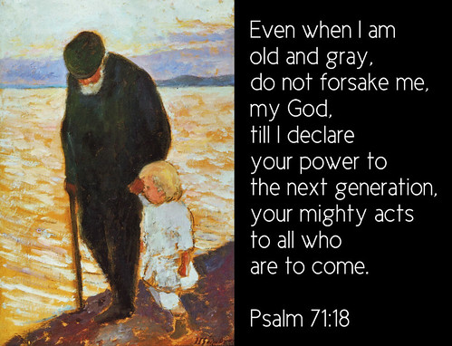
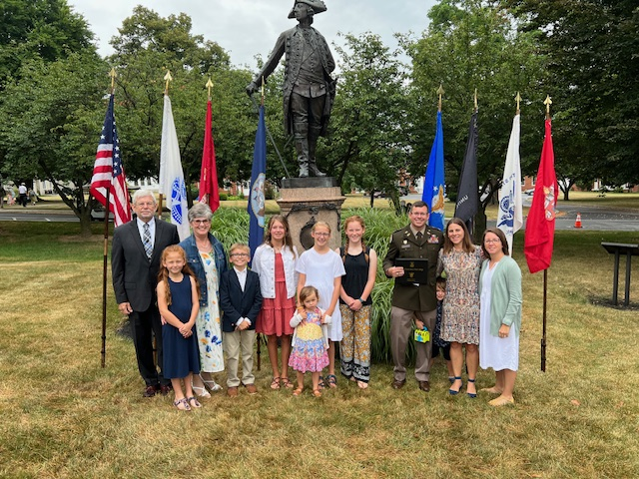
Even when I am old and gray, do not forsake me, my God, till I declare your power to the next generation, your mighty acts to all who are to come.
Psalm 71:28
Your Teacher
Ron Vandiver
December 27, 1952
Retired United States
Army ABN RGR
Married: Diann
8 June 1974
Children: Three w/8
Grandchildren
Dog; Chocolate
2514 Rogers Road
Graham, NC 27253
757-570-1654
You have permission
to invite yourself to
our house, if you want
to know us better.
Recommend as a teacher you provide for your students a key verse that
provides some insight into who you are upfront. I also think some general
bio info is helpful in knowing how they might relate to you.

Slide 3
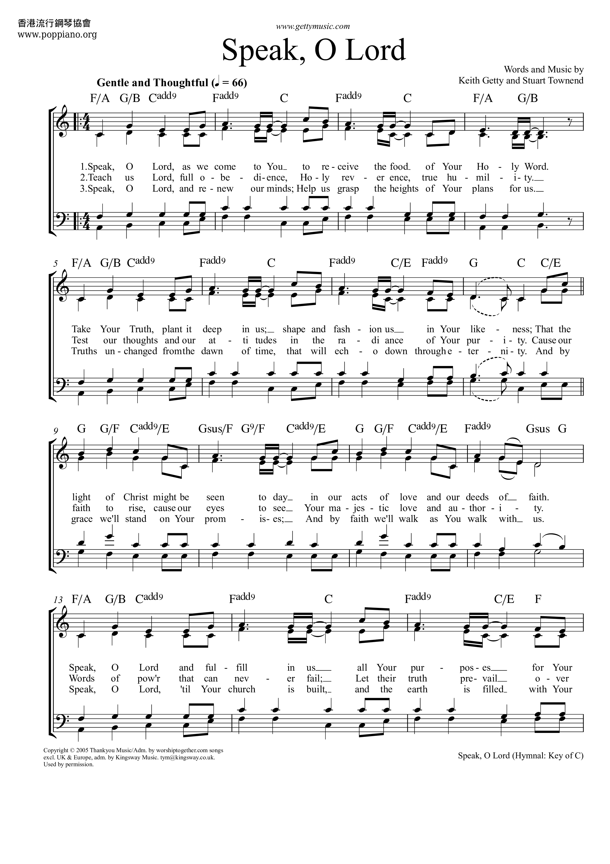
Speak, O Lord
Verse 1
Speak, O Lord, as we come to You
To receive the food of Your Holy Word.
Take Your truth, plant it deep in us;
Shape and fashion us in Your likeness,
That the light of Christ might be seen today
In our acts of love and our deeds of faith.
Speak, O Lord, and fulfill in us
All Your purposes for Your glory.
Recommend you consider having your class sing this hymn
to start the class. It may different from what you normally do, but I believe it will help set their mind and heart where it needs to be in order to benefit from this teaching period.

Slide 4
Speak, O Lord
Verse 2
Teach us, Lord, full obedience,
Holy reverence, true humility;
Test our thoughts and our attitudes
In the radiance of Your purity.
Cause our faith to rise; cause our eyes to see
Your majestic love and authority.
Words of pow'r that can never fail—
Let their truth prevail over unbelief

Slide 5
Speak, O Lord
Verse 3
Speak, O Lord, and renew our minds;
Help us grasp the heights of Your plans for us
Truths unchanged from the dawn of time
That will echo down through eternity.
And by grace we'll stand on Your promises,
And by faith we'll walk as You walk with us.
Speak, O Lord, till Your church is built
And the earth is filled with Your glory

Slide 6
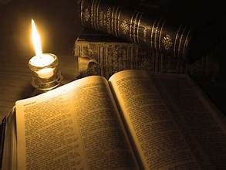
Communing With God Together In His Word Individual and Corporate Settings
READING BROADLY WITH A DISCIPLINED APPROACH as An Individual
LISTENING TO THE VOICE OF GOD THROUGH THE READ AND SUNG WORD IN
CORPORATE WORSHIP

Slide 7
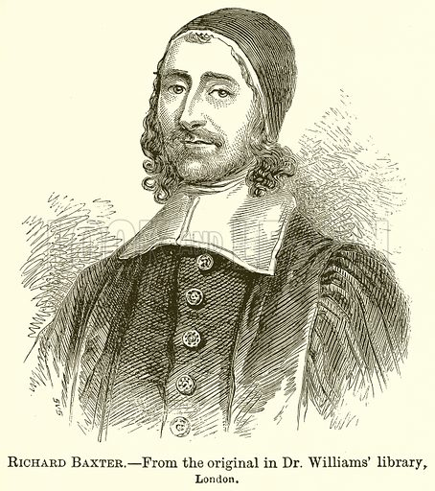
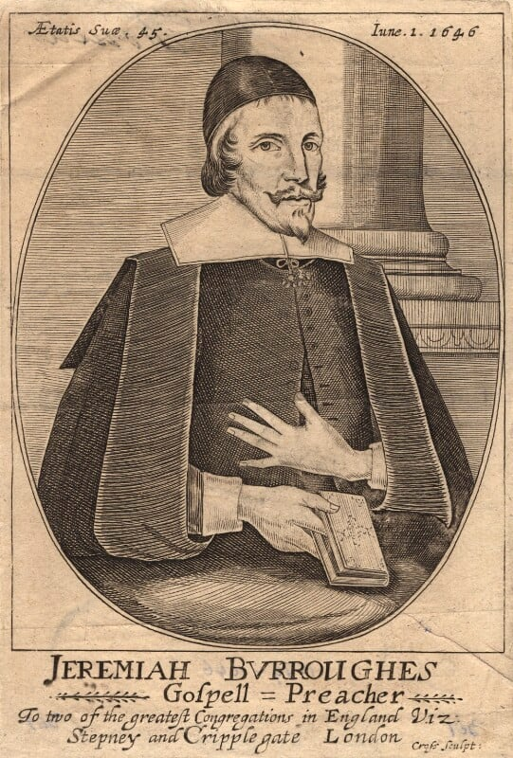
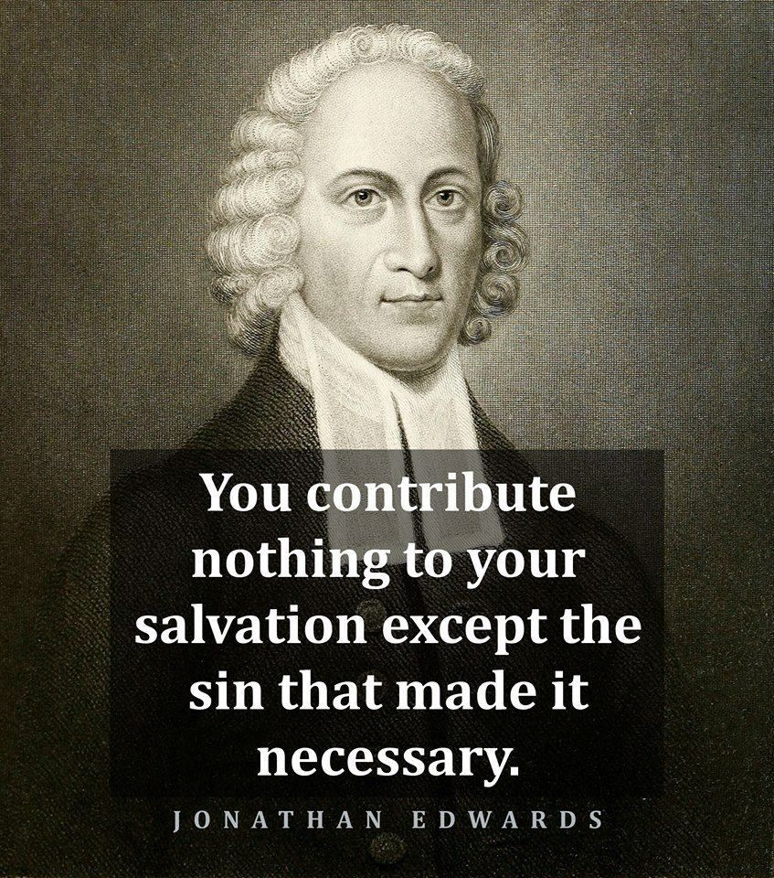
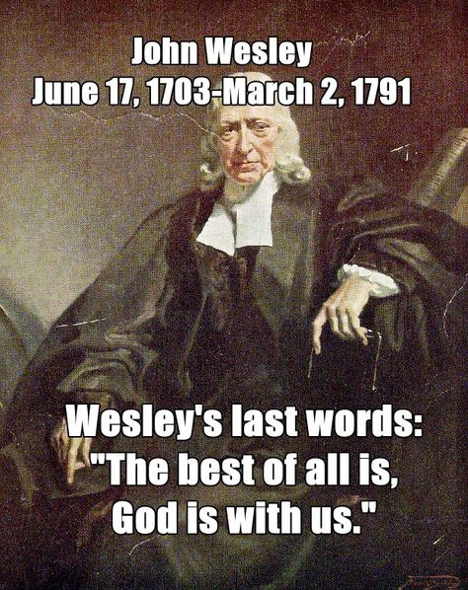
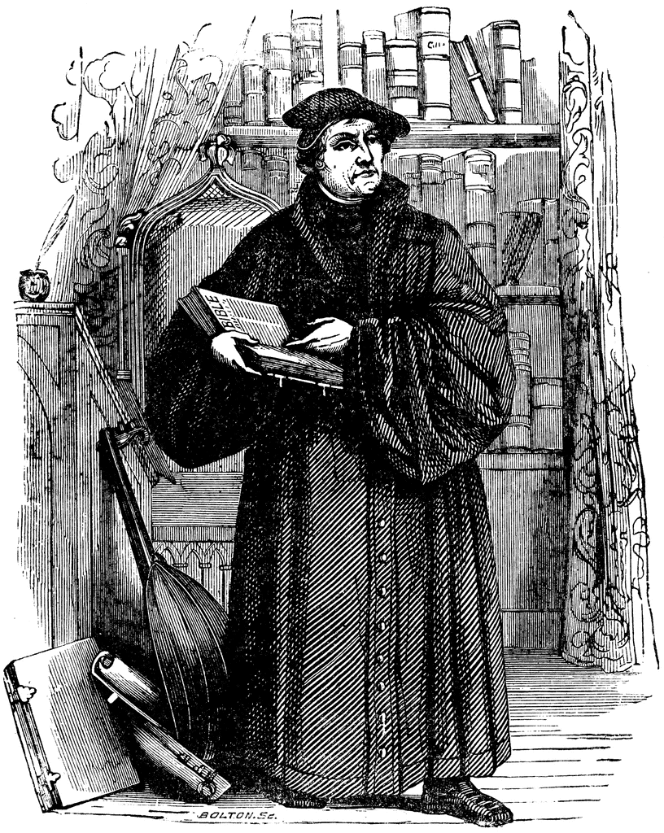
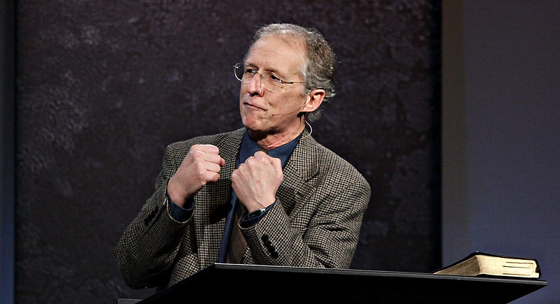
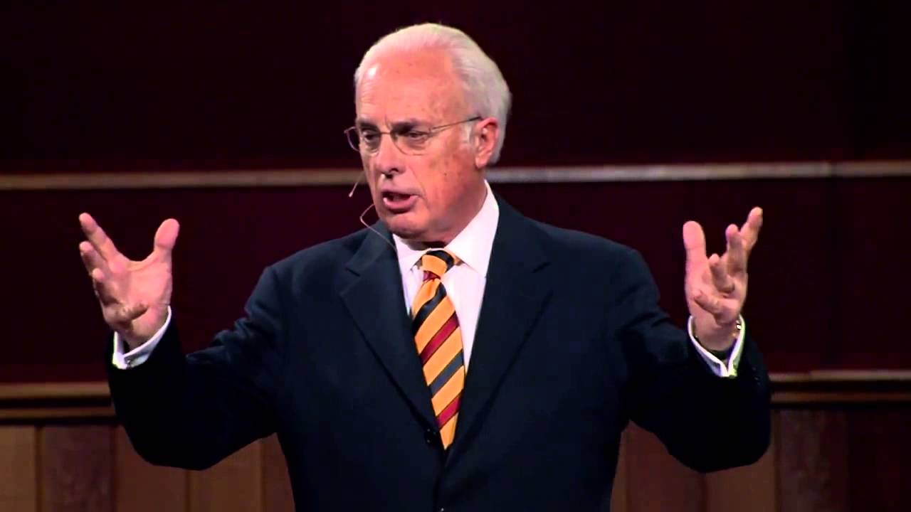
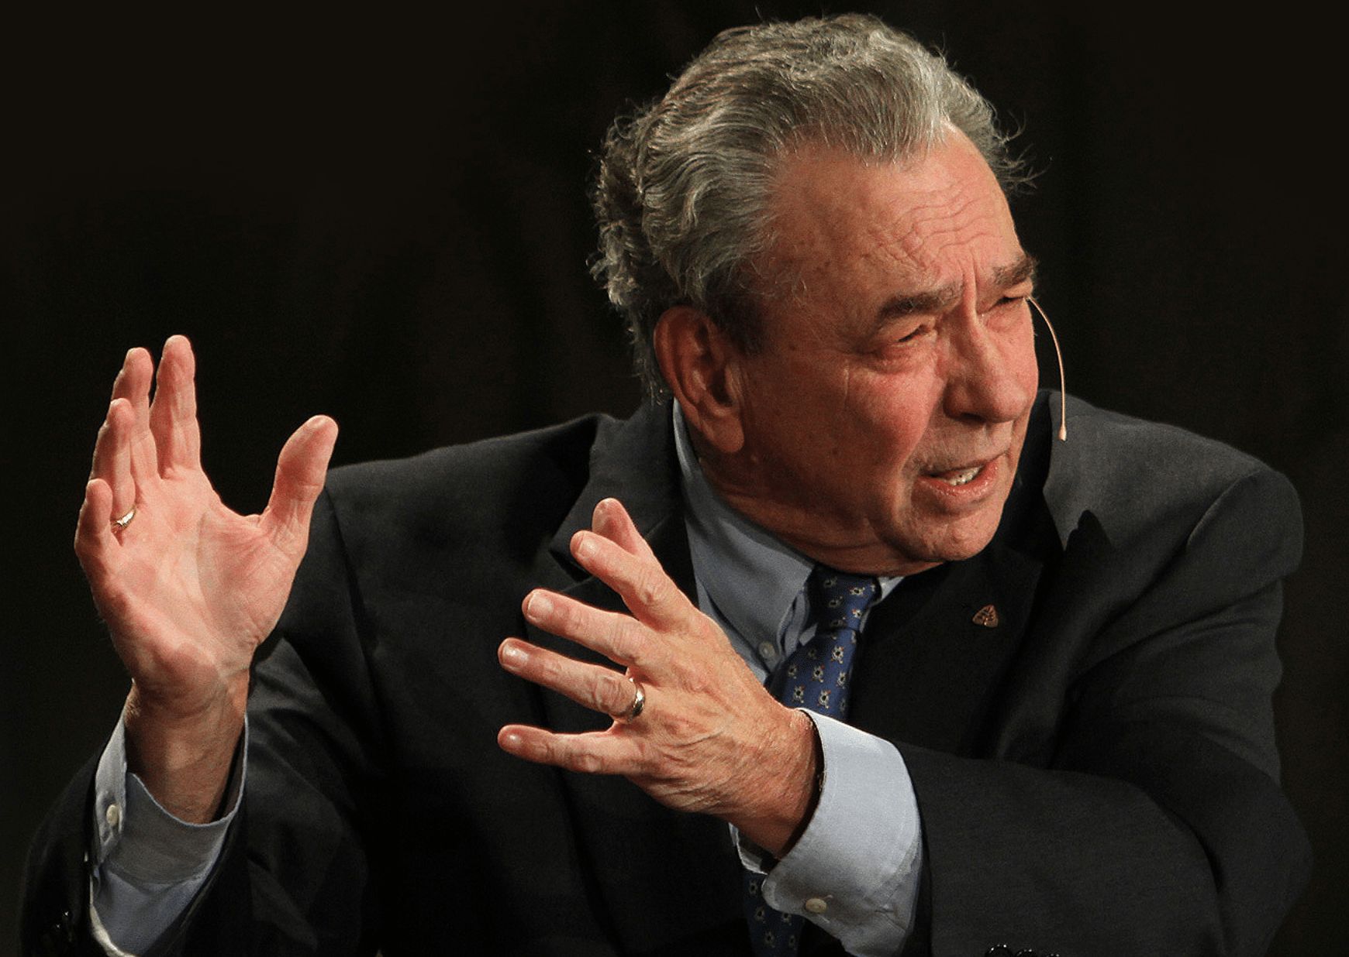
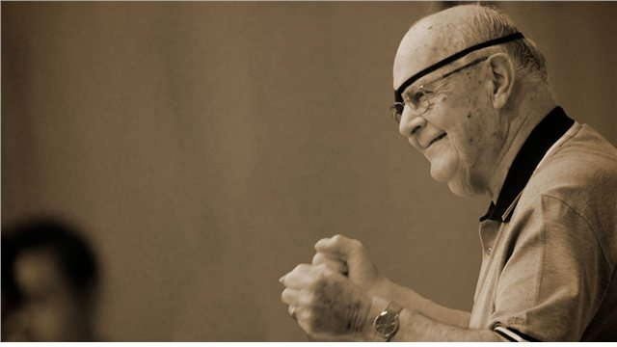
TO GOD
BE THE GLORY
It is my joy to share with you the overflow of what I learn as I continue to be a good and faithful student of the Holy Spirit as He leads me into the Word and to gifted men of aged past and present with such great knowledge, insight and wisdom. I take no credit for original thoughts.

Slide 8
The Word
Dwell In Us
This class answers first the questions: “Why is the Bible so critical for the Christian life?” We should make mastering the Scriptures one of the top priorities in our lives and as we do this with sanctification as the end product, we will let the Scriptures master us. That is why we are asked to let the word dwell in us richly (Col. 3: 16) and without the word dwelling in us richly we cannot see the transforming power of God’s Word. “But what does that require of us in simple terms?”
Secondly, this class will answer as we sit under faithful reading of the Word in corporate worship: (1) “Why Public Scripture Reading Consist As An Essential Element of Worship In The Service?” and (2) “What Is The Purpose and Benefit of The Benediction at the End of The Service?”
We should have the same posture as David, who says in Psalm 19, “More to be desired are they [the Scriptures] than gold, even much fine gold; sweeter also than honey and drippings of the honeycomb.”

Slide 9
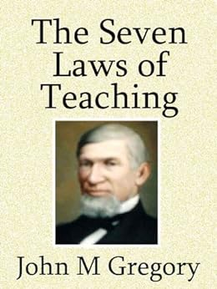
Teaching
Practice
THE LAW OF THE TEACHER – If you stop growing today, you stop teaching tomorrow. If I am to be an effective teacher I must teach from the overflow of a full life.
“The teacher must know that which he would teach...Imperfect knowing must be reflected in imperfect teaching.” -- John Milton Gregory
THE LAW OF ACTIVITY – Maximum learning is always the result of maximum involvement. Activity in learning is never an end in itself; its always a means to an end. Never forget your purpose. Your objective determines your outcome. You achieve that for which you aim. Task is not to impress people, but to impact them; not just to convince them, but to change them. Romans 8 informs the believer that every believer is predestined to be conformed to the image of Christ. If true, then how much change should we rightfully expect?
“Knowledge cannot be passed like a material substance from one mind to another, for thoughts are not objects which may be held and handled...Ideas must be rethought, experience must be re-experienced.” –John Milton Gregory

Slide 10
Teaching
Practice
THE LAW OF COMMUNICATION – To truly impart information requires the building of bridges. All communications has three essential components: intellect, emotions, and volition – in other words, thought, feeling, and action. So whatever it is to communicate to another individual, it involves: (1) something I know, (2) something I feel, and (3) something I’m doing.
“It is the teacher’s mission...by sympathy, by example, and by every means of influence – by objects for the senses, by facts for the intelligence – to excite the mind of pupils, to stimulate their thoughts...The greatest of teachers said: ‘The seed is the word.” The true teacher stirs the ground and sows the seed.” -- John Milton Gregory
THE LAW OF THE HEART – Teaching that imparts is not head to head, but heart to heart. To understand this you must know how I defined the heart in my studies – the biblical definition. To the Hebrews, heart embraced the totality of human personality – one’s intellect, one’s emotions, one’s will. The Teaching-Learning Process: teaching is causing people to learn; learning is change. Learning means a change in the way you think, feel and behave.
“How can the teacher’s manner fail to be earnest and inspiring when his subject matter is so rich in radiant reality” -- John Milton Gregory

Slide 11
Teaching
Practice
THE LAW OF ENCOURAGEMENT – Teaching tends to be most effective when the learner is properly motivated. Motivation – two sources: internal and external. Motivated people become change agents – path finders for others.
“The nature of mind, as far as we can understand it, is that of a power or force actuated by motives. The striking clock may sound in the ear, and the passing object may paint its image in the eyes, but the inattentive mind neither hears nor sees.”
-- John Milton Gregory
THE LAW OF READINESS – The teaching-learning process will be most effective when both student and teacher are adequately prepared. There is a value of giving “homework” – you don’t come in cold to class.
“Many teachers go to their work either partly prepared or wholly unprepared. They are like messengers without a message. They lack entirely the power and enthusiasm necessary to produce the fruits which we have a right to look for from their efforts.” -- John Milton Gregory

Slide 12
A Series of Bottomlines For Each Of You To Remember: If we are to live the Christian life faithfully and understand what God requires of us, we must do more than casually read the Bible and depend upon others to share the fruit of their study. We must interact with God’s Word personally, by allowing the Holy Spirit to saturate His message into, and etch His truth upon, our heart and mind. There are many ways to study the Bible, but the most important principle to remember is that we need to read the Bible for ourselves in a way that will help us answer what it says, what it means, and how to apply it to our lives. Our Father wants us to understand the immeasurable benefits of the Word in our life. It is the Word that wakens our faith and produces in us a sweeter, higher, longer joy than anything this world can offer. And this joy we share for the Word is a community treasure. As the Word is alive in us, it is alive within the fellowship of our church. And the outcome of the overflow of that reality at work in us: God is glorified!

Slide 13
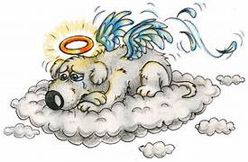
I’ll Do It
Tomorrow
I JUST NOT FEELING IT
I FEAR NO PHRASE HAS HINDERED ME MORE
“Just Not Feeling It, How Routine Awakens Devotion”, Scott Hubbard
https://www.desiringgod.org/articles/just-not-feeling-it

Slide 14
Friend of Joy
And Freedom
The very thought of routine spirituality — planned, scheduled, disciplined — seems to undermine the ministry of the life-giving, freedom-bestowing Spirit. “Where the Spirit of the Lord is, there is freedom” (2 Corinthians 3:17) — and where the spirit of routine is (we may think), there is bondage.

Slide 15
Daniel’s
Routine
Whether lions waited or not

Slide 16
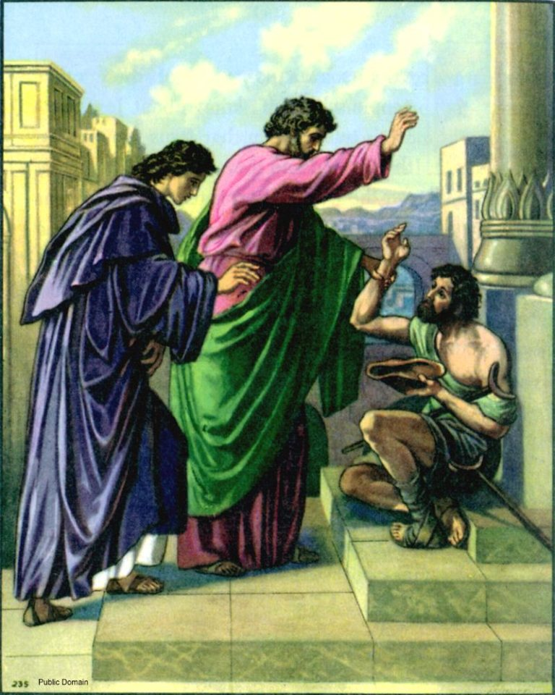
Peter and John’s
Routine
….Even after Pentecost had brought the Holy Spirit

Slide 17
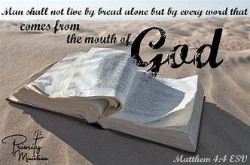
Our Lord’s
Routine
1 Then Jesus was led up by the Spirit into the wilderness to be tempted by the devil.
2 And after He had fasted forty days and forty nights, He then became hungry.
3 And the tempter came and said to Him, “If You are the Son of God, command that these stones become bread.”
4 But He answered and said, “It is written, ‘Man shall not live on bread alone, but on every word That proceeds out of the mouth of God.’ ”
5 Then the devil * took Him into the holy city and had Him stand on the pinnacle of the temple,
6 and * said to Him, “If You are the Son of God, throw Yourself down; for it is written,
‘He will command His angels concerning You’;
and
‘On their hands they will bear You up,
So that You will not strike Your foot against a stone.’ ”
7 Jesus said to him, “On the other hand, it is written, ‘You shall not put the Lord your God to the test.’ ”
8 Again, the devil * took Him to a very high mountain and * showed Him all the kingdoms of the world and their glory;
9 and he said to Him, “All these things I will give You, if You fall down and worship me.”
10 Then Jesus * said to him, “Go, Satan! For it is written, ‘You shall worship the Lord your God, and serve Him only.’ ”
Matthew 4:1-10
Our Lord Jesus himself after fasting for forty days spontaneously defeated the devil’s lies because he had routinely memorized Deuteronomy

Slide 18
Pay attention to the psalm and you may notice something that rivals the intensity of the writer’s feelings: the consistency of his routine
Feelings or
Routines ? Both
Feelings
Routine
“Blessed are you, O Lord!” he shouts (verse 12). His soul, like his song, “is consumed with longing for your rules at all times” (verse 20). Both midnight and early morning may find him awake (verses 62, 147), too ecstatic to sleep, for “your testimonies are my delight” (verse 24). His hates and his loves burn too bright to be hidden (verses 104, 119)
Scripture poured out of the man’s heart only because he had previously, even fastidiously, “stored” it there (verse 11). “I set your rules before me” was the watchword of his life, no matter the day (verse 30). With a devotion that might make us uncomfortable, he declares, “Seven times a day I praise you for your righteous rules” (verse 164).

Slide 19
So,
Brothers and Sisters,
“Do you possess a heart bent to knowing your God through His Word?”
BENT
The goal of the Spiritual Discipline of Bible Intake is to cultivate a continuous deeper relationship with God by getting as much of God’s Word in our life as possible.

Slide 20
So, you have an invitation already in your heart if you are in Christ Jesus
Personally
Addressed
An Invitation To Intimacy
With Your God
God drafted it personally through almost 40 human authors, in 66 volumes, 1,189 chapters, 31,173 verses and 774,746 words. No expense was spared on this invitation. Jesus Christ gave His life to deliver it to you. Moses, Isaiah, David, John, Paul, Jeremiah, Daniel, are among the chosen saints who became living pens through which the Holy Spirit extended the Father’s request for the pleasure of your company.

Slide 21
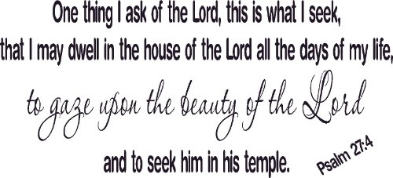
SEEING
MOST CLEARLY
Everything David ever wanted was wrapped up, tied up, and tangled up in his longing to be in the presence of God. So, too, should all our longings be shaped and colored by a desire to see God. And we will see Him most clearly in His Word.

Slide 22
IN HIS WORD, He shows me His eyes, able to see me in my valleys and on my mountaintops. I find powerful arms, capable of holding me secure in the fiercest of spiritual storms and as gentle to the touch as the breeze upon my face. I see a smile that welcomes me to green pastures, and to the shadows, and makes all grace abound toward me, fingers that knitted me together in my mother’s womb, and hands that provide me discipline, provision, power and protection through circumstances seen and unseen. His ears hear my laments and my shouts of praise that are silent to others, and He is always bent in my direction to listen to me. His nose inhales the savor of my sacrifices. He loves me with a heart whose desire is toward me.
Perhaps, herein lies God’s motive for making Himself known to us. It is to invite us to know Him intimately, to see Him as ultimately approachable, reachable, touchable, and accessible.
God’s
Motive

Slide 23
Sin, if it is allowed to build up in our lives, will gum up the workings of every spiritual pursuit.
Daily Sin
Check
Every believer should be in the habit of allowing the Holy Spirit to do a periodic sin check.
“Search me, O God, and know my heart; Try me and know my anxious thoughts; And see if there be any hurtful way in me, and lead me in the everlasting way.” Psalm 139:23-24

Slide 24
Longings
After God
Lord, give me more of thy likeness; Enlarge my soul to contain fullness of holiness; Engage me to live more for thee. Help me to be less pleased with my spiritual
experiences, and when I feel at ease after sweet communings, teach me it is far too little I know and do. Blessed Lord,
let me climb up near to thee, and love, and long, and plead, and wrestle
with thee, and pant for deliverance from the body of sin, for my heart is wandering and lifeless, and my soul mourns to think it should ever lose sight of its Beloved. Wrap my life in divine love, and keep me ever desiring thee, always humble and resigned to thy will, more fixed on thyself, that I may be more fitted for doing
and suffering.
Intimacy
With God
My dear Lord, can but tell thee that thou knowest I long for nothing but thyself, nothing but holiness, nothing but union with thy will. Thou hast given me these desires, and thou alone canst give me the thing desired. My soul longs for communion with thee, for mortification of indwelling corruption, especially spiritual pride. How precious it is to have a tender sense and clear apprehension of the mystery of godliness, of true holiness! What a blessedness to be like thee as much as it is possible for a creature to be like its Creator!
I
The Valley Of Vision, pp.230-231

Slide 25
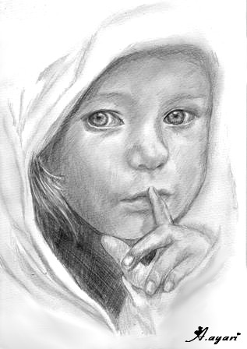
There is much more I could say, but time does not allow
So….let’s turn our thoughts from an individual setting with the Word to a corporate worship setting.
This morning I want to turn your hearts and minds to listening to the voice of God through the Read Word (Scripture Reading and Benediction).
And if time permits…the Sung Word.
Listen !

Slide 26
Based Upon What Is Specifically Prescribed In The New Testament, The Word Includes Five Expressions In Corporate Worship:
Reading The Bible (1 Tim. 4:13)
Preaching The Bible (2 Tim. 4:2)
Pray The Bible (I Tim.2:8, 3:14-15)
Singing The Bible (Eph. 5:19; Col. 3:16)—the Psalms As Well As Scripture Songs That Reflect The Development Of Redemptive History In The Birth-life-death-resurrection-ascension Of Jesus; Praying The Bible—the Father’s House Is “A House Of Prayer” (Matt. 21:13)
Seeing The Bible In The Two Sacraments Of The Church, Baptism And The Lord’s Supper (Matt. 28:19; Acts 2:38–39; 1 Cor. 11:23–26; Col. 2:11–12)

Slide 27
Listening To The Voice of God Through The Read Word in Corporate Worship

Slide 28
Listening To The Voice of God Through The Read Word Rooted In The Whole History Of The People Of God, Beginning In The Days of Moses
When the children of Israel gathered at Mt. Sinai for worship after the Exodus from Egypt, Moses read God’s word aloud to them. Exodus 24:7 says “he took the book of the covenant and read it in the hearing of the people.”
When Israel finally arrived in the Promised Land, Joshua read Scriptures aloud to them again. Joshua 8:35 tells us “There was not a word of all that Moses had commanded which Joshua did not read before all the assembly of Israel.”
When the long lost book of the law was discovered in the Temple in the days of good King Josiah (2 Chronicles 34:14), we learn that the King himself “read in their hearing all the words of the book of the covenant which was found in the house of the Lord” (2 Chronicles 34:30).
After the people of Israel returned from exile in the days of Ezra and Nehemiah, Ezra read the book of the law of Moses to the assembled people from early morning until midday (Nehemiah 8:1-8), with all the people standing out of reverence for God’s word!

Slide 29
Listening To The Voice of God Through The Read Word Rooted In The Whole History Of The People Of God, Beginning In The Days of Moses
This story of the public reading of Scripture reaches a high point when Jesus famously launched His public ministry by standing up to read the Scriptures. “And he came to Nazareth, where he had been brought up. And as was his custom, he went to the synagogue on the Sabbath day, and he stood up to read” (Luke 4:16).

Slide 30
The Public Reading Of Scripture Is An Essential Element Of Christian Worship For The People Of God.
The public reading of Scripture is a means of grace. It not only serves as an opportunity whereby we openly and corporately sit under His word– acknowledging his authority, acknowledging our dependence upon the initiative of his self-revelation, acknowledging our glad surrender to the Lordship of his word–but it is also a God-appointed means whereby we are strengthened by and receive his favor. The Lord has deigned to bless and edify His people by it.
In the reading of God’s word, God speaks most directly to His people. And so, this act of worship, in which the verbal self-revelation of God is addressed unedited to the hearts of his gathered people.

Slide 31
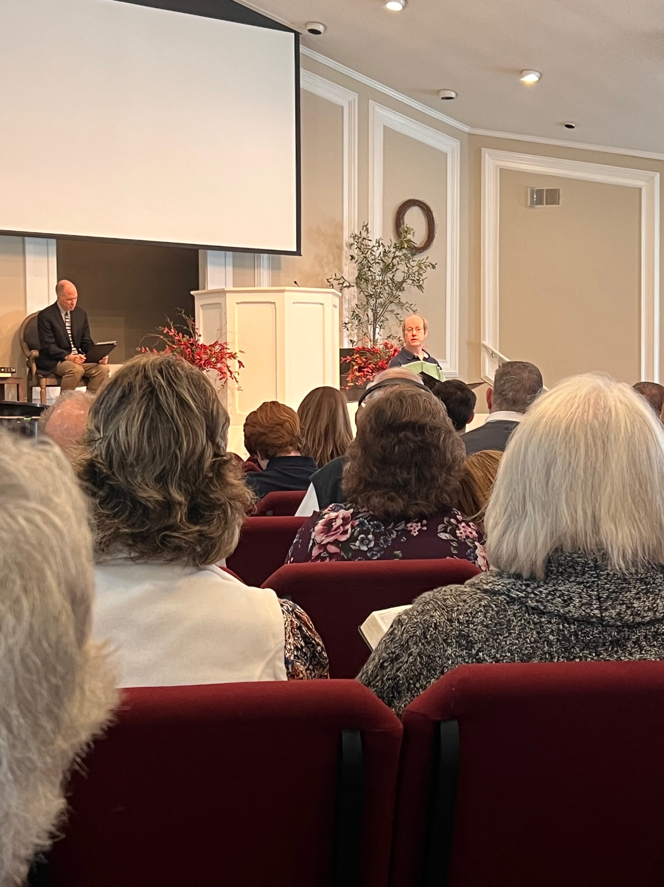
SCRIPTURE READING IN THE CORPORATE WORSHIP SERVICE Why It Consist of An Essential Element of Worship In The Service
THE
READ
WORD
It Upholds the Scriptures' Supremacy (supremacy)
It Obeys the Biblical Command (obedience)
It Instructs the Church Corporately (instruction)
It Voices the Divine Truth (God-speaks)
It Edifies the Truly Regenerated (edification)
It Demonstrates the Church's Authority (authority)

Slide 32
The Benediction in Corporate Worship It Is More Than A Prayer, It Is A Blessing On God’s People
THE
READ
WORD
God has designed the pronouncement of a Scriptural blessing or benediction to be the conclusion or culmination of the corporate worship of his people. By it the people who have gathered together in God’s name and with his presence among them depart with the assurance that God has indeed been in their midst and that he intends to bless his people.
Those in attendance should leave the special presence of God with their faith stirred toward his promises, knowing that they have been blessed and shall be blessed.

Slide 33
“The last thing said in the Bible is a benediction. ‘The grace of our Lord Jesus Christ be with you all. Amen.’” So the last thing in corporate worship should be a benediction as God’s people anticipate the face of God shining upon them in the new heavens and new earth.

Slide 34
SINGING PSALMS AND HYMNS AND SPIRITUAL SONGS The Only Instrument Referred To In New Testament Worship Is The Human Voice
THE
SUNG
WORD
The 400+ references to singing in Scripture includes 50 direct commands to sing. The largest book in the Bible, and the most quoted book in the New Testament, is the Psalms, which is essentially a songbook. Evidently, it’s of paramount importance to God that his people—every last one of them—sing his praises.
It’s God’s design that the local church’s congregation is mostly an untrained choir of blood-bought saints.

Slide 35
Whether you have a voice that’s meant for public singing or not, your voice was placed in this world by the Creator. As strange as it is to say, in this instance, your opinions on your vocal prowess are irrelevant. Your audience is the Triune God alone.

Slide 36
“The Sung Word” We Sing to Remember God’s Word…the Word of Christ
Israel Will Fall Away
¹⁴ Then the Lord said to Moses, “Behold, the time for you to die is near; call Joshua, and present yourselves at the tent of meeting, that I may commission him.” So Moses and Joshua went and presented themselves at the tent of meeting. ¹⁵ The Lord appeared in the tent in a pillar of cloud, and the pillar of cloud stood at the doorway of the tent. ¹⁶ The Lord said to Moses, “Behold, you are about to lie down with your fathers; and this people will arise and play the harlot with the strange gods of the land, into the midst of which they are going, and will forsake Me and break My covenant which I have made with them. ¹⁷ Then My anger will be kindled against them in that day, and I will forsake them and hide My face from them, and they will be consumed, and many evils and troubles will come upon them; so that they will say in that day, ‘Is it not because our God is not among us that these evils have come upon us?’ ¹⁸ But I will surely hide My face in that day because of all the evil which they will do, for they will turn to other gods.
¹⁹ “Now therefore, write this song for yourselves, and teach it to the sons of Israel; put it on their lips, so that this song may be a witness for Me against the sons of Israel. ²⁰ For when I bring them into the land flowing with milk and honey, which I swore to their fathers, and they have eaten and are satisfied and become prosperous, then they will turn to other gods and serve them, and spurn Me and break My covenant. ²¹ Then it shall come about, when many evils and troubles have come upon them, that this song will testify before them as a witness (for it shall not be forgotten from the lips of their descendants); for I know their intent which they are developing today, before I have brought them into the land which I swore.” ²² So Moses wrote this song the same day, and taught it to the sons of Israel.

Slide 37
HYMNS TEACH Let The Word Of Christ Dwell In You Richly, Teaching And Admonishing One Another In All Wisdom, Singing Psalms And Hymns And Spiritual Songs, With Thankfulness In Your Hearts To God.
While the New Testament is silent on many of the specifics of corporate worship, Scripture is clear that the Word of Christ must be central. When the hymns we sing are aligned with the Word of God, our souls are nourished by its truth. Singing is a unique way to “let the word of Christ dwell richly” in us. One, if not the primary, reason our songs should be closely tied to the Word of God is their didactic (instructive) effects.
Singing for the believer is formative and responsive, and therefore must be informed by Scripture. We learn what we sing.

Slide 38
HYMNS ADMONISH Let The Word Of Christ Dwell In You Richly, Teaching And Admonishing One Another In All Wisdom, Singing Psalms And Hymns And Spiritual Songs, With Thankfulness In Your Hearts To God.
We sing to admonish the weak and the weary that their salvation is in God. We sing to admonish the doubting to believe and be renewed. We sing to admonish the suffering that they have a hope that is unwavering.
Our songs ought to exhort and admonish. Our songs ought to encourage and remind. In this practice of song, God's people will be pointed to the Scriptures, reminded of truth, and rooted in the gospel of Christ.
Admonishing(3560) (noutheteo from noús = mind + títhemi = place, this verb describing exertion of influence upon nous implying resistance) (warning, cautioning, gently reproving, exhorting) literally means to place in the mind and so to warn or give notice to beforehand especially of danger or evil. The idea is to lay it on the mind or heart of the person, with the stress being on influencing not only the intellect, but also the will, emotions and disposition.

Slide 39
HYMNS PROVOKE THANKFUL HEARTS Let The Word Of Christ Dwell In You Richly, Teaching And Admonishing One Another In All Wisdom, Singing Psalms And Hymns And Spiritual Songs, With Thankfulness In Your Hearts To God.
We should choose hymns that provoke thankful hearts. When we sing robust theological truth, our hearts should erupt with praise. The aim of singing hymns is engaging both the head and the heart. The reason we read, study, and meditate on the Scriptures is not primarily so that we might amass knowledge, but so that our knowledge would lead to worship. The chief end of theology is doxology.
We should sing songs that make our hearts rejoice. From the content of the lyrics to the movement of the melody, we want beauty and transcendence to come together and serve the people of God. In our pursuit of theological precision, let us not neglect the pursuit of heartfelt response.
Singing is a holy practice. We sing because God has commanded it, and our songs should fill our hearts with thankfulness and delight in our great God.

Slide 40
Brothers and Sisters, “Why singing matters both in our private devotion and corporate worship?”
‘7 Biblical Reasons Why Singing Matters’
You Obey God’s Will
You Dig Roots Into The Word of God
You Proclaim the Gospel To Unbelievers
You Make War Against God’s Enemies
You are Spiritually Strengthened For The Trails Of Life
You Experience The Joy That Only Comes From the Holy Spirit
You Glorify God

Slide 41
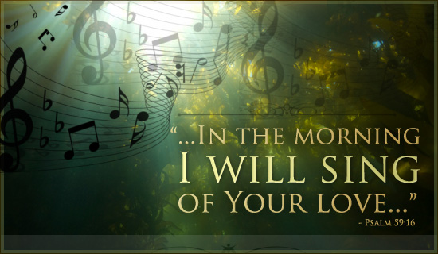
So sing and sing often, with great courage, and just know that your singing matters to God, and to the people, and to the angels in His kingdom. It even matters to Satan who will flee from you lickety-split when you start singing praises to God. So tomorrow morning if it’s a beautiful day, rise up and sing with joy, and if trials hit, sing your way through them as well because singing really does matter.

Slide 42
It is Jonathan Edwards who would say, “The duty of singing praises to God, seems to be appointed wholly to excite and express religious affections. No other reason can be assigned, why we should express ourselves to God in verse, rather than in prose, and do it with music, but only, that such is our nature and frame, that these things have a tendency to move our affections.”
And God made these song-awakened, song-carried affections for himself. Christian singing is the musical use of the voice to express truth that accords with God’s word, and feelings that accord with God’s worth. It is a gift beyond measuring.
Therefore,
Make a joyful noise to the Lord, all the earth! Serve the Lord with gladness! Come into his presence with singing! (Psalm 100:1–2)

Slide 43
Where Joy And Fear Are Held Together
Our Closing Thought
John Calvin described reverence as the place where joy and fear are held together. Not the fear of trembling and despair, but the kind that cultivates awe and respect when contemplating God’s holiness, nearness, grace and power. This kind of reverence does not invite worshipers into what C.S Lewis has called “an obligation to feel,” but into a space where personal feelings serve only as a background to the drama of God’s being. “Be still and know that I am God (Psalm 46:10).”
This is the kind of fear that Scripture calls the beginning of wisdom. We were built for reverence because we were built to glorify God. We develop a capacity for deep joy in the same measure that we learn to revere God, ”Humble yourself before the Lord, and He will lift you up (James 4:10).”

Slide 45
Feeling Deeply
Your testimonies are my delight. (Psalm 119:24)
My soul is consumed with longing for your rules at all times. (Psalm 119:20)
Behold, I long for your precepts; in your righteousness give me life. (Psalm 119:40)
As John Piper has noted,
If we just know him in our minds, we’re not doing anything different than the devil. The devil may be one of the most theological, orthodox beings in the universe. He just hates what he knows about God.
When you hear God’s word in corporate worship, listen. Whether in the call to worship, or the sermon, or the benediction, let your heart be warmed by the flame of God’s voice. Allow your heart to tremble at the reality and veracity of God’s word.

Slide 46
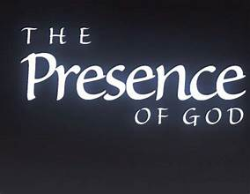
When Men and Women Come Into God’s Presence They Know It
There is a seriousness that must mark it, a solemnity and honor that must attend it, a gravity that must saturate it.
Moses takes off his shoes (Ex. 3)
Israel is struck with fear (Ex. 20)
Isaiah quakes (Isa. 6)
Job silences his lips (Job 40)
John falls down as though dead (Rev. 1)
Even the elders and angels, who are worshiping
day in and day out before the throne, aren’t
casual in their worship (Isa. 6; Rev. 4)

