Slide 1
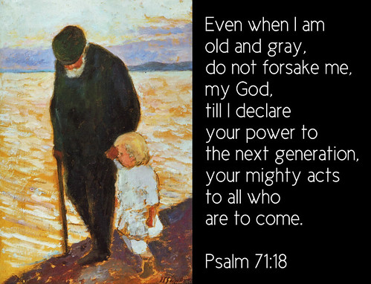
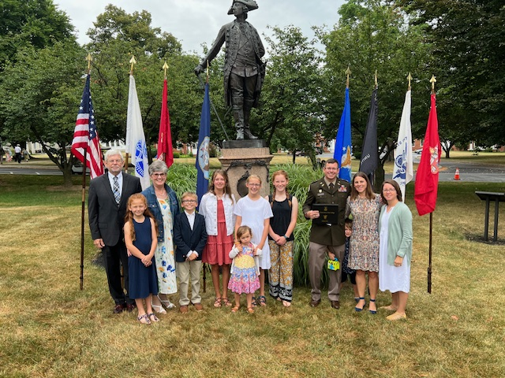
Even when I am old and gray, do not forsake me, my God, till I declare your power to the next generation, your mighty acts to all who are to come.
Psalm 71:18
Your Teacher
Ron Vandiver
December 27, 1952
Retired United States
Army ABN RGR
Married: Diann
8 June 1974
Children: Three w/8
Grandchildren
Dog: Chocolate Lab
2514 Rogers Road
Graham, NC 27253
757-570-1654
You have permission
to invite yourself to
our house, if you want
to know us better.

Slide 2
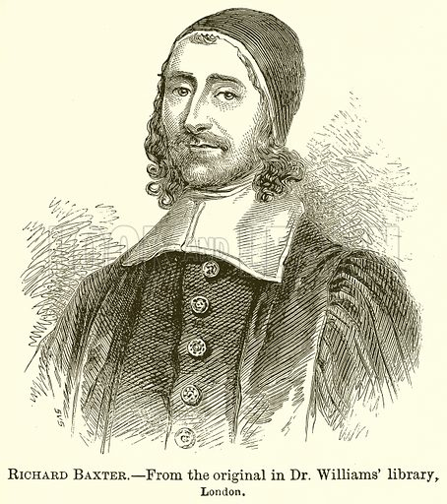
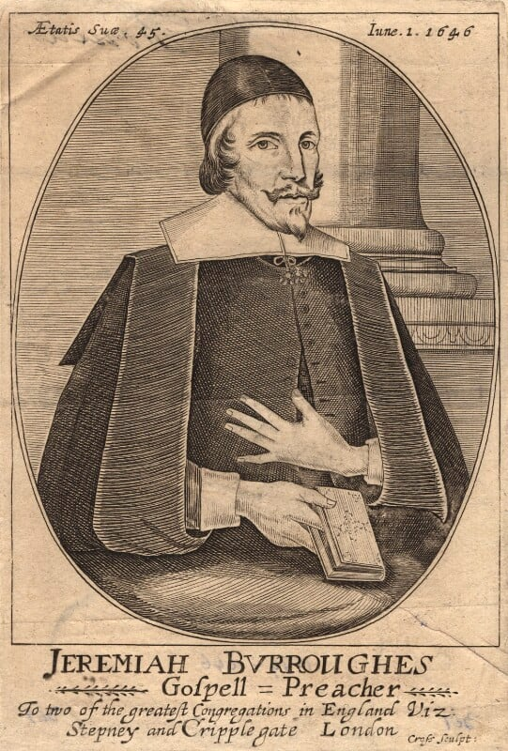
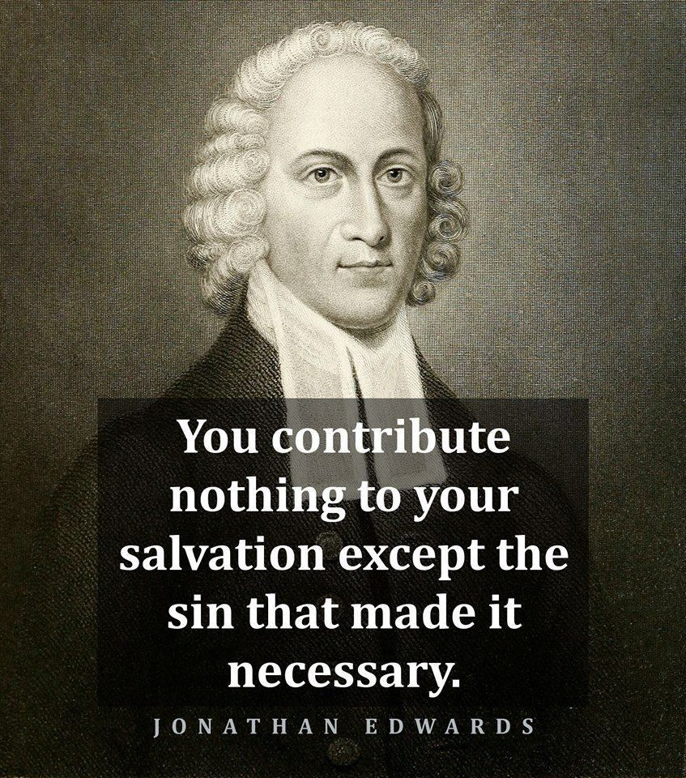
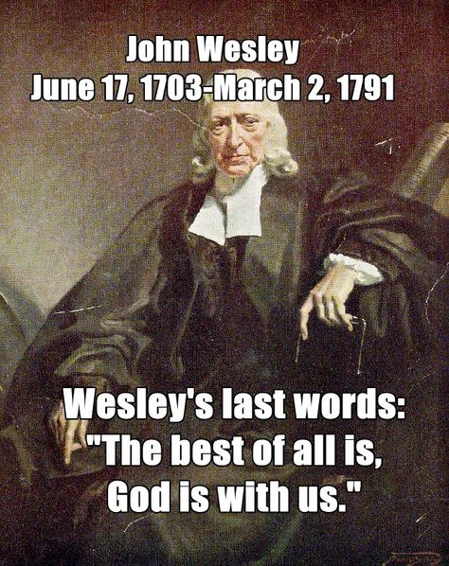
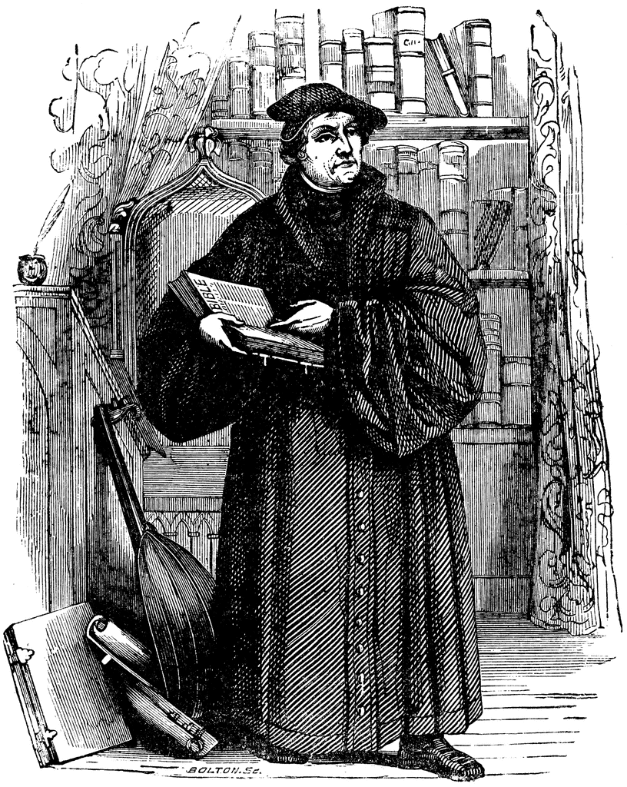
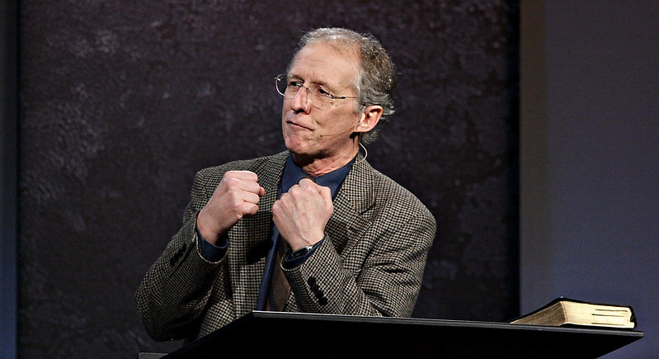
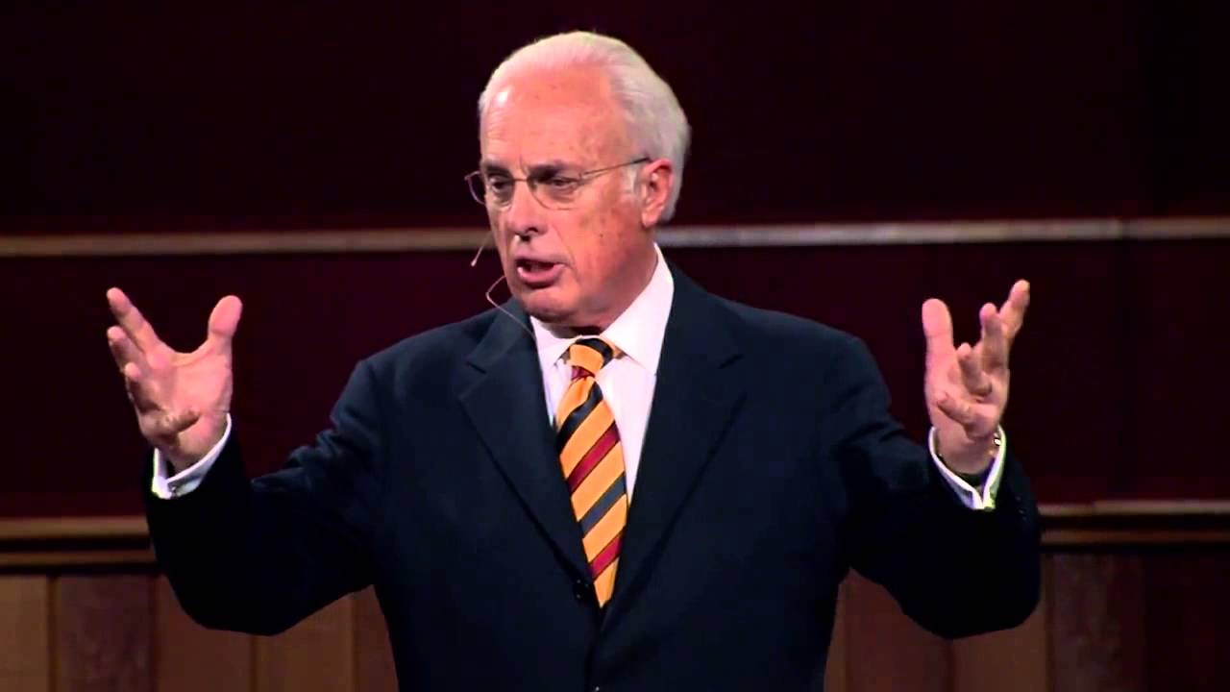
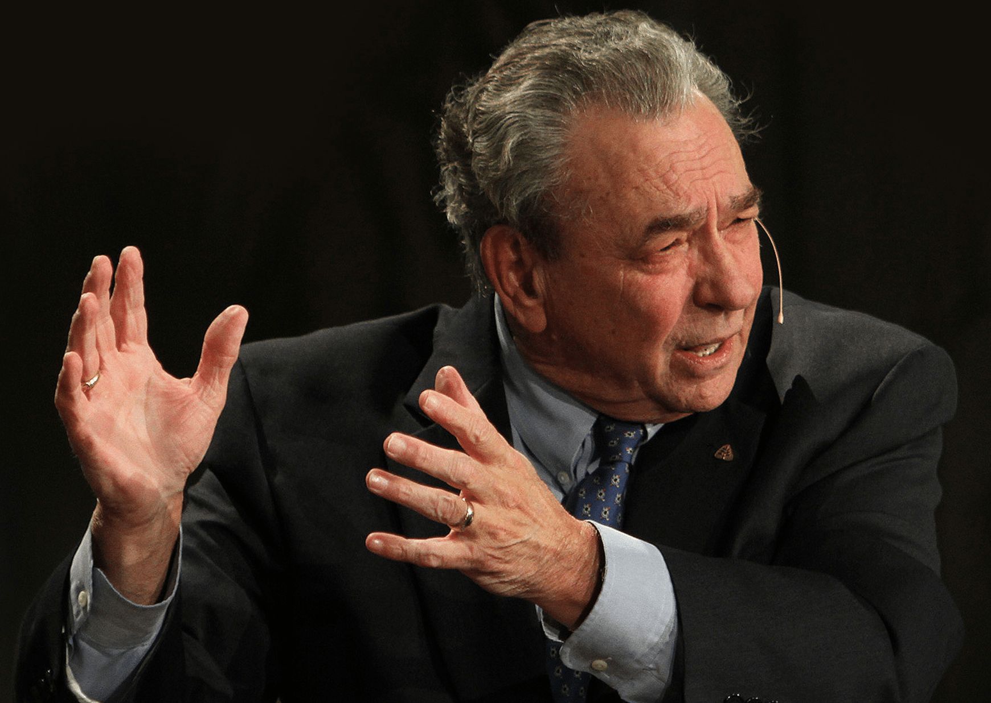
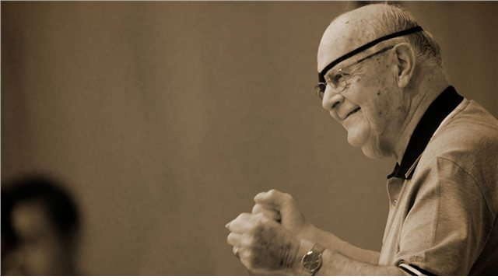
It is my joy to share with you the overflow of what I learn as I continue to be a good and faithful student of the Holy Spirit as He leads me into the Word and to gifted men of aged past and present with such great knowledge, insight and wisdom. I take no credit for original thoughts.

Slide 3
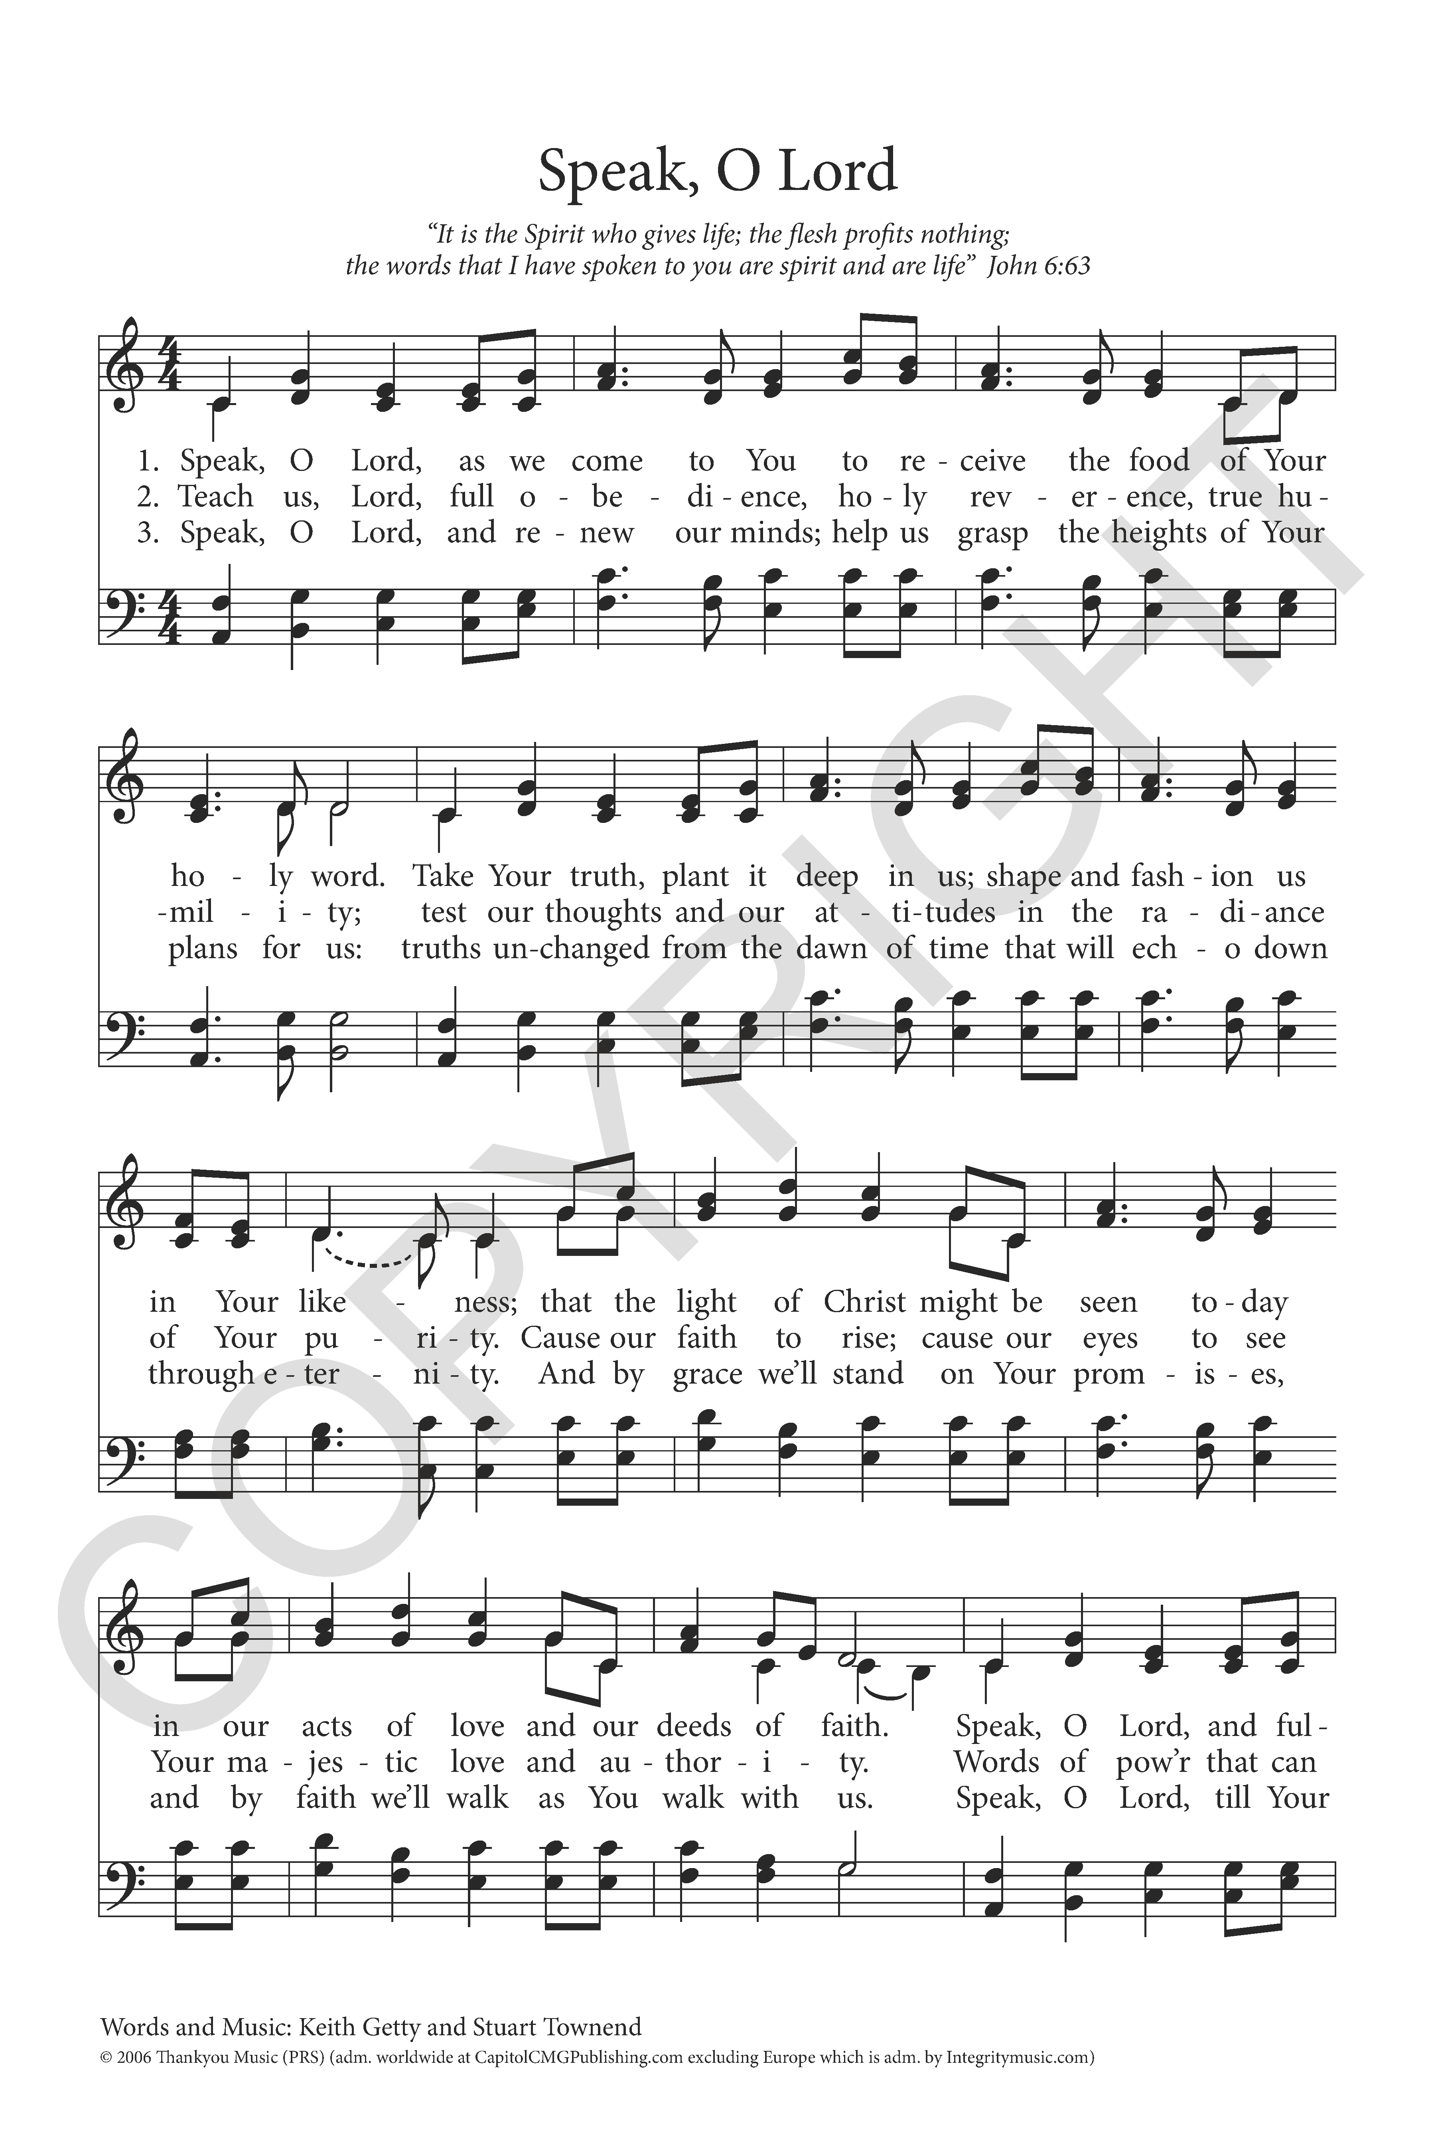
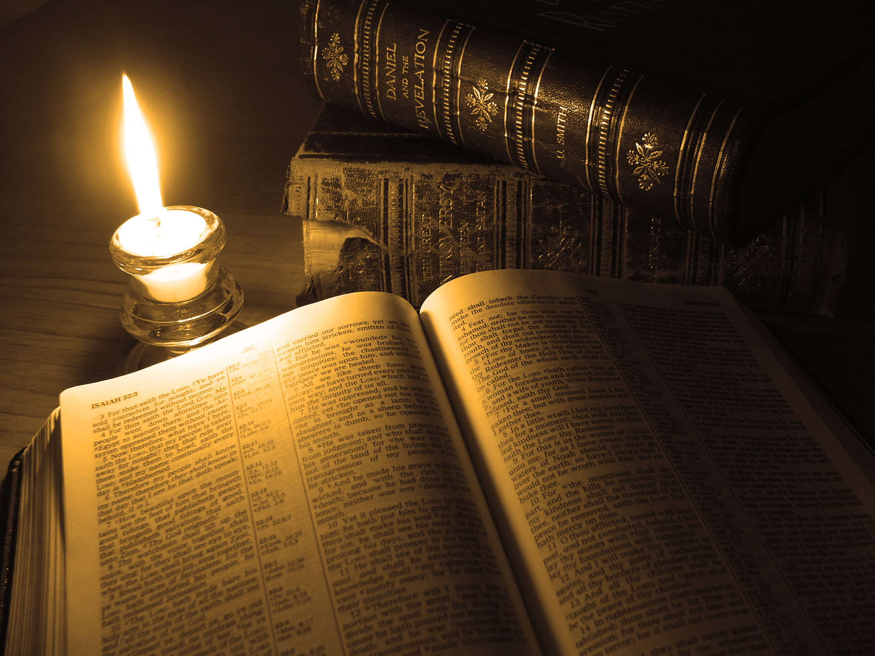
Speak, O Lord, as we come to You
To receive the food of Your Holy Word.
Take Your truth, plant it deep in us;
Shape and fashion us in Your likeness,
That the light of Christ might be seen today
In our acts of love and our deeds of faith.
Speak, O Lord, and fulfill in us
All Your purposes for Your glory

Slide 4
Teach us, Lord, full obedience,
Holy reverence, true humility;
Test our thoughts and our attitudes
In the radiance of Your purity.
Cause our faith to rise; cause our eyes to see
Your majestic love and authority.
Words of pow'r that can never fail—
Let their truth prevail over unbelief

Slide 5
Speak, O Lord, and renew our minds;
Help us grasp the heights of Your plans for us—
Truths unchanged from the dawn of time
That will echo down through eternity.
And by grace we'll stand on Your promises,
And by faith we'll walk as You walk with us.
Speak, O Lord, till Your church is built
And the earth is filled with Your glory

Slide 6
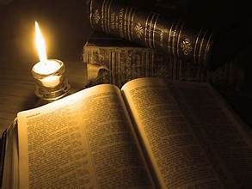
Communing With God Together In His Word Individually and Corporately
READING IN A PRIVATE SETTING WITH YOUR GOD (TALKING AND LISTENING)
LISTENING TO THE VOICE OF GOD THROUGH THE READ, SUNG AND PREACHED WORD IN
THE CORPORATE WORSHIP

Slide 7
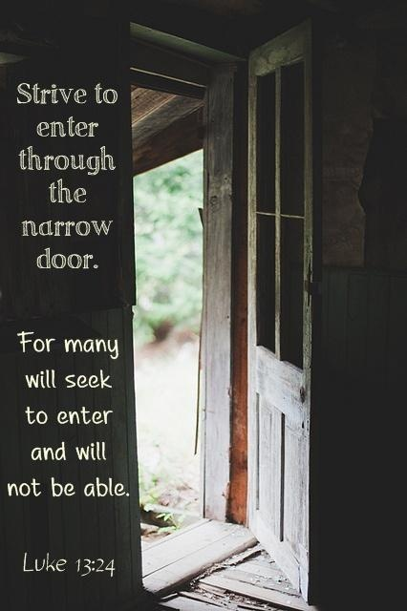
The Christian life is not a leisurely stroll but a purposeful journey. Jesus tells us we must “strive to enter through the narrow door,” knowing that the Christian life permits no complacency, that salvation must be “worked out,” not waited out (Luke 13:24; Philippians 2:12). The Christian is not a passive spectator in sanctification but an active participant.

Slide 8
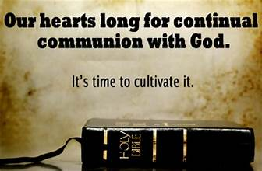
The Book Is More Than Paper And Ink: It Talks With Us.
Was not that the promise, “When thou awakes, it shall talk with thee” (Prov.6:22 KJV)? We open the Book with this prayer, “Speak, Lord, for Your servant hears” (I Sam.3:9), and we often close it with this feeling “Here I am, for you called me” (I Sam 3:6). As surely as if the promise had never been uttered before, but the Lord had made Holy Scripture to be His direct word to our heart and conscience.

Slide 9
Communion With Our God
It is here I ask should we not sense a great need to commune with God in Scripture every day? Whatever else we are as believers, are we people who long to meet our Triune God in His Word.
Communion with God in Scripture is one of the great distinguishing marks of a Christian, an acid test of true spiritual life. Whatever else we are as believers, we are people who meet God in the Bible.
Are you passing
the acid test
of the true spiritual life?

Slide 10
Come Fearfully. God is in this book. Scripture is the breath of His mouth, the Word of His Son, the light of His presence, the unveiling of His mind, the bread of His baking, the mirror of His glory, the energy of His creation, the repairman of His image, the irrigating water of His life in the soul, and the sword of His Spirit. We should read “rejoicing with trembling” (Ps.2:11)

Slide 11
2.Come prayerfully. There is no better fodder for prayer than to speak God’s Word back to Him. Maintain a constant dialogue with God through the Holy Spirit as you commune with Him. Plead for strength to obey every precept, embrace every promise, pursue every example, and experience every truth.

Slide 12
Come Thoughtfully. Scripture does its best work in us when we linger and hide its truth deep within. “Thy word I have hidden in mine heart that I might not sin against thee” (Ps. 119:11).

Slide 13
4. Come Realistically. Reading the Bible with realism also means that we will often read the Word and feel very little of God at all. The book itself preps us to expect such dry times.

Slide 14
5.Come Systematically. Wasn’t it Spurgeon who said that it takes a whole Bible to make a whole Christian? We must resolve, therefore, to mine its depths all day, every day (but his delight is in the law of the Lord, and on his law he meditates day and night Ps.1:2). Only then will it become our constant reference point, the lens through which we view all of life.

Slide 15
6. Come submissively. Determine to hear God’s mind, not your own; to pursue His will, not your own; to be done with the Adamic habit of measuring God “by the yardstick of your own carnal stupidity” (as John Calvin says), and to take Him as He reveals Himself, on His terms, not your own. Let there be no “not yet” in your prayer for submission. “Give me spiritual chastity now” must be the cry of every reader determined to find God in this book.

Slide 16
7.Come expectantly. The closest possible connection exists between God and His Word. Why do you think He made the universe with words, when a mere thought would have done it all? Was it not to teach us the glory of His voice? When He speaks, nothing remains the same; everything changes. And when His Son came into the world, how does He introduce Him to us? As His Word, His voice of self-revelation, through whom He made all things So, when we come to the Bible, we should come expecting to meet the Lord Christ. It is His book. It is all about Him.

Slide 17
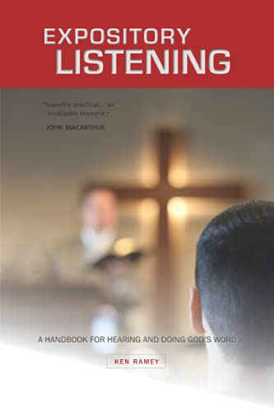

Slide 18
We Must Seek To Understand The Bible’s Meaning, And We Must Pause To Contemplate What We Understand And, By The Spirit, To Feel And Express The Appropriate Response Of The Heart.
If God indicts us (2 Cor. 7:8–10), we respond to him with sorrow and repentance.
If he commends us (Ps. 18:19–20), we respond to him with humble gratitude and joy.
If he commands us to do something (Matt. 28:19–20), we look to him for strength and resolve to obey with his help.

Slide 19
God Communicates With Us In Many Ways Through The Bible And Seeks The Response Of Our Communion With Him. (cont.)
If he makes a promise (Heb. 13:5–6), we marvel at his grace and trust him to do what he says.
If he warns us of some danger (Luke 21:34), we take him seriously and watch with a thankful sense of his presence and protection.
If he describes something about himself (Isa. 46:9–11), his Son (Mark 1:11), or his Holy Spirit (John 16:13–14), we affirm it and admire it and pray for clearer eyes to see and enjoy his greatness and beauty.
John Piper, “Reading the Bible in Prayer and Communion with God,” in The ESV Study Bible (Crossway Bibles, 2008), 2570–2572. Bullet points added.

Slide 20
Reading the Bible always is a noble goal. And it’s a goal that positions us well to commune with God. Keep communion as your aim, and remember the words of Scripture are there for us to know God’s heart, to commune with the Living Christ, and to respond appropriately to his beauty and to his voice.
As we read the Word we must ask God:
to give us eyes to see the worth of Scripture
to awaken us in an unyielding desire for the Word of God.

Slide 21
The Word of God awakens and strengthens faith. When we go the Word of Christ, we put ourselves in the path of the Spirit’s willingness to reveal Christ to us and strengthen our faith.
Through hearing the Word, God supplies the Holy Spirit. Conscious fellowship with the Spirit is given when we hear the Word of God with faith.
The Word of God creates and Sustain Life. The life that comes from the Word is a life of joy, because the Word brings us from the darkness of impending sorrow to the light of the glory of Christ.
The Word of God gives us hope. Christ is the sum of all our hopes.

Slide 22
The Word of God leads us to freedom. Jesus said, “You will know the truth and the truth will set you free.” (John 8:32)
The Word of God is the key to answered prayer. We hear the words of Jesus as living words spoken by a living person. It is a spiritual act of relating to a living person when you take his words into your mind. His is meant for His words to abide in us.
The Word of God is our source of wisdom. “in Him are hidden all the treasures of wisdom and knowledge” (Col.2:3). The Word of God is more valuable than anything on earth.

Slide 23
How can we not afford to use this Book every day of our lives?
The Word of God gives us crucial warnings. God sounds the warning when we are about to take the wrong paths!
The Word of God enables us to defeat the devil. The Word of God is the power that overcomes the Devil.
The Word of God is, therefore, the source of great and lasting joy. Because of the last nine reasons. “Oh how I love your law! It is my meditation all the day” (Ps 119:97)

Slide 24
There is much more I could say, but time does not allow
So….let’s turn our throughs from an individual setting with the Word to a corporate worship setting.
This morning I want to turn your hearts and minds to what we need to know, how we need to prepare, how we need to respond as we listening to the voice of God through the Preached Word, Read Word (Scripture Reading and Benediction), the Sung in Corporate worship.
BENEDICTION
SUNG WORD
READ WORD
Preached Word

Slide 25
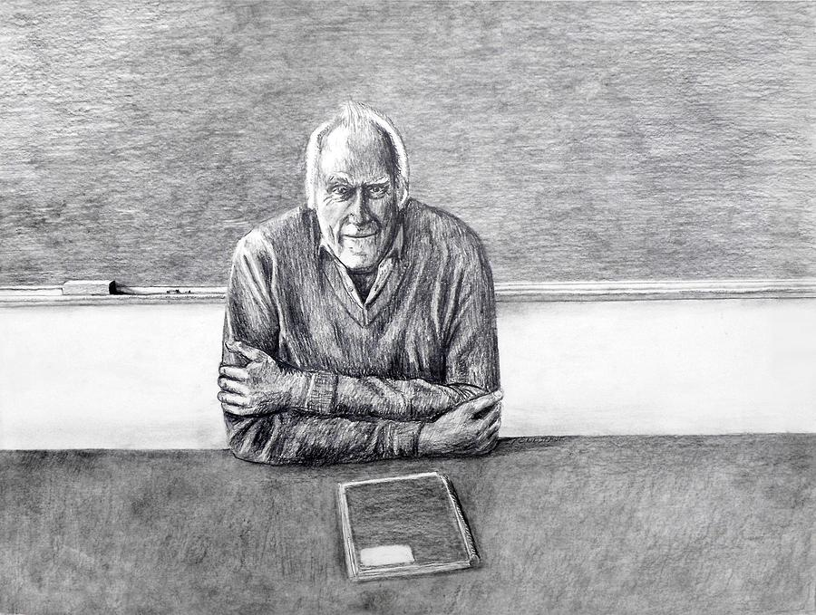
R3
Five reasons why you need to be under the preaching of our pastor physically present in the corporate worship setting, not remotely as your first choice
Five responses required of you when you hear the Word preached
Five blessings/benefits received from hearing well the faithful preaching of God’s Word
What I need to teach you

Slide 26
Five reasons why you need to be physically present under the preaching of our pastor in the corporate worship setting, not remotely as your first choice:
Our Christian Faith Is Fueled By Hearing God’s Word
Hearing God’s Word From Our Own Shepherd Is Unique To Every Other Encounter With God’s Proclaimed Word
Never Underestimate The Power Of Personal Connection
Spiritual Fruit Comes From Hearing With Others
Public Sermons Lead To Corporate Discipleship

Slide 27
Hearing Thru
Preaching
What is needed for us to be able to effectively listen to God? What can we do to prepare our hearts so we are in a position where we can hear what the Lord is seeking to reveal or communicate to us through the preaching of the Word?

Slide 28
“Whereas I have shelves of books on how to preach, I have only one book on how to listen to sermons. This wonderful Catechism question (Q.160. Westminster Larger Catechism) helps to correct the misnomer that preaching is only upon the preacher. All of us as the Body of Christ have a part to play when it comes to the preached word and having the “ears to hear.” Let us therefore give greater diligence to the requirements of the word preached for our individual and corporate good.”
Ken Ramsey, Expository Listening (Kress Biblical Resources; Woodlands, TX, 2010)

Slide 29
Question 160: What is required of those that hear the Word preached?
Answer: It is required of those that hear the Word preached,
that they attend upon it with diligence, preparation, and prayer;
examine: What they hear by the Scriptures;
receive the truth with faith, love, meekness, and readiness of mind, as the Word of God;
meditate, and confer of it;
hide it in their hearts, and bring forth the fruit of it in their lives.
Attend
Upon It

Slide 30
Question 160: What is required of those that hear the Word preached?
Answer: It is required of those that hear the Word preached,
that they attend upon it with diligence, preparation, and prayer;
Attend
Upon It

Slide 31
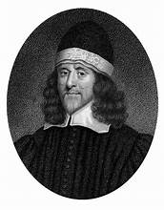
Turning The
Heart To God
“It is not the letter of the Word that ordinarily doth convert, but the spiritual meaning of it, as revealed and expounded….There is the letter, the husk; and there is the spirit, the kernel, and when we by expounding the Word do open the husk, out drops the kernel. It is the meaning of the word which is the word indeed, it is the sense of it which is the soul….Now, preaching in a more special manner reveals God’s Word. When an ointment box is once opened, then it casts its savour about; and when the juice of a medicinal herb is once strained out and applied, then it - heals. And so it is the spiritual meaning of the Word let into the heart which converts it and turns it to God.”
Thomas Goodwin, English Puritan theologian and preacher (1600-1679)

Slide 32
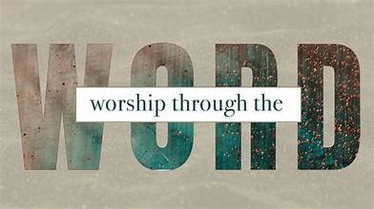
Come not to hear with careless heart, as if you were to hear a matter that little concerned you, but come with a sense of the unspeakable weight, necessity, and consequence of the Holy Word which you are to hear; and when you understand how much you are concerned in it, it will greatly help your understanding of every particular truth….
Make it our work with diligence to apply the word as you are hearing it….Cast not all upon the minister, as those that will go no further than they are carried as by force….You have work to do as well as the preacher, and should all the time be as busy as he….you must open your mouths, and digest it, for another cannot digest it for you…therefore be all the while at work, and abhor an idle heart in hearing, as well as an idle minister.
Chew the cud, and call up all when you come home in secret, and by meditation preach it over to yourselves. If it were coldly delivered by the preacher, do you…preach it more earnestly over to your own hearts…
Chew The
Cud

Slide 33
“preparation consists in the readinese of the faculties of the soul and the graces of the spirit of God, presently to act upon the setting upon a holy duty. When a man or woman shall find the faculties of their soul and the graces that are in them, to be ready to act as soon as ever they fall upon duty, just as you see a company of Ringers when they have made all preparation for the raising of the bels, then in an instant when they begin to pull, all the bels go in that tune that according to their skill they set them in. And so it should be with our hearts, the faculties of our souls and graces, though now we are not upon duty, yet we should be so ready that as it were upon a pull, all the faculties of our souls and graces of Gods Spirit should work in a melodious way; There are those that keep their hearts so prepared as at the very first moment that they set about the duty of Worship, all faculties and graces begin to act and to stir and are working towards God, as a fire, when all the matter is ready laid, presently it comes to be kindled and flame out; and thus it should be with our hearts:” Gospel Worship Jeremiah Burroughs (1599-1646) - A Popular Independent Puritan Preacher and a Member of the Westminster Assembly
Preparation
Of the Soul

Slide 34
Question 160: What is required of those that hear the Word preached?
Answer: It is required of those that hear the Word preached,
that they attend upon it with diligence, preparation, and prayer;
examine: What they hear by the Scriptures;
receive the truth with faith, love, meekness, and readiness of mind, as the Word of God;
meditate, and confer of it;
hide it in their hearts, and bring forth the fruit of it in their lives.
Examine
What Is Heard

Slide 35
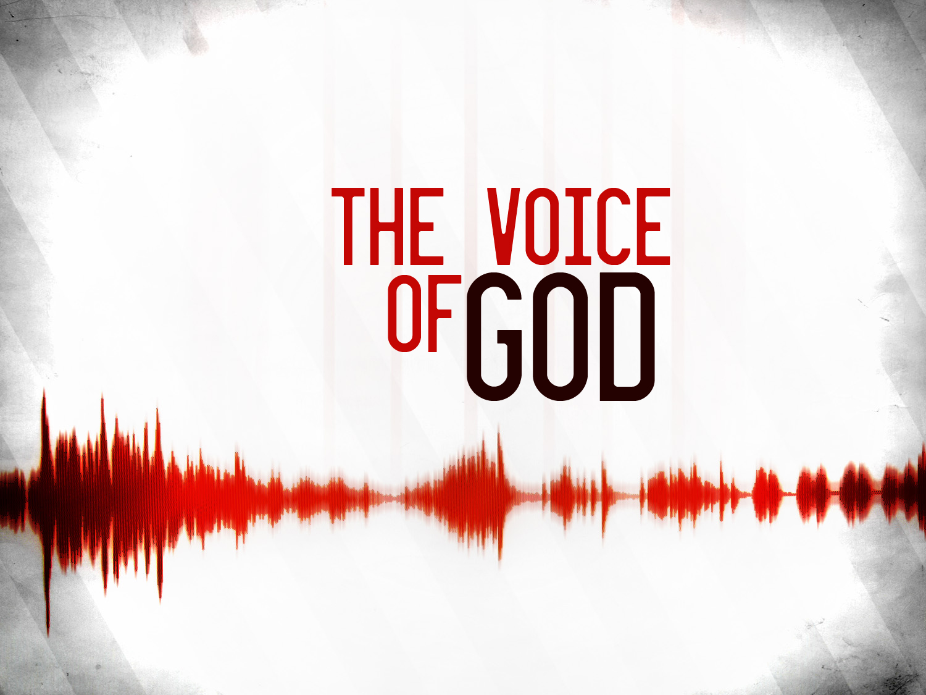
Testing What
You Hear
The Bereans, you remember in the Book of Acts, tested what they heard, according to the Scriptures (Acts 17:11). We ought to also hear what is preached and examine it according to the Scriptures: is this faithful to what the Bible teaches? This, of course, requires you to know what the Bible teaches, which requires you to read and study the Bible. We know from week to week the passages to be preached. Is that intentional on the part of our elders? Are they expecting something from us pre and post sermon?

Slide 36
Question 160: What is required of those that hear the Word preached?
Answer: It is required of those that hear the Word preached,
that they attend upon it with diligence, preparation, and prayer;
examine: What they hear by the Scriptures;
receive the truth with faith, love, meekness, and readiness of mind, as the Word of God;
meditate, and confer of it;
hide it in their hearts, and bring forth the fruit of it in their lives.
Receive As
The Word

Slide 37
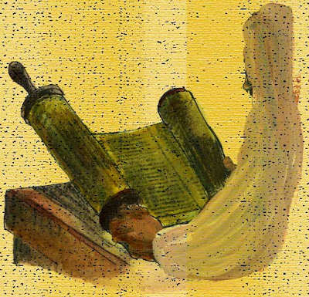
Active Not
Passive
There is a certain posture in which we should receive faithful preaching.
We are to receive the truth with faith.
We are to believe what God says is true.
We are to trust what God tells us to trust.
We are to do what He tells us to do.
We area to think how He tells us to think.

Slide 38
When you read the Bible or listen to faithful preaching, there is more happening than mere communication of ideas. The Word is more than ink and paper, and preaching is more than a speech. The Word is living, as the Lord is working effectually by His Holy Spirit through it. There are many pictures of this in Scripture:
the Lord through His Word is sowing imperishable seeds (1 Peter 1:23),
bringing about repentance and faith (Rom. 10),
feeding our souls with the Bread of Life (Matt. 4:4; John 6:35), creating a source of living waters in our hearts (John 7:38),
and washing His church (Eph. 5:26).
To have the Word abide in us is to be in union with Christ and to be conformed to His will so that we learn to desire what is godly and holy (John 15:7).
Our
Posture

Slide 39
We are also to receive it with ______________.
Also For The
Brethren
It is His word of love to you, and you are to receive it with love to Him and for the brethren as well – for we are gathered in one spirit in worship to our God.
We are to receive it with meekness or humility. It is arrogant and prideful to place your opinion over God’s. Not the time to wordsmith the pastor, or get into a silent debate.
It is also to be read with readiness of mind. You are desirous of receiving what it is that the word of God is saying to you.

Slide 40
Question 160: What is required of those that hear the Word preached?
Answer: It is required of those that hear the Word preached,
that they attend upon it with diligence, preparation, and prayer;
examine: What they hear by the Scriptures;
receive the truth with faith, love, meekness, and readiness of mind, as the Word of God;
meditate, and confer of it;
hide it in their hearts, and bring forth the fruit of it in their lives.
Receive As
The Word

Slide 41
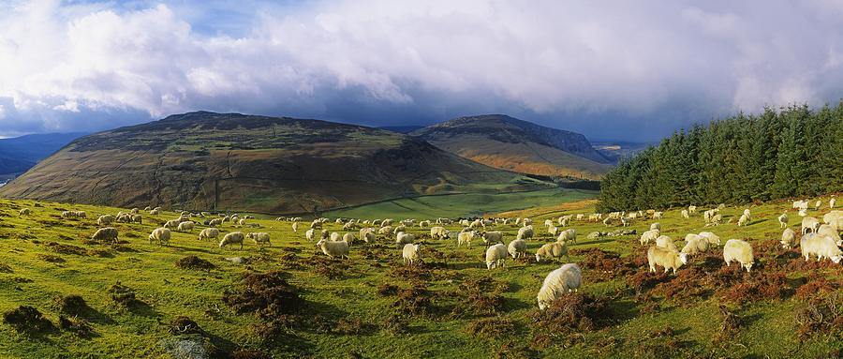
Meditate
And Confer
You need to reflect deeply about what is said and what it means for you, for others, for the church, and for the world. And then you need to confer of it [confer (with somebody) (on/about something) to discuss something with someone, in order to exchange opinions or get advice]
In Scotland, the phrase often heard that often started those kinds of conversations would say something like this, “where have you been grazing?” What was meant was this: “Where in the Bible have you been lately reading and meditating and reflecting? Let’s talk about what you have been learning.”

Slide 42
Question 160: What is required of those that hear the Word preached?
Answer: It is required of those that hear the Word preached,
that they attend upon it with diligence, preparation, and prayer;
examine: What they hear by the Scriptures;
receive the truth with faith, love, meekness, and readiness of mind, as the Word of God;
meditate, and confer of it;
hide it in their hearts, and bring forth the fruit of it in their lives.
Receive As
The Word

Slide 43
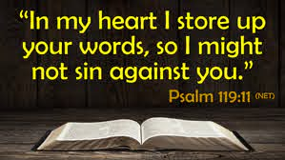
” At the very least, that means there is some memorization going on. You’re going to hide the word in your heart. There are certain words of Scripture that you store up in your heart.”

Slide 44
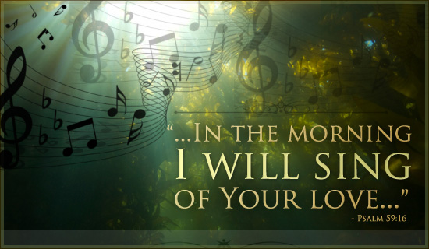
“Bring forth the fruit of it in their lives.”
We never want to be satisfied with simply being hearers of the word.
How does Jesus finish the Sermon on the Mount? Be hearers and doers of the word (Matt 7:24–27).
How does he put it in the Great Commission? “Go make disciples . . . teaching them to obey all that I have commanded” (Matt 28:19-20).
Be and Do

Slide 45
Five blessings/benefits received from hearing well the faithful preaching of God’s Word
Helps us in the life-giving act of self-forgetfulness
Refills our faith
We are genuinely changed; grow in grace
We are Equipped for the work of the ministry
Through hearing and receiving His Word we encounter him and experience joy with Him

Slide 46
TO FORGET OURSELVES - One of the great blessings of good preaching is that it helps us in the life-giving act of self-forgetfulness. Faithful preaching exposes our sin and challenges us to change, but it does so in the stanzas, while the chorus calls us away from self to Savior. It is a glorious thing for our souls to be free from our regular pre-occupation with self, even if only for a few moments at the sermon’s climax, so we are captivated by Christ.
TO FILL OUR FAITH -- We need an external word, “Faith comes from hearing, and hearing through the word of Christ.” (Rom.10:17)

Slide 47
TO GROW IN GRACE -- And according to I Cor. 15:1-2, (Now I would remind you, brothers, of the gospel I preached to you, which you received, in which you stand, 2 and by which you are being saved, if you hold fast to the word I preached to you—unless you believed in vain.) the preached gospel is not only what we have received in the past to become believers, but it is the grace in which we presently stand, and that which we will be finally saved, if we continue to receive and hold unto the gospel. The ongoing preaching of the gospel is vital to the ongoing life of faith.
TO BE EQUIPPED -- It is a great benefit of faithful preaching. God gave “the shepherds and teachers, to equip the saints for the work of the ministry, for the building up of he body of Christ” (11 And he gave the apostles, the prophets, the evangelists, the shepherds and teachers, 12 to equip the saints for the work of ministry, for building up the body of Christ, Eph.4:11-12).
TO ENCOUNTER JESUS -- Such will significantly change our perspective and experience of preaching. What if you came to worship in the next hour not merely to hear Pastor Ndzi, but to encounter Jesus?

Slide 48
Brothers and Sisters, as you hear the preaching of God’s Word from our Beloved Pastor/Teacher ask yourself this question: “what is the proper spiritual posture I should take for listening to the sermon?”
As you sit quietly and pray and meditate on the text and the songs, remind yourself of what Psalm 19:10–11 says about the words of God: “More to be desired are they than gold, even much fine gold; sweeter also than honey and drippings of the honeycomb. Moreover by them is thy servant warned; in keeping them there is great reward.” So because the Word of God is greater than all riches and sweeter than all honey, take heed how you hear. Desire it more than you desire all these things.

Slide 49
As Proverbs 2:3–5 says, “If you cry out for insight and raise your voice for understanding, if you seek it like silver and search for it as for hidden treasures; then you will understand the fear of the Lord and find the knowledge of God.” May God make us a people who hear the Word of God and bear fruit a hundredfold so that the lamp of our lives will be on a lampstand giving light to all who enter the kingdom of God. Take heed how you hear!
Yes, those are in fact Jesus’ words to all of us: “Take care how you listen” (Luke 8:18). We take care because how we listen to the sermon today reveals a lot about the condition of our own hearts, making Sunday a good day to evaluate our own posture of intake.
May God make us a people who hear the Word of God and bear fruit a hundredfold so that the lamp of our lives will be on a lampstand giving light to all who enter the kingdom of God.

Slide 50
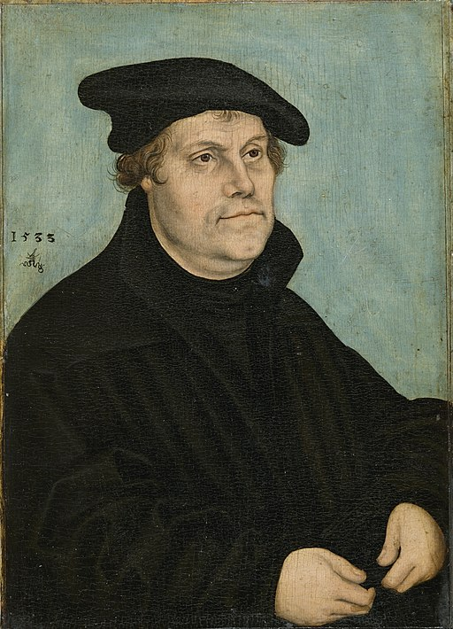
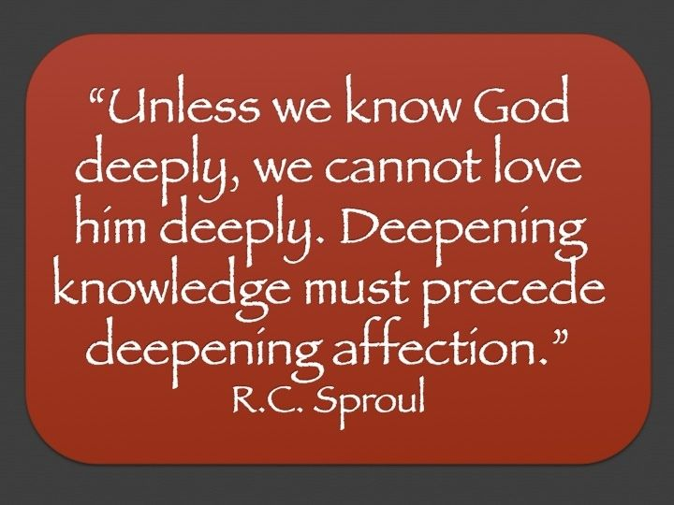
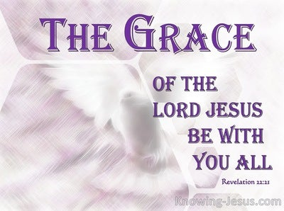
John Calvin described reverence as the place where joy and fear are held together. Not the fear of trembling and despair, but the kind that cultivates awe and respect when contemplating God’s holiness, nearness, grace and power.
This kind of reverence does not invite worshipers into what C.S Lewis has called “an obligation to feel,” but into a space where personal feelings serve only as a background to the drama of God’s being. “Be still and know that I am God (Psalm 46:10).”

Slide 51
BELOW THE LINE SLIDES FOR FUTURE USE

Slide 52
Lesson Points Remaining
Listening To the Voice Of God Through The Read Word In Corporate Worship
The Benediction In Corporate Worship
The Sung Word In Corporate Worship
Wait Up! I think I see some grains of sands. He still has a few minutes left.
Mister, I see one! I really do!

Slide 53
Whether you have a voice that’s meant for public singing or not, your voice was placed in this world by the Creator. As strange as it is to say, in this instance, your opinions on your vocal prowess are irrelevant. Your audience is the Truine God alone.

Slide 54
Where Joy And Fear Are Held Together
Our Closing Thought
John Calvin described reverence as the place where joy and fear are held together. Not the fear of trembling and despair, but the kind that cultivates awe and respect when contemplating God’s holiness, nearness, grace and power. This kind of reverence does not invite worshipers into what C.S Lewis has called “an obligation to feel,” but into a space where personal feelings serve only as a background to the drama of God’s being. “Be still and know that I am God (Psalm 46:10).”
This is the kind of fear that Scripture calls the beginning of wisdom. We were built for reverence because we were built to glorify God. We develop a capacity for deep joy in the same measure that we learn to revere God, ”Humble yourself before the Lord, and He will lift you up (James 4:10).”

Slide 55
In 1533 Martin Luther said,
“The Word of God is the greatest, most necessary, and most important thing in Christendom”

Slide 56
In 1539, commenting on Psalm 119, Luther wrote, “In this psalm David always says that he will speak, think, talk, hear, read, day and night constantly — but about nothing else than God’s Word and Commandments. For God wants to give you His Spirit only through the external Word” (1359).
This phrase is extremely important. The “external Word” is the Book. And the saving, sanctifying, illuminating Spirit of God, he says, comes to us through this “external Word.”

Slide 57
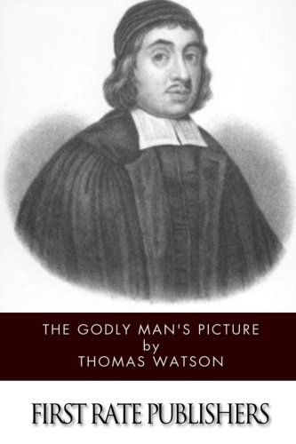
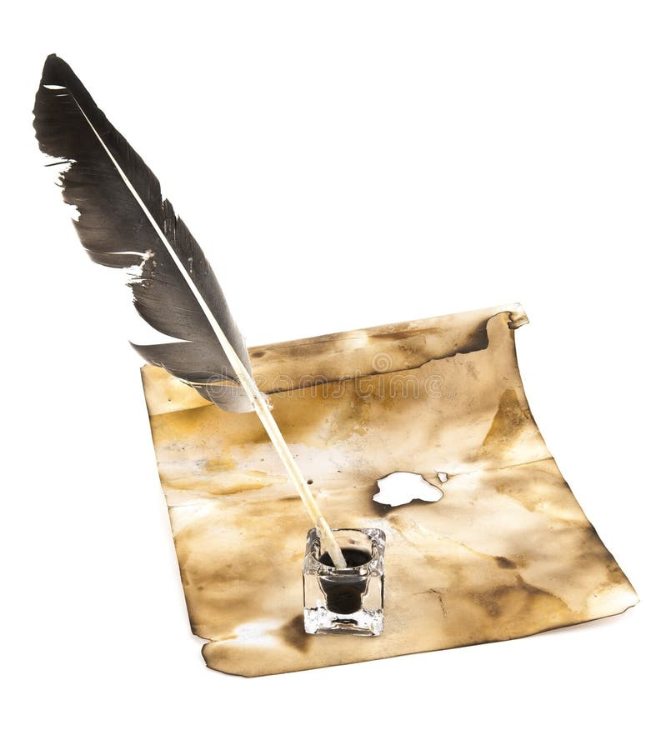
In the Book of God are scattered many truths as so many pearls. John 5: 39. 'Search the Scriptures.’ Search as for a vein of silver. This blessed Book will fill your head with knowledge, and your heart with grace. God wrote the two tables with his own fingers; and if he took pains to write, well may we take pains to read.

Slide 58
When Men and Women Come Into God’s Presence They Know It
There is a seriousness that must mark it, a solemnity and honor that must attend it, a gravity that must saturate it.
Moses takes off his shoes (Ex. 3)
Israel is struck with fear (Ex. 20)
Isaiah quakes (Isa. 6)
Job silences his lips (Job 40)
John falls down as though dead (Rev. 1)
Even the elders and angels, who are worshiping
day in and day out before the throne, aren’t
casual in their worship (Isa. 6; Rev. 4)

Slide 59
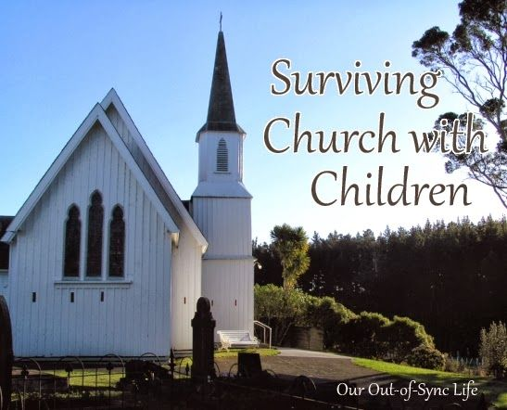
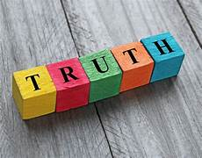
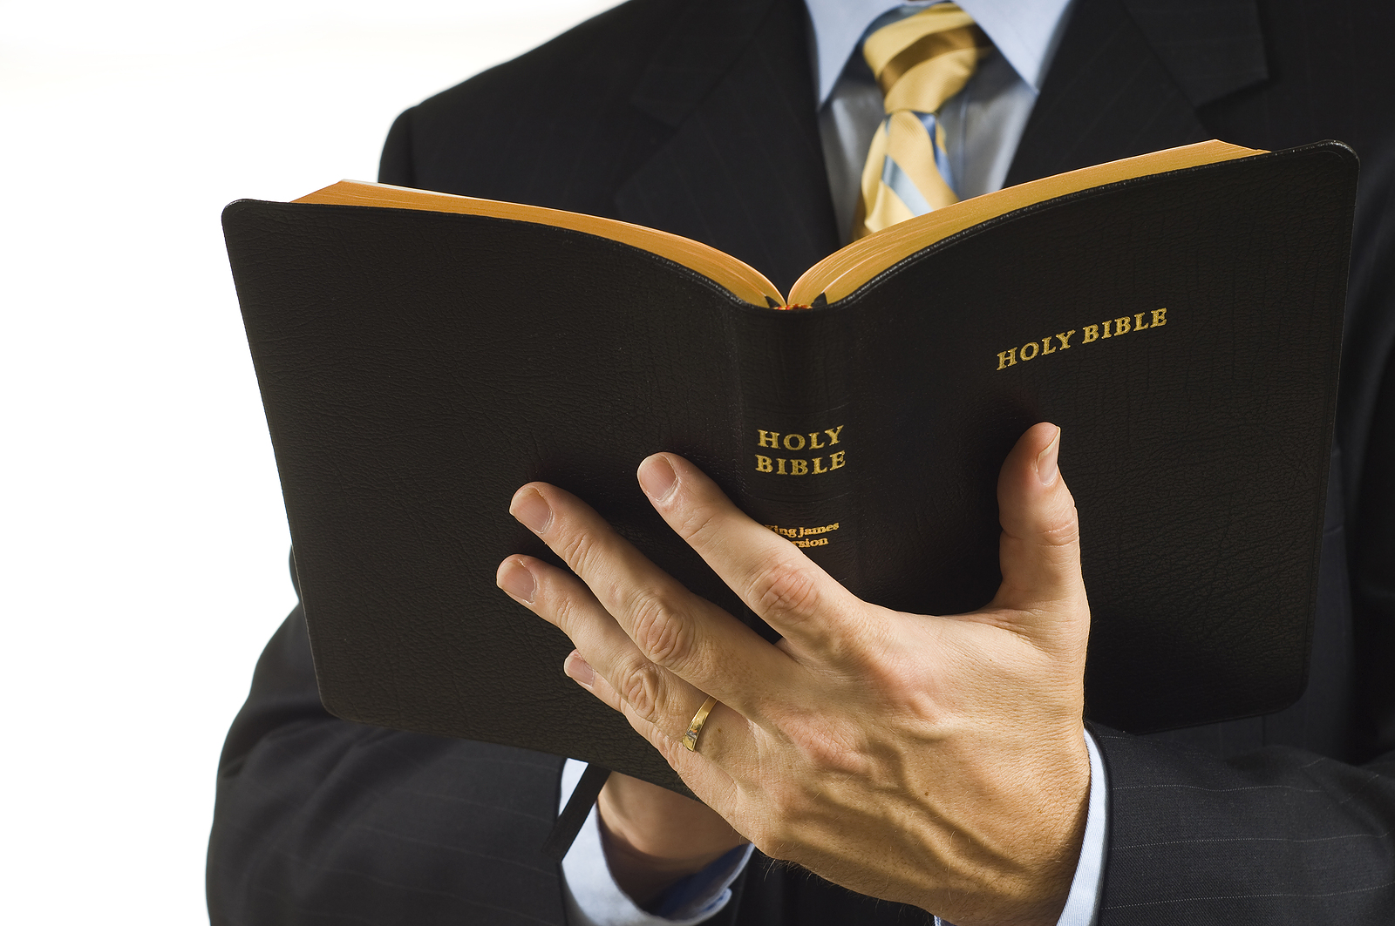
How Can I Best Incorporate My Toddler in Church? — Dr. Mohler Responds to Letters from Listeners of The Briefing
“Now, so long as you have a child, you have the risk of distraction. And by the way, I consider that glorious. When a child being a child all of a sudden has a little eruption, you hear noise, you see movement from a child that's just normal. But I think one of the bigger issues here is whether or not the child is meaningfully able to understand what is going on. And I think that can come quite early. One of the sweetest things I can just mention is hearing tiny, tiny little children, preschool children, indeed older toddlers singing hymns as they fall asleep at night because they have learned them in big church and those hymns are going right into those little hearts.
The preaching of the Word of God is going right into that little heart. And that is just really, really sweet. I say that as a father, I say that as a grandfather, wouldn't happen if those little bodies weren't sitting with mom and dad in church and those little legs wiggling under the pew because they're not long enough to reach the floor. God's glory is in that. But there's a pretty big distinction between a one-year-old and a three-year-old, and parents will have to make some judgments about that. And infancy really is infancy when exactly that comes to an end. And once again, I'm not going to make this decision for parents, but I'll simply say to Heath and to other parents like Heath of very young children, I think this is one of those issues in which you're not bound by the conscience.
You just do what is right you believe as a worshiper, a believer in worship, and also as a parent of a precious one-year-old, moving that child to where that child will be able to understand at least something. ”

Slide 60
A reminder that in the course syllabus for this class Ken and I wrote, “This class’s content is not just to remind us that hearing and reading the Word is a means of gaining biblical information for our head, but to teach us what we must do in order to receive its benefits – receive spiritual nourishment and bear fruit.
Therefore, let us as we read the Word…
Communing with God via Scripture. https://tabletalkmagazine.com/article/2018/10/communing-god-via-scripture/Dr. Neil C. Stewart is senior pastor of Christ Covenant Church in Greensboro, N.C.

